Slide 1
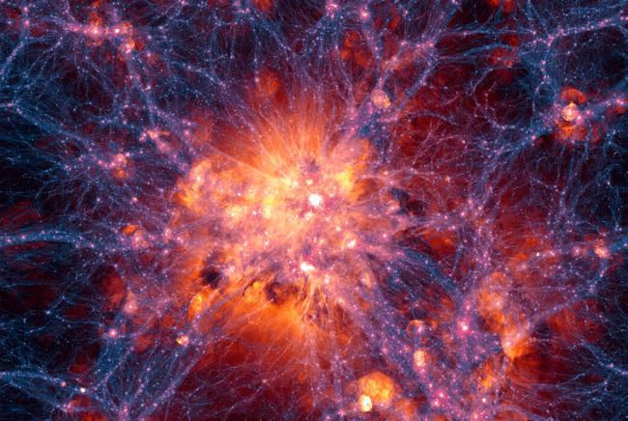

The Odd-Parity part of the Observed Galaxy Trispectrum
arXiv: 2402.16478
Pritha Paul
Chris Clarkson
Roy Maartens

Slide 2
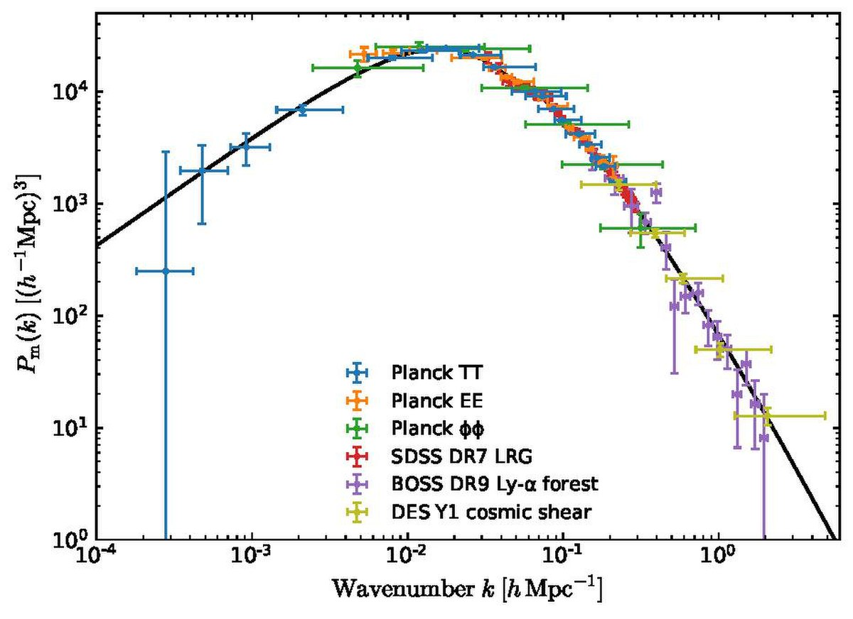
LARGE SCALE STRUCTURE COSMOLOGY
Galaxy positions can be compressed into a power spectrum (Fourier counterpart of the 2 Point function.)
Statistics beyond the Power Spectrum.

Slide 3
STATISTICS BEYOND THE POWER SPECTRUM - BISPECTRUM
Bispectrum
x
3 Point Correlation Function
x + r₁
x + r₂

Slide 4
STATISTICS BEYOND THE POWER SPECTRUM - TRISPECTRUM
Trispectrum
x
x + r₃
4 Point Correlation Function
x + r₁
x + r₂
Notes:
The four point correlation function probes tetrahedral shapes formed by 4 galaxies.

Slide 5
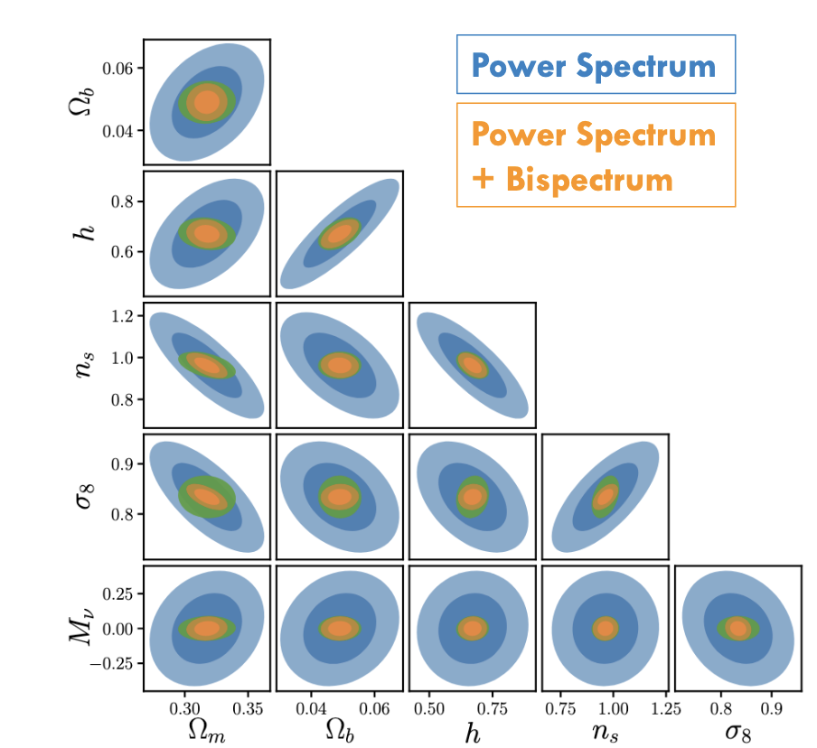
WHY HIGHER ORDER STATISTICS?
Primordial Non-Gaussianity.
Break parameter degeneracies.
Better cosmological constraints.
Probing parity violation.

Slide 6
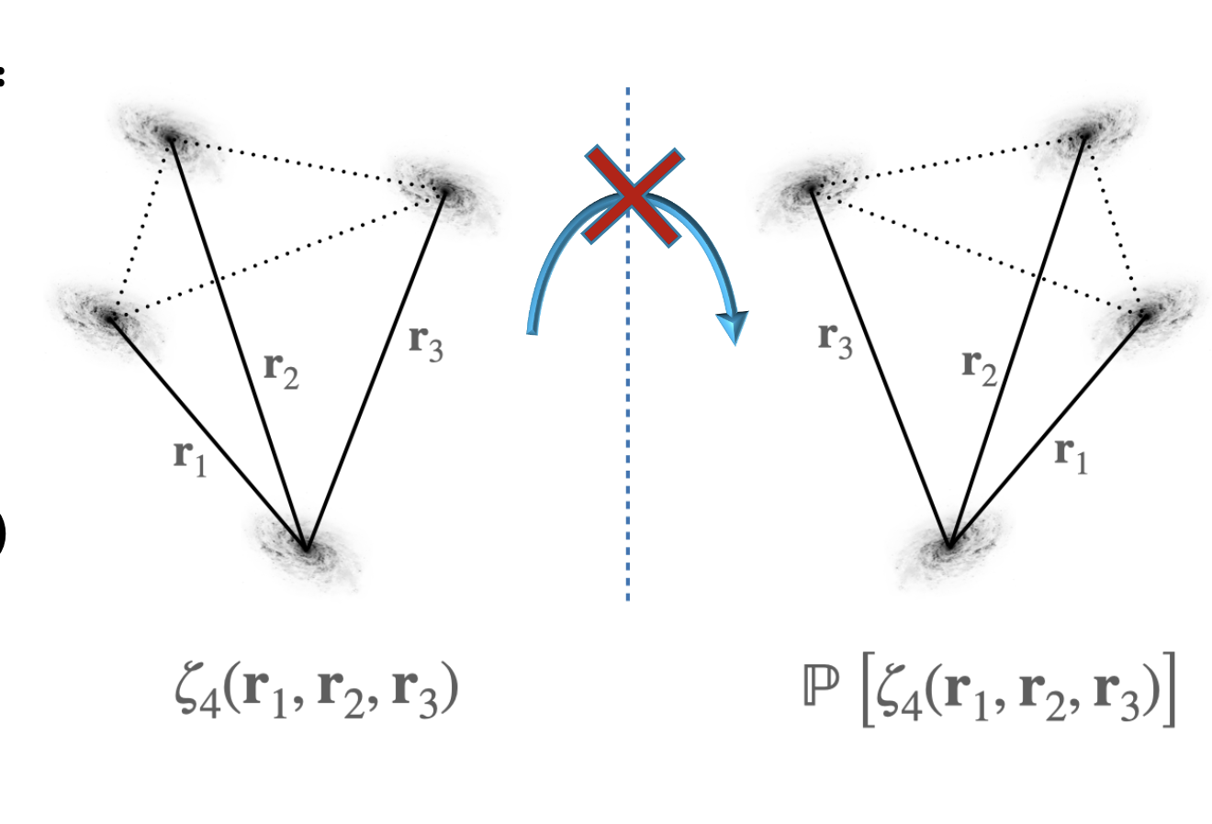
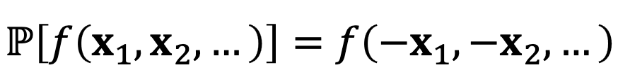
PARITY VIOLATION
General Relativity is invariant under this parity transformation.
Lue+99, Gluscevic+10, Liu+20, Cahn+21, Philcox 22

Slide 7
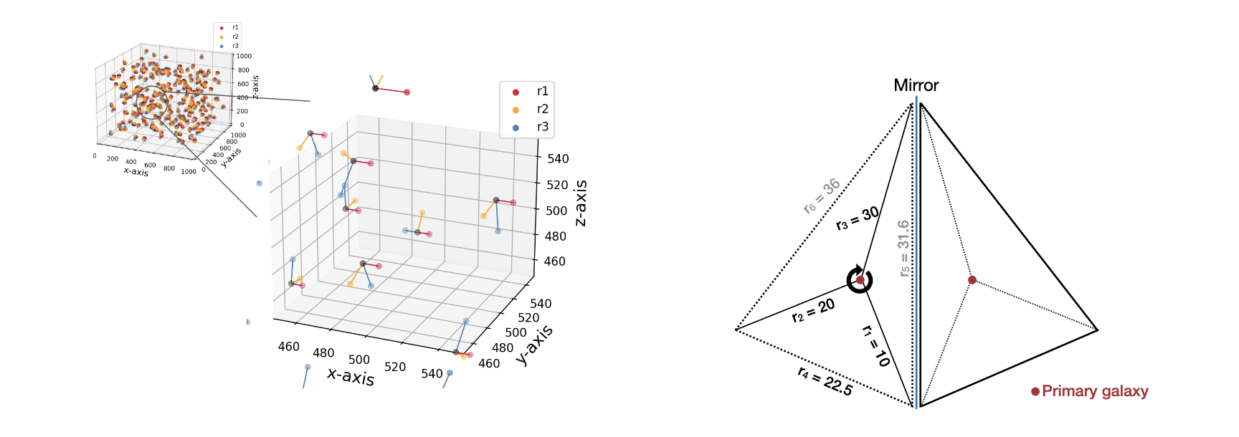
PARITY VIOLATION IN THE 4-POINT FUNCTION
Uses the 4 PT correlation function
Probing scales of 79 Mpc
From the Luminous Red Galaxies of the Baryon Oscillation Spectroscopic Survey (BOSS)
LOWZ – 3.1 σ evidence for a non-zero parity– odd 4 PCF
CMASS – 7.1 σ evidence
Hou, Slepian & Cahn 2023

Slide 8
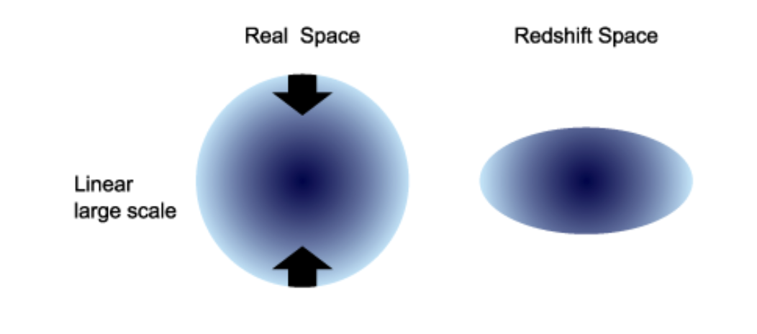

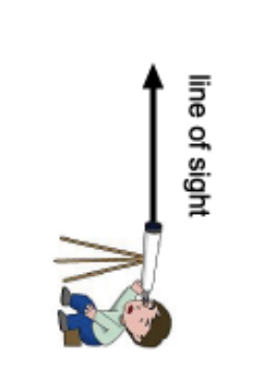
OBSERVING IN REDSHIFT SPACE
First approximation is given by the Kaiser Redshift Space Distortions.
Consider galaxy clustering in the relativistic framework.
Effects beyond Kaiser RSD are suppressed by .
Peculiar velocities and gravitational redshift break symmetry along LOS.
Ellipses distort into egg-shapes.
Shun Saito 2016
Pritha Paul

Slide 9
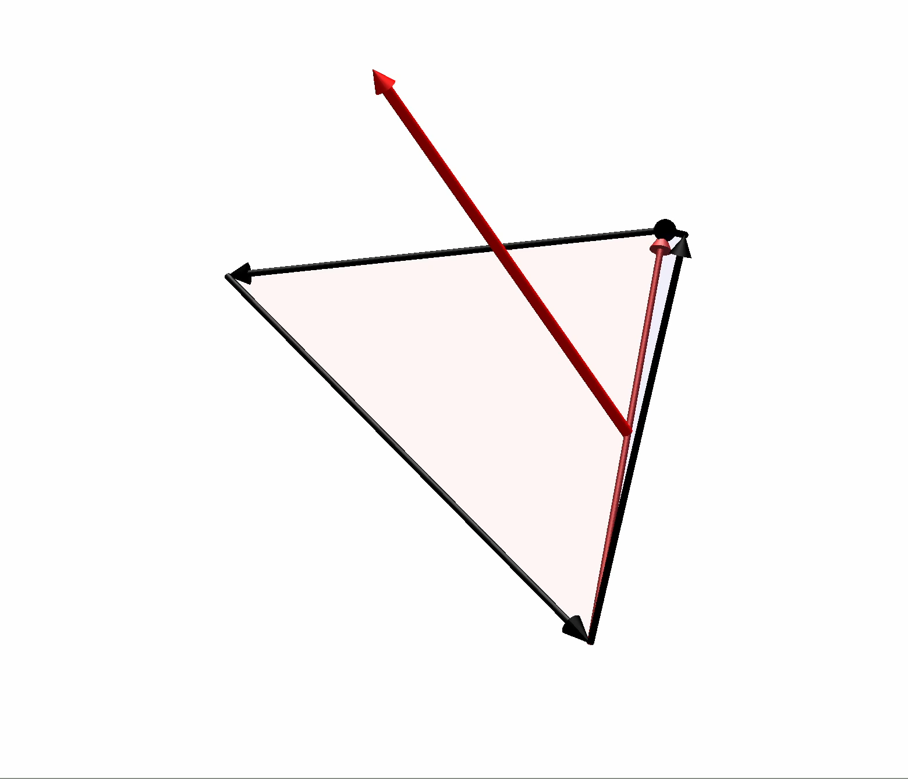
TRISPECTRUM WITH A LINE OF SIGHT

Slide 10

TRISPECTRUM – THEORY
The trispectrum of the observed galaxy number density fluctuations is defined by -
Trispectrum
Dirac Delta function
Expanding the density field to third order -
Third Order Density Field
Second Order Density Field

Slide 11
TRISPECTRUM – THEORY
At tree level, the terms that contribute to the trispectrum are -
Third order contribution
Second order contribution
Breaking the density field into -
Relativistic Contribution
Newtonian Contribution

Slide 12
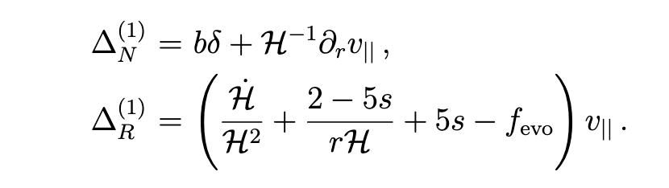
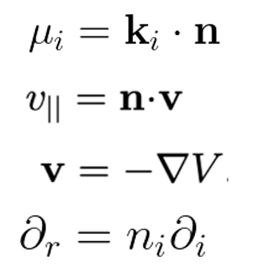
FIRST ORDER CONTRIBUTION
Standard Kaiser Terms
Doppler Effect
(Clarkson et. al 2019)
(Di Dio & Seljak 2019)

Slide 13
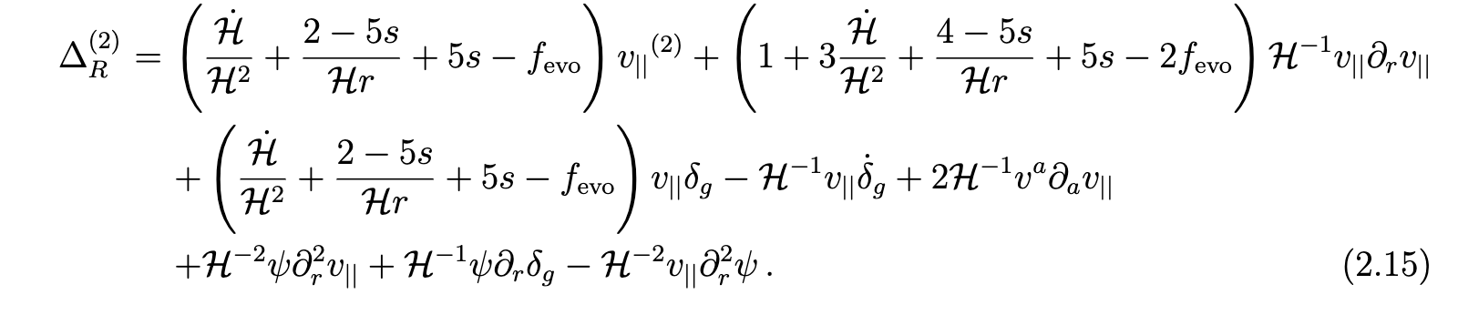

SECOND ORDER CONTRIBUTION
Second order density fluctuations
Second order peculiar velocity contribution
(Clarkson et. al 2019)
(Di Dio & Seljak 2019)

Slide 14
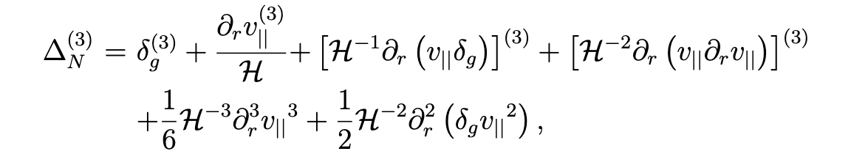
THIRD ORDER CONTRIBUTION
Third order density fluctuations
(Di Dio & Seljak 2019)

Slide 15
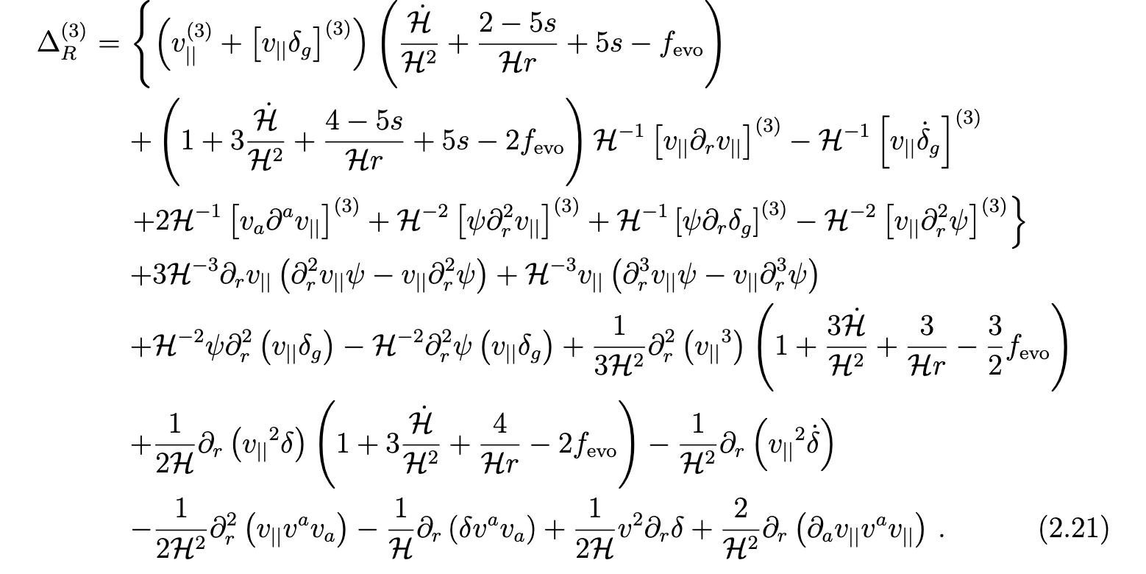
THIRD ORDER CONTRIBUTION
Third order peculiar velocity contribution
Coupling terms
Transverse derivatives
(Di Dio & Seljak 2019)

Slide 16
TRISPECTRUM – THEORY
Defining the parity even and parity odd part of the trispectrum -
Parity preserving part
Parity odd part

Slide 17
ODD AND EVEN TRISPECTRUM

Slide 20
CONCLUSIONS
Parity violation in the 4PCF has been detected.
I have worked with the Trispectrum, which is the Fourier counterpart of the 4PCF.
At scales beyond equality scales, there is a 100% correction.
Below equality scales, there is still a 10% correction.
Previous studies have not included this effect.
It is important to be aware of this effect to make sure there is no contamination, when aiming to detect intrinsic parity violation.

Slide 21
EXTRA SLIDES – 1

