Slide 1
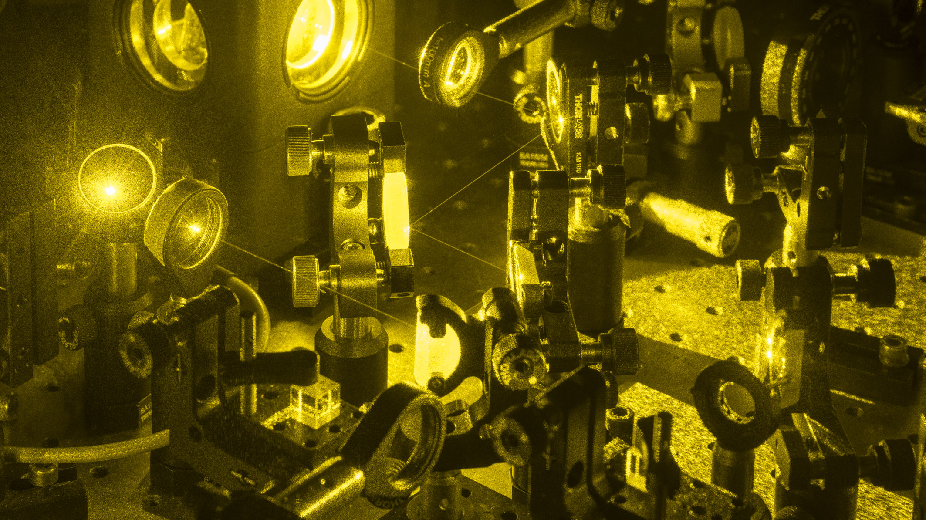

Rare-Earth Ion-Doped Crystals as Quantum Memories
Jingjing Chen and Théo Norbert Julio Sanchez Mejia
Department of Applied Physics - QRAM Group
UNIGE Young Researchers Day 2022
Photo credit: Olivier Zimmermann

Slide 2
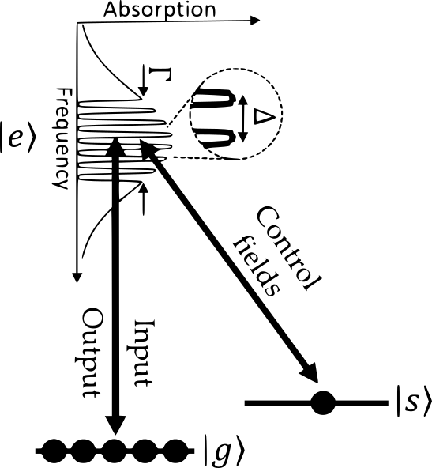
Rare-Earth Ion-Doped Crystals as Quantum Memories

