Slide 1
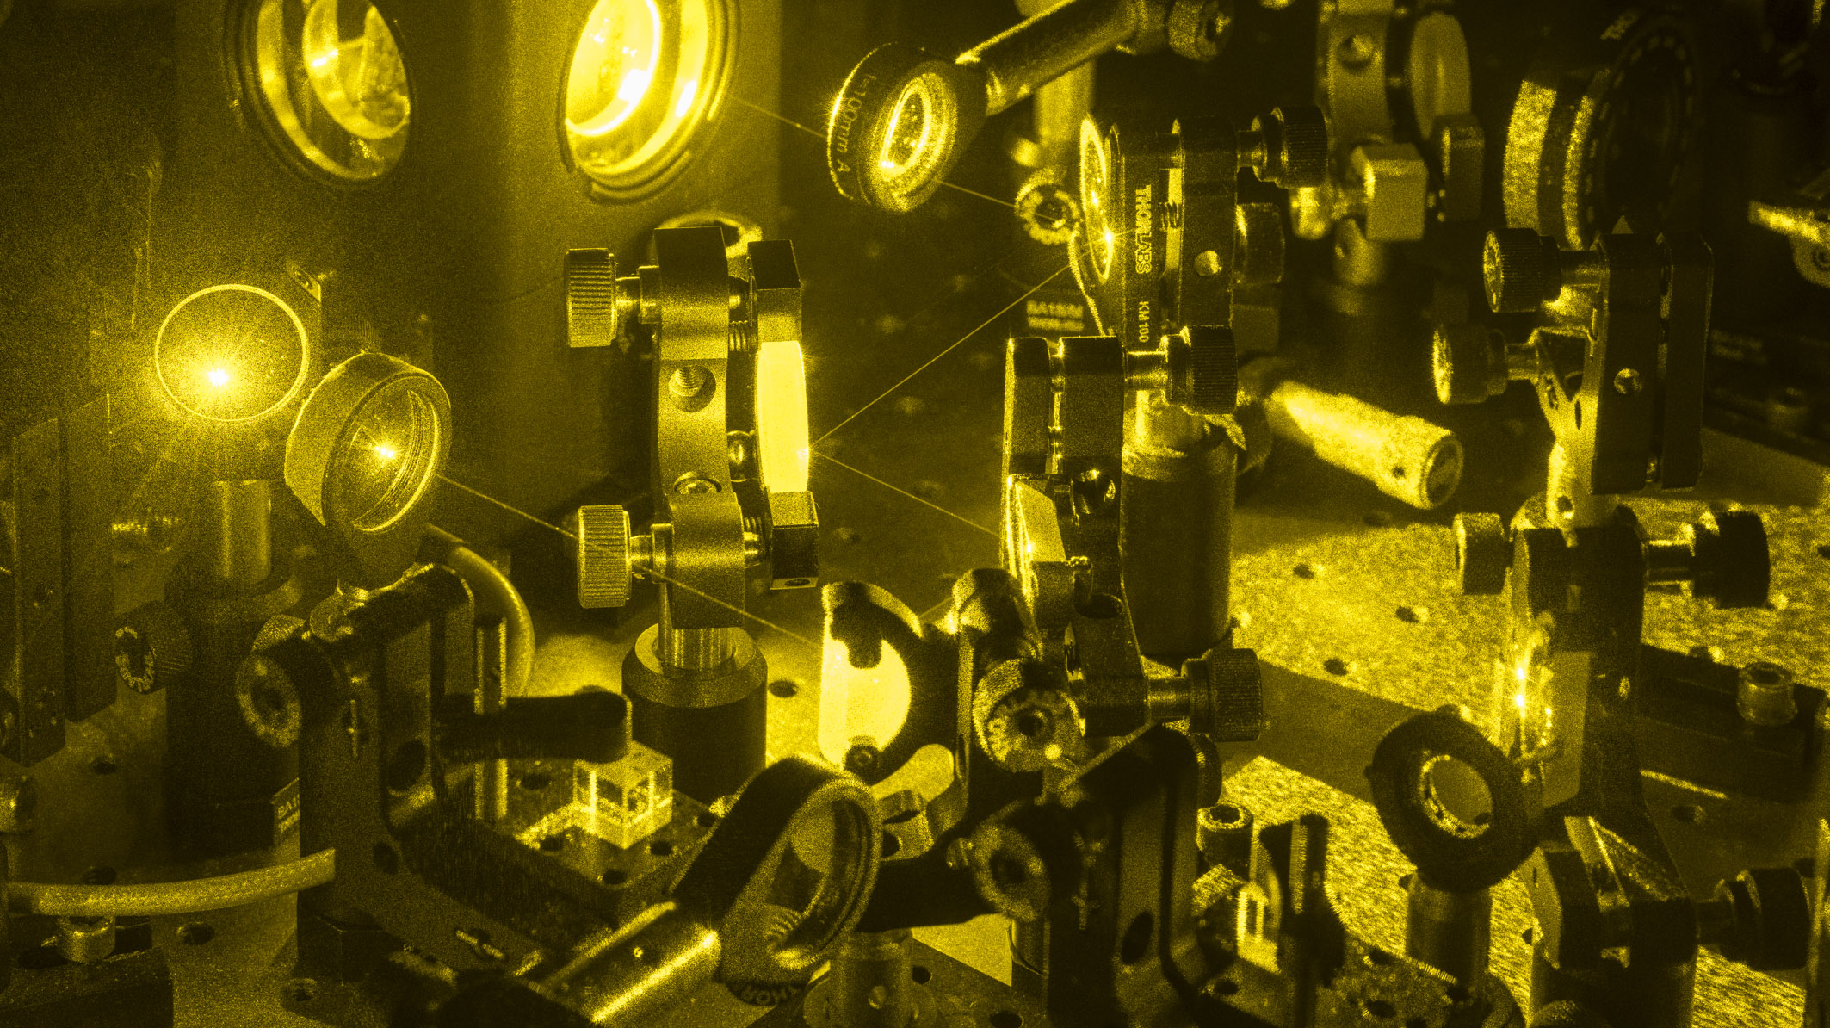

Rare-Earth Ion-Doped Crystals as Quantum Memories
Jingjing Chen and Théo Norbert Julio Sanchez Mejia
Department of Applied Physics - QRAM Group
UNIGE Young Researchers Day 2022
Photo credit: Olivier Zimmermann

Slide 2

A Tale of Two Qubits
Flying Qubit
Stationary Qubit
Good at propagating
Good at performing operations
Photons
No Comment

Slide 3
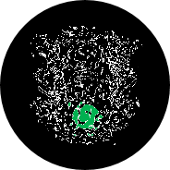
Limited by Distance
1 kilometre
100 kilometres
1000 kilometres

Slide 4
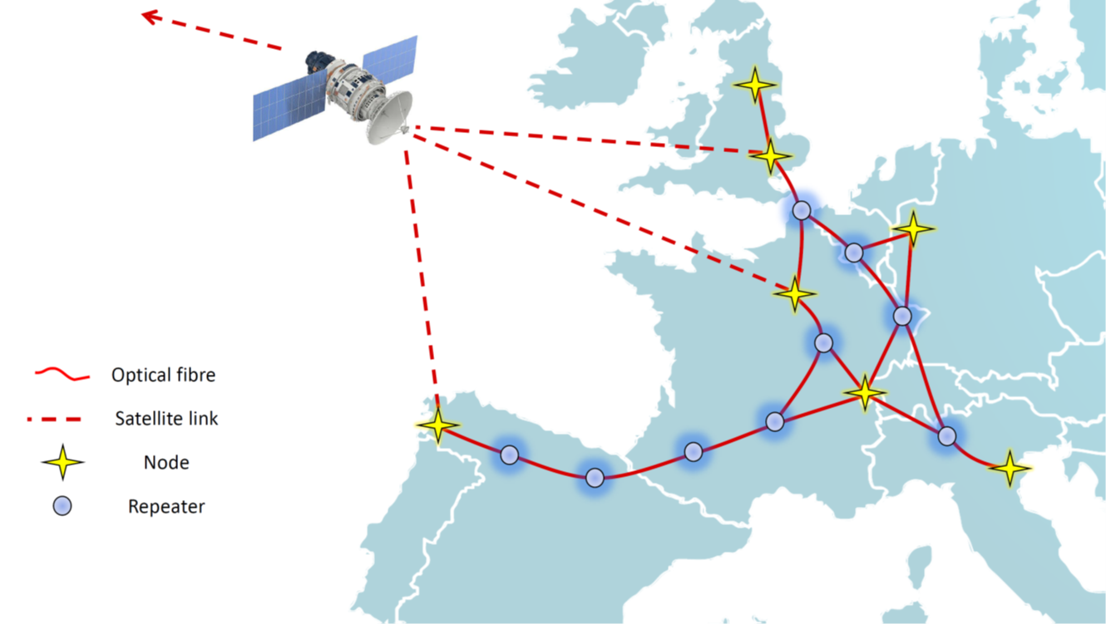
The Quantum Repeater

Slide 5
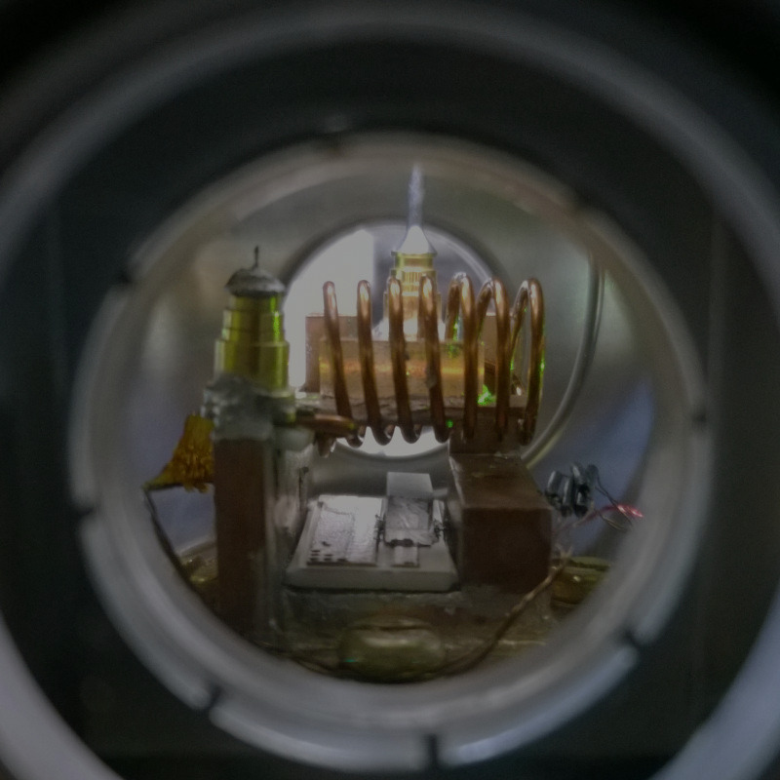
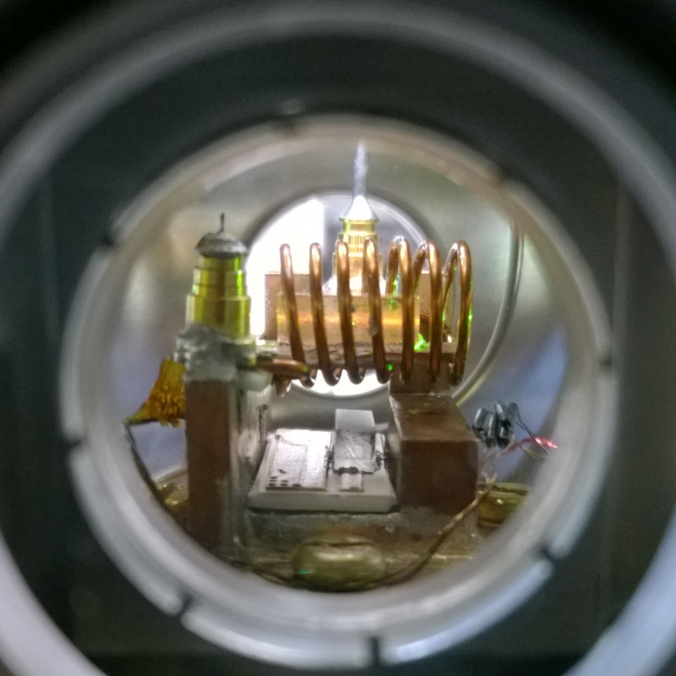
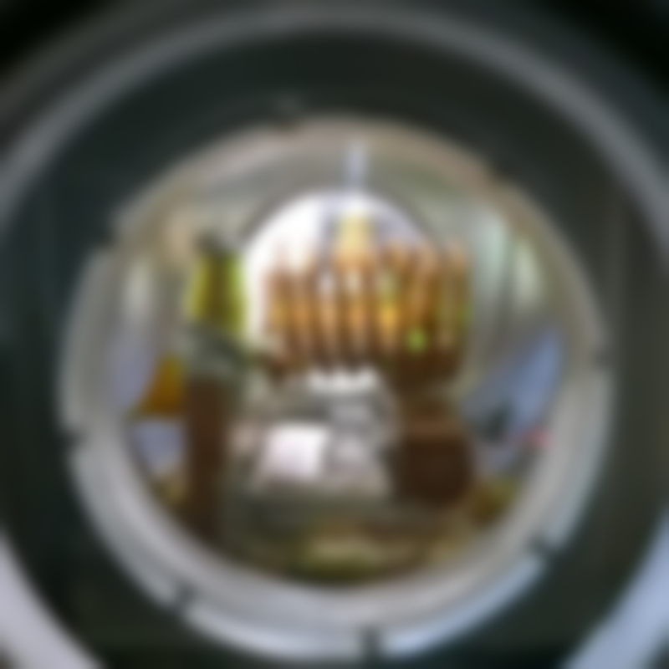
The Quantum Repeater
Decay
Dephasing
Storage efficiency
Storage fidelity
Storage time – to reach the next node at longer distances
Multimode capacity – to achieve high data rates in quantum communication network

Slide 6
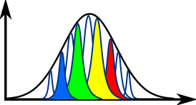
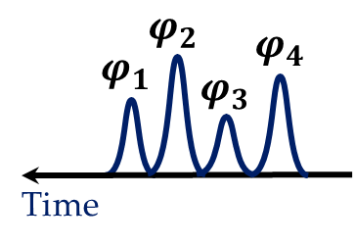
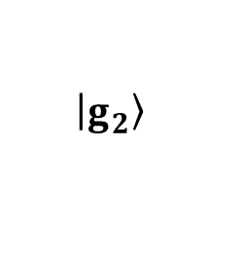
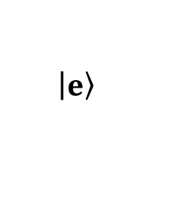
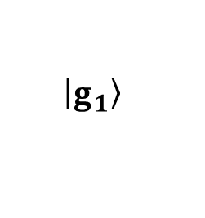
The Lambda System
Absorption
$$\left|\left.e\right\rangle \right.$$
Frequency
Optical transitions
$$\left|\left.g_{2}\right\rangle \right.$$
Spin
transition
$$\left|\left.g_{1}\right\rangle \right.$$

Slide 7
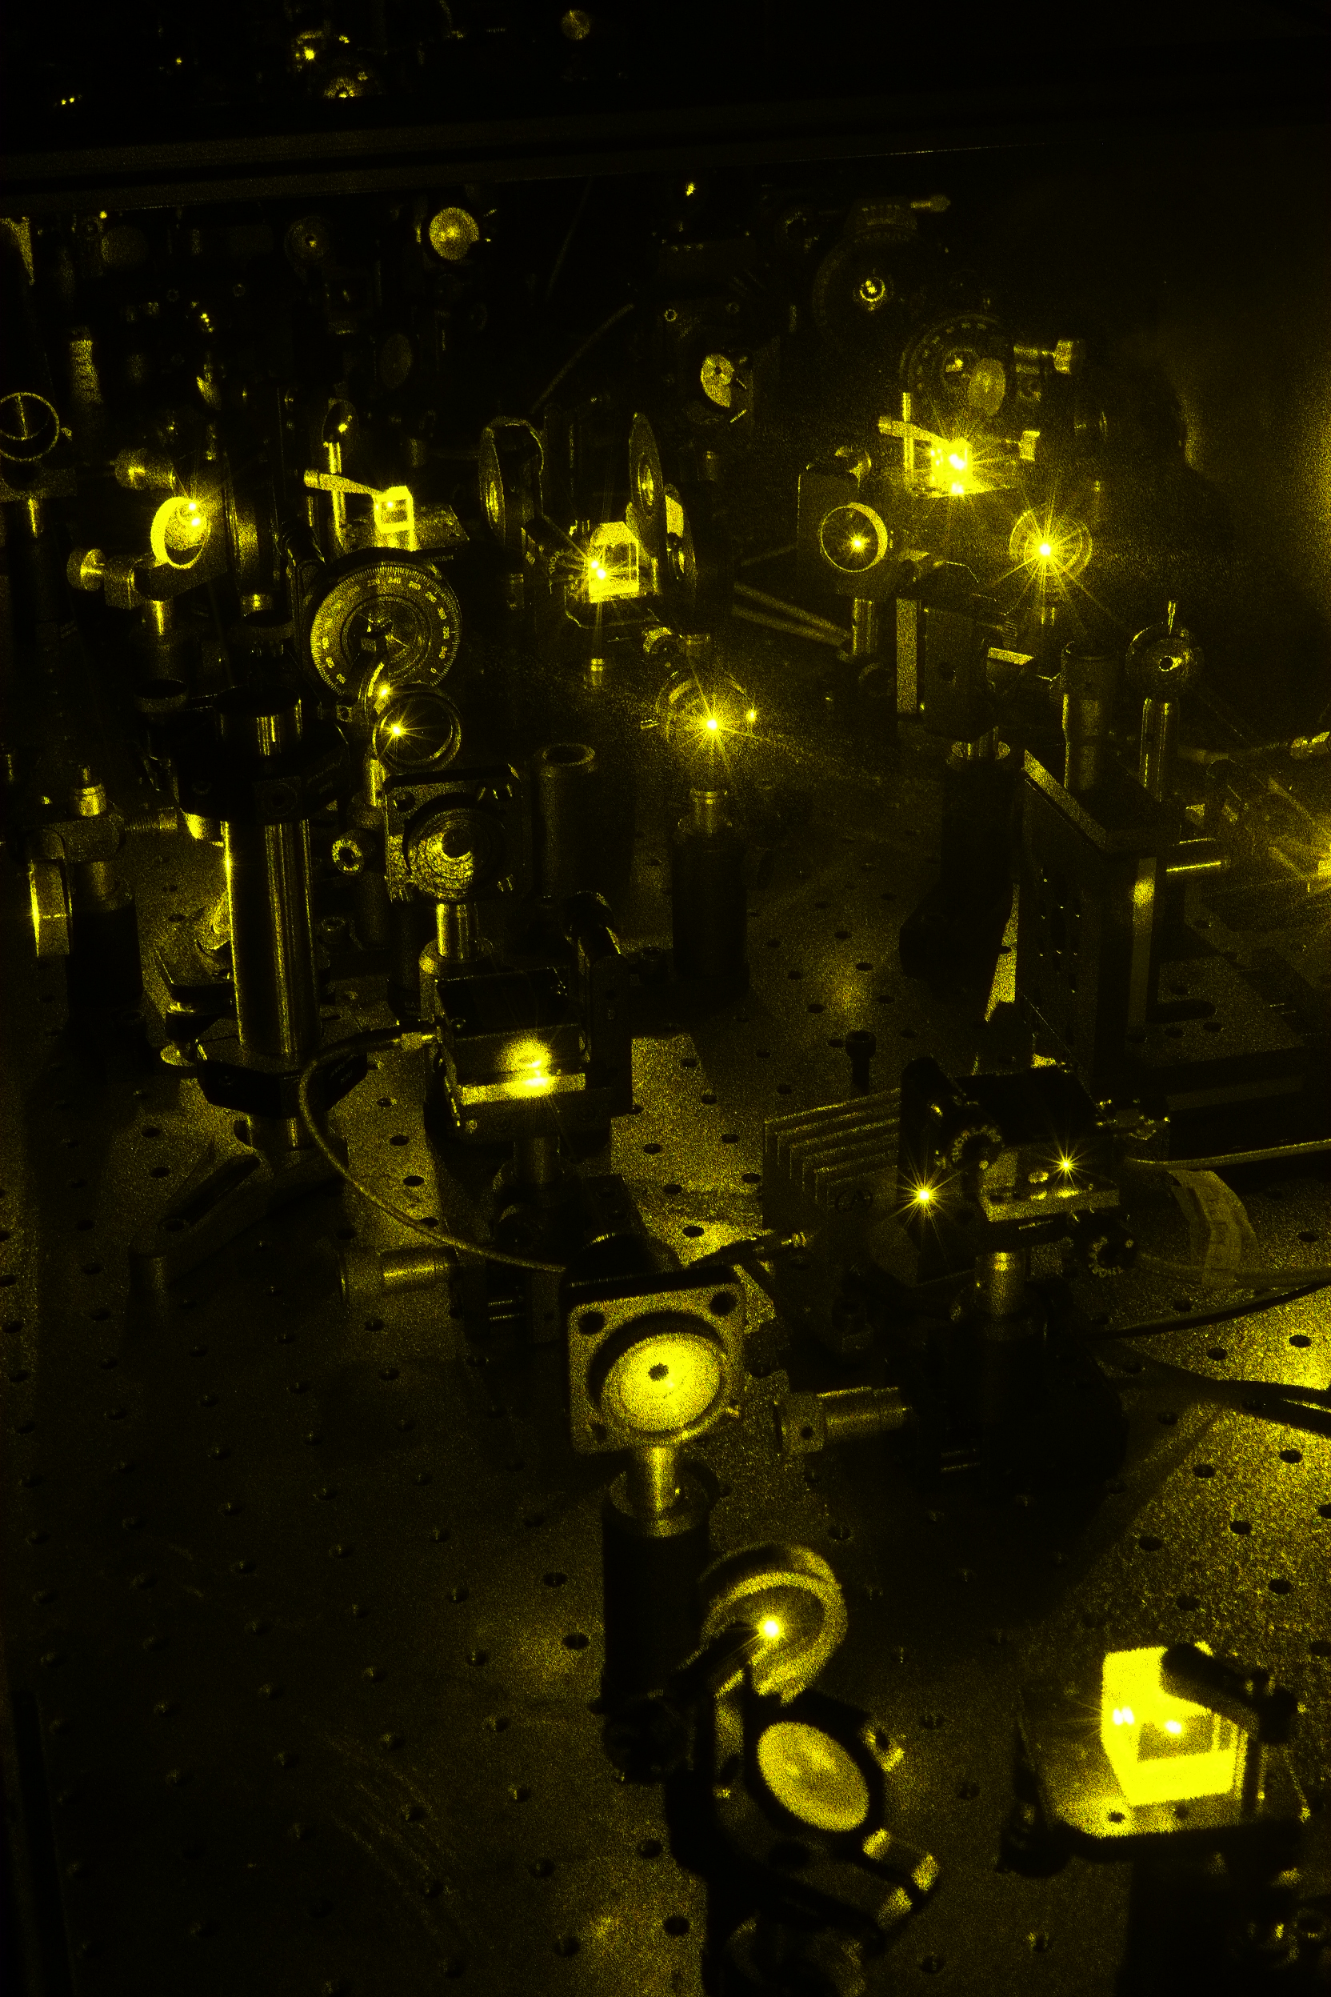

${\text{Eu}}^{3+}:{\text{Y}}_{2}\text{Si}{\text{O}}_{5}$ - Magnetic Field

Slide 8
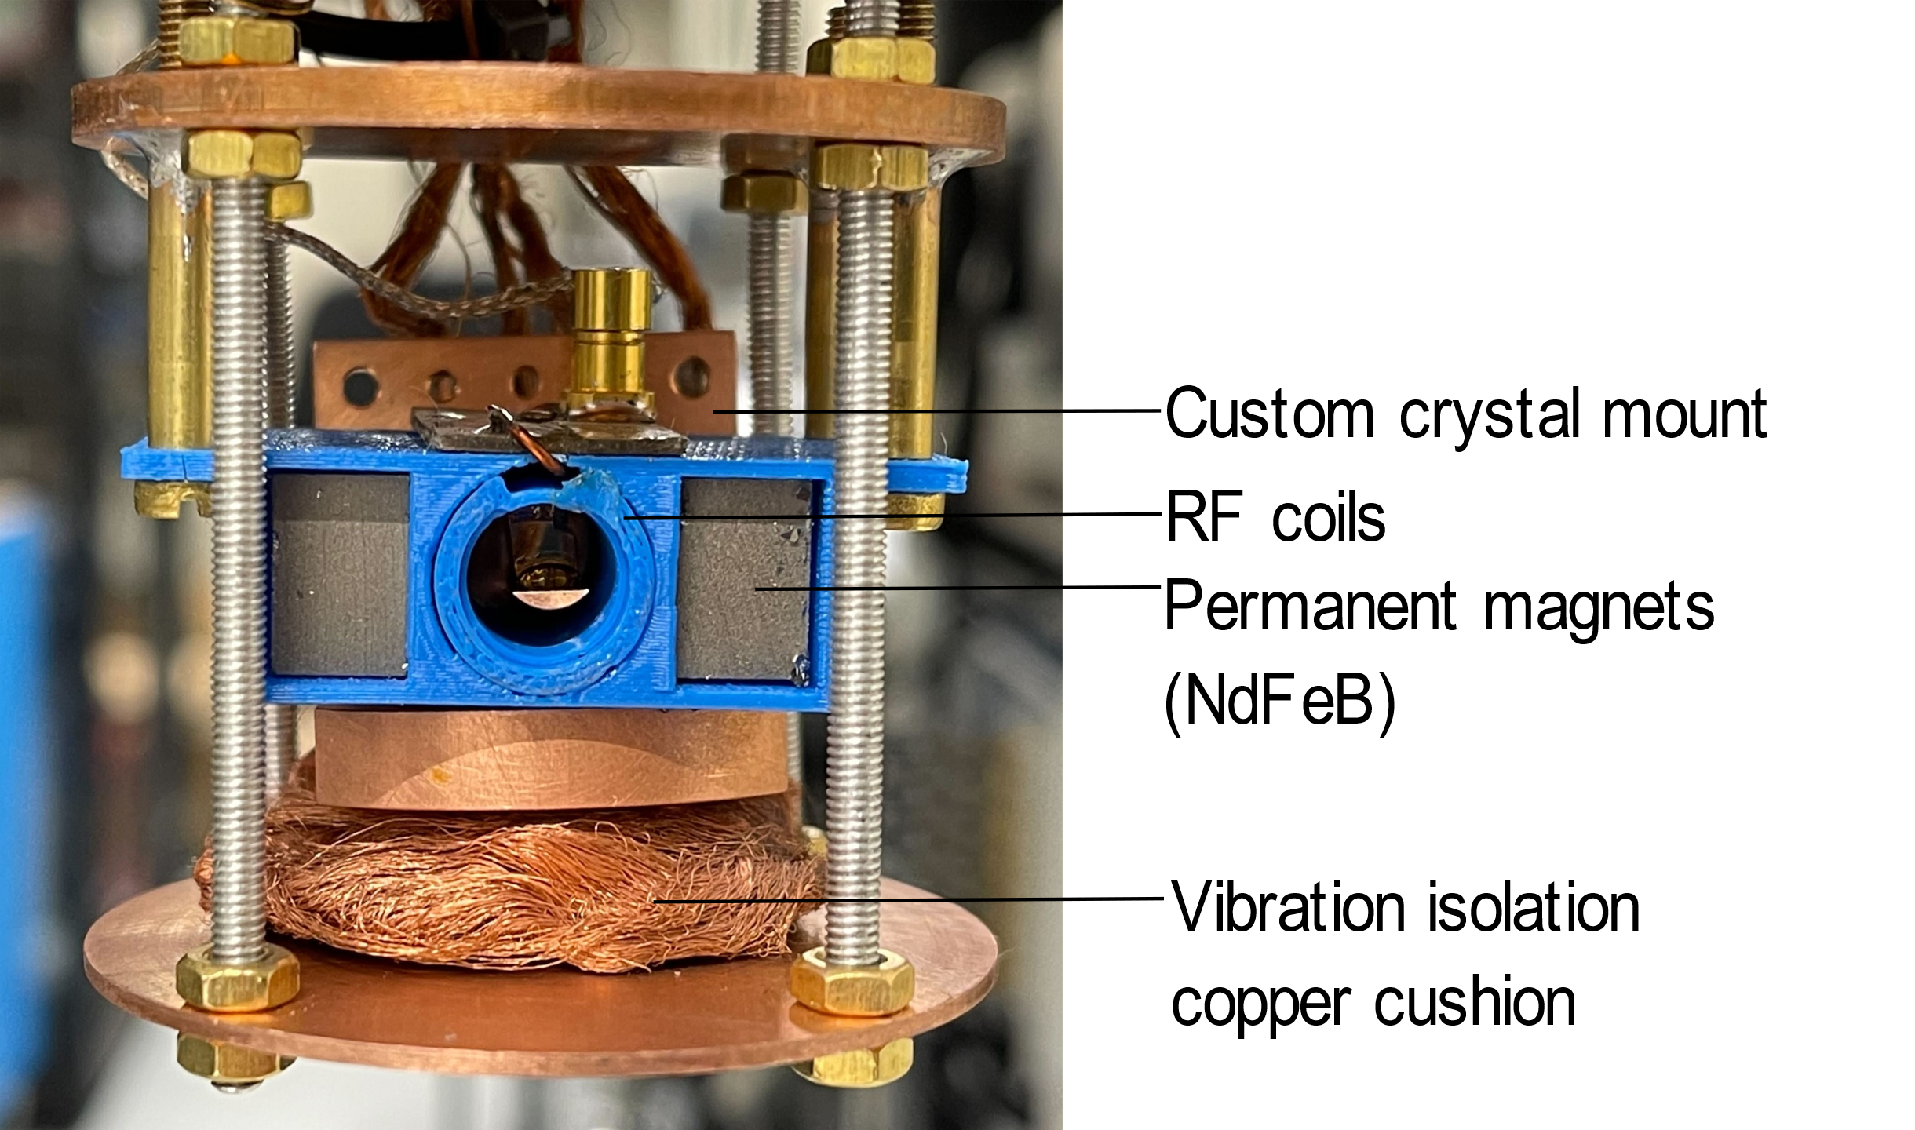
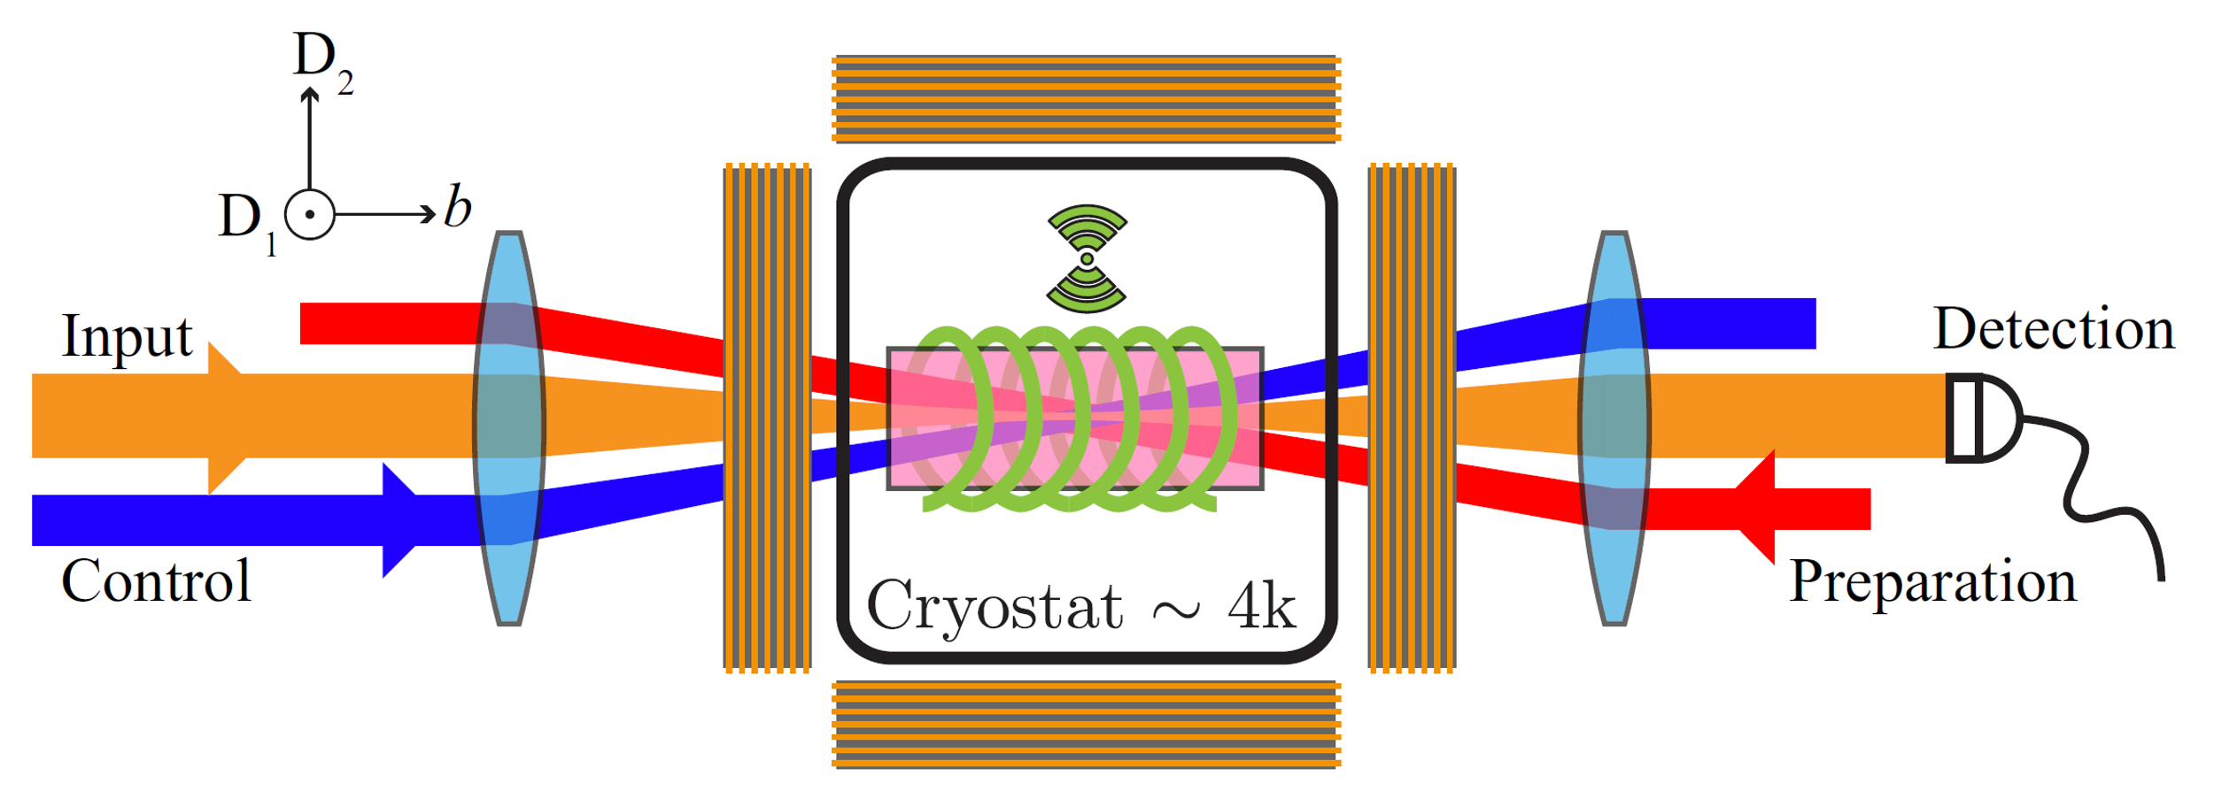
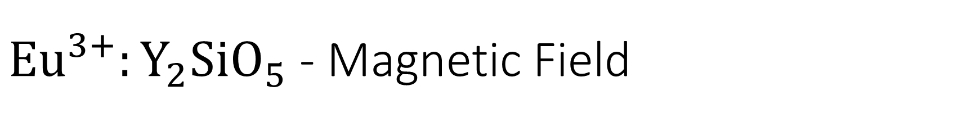
${\text{Eu}}^{3+}:{\text{Y}}_{2}\text{Si}{\text{O}}_{5}$ - Magnetic Field
Crystal is sandwich by two permanent magnets to provide a magnetic field of ~250mT
Customed crystal mount thermally and vibrationally isolated from other components

Slide 9
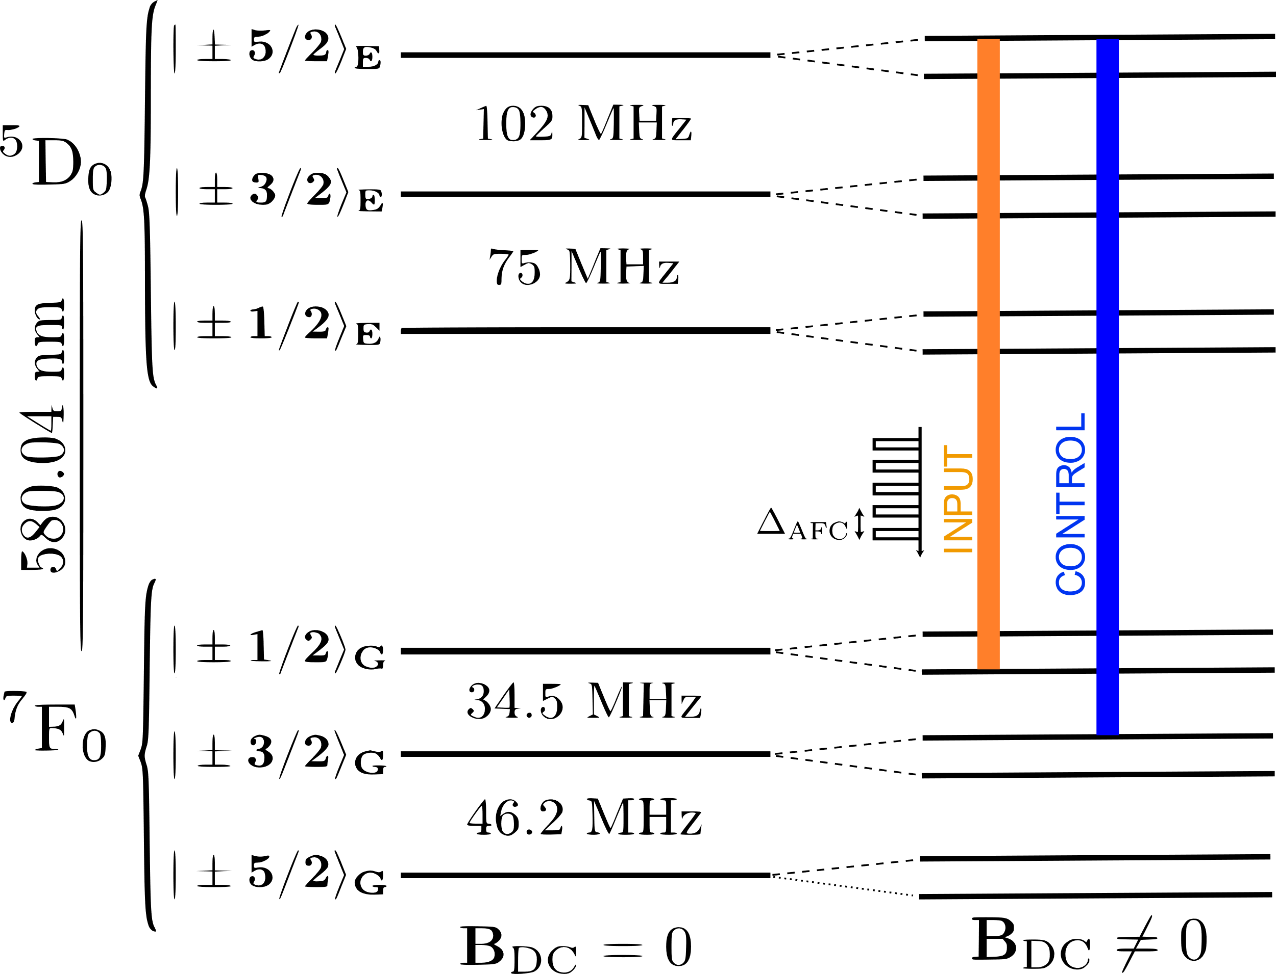
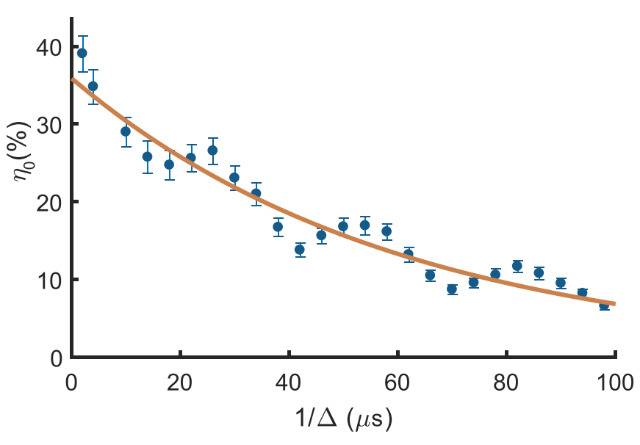
${\text{Eu}}^{3+}:{\text{Y}}_{2}\text{Si}{\text{O}}_{5}$ - Magnetic Field

Slide 10
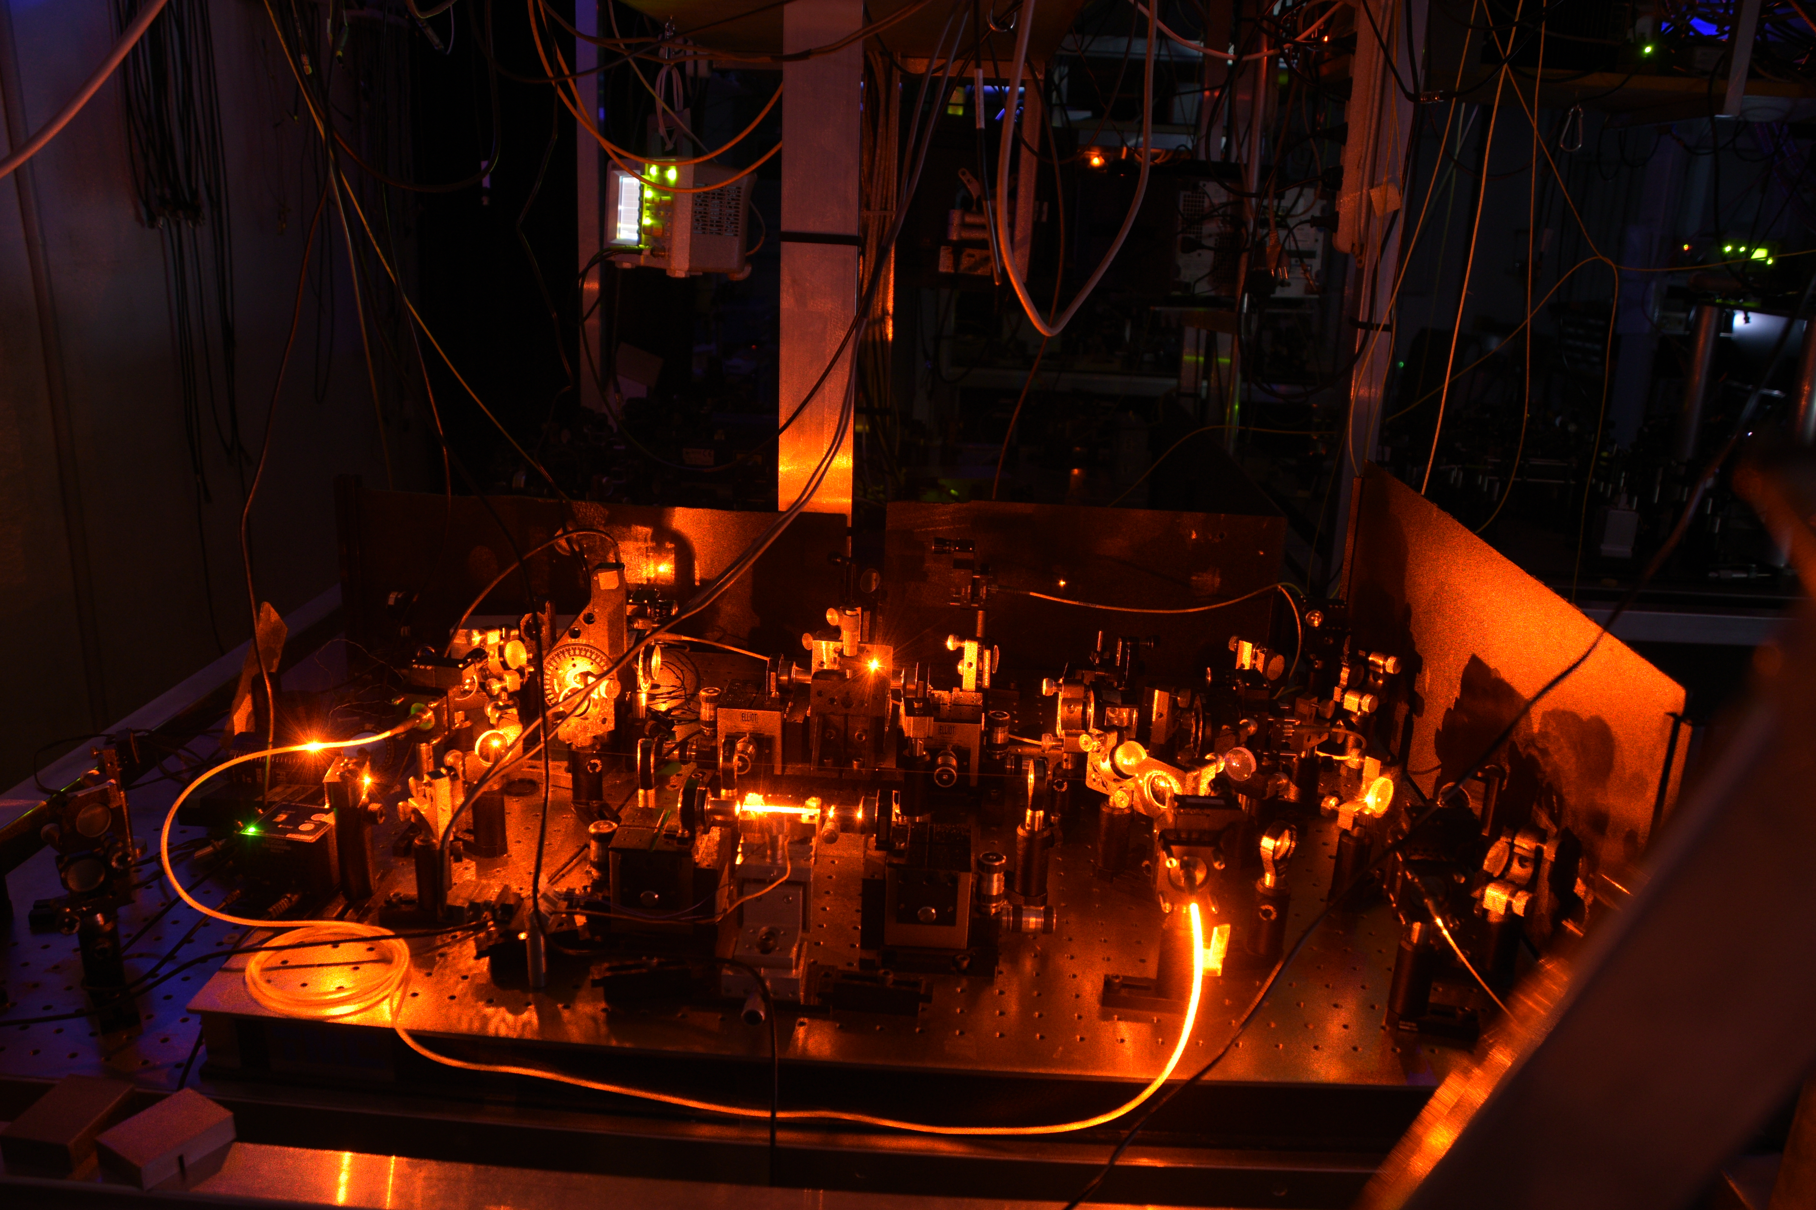

${\text{Yb}}^{3+}:{\text{Y}}_{2}\text{Si}{\text{O}}_{5}$
Spin-Wave Storage

Slide 11
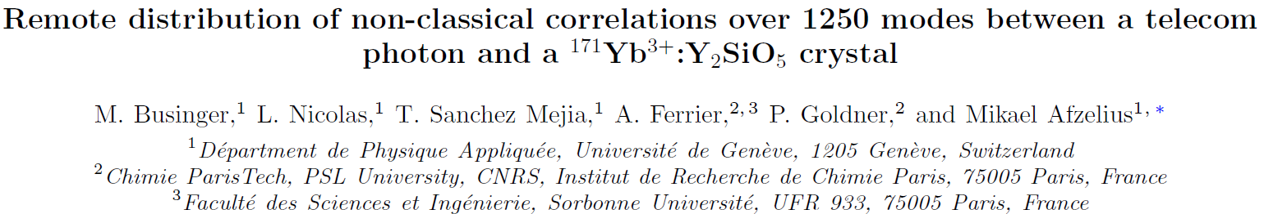
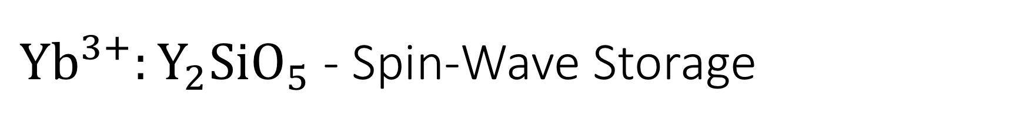
${\text{Yb}}^{3+}:{\text{Y}}_{2}\text{Si}{\text{O}}_{5}$ - Spin-Wave Storage
Our number of modes is great, but we don’t store them for nearly long enough!!!

Slide 12
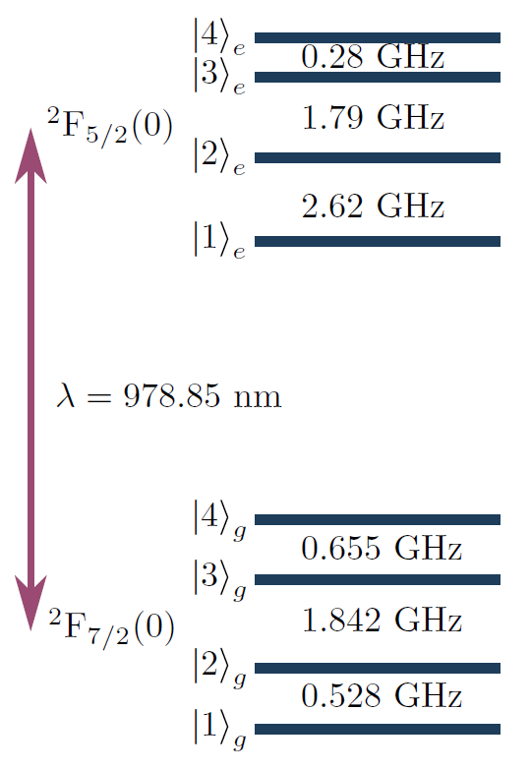
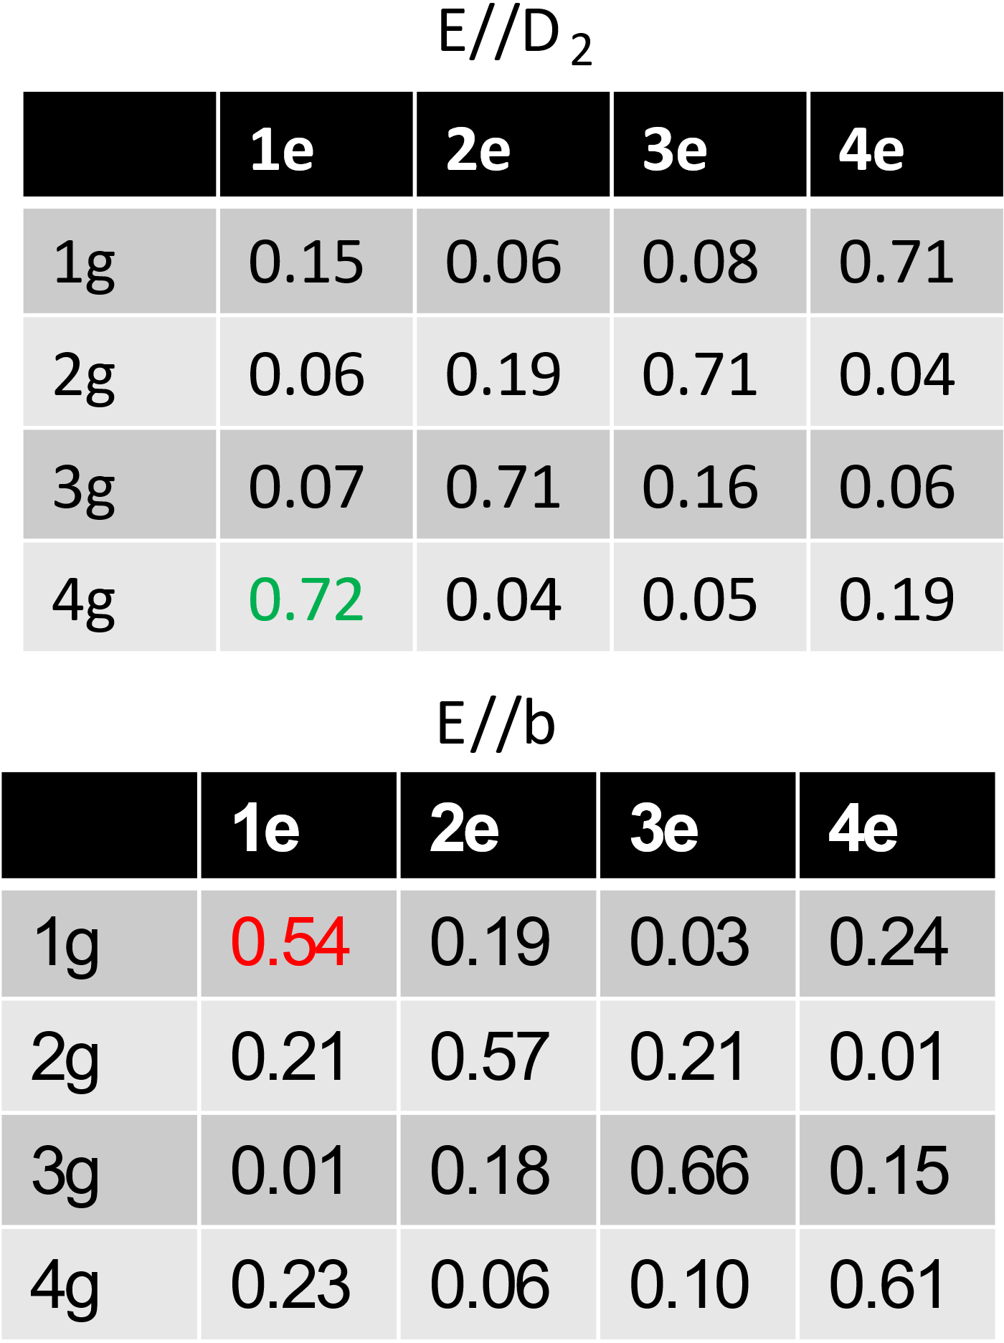
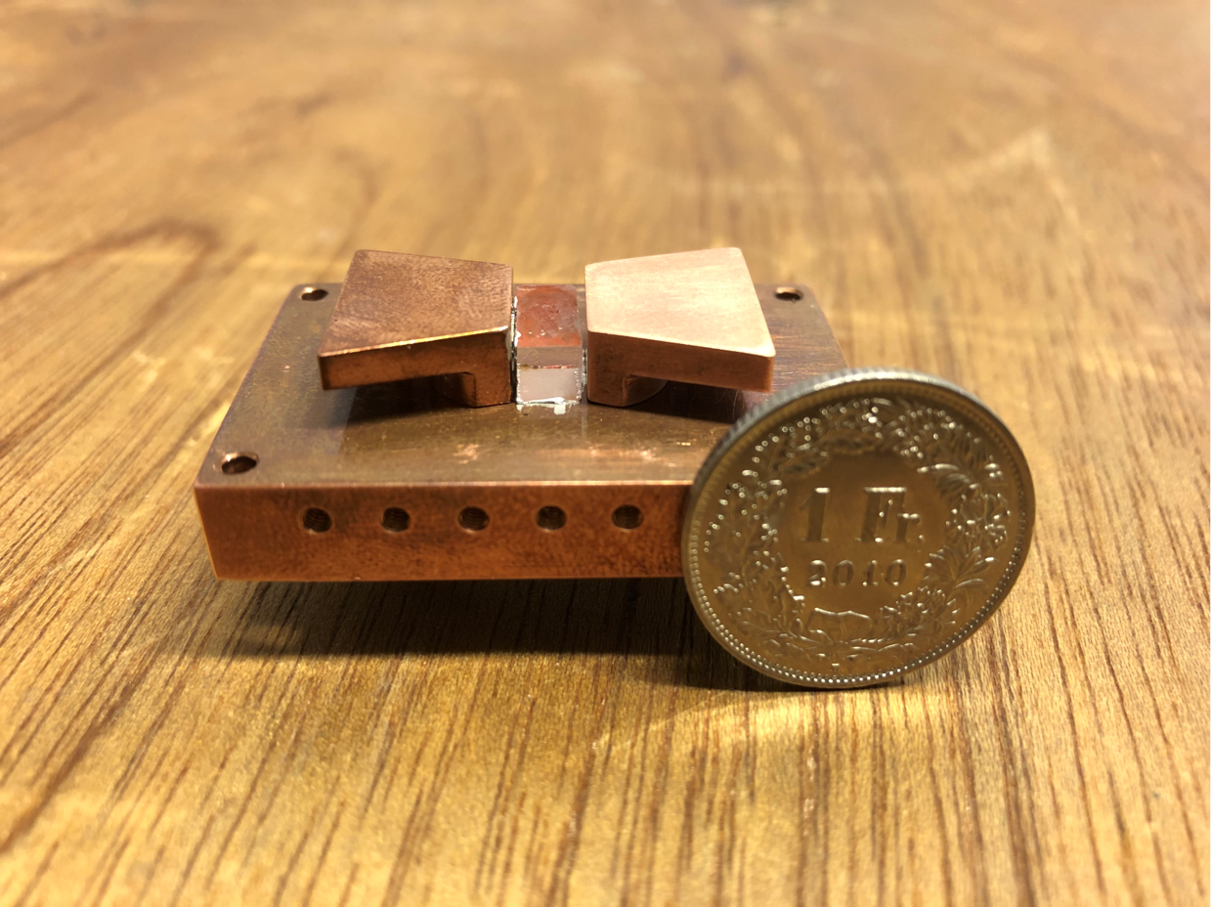
${\text{Yb}}^{3+}:{\text{Y}}_{2}\text{Si}{\text{O}}_{5}$ - Spin-Wave Storage
Microwave pulses can be added to even further increase the lifetime
Notes:
RELAXATION BETWEEN GROUND/SPIN STATES IS SEVERAL ORDERS OF MAGNITUDE LONGER THAN OPTICAL RELAXATION

Slide 13
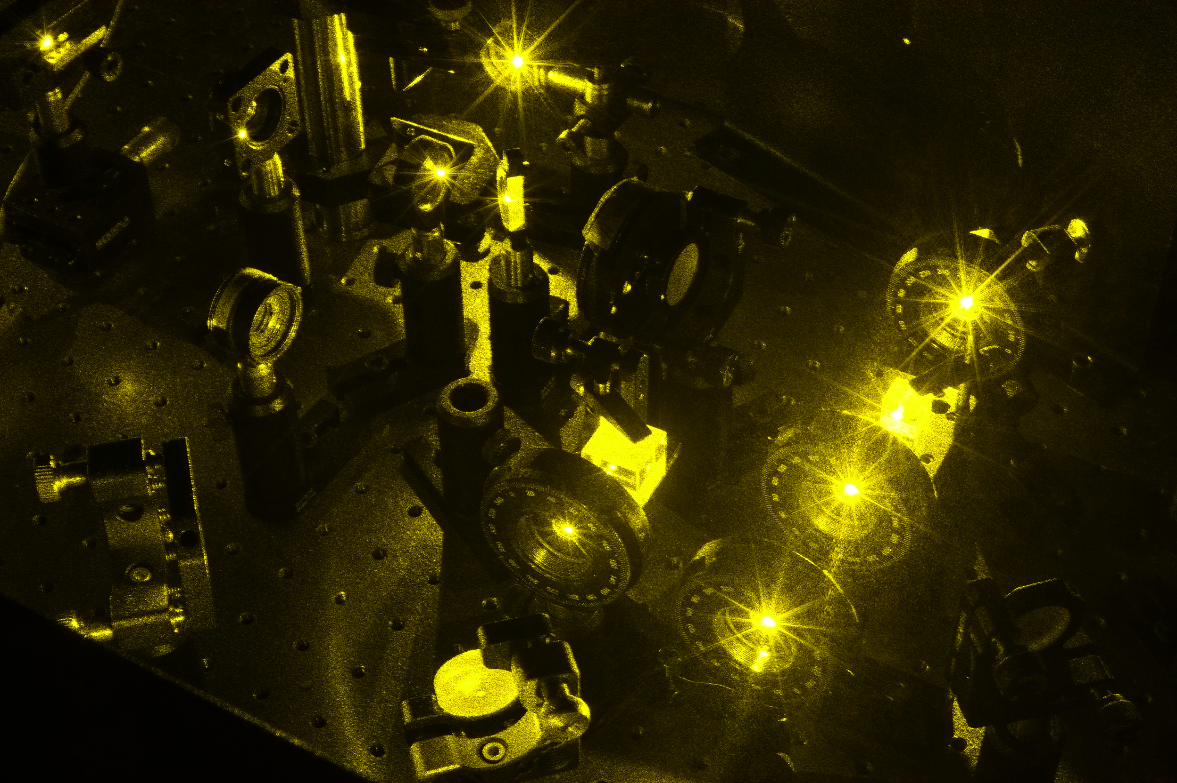
Questions

