Slide 1


Laser-ARPES measurements of Sr₂RuO₄ under uniaxial strain
Andrew Hunter
DQMP
University of Geneva
Young Researchers Day
16th September 2022
Notes:
PhD student in DQMP
Condensed matter physics
Specifically how material properties can change with uniaxial strain

Slide 2
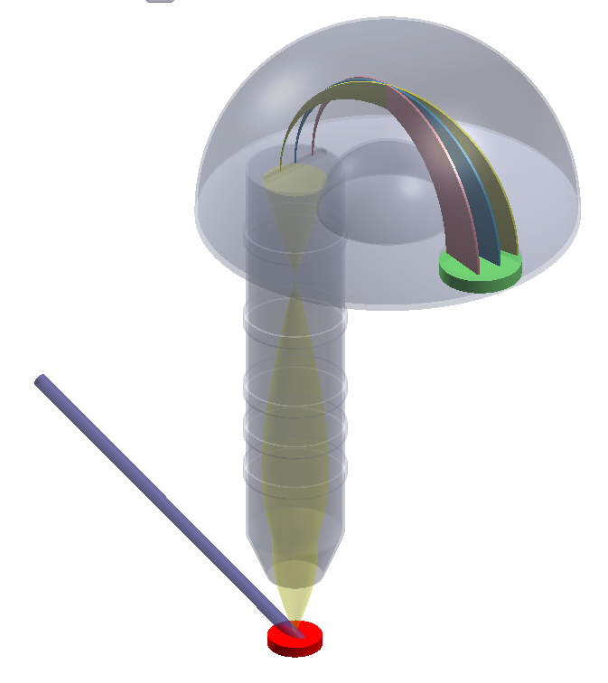
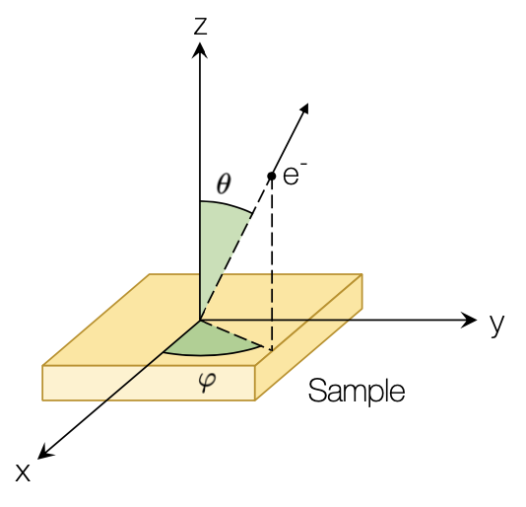
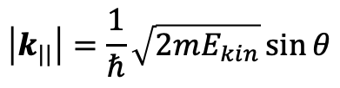

Laser-ARPES measurements of Sr₂RuO₄ under uniaxial strain
Hemispherical
Analyzer
k
UV source
2D detector
Lens
ε
$$\left|k_{||}\right|=\frac{1}{ℏ}\sqrt{2mE_{kin}}\sin{θ}$$
Sample goniometer
$$E_{kin}=hν−φ−\left|E_{B}\right|$$
Notes:
-Principle: direct probe of electronic band structure by photoelectric effect
-i.e. photon in (from laser), electron out
-Symmetry of sample surface preserves electron momentum in plane -> simple conversion from angle to parallel momentum.
-Hemispherical analyser measures energy distribution.
-Sweep angle between sample and detector -> measure electron E vs k

Slide 3
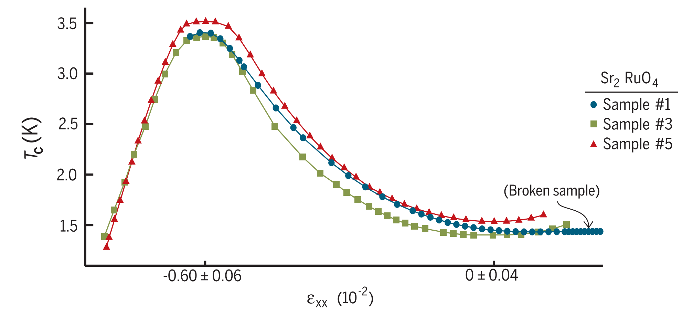

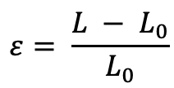


Laser-ARPES measurements of Sr₂RuO₄ under uniaxial strain
$$ε= \frac{L − L_{0}}{L_{0}}$$
$$F$$
$$F$$
$$L$$
$$L_{0}$$
A. Steppke, Science 2017
Notes:
SRO - interesting behavior with uniaxial strain.
Superconductor at low T -> strain causes Tc to peak -> unusual response
We want to understand this from e-structure

Slide 4
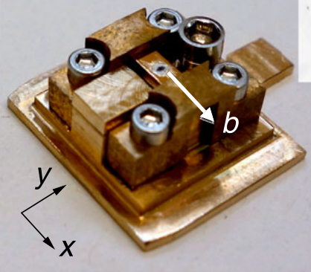
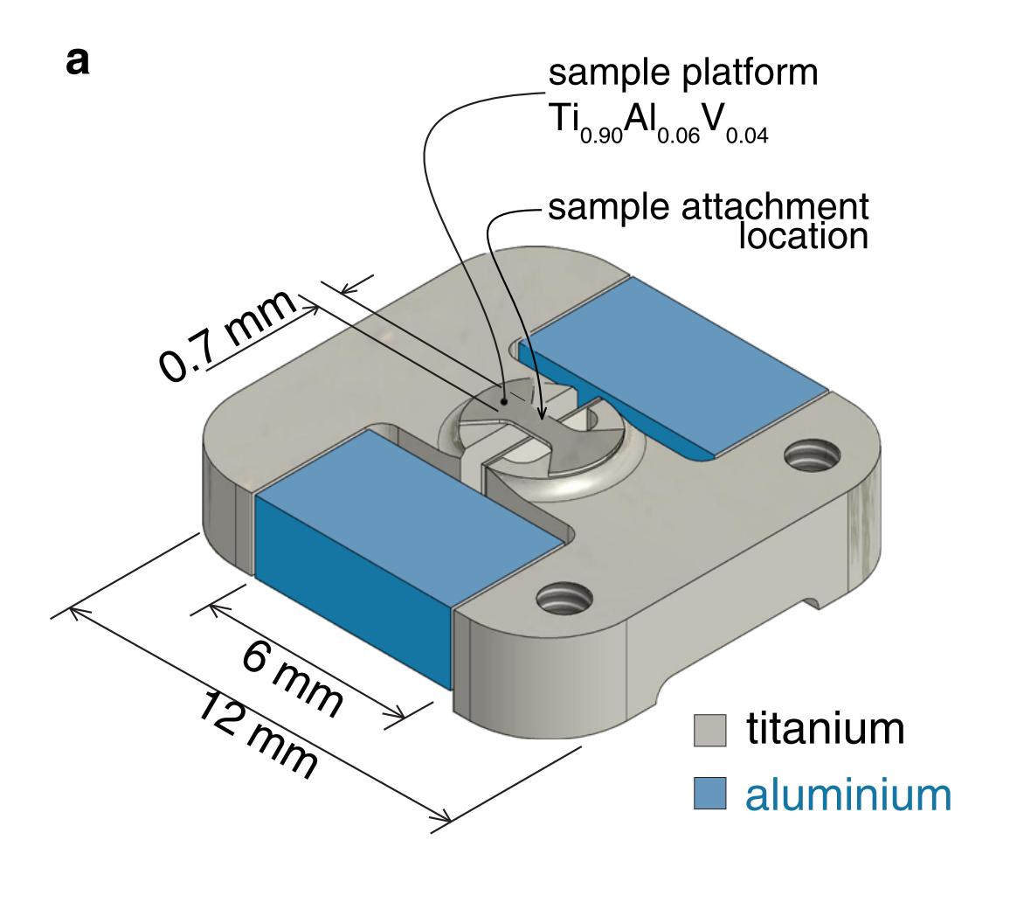
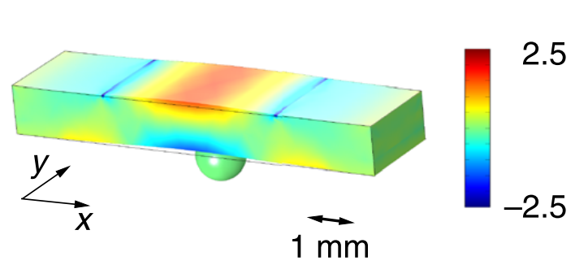
Laser-ARPES measurements of Sr₂RuO₄ under uniaxial strain
V. Sunko, npj Quant. Mater. 2019
Strain relaxation through epoxy?!
S. Riccò, Nat. Comm. 2018
Notes:
Strain experiments are difficult
-2 methods here rely on sample attached to bridge
Strain applied by bending bridge, or differential thermal contraction.
Difficult to say how strain goes from bridge, through epoxy and into sample.
Difficult to systematically vary and study effects of strain.

Slide 5
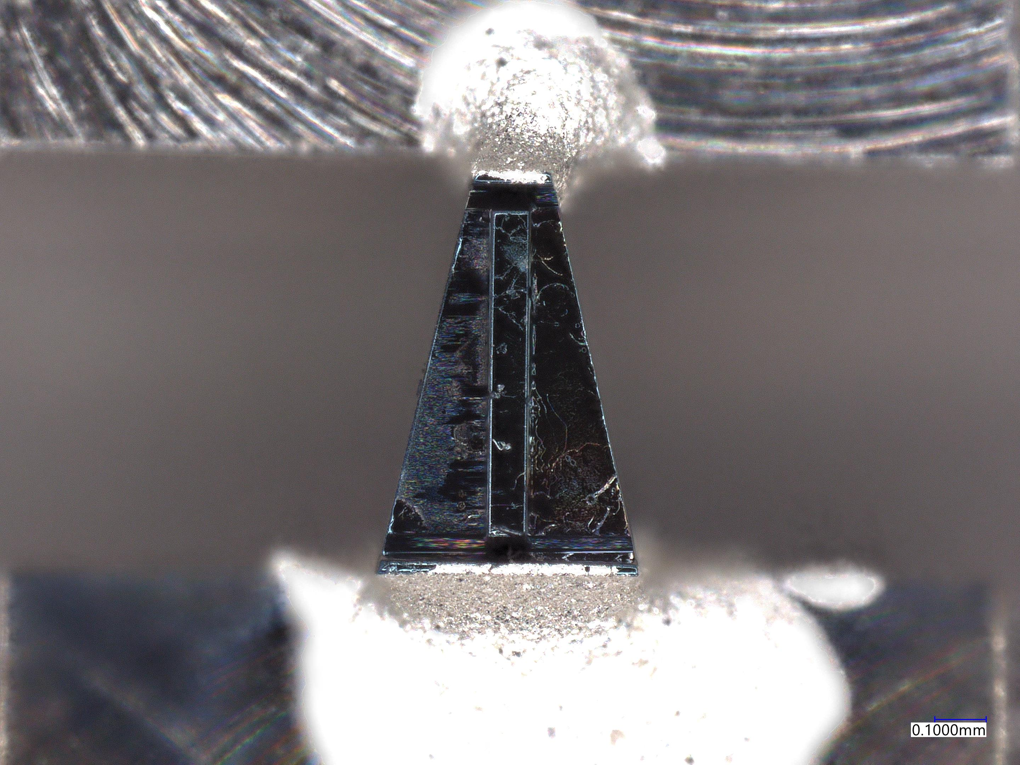
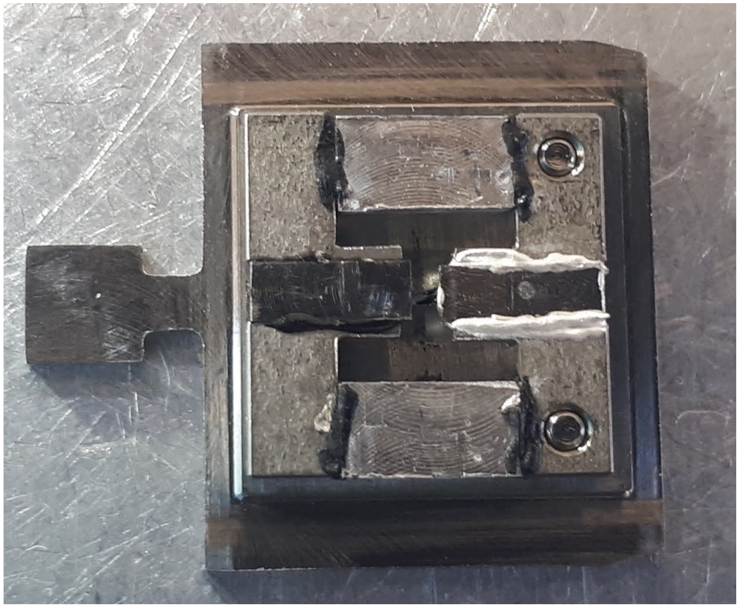
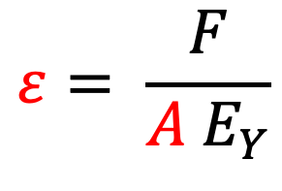
Laser-ARPES measurements of Sr₂RuO₄ under uniaxial strain
$$ε= \frac{F}{A E_{Y}}$$
Aluminium
a
a
450 μm
150 μm
700 μm
Titanium
Notes:
Extension of thermal contraction idea
Same cell design -> difference is what we apply strain to
Micromachined sample with tapered profile (FIB)
Strain sample directly
Sample geometry means that strain depends on cross-sectional area

Slide 6
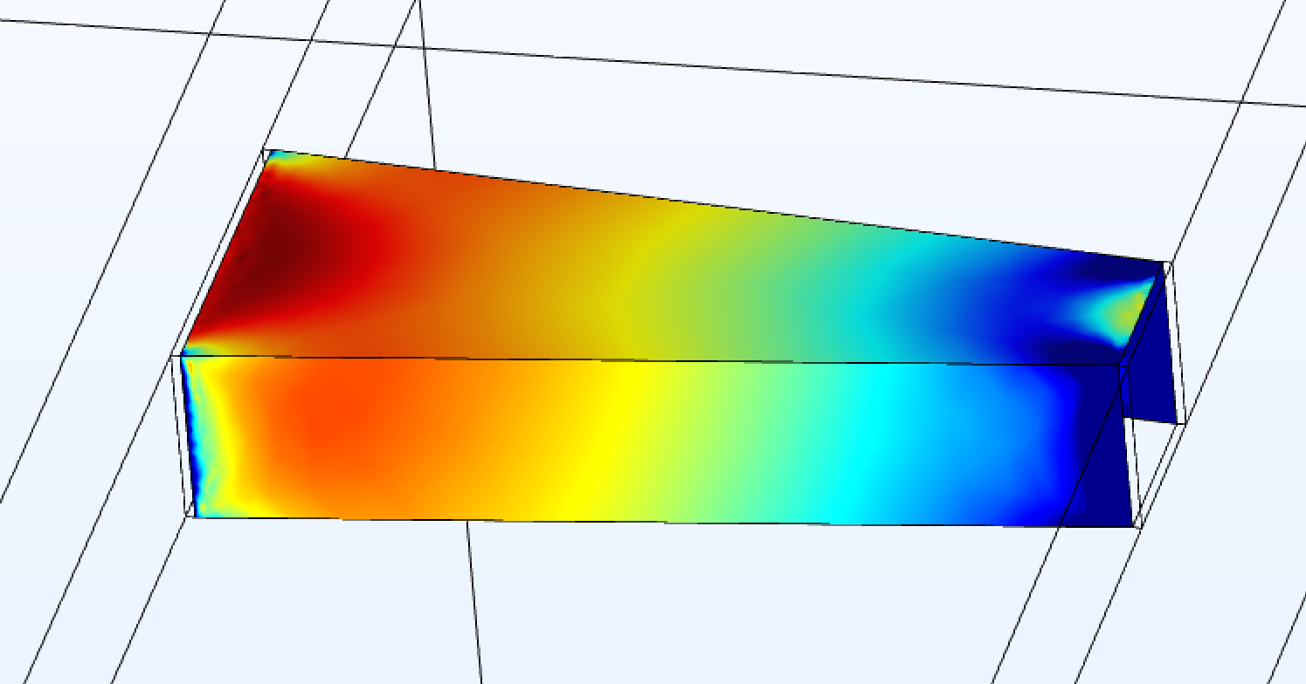
μ-
Laser-ARPES measurements of Sr₂RuO₄ under uniaxial strain
$$ε= \frac{F}{A E_{Y}}$$
-0.75
a
a
Strain (%)
450 μm
150 μm
700 μm
-0.25
Notes:
FEA work shows difference in strain along sample
To resolve this position dependence, need small spot size -> u focused laser arpes

Slide 7
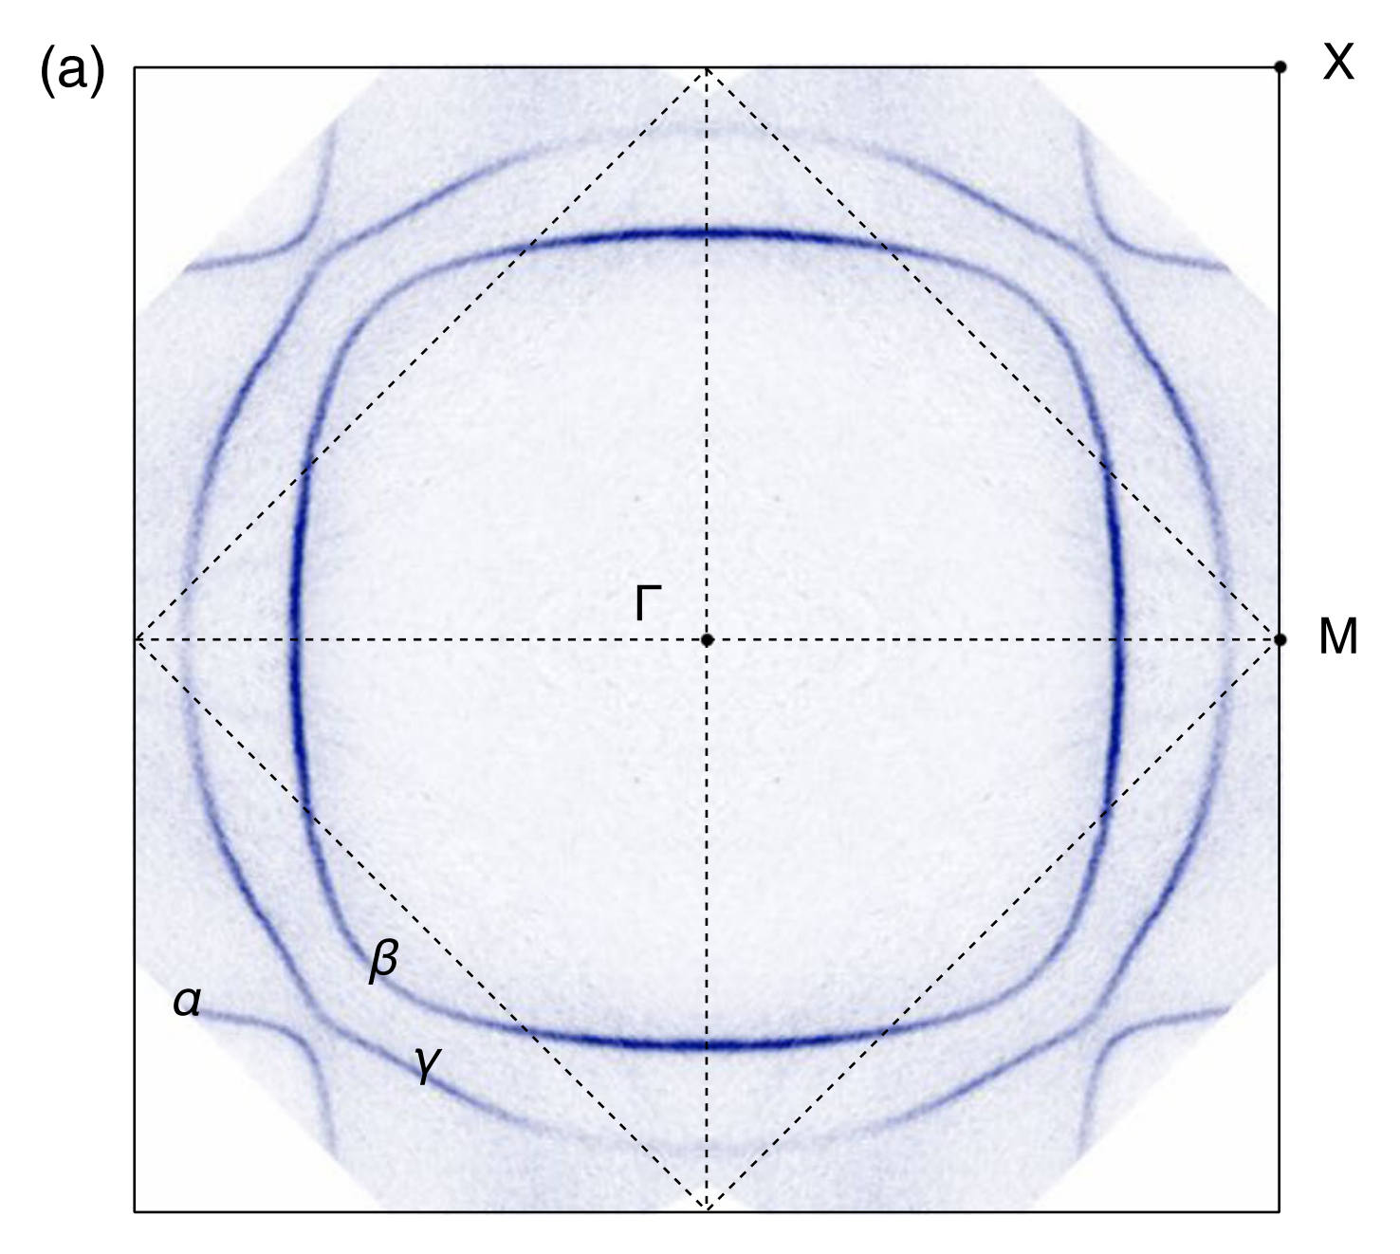
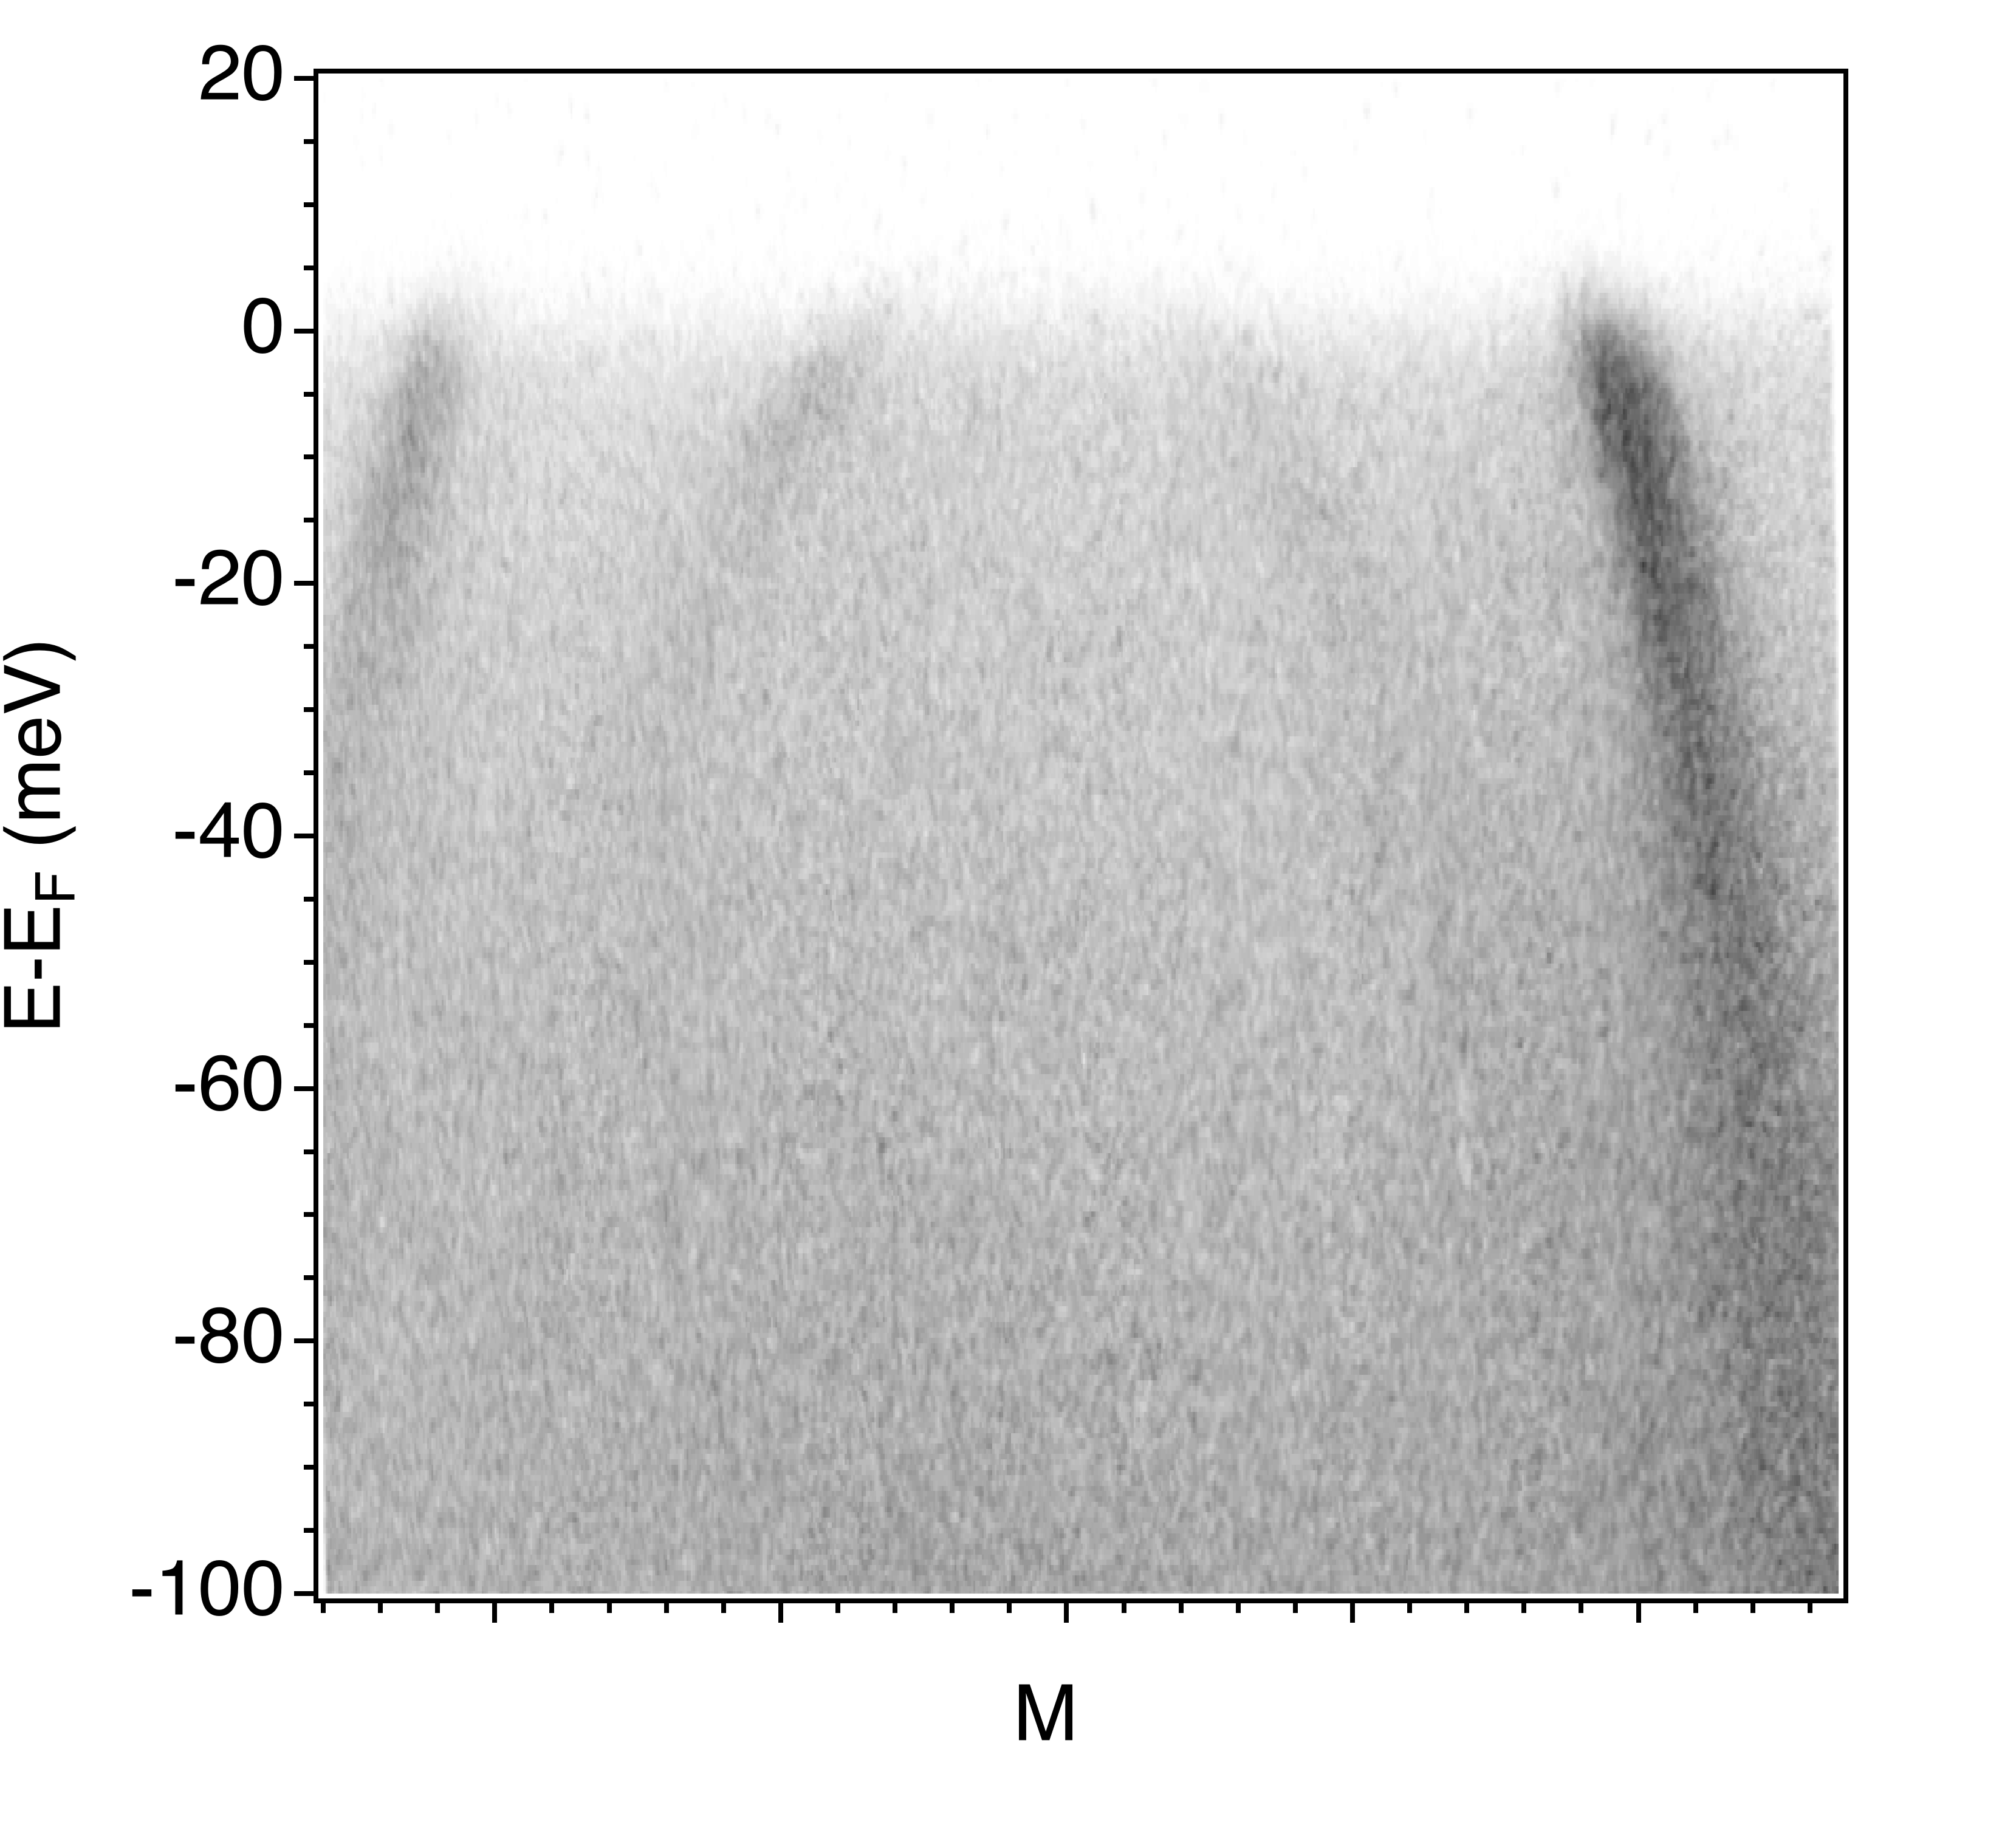
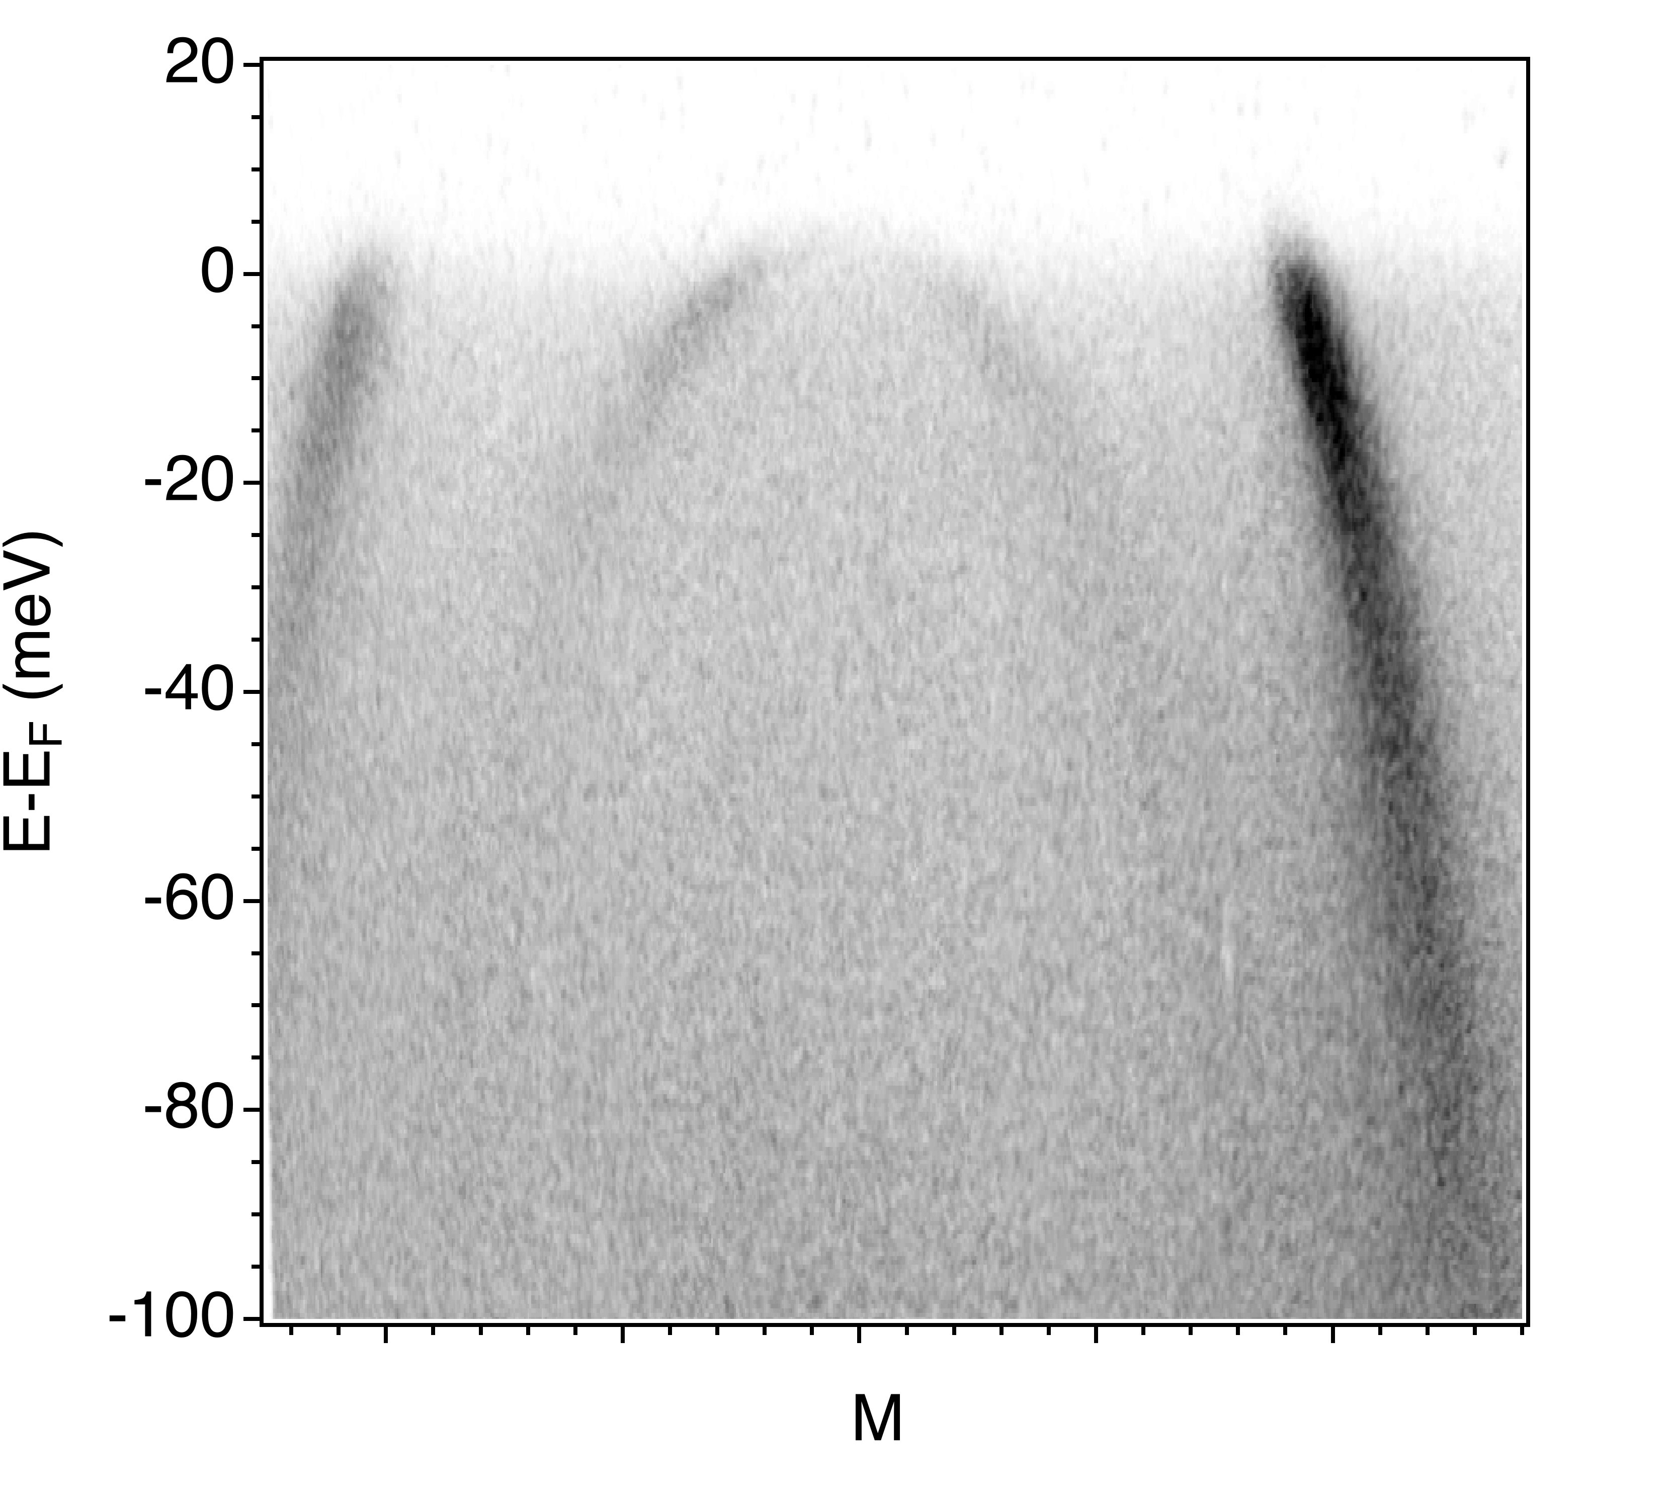
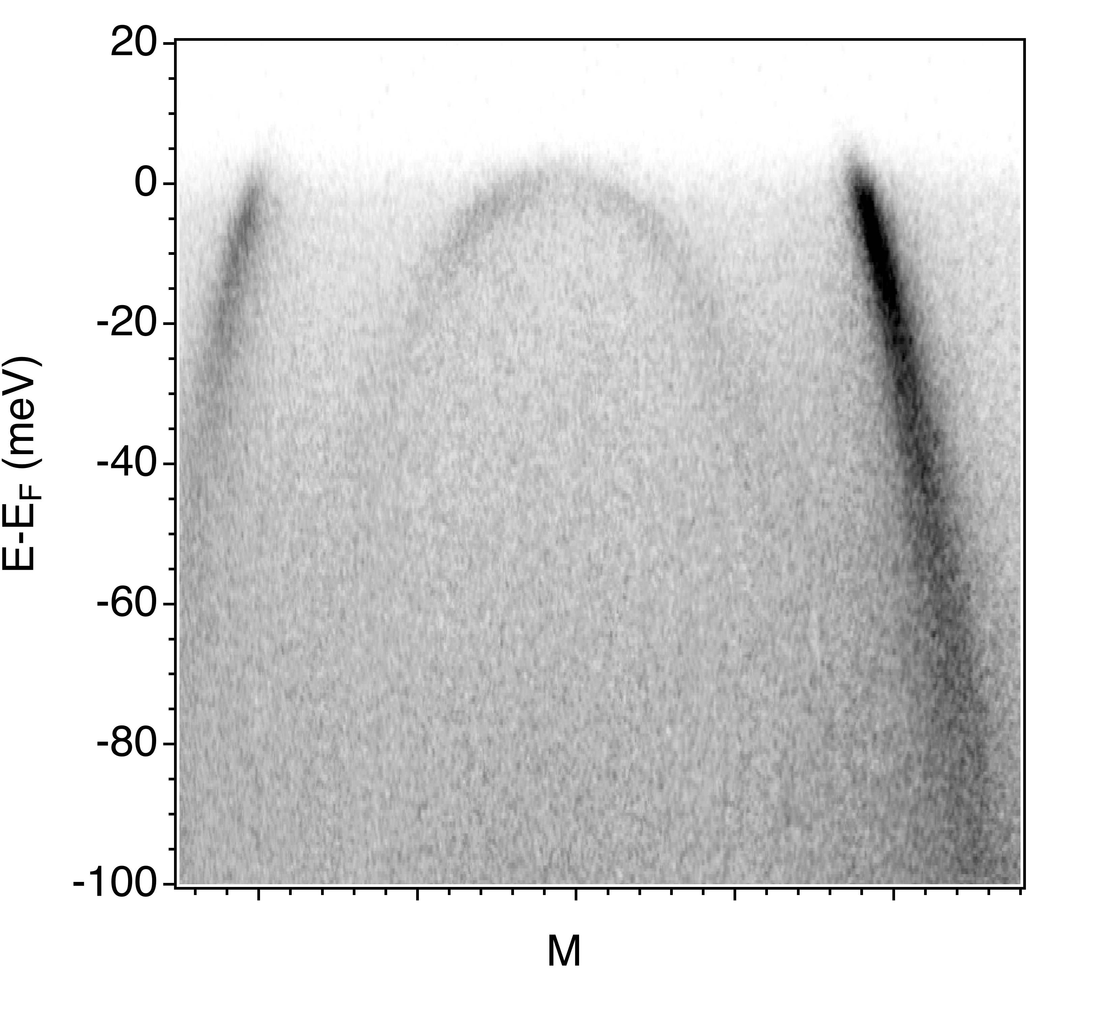
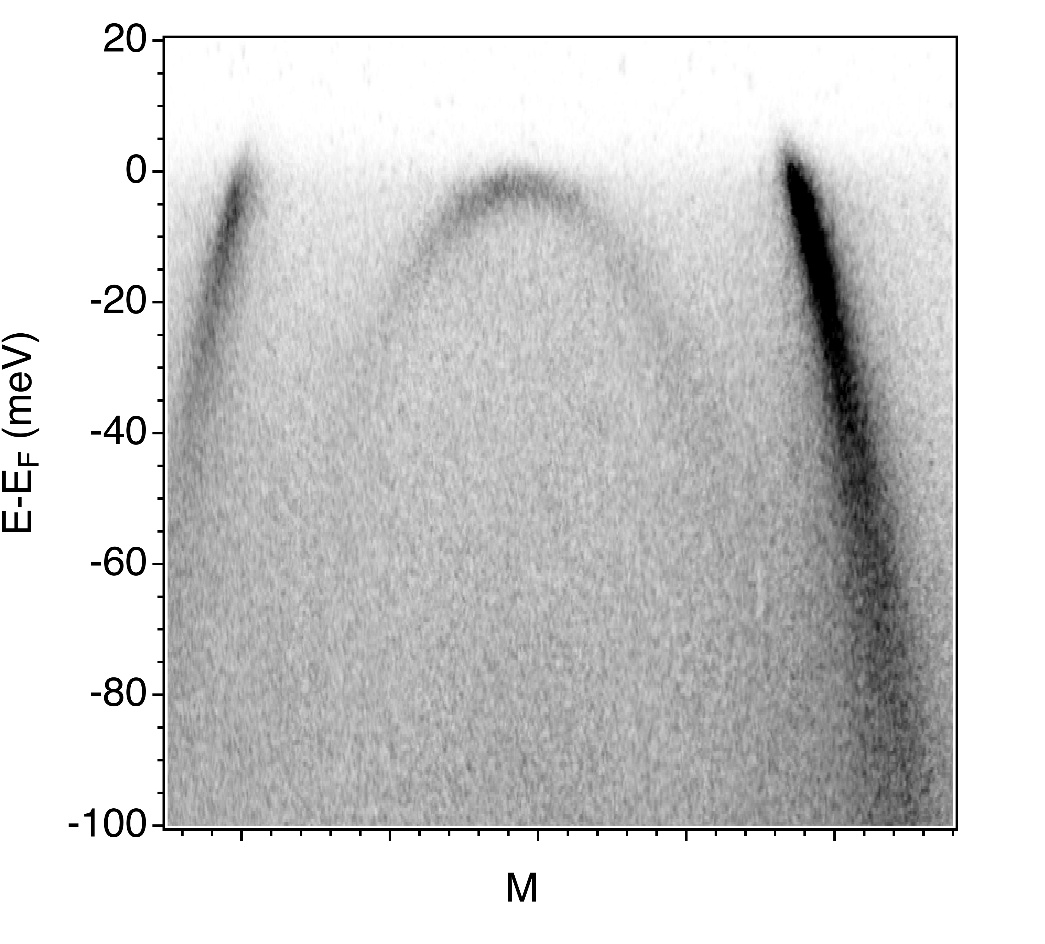
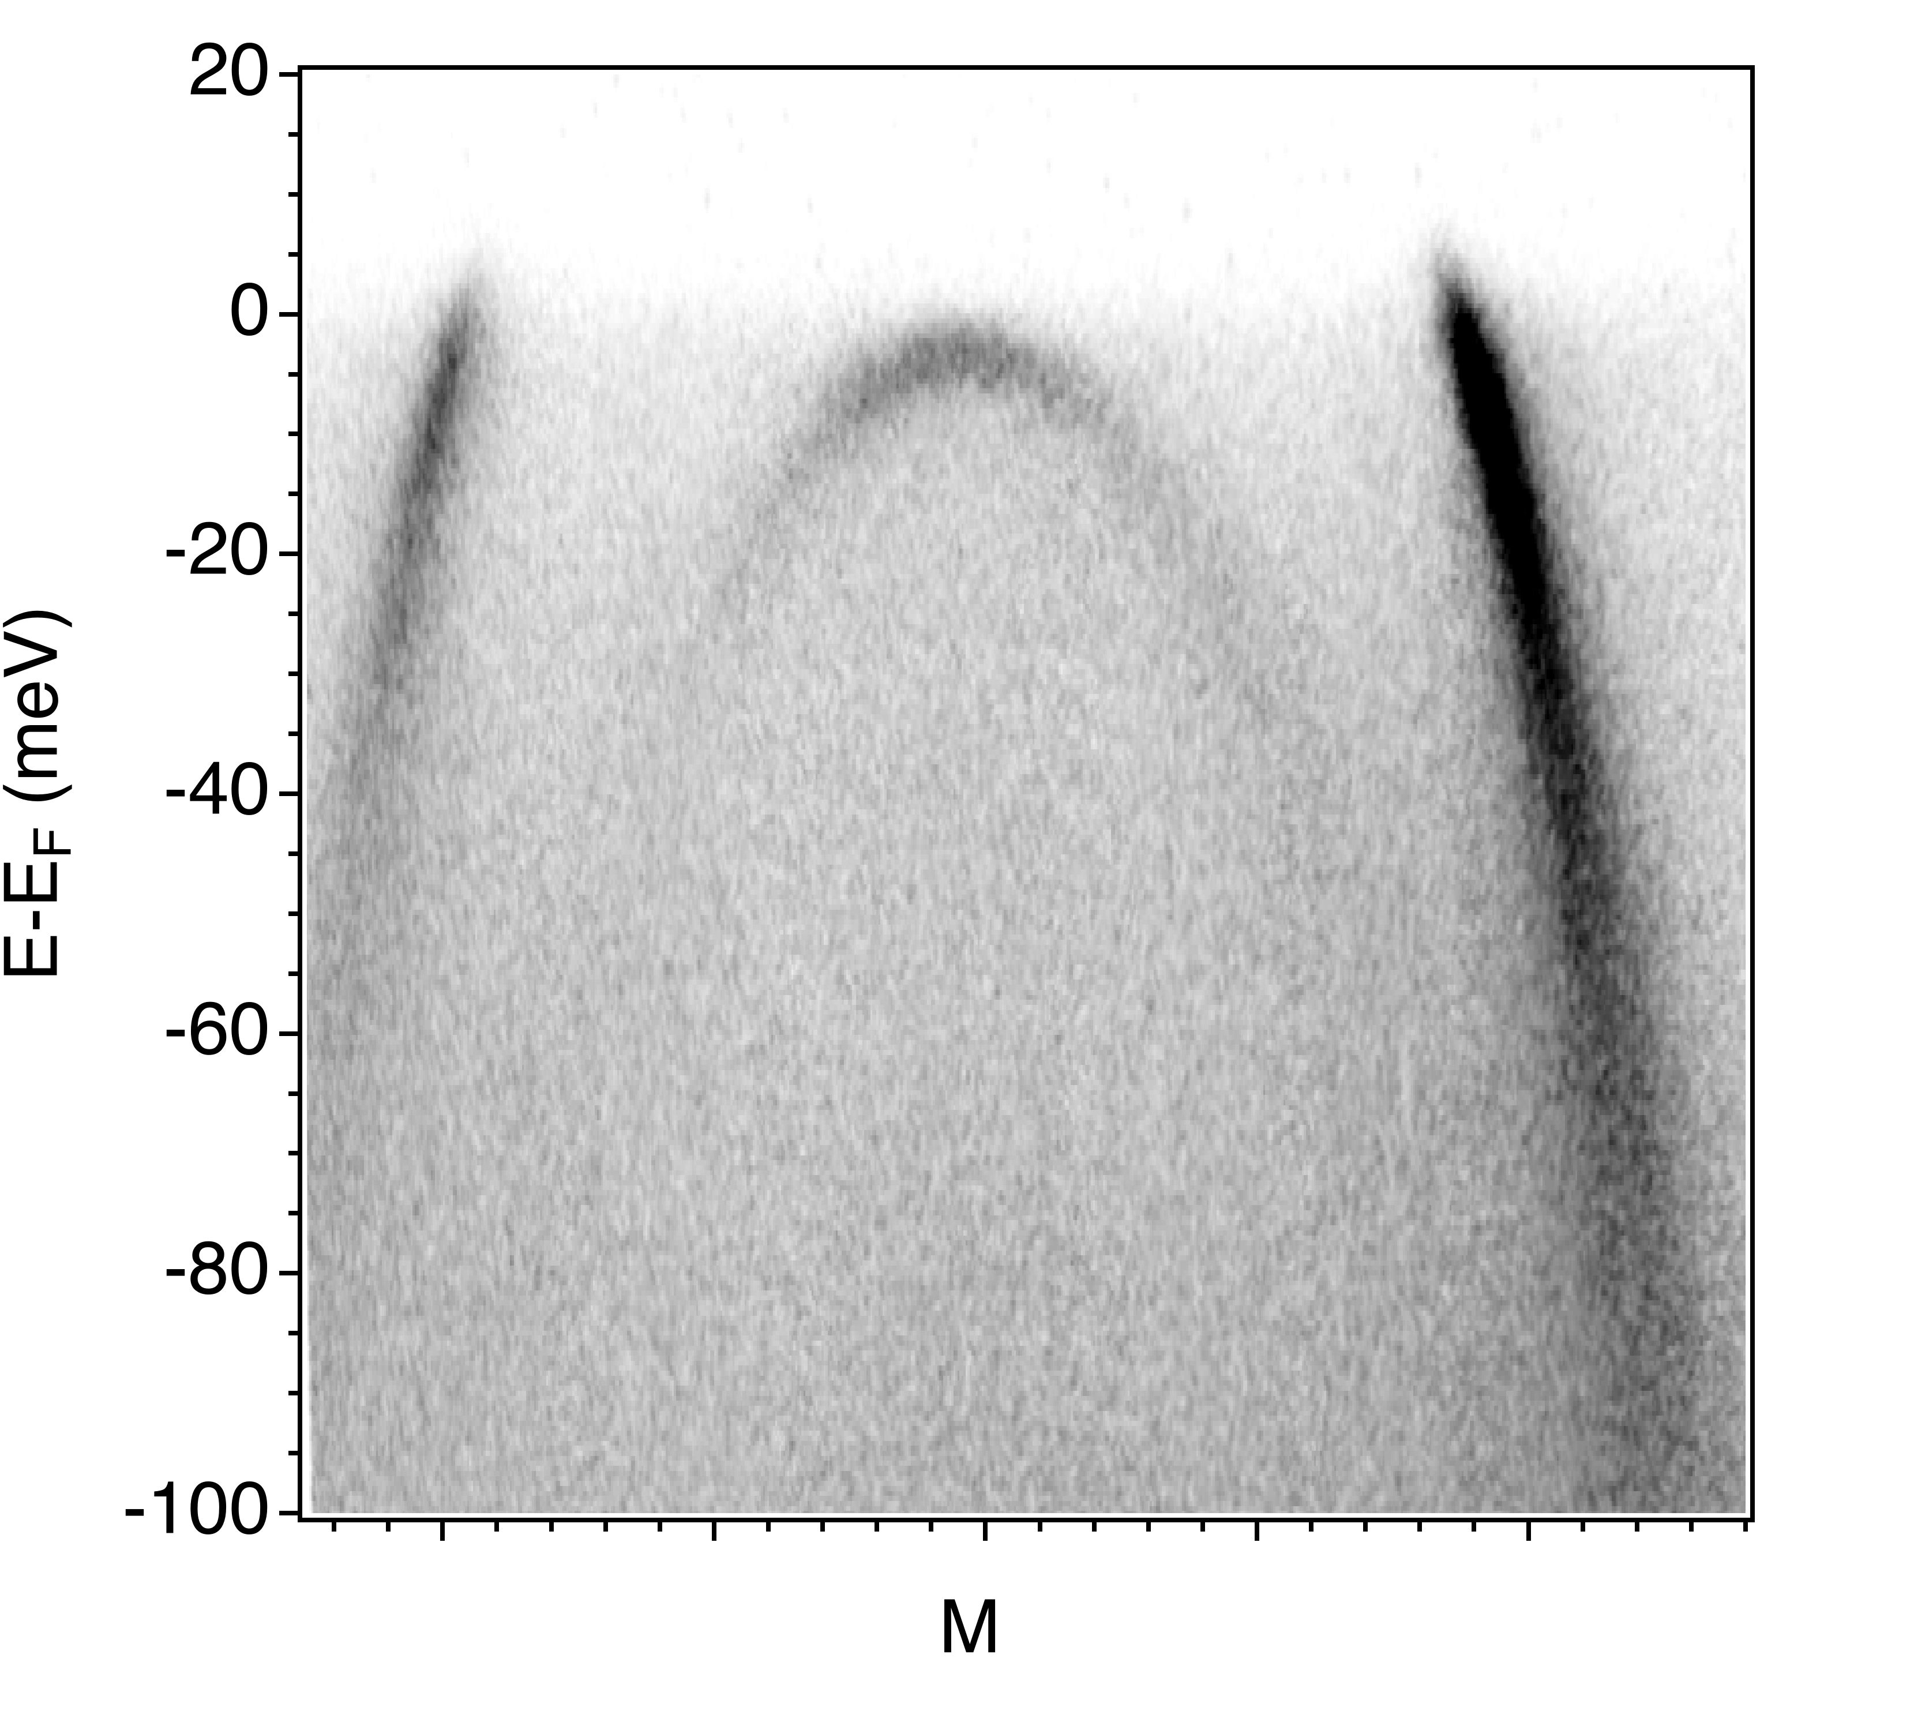
Laser-ARPES measurements of Sr₂RuO₄ under uniaxial strain
100 μm
𝛾
𝛽
Strain/position
Notes:
Have tapered sample + micro-focused laser
Moving on the sample -> chose a different strain
Measure dispersion cuts indicated by FS, region where response to strain should be strongest
-> the results I get showing VHS (top of gamma) move across Ef with increased strain (believed to cause spike in Tc)

Slide 8
Laser-ARPES measurements of Sr₂RuO₄ under uniaxial strain
100 μm
𝛾
𝛽
Strain/position
Notes:
-> the results I get showing VHS (top of gamma) move across Ef with increased strain (believed to cause spike in Tc)

Slide 9
Conclusion
Developed a new technique for ARPES experiments under quasi-continuous strain
Demonstrated the tuning of a VHS across the Fermi level in Sr₂RuO₄
𝛾
𝛽
Strain/position

