Slide 1
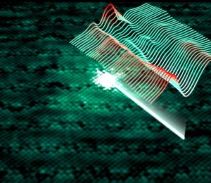
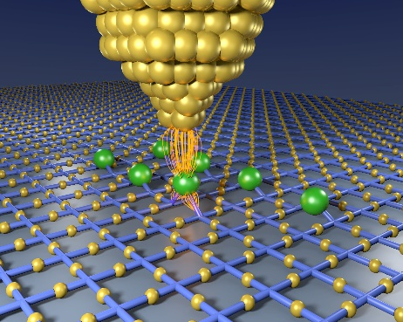



Investigating High Temperature Cuprate Superconductors by Scanning Tunneling Microscopy
Tejas Parasram Singar
Department of Quantum Matter Physics
University of Geneva, Switzerland
tejas.singar@unige.ch
Young Researchers Day
Illustration: X. Ravinet, Scientify
September 16, 2022
Credits: CFEL

Slide 2
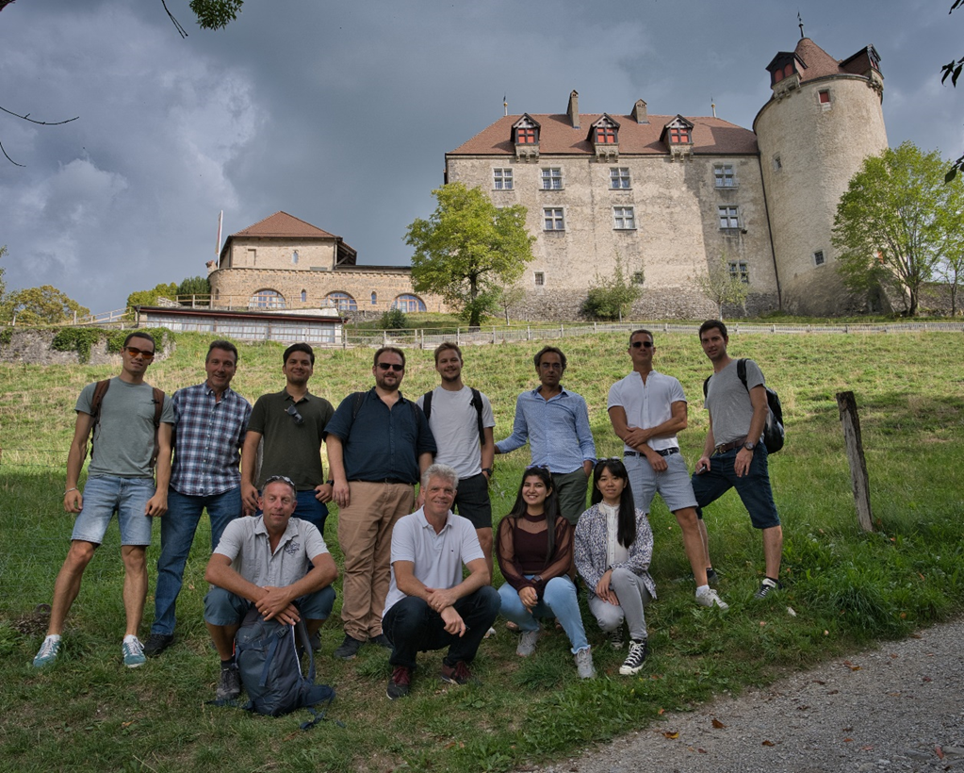
Acknowledgements
STM team Geneva
  Prof. C. Renner
  Dr. I. Maggio-Aprile
  Dr. A. Scarfato
  Dr. Á Pásztor
  Dr. L. Sun
  V. Pasquier
  T. Singar
  A. Ørsted
  I. Pushkarna
  G. Manfrini, A. Guipet, L. Stark
Single Crystals
  G. Gu (Brookhaven)
Theory
  Ch. Berthod (UniGE)
dqmp.unige.ch/renner/

Slide 3
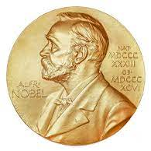
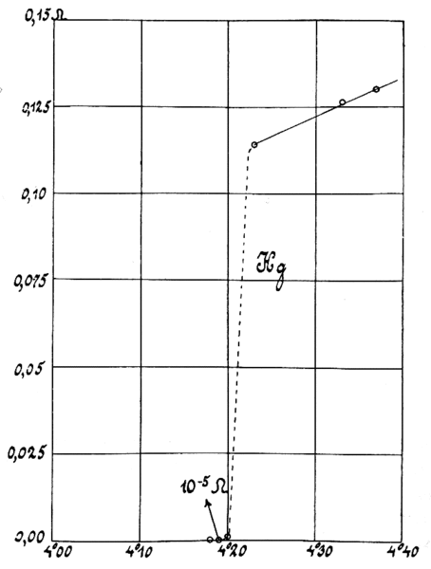
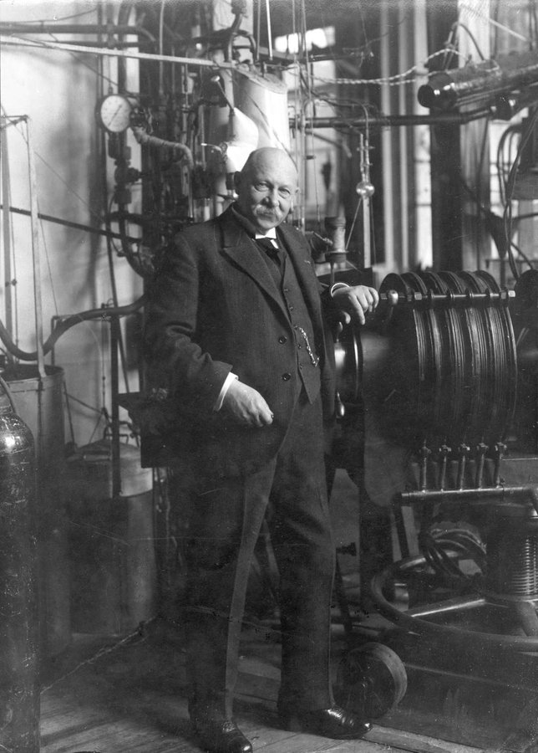
Superconductivity
Sudden drop in resistivity below a certain critical temperature, T_{c}
Resistance (Ω)
Critical Temperature, T_{c}
Temperature (K)
Heike Kamerlingh Onnes (1911)
H. Kamerlingh Onnes, Commun. Phys. Lab. Univ.
Leiden. Suppl. 29 (Nov. 1911)

Slide 4
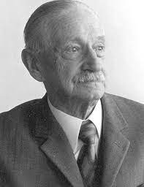
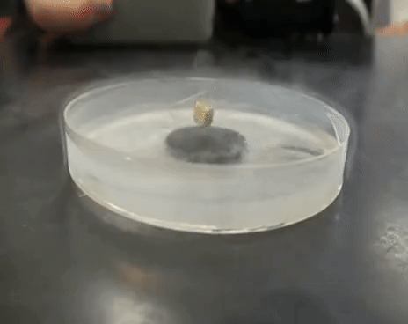
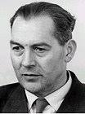
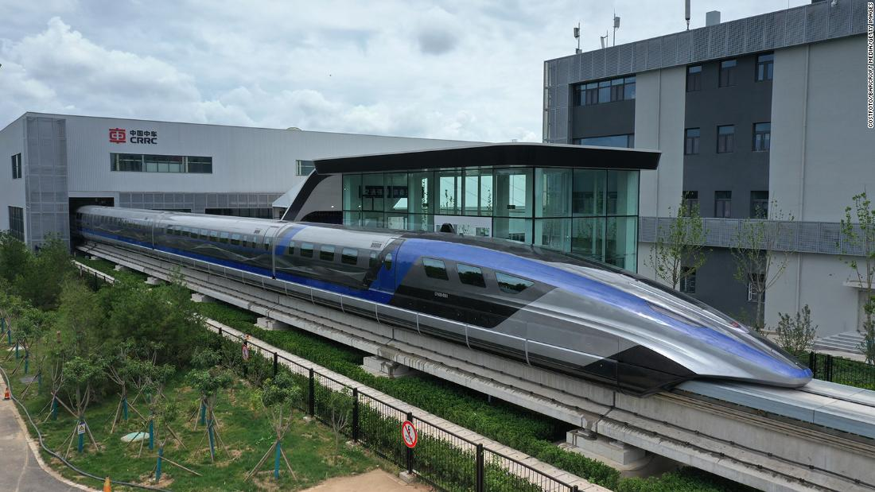
High Temperature Superconductivity (HTS)
Perfect diamagnetism state
Optimally doped Bi₂Sr₂Ca₁Cu₂O_{8+δ} (T_{c} ≈ 88 K)
Walther Meissner
Credit: Youtube.com
Robert Ochsenfeld
“Meissner-Ochsenfeld effect”

Slide 5
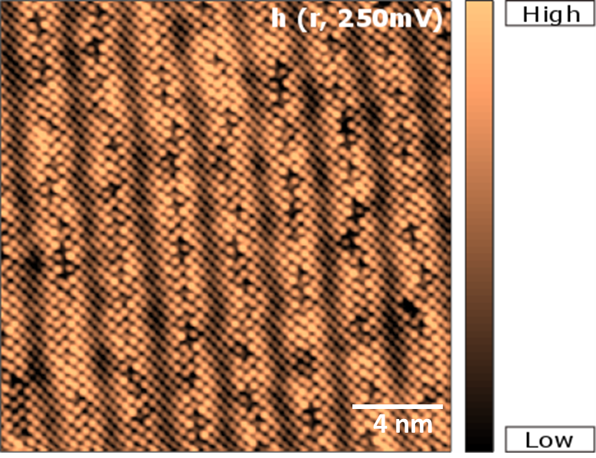
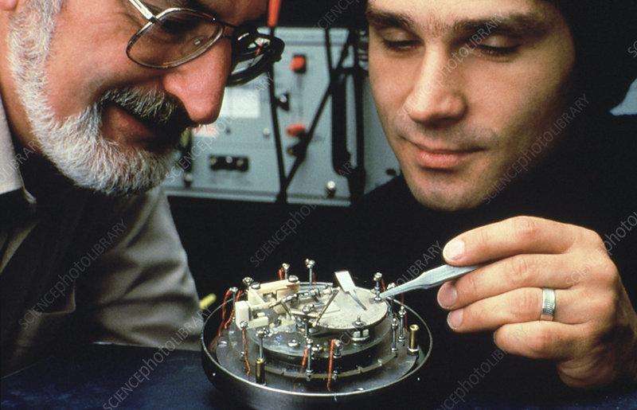
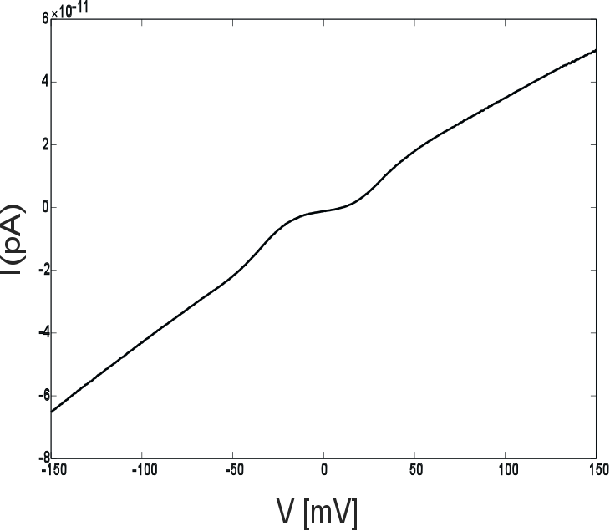
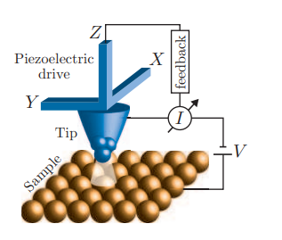
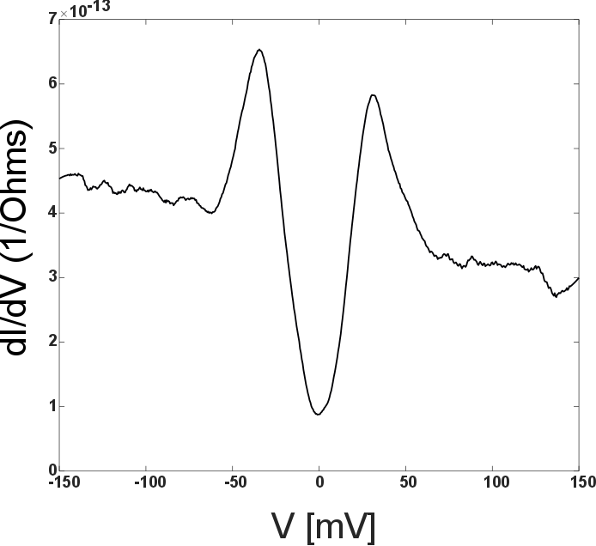

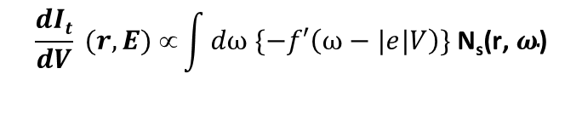
Scanning Tunneling Microscope (STM) in a nutshell
Bi₂Sr₂Ca₁Cu₂O_{8+δ} (Overdoped, 52 K)
Bi-2212
Binning & Rohrer (1982)
Credit: IBM research/Science photo library
$$\frac{dIt}{dV} (r,E) ∝\int{dω \{−f′\left(ω−|e|V\right)}\} \text{N}\text{s}\text{(}\text{r}\text{, }ω\text{)}$$
Local Density of States (LDOS) of the sample
Schematic of STM setup
Fischer et al. (2007)
Daniel Cattermole, Getty Images

Slide 6
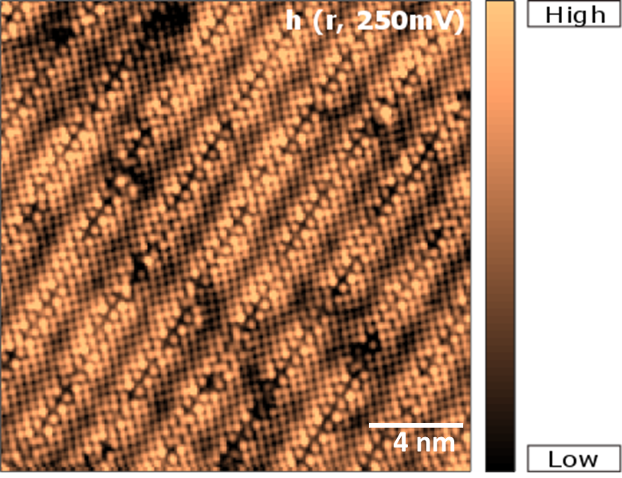
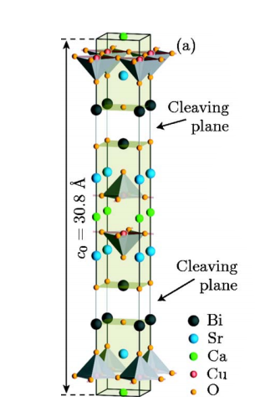
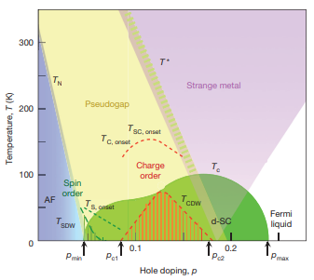
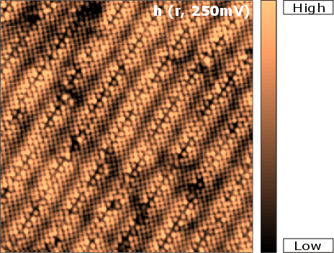
Material under investigation
Imaging individual atoms
Bi-2212 Crystal structure
Bi-2212 Phase Diagram
Heavily underdoped Bi-2212 (T_{c} ≈ 52 K)
Heavily overdoped Bi-2212 (T_{c} ≈ 52 K)
Fischer et al. Reviews of Modern
Physics, 79(1):353-419, 2007
Underdoped
Overdoped
B. Keimer et al. Nature, 518(7538):179–186 (2015)
4 nm

Slide 7
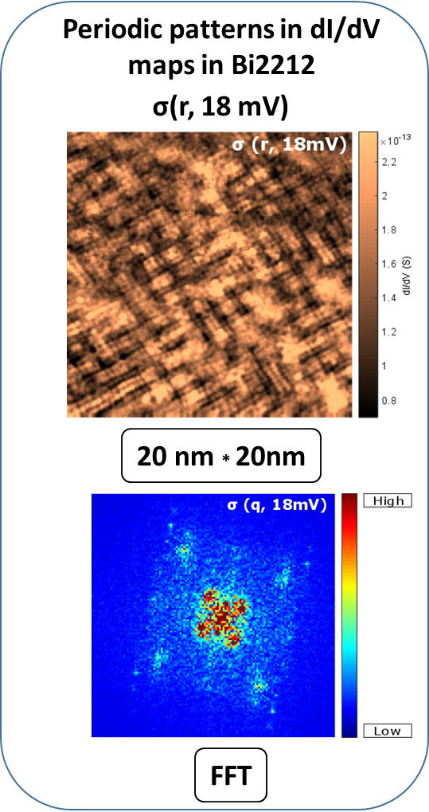
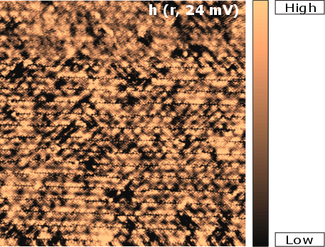
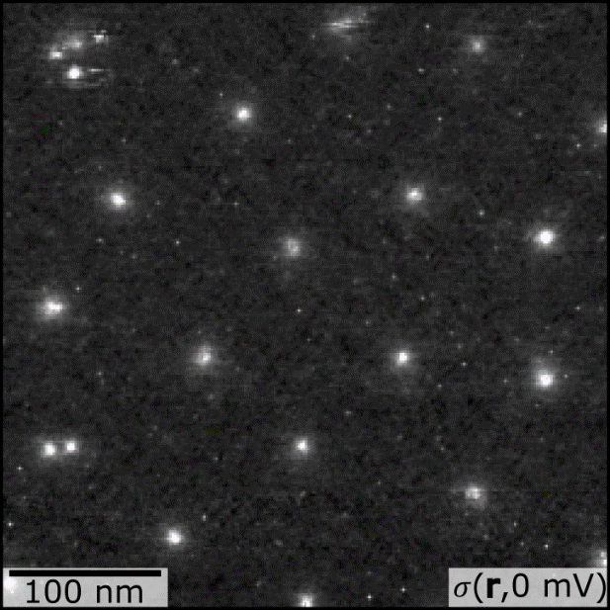
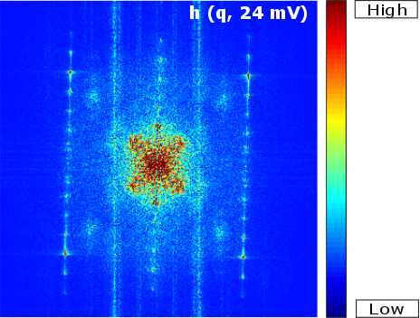
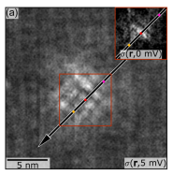
Physics we are after
Charge Density Waves (CDW)
Quasi-Particle Interference (QPI)
Magnetic Vortices in Overdoped Bi-2212
Heavily underdoped Bi-2212 (T_{c} ≈ 52 K)
Heavily overdoped Bi-2212 (T_{c} ≈ 52 K)
Topography
map (50 nm)²
Atomic peak
q₅ ≈ (3/4)*Q_{Atomic}
q₁ ≈ (1/4)*Q_{Atomic}
Gazdic et al. Phys. Rev. X 11, 031040, 2021

Slide 8
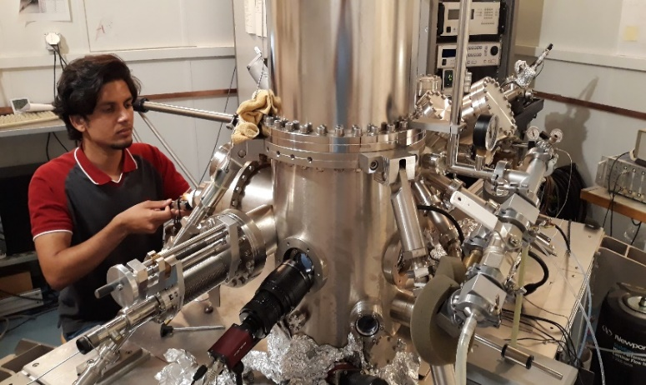
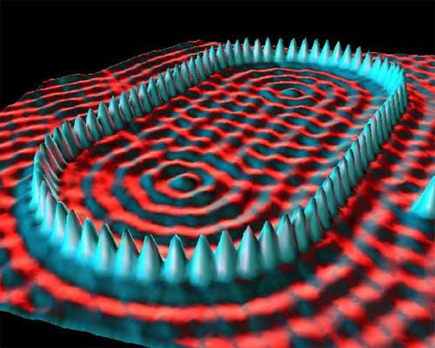
Summary
A peak into the Nano world:
Charge ordering in Bi-2212 system
  - Heavily underdoped Bi-2212
  - Heavily overdoped Bi-2212
Exploiting different STM acquisition modes to image charge modulations
Role of the hole doping and the changes in underlying physics
STM vortex studies in Bi-2212
Thank you for your attention !!
dqmp.unige.ch/renner/
Crommie, Lutz & Eigler; IBM (1993)

