Slide 1


Resonant Inelastic X-ray Scattering Study of Electron-Exciton Coupling in high-T_{c} cuprates
F. Barantani,^{1,2} M. K. Tran,¹ I. Madan,² I. Kapon,¹ N. Bachar,¹ T. C. Asmara,³ E. Paris,³ Y. Tseng,³ W. Zhang,³ Y. Hu,^{4,5} E. Giannini,¹ G. Gu,⁶ T. P. Devereaux,^{5,7,8} C. Berthod,¹ F. Carbone,² T. Schmitt,³ and D. van der Marel¹
¹Department of Quantum Matter Physics, University of Geneva, 1211 Geneva, Switzerland
²Institute of Physics, École Polytechnique Fédérale de Lausanne, Lausanne, 1015, Switzerland
³Photon Science Division, Paul Scherrer Institut, 5232 Villigen PSI, Switzerland
⁴Department of Applied Physics, Stanford University, CA 94305, USA
⁵Stanford Institute for Materials and Energy Sciences, SLAC,CA 94025, USA
⁶Brookhaven National Laboratory, Upton, NY 11973 5000, USA
⁷Department of Materials Science and Engineering, Stanford University, Stanford, CA 94305, USA
⁸Geballe Laboratory for Advanced Materials, Stanford University, CA 94305, USA
Geneva, September 16th 2022

Slide 2
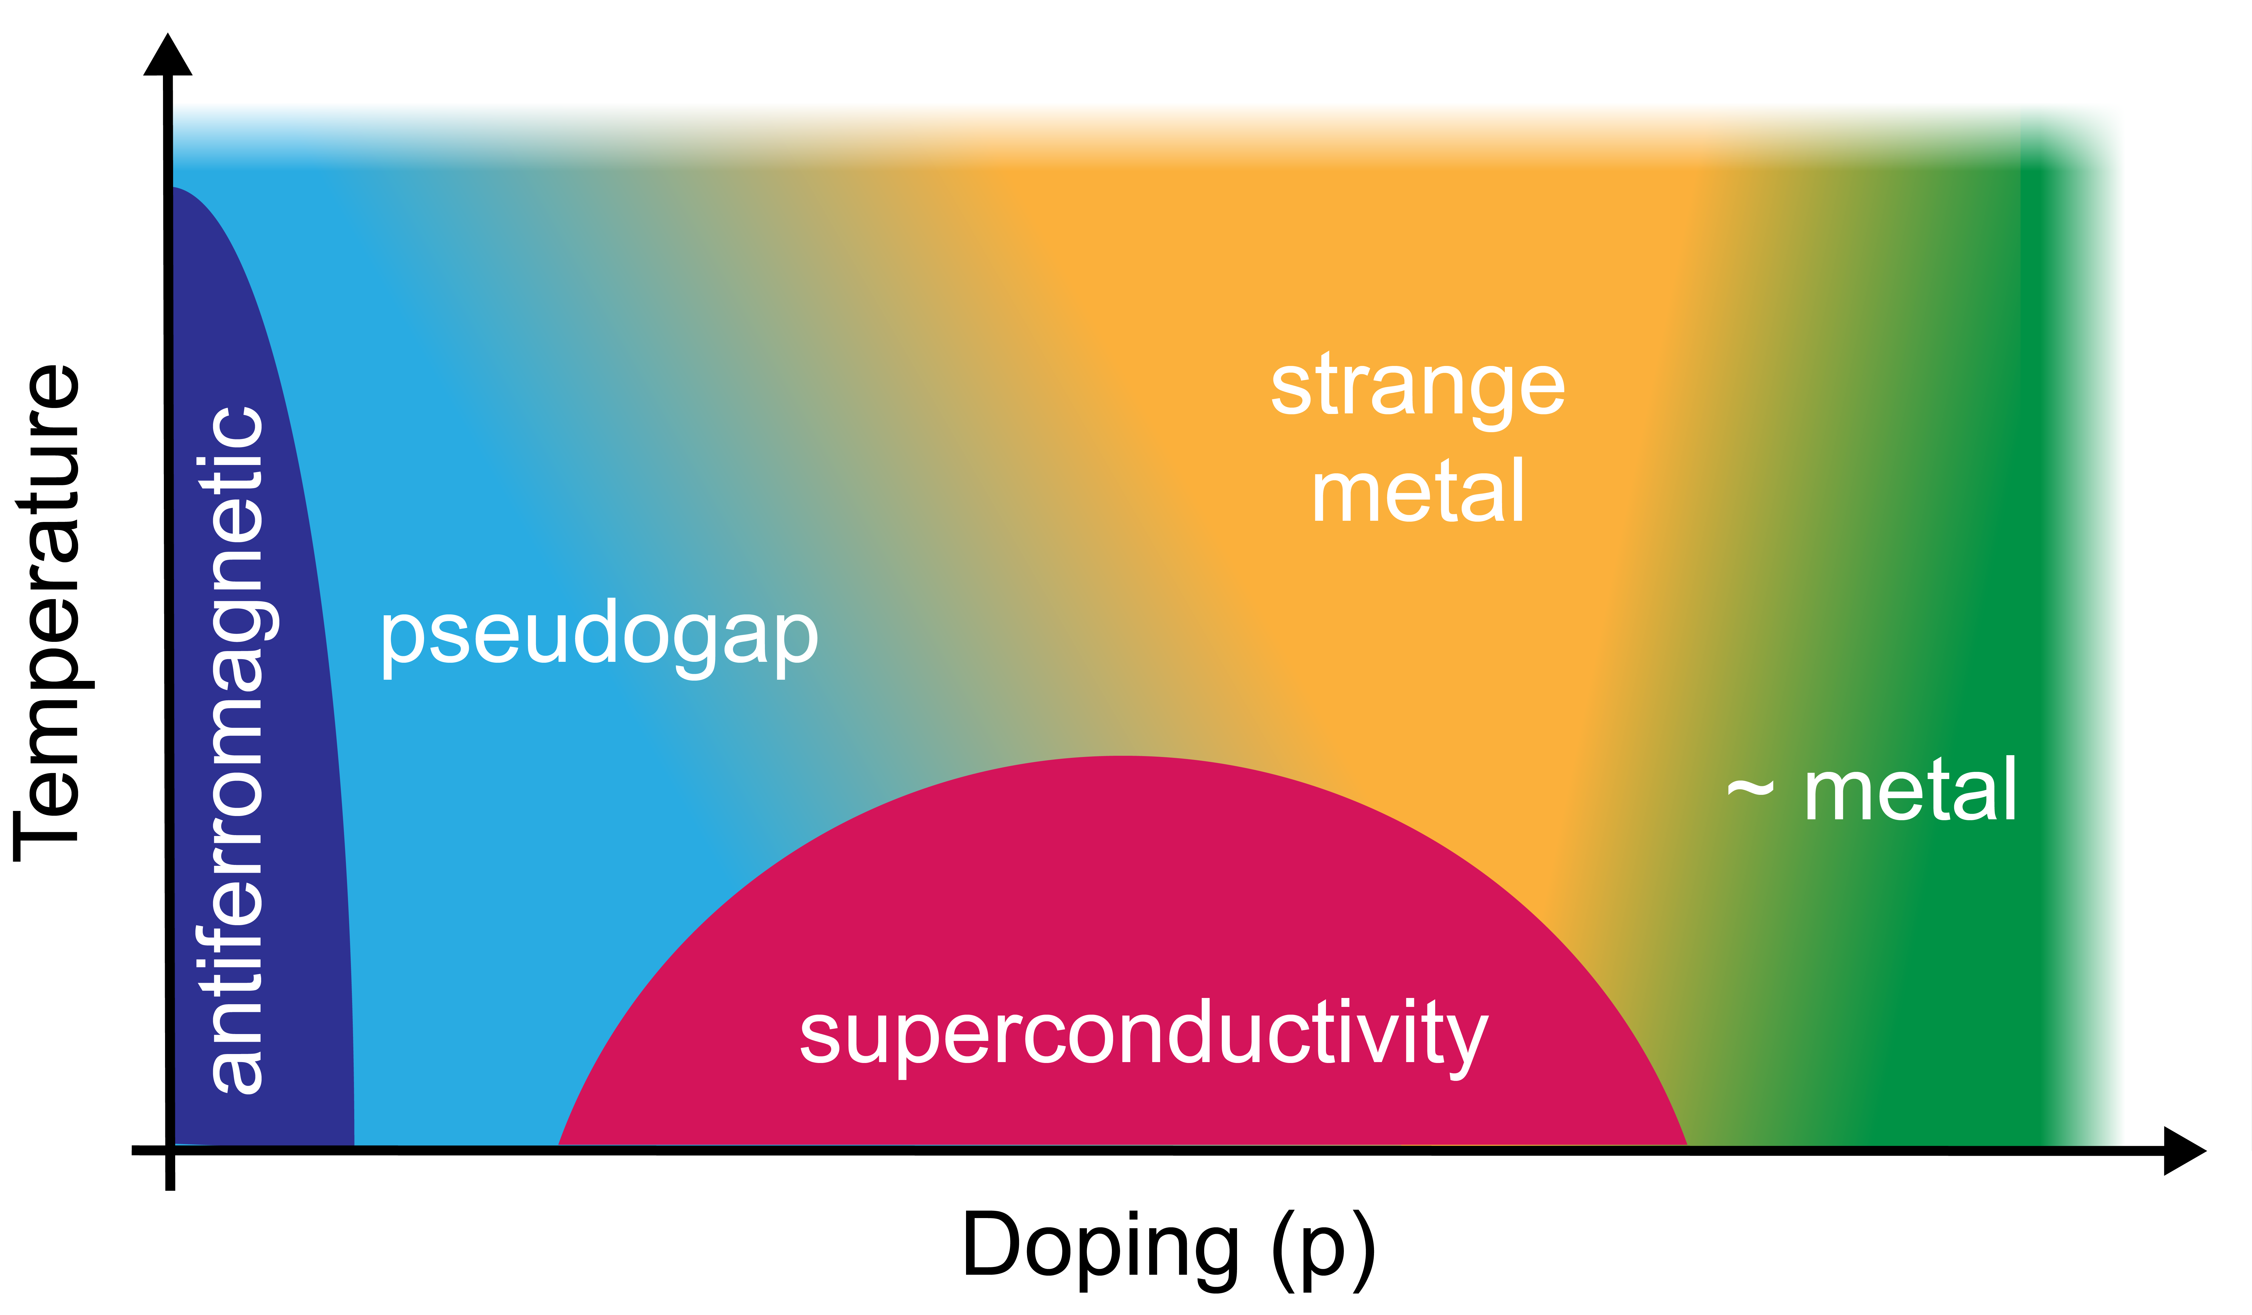
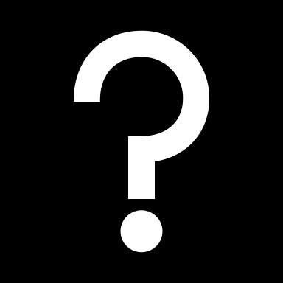
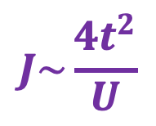
High temperature superconductors: quick overview (from last 40 years)
Changing the carrier concentration:
many different ground states
(AFM, SC, pseudogap, strange metal, Fermi liquid,...)
Interplay between competing interactions
Itinerant
electrons
Localized
electrons
(t)
(U)
$$J\sim \frac{4t^{2}}{U}$$
Spin interaction
(for large U)

Slide 3
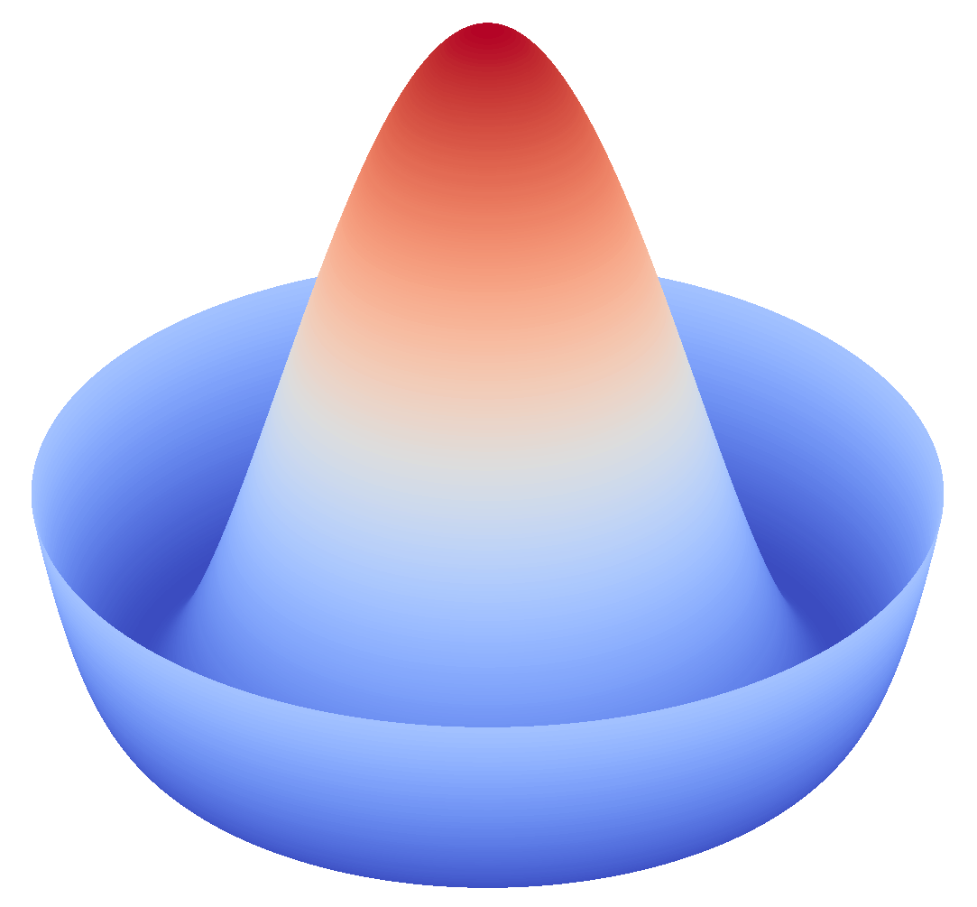
Common threads in physics
Although this may seem a paradox, all exact science is dominated by the idea of approximation.
(Bertrand Russel)
Low energy
High energy
Renormalized low energy physics
Is it legit?
symmetry breaking in superconductivity
Symmetry is what we see at a glance. (B. Pascal)
antiferromagnetism

Slide 4
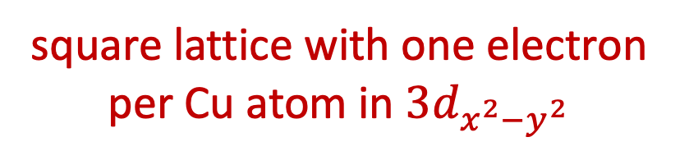
Technicalities (I)
ADRESS @ SLS (PSI, Switzerland)
square lattice with one electron per Cu atom in $3d_{x^{2}−y^{2}}$
Ca
Cu
O
Sr
Bi
Cu-O planes
Approximation!
real crystal: Bi₂Sr₂CaCu₂O_{8-x}
This is the hole doping

Slide 5
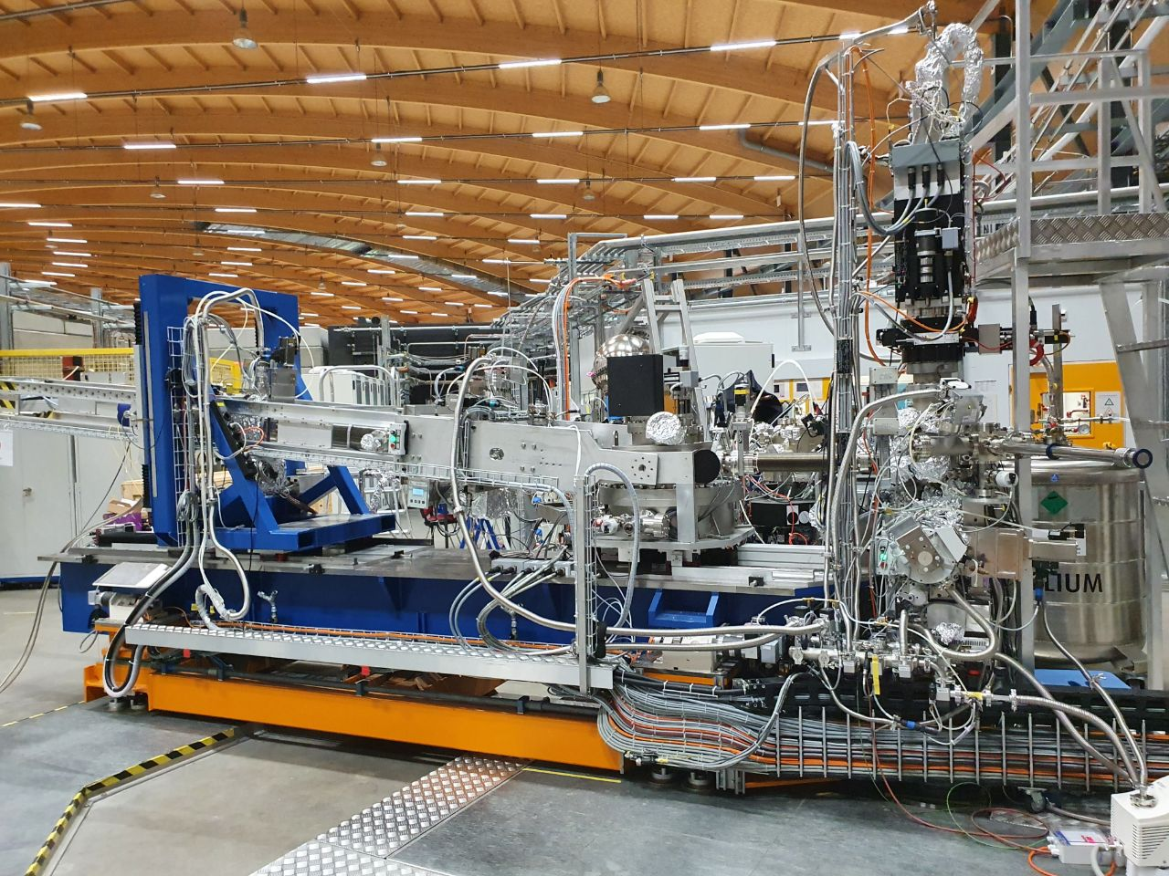
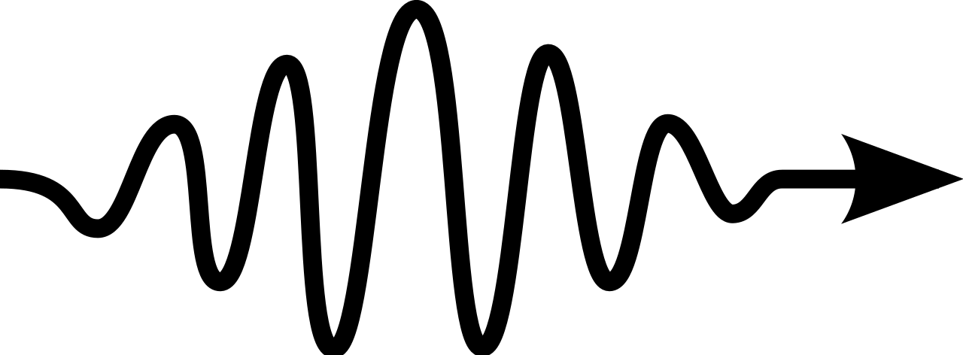
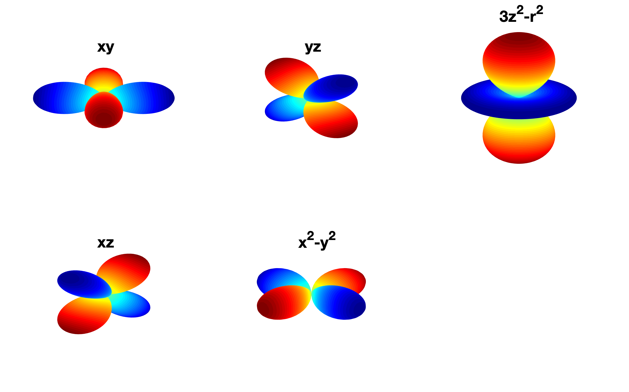
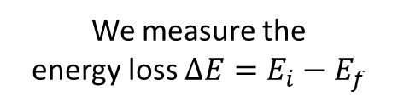


Technicalities (II)
ADRESS @ SLS (PSI, Switzerland)
Resonant inelastic x-ray scattering (RIXS)
We measure the
energy loss ${∆E=E}_{i}−E_{f}$
photon in
$$E_{i},k_{i}$$
photon out
Crystal field levels
$$E_{f},k_{f}$$
crystal
[photon energy ∼1keV]
dd excitons
RIXS spectrum
Cu

Slide 6

Signature at the superconducting temperature
UD
OP
OD
Energy center of mass
$$E=\frac{\int_{ω_{0}}^{ω_{f}}{ω∙i\left(ω\right)dω}}{\int_{ω_{0}}^{ω_{f}}{i\left(ω\right)dω}}$$

Slide 7
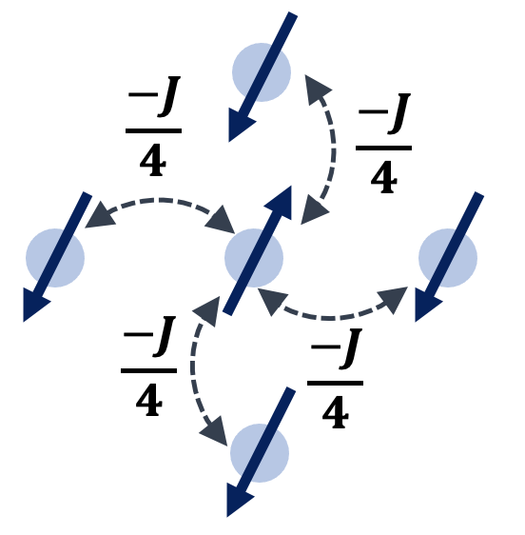
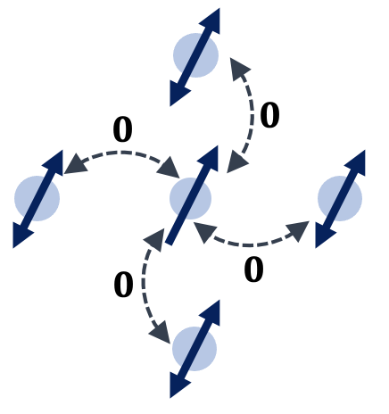
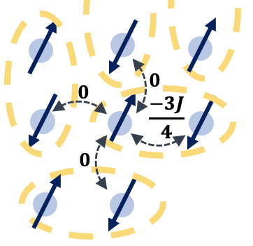
underdoped
overdoped
“normal” (T>T_{c}) state: AFM local order
normal (T>T_{c}) state: more Fermi-liquid like (no spin fluctuations)
‘disordered’ phase
‘ordered’ phase
T_{c}
Temperature
superconducting state (T<T_{c}): spin singlet pairing
‘less-ordered’ phase
Cooper’s pairs
Doping

Slide 8
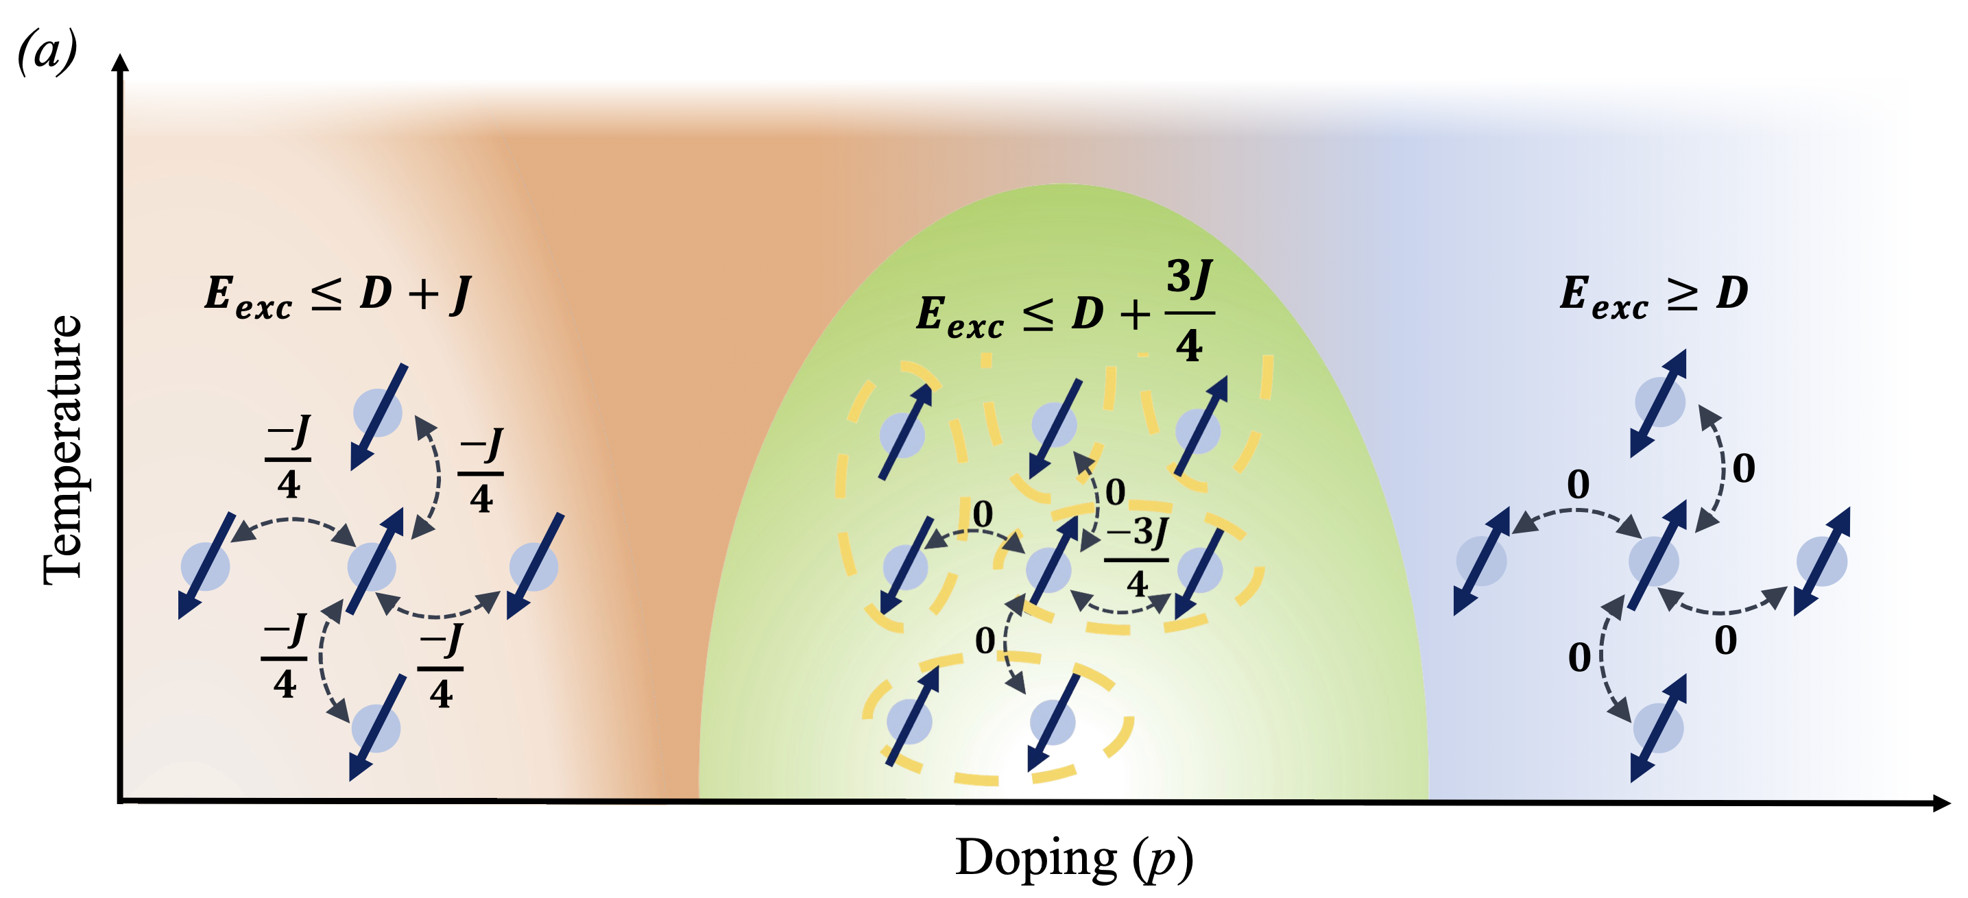


Phase diagram with exciton energy
Exp SC-induced effect
OP
UD
OD
$$E_{sc}=−\frac{1}{4}J$$
$$E_{sc}=+\frac{3}{4}J$$

Slide 9
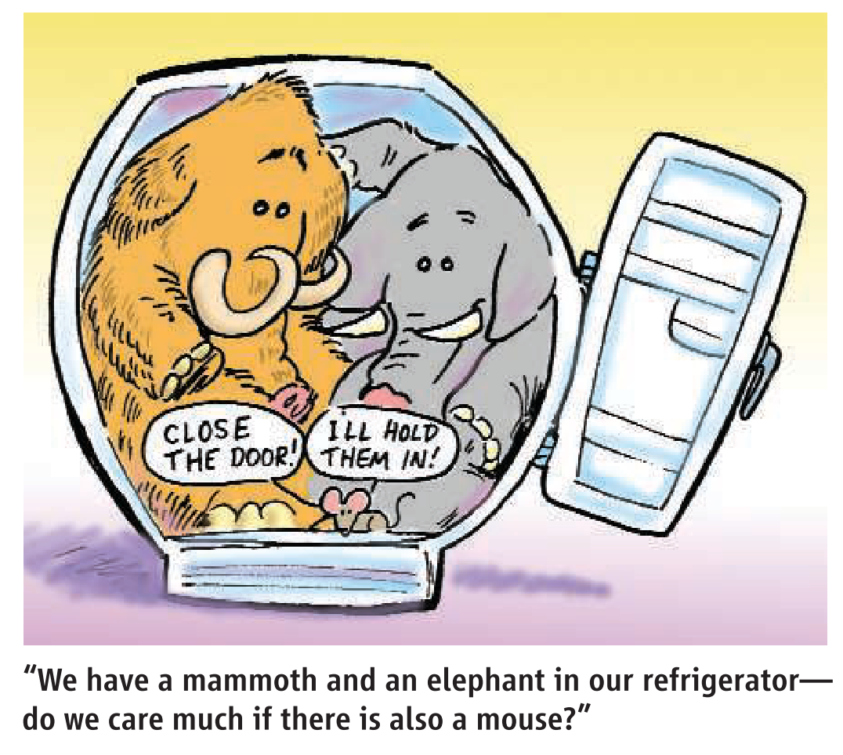

Conclusions
Coupling of high energy excitations (≈ 2 eV) to low energy physics (SC ≈ 20 meV )
Cooper’s pairs and dd excitons and involve the same electrons
The “order” of the spin system changes in opposite directions for UD and OD when crossing the superconducting transition
P. W. Anderson, Science 316, 1705 (2007)
Maybe we have to question our approximations…
F. Barantani et al.,
Phys. Rev. X 12, 021068 (2022)

Slide 10

Thank you for your attention!

Slide 11
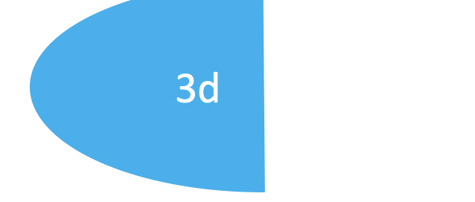
Resonant Inelastic X-ray Scattering
photon in – photon out technique
probe collective modes at finite momentum q
elemental specific (Cu in our case)
Parameters:
X-ray energy (resonant at Cu-L₃ edge)
Polarization (𝜎)
Momentum transfer ($q_{⊥}=2c^{∗}$)
BZ direction (nodal and antinodal)
Temperature
E
E
$$ω_{i},k_{i}$$
$$q_{∥}$$
$$ω_{f},k_{f}$$
$$q_{∥}$$
$$ω_{i},k_{i}$$
$$ω_{f},k_{f}$$
2p
2p
$$q$$
L. J. P. Ament et al., Rev. Mod. Phys. 83, 705 (2011).

Slide 12


underdoped
overdoped
T
“normal” (T>T_{c}) state: AFM local order
normal (T>T_{c}) state: more Fermi-liquid like
(no spin fluctuations)
SC
N
SC
N
$∆E=\left(E_{d}+\frac{3}{4}J\right)−\left(E_{d}+J\right)$=
$$=−\frac{1}{4}J$$
$∆E=\left(E_{d}+\frac{3}{4}J\right)−\left(E_{d}\right)$=
$$=+\frac{3}{4}J$$
T_{c}
SC (T<T_{c}) state: spin singlet pairing
SC (T<T_{c}) state: spin singlet pairing

Slide 13
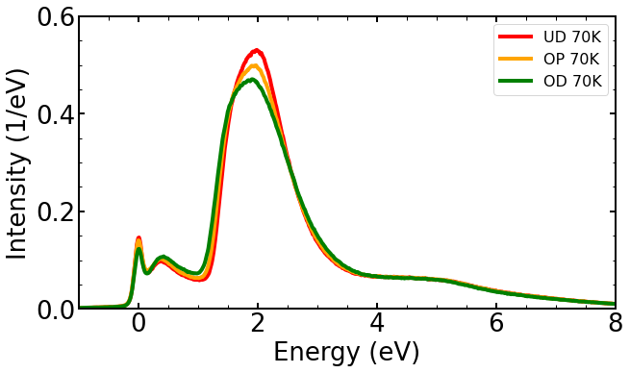
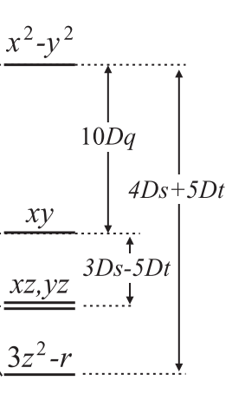
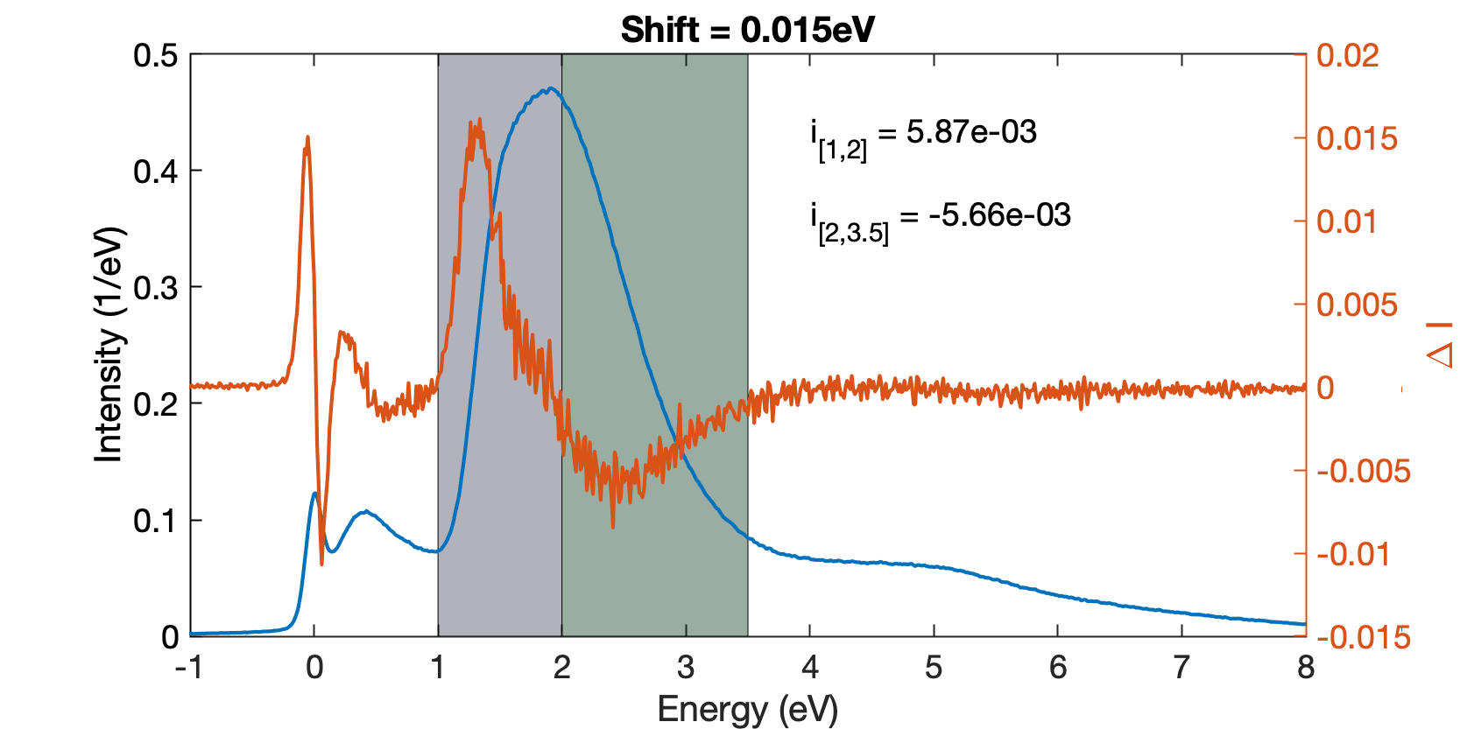
dd excitons
Localized orbital excitations on the Cu site (dipole forbidden)
No change in site occupancy: no energy cost of order U, so the energy corresponds to splitting due to the crystal field [23, 24]
Robust against doping: excitons in the AF insulator region.
t_{2g}
e_{g}
Moretti Sala et al. (2011) New Journ. Phys., 13(4), 043026

