Slide 1

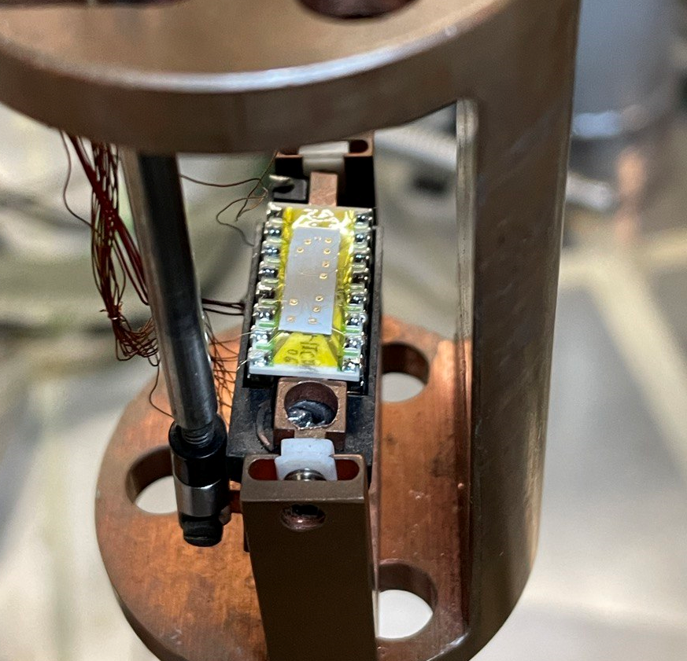
Ionic gating with Li-ion conductive glass ceramics
Margherita Melegari
16th September
Young Research Day 2022

Slide 2
The role of FETs in fundamental studies
Temperature [K]
Magnetic Field [T]
Carrier Density [cm⁻²]
Carrier density influences the conductivity and the electronic phase of a material, giving us the possibility to play with
it in order to go far beyond the borders of classical physics
Field Effect Transistor
D
S
First FET was made in 1959 with a solid-state dielectric (SiO₂)
Through the application of an electric field, it can tune charge density inside a material
SiO₂
Unable to reach high carrier densities (only up to 10¹³ cm⁻² ), due to the breakdown
voltage limitation of silicon oxide dielectric
G

Slide 3
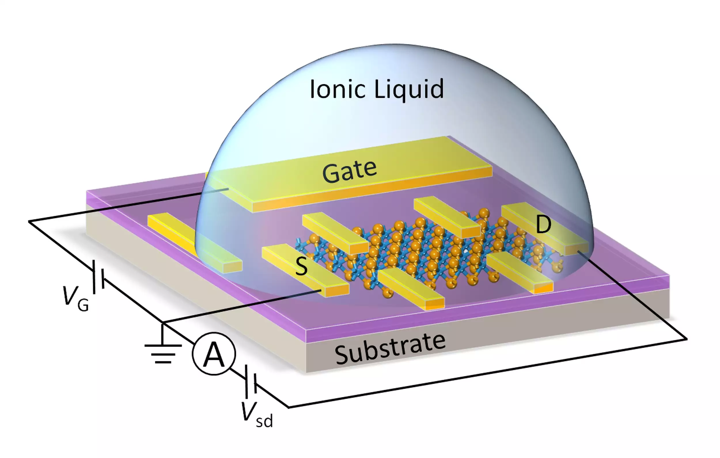
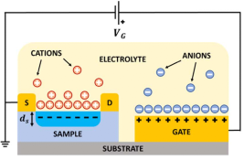
Ionic Gating
Liquid Electrolyte
Able to reach carrier densities up to 10¹⁴ cm⁻² thanks to the formation
of an electric double (EDL) at the surface with the gated material
What is this EDL?
Under the action of an electric field, mobile ions present in the electrolyte accumulate close to the gated material creating a nanocapacitor of 1nm thickness
This allow us to easily tune the charge density, thanks to the capacitance values in the order of μF, a magnitude larger with respect to normal solid-state dielectrics
The technique is cumbersome, due to the liquid phase of the electrolyte
The IL covers completely the device surface, hindering the possibility to use further techniques
What about a solid Electrolyte?

Slide 4
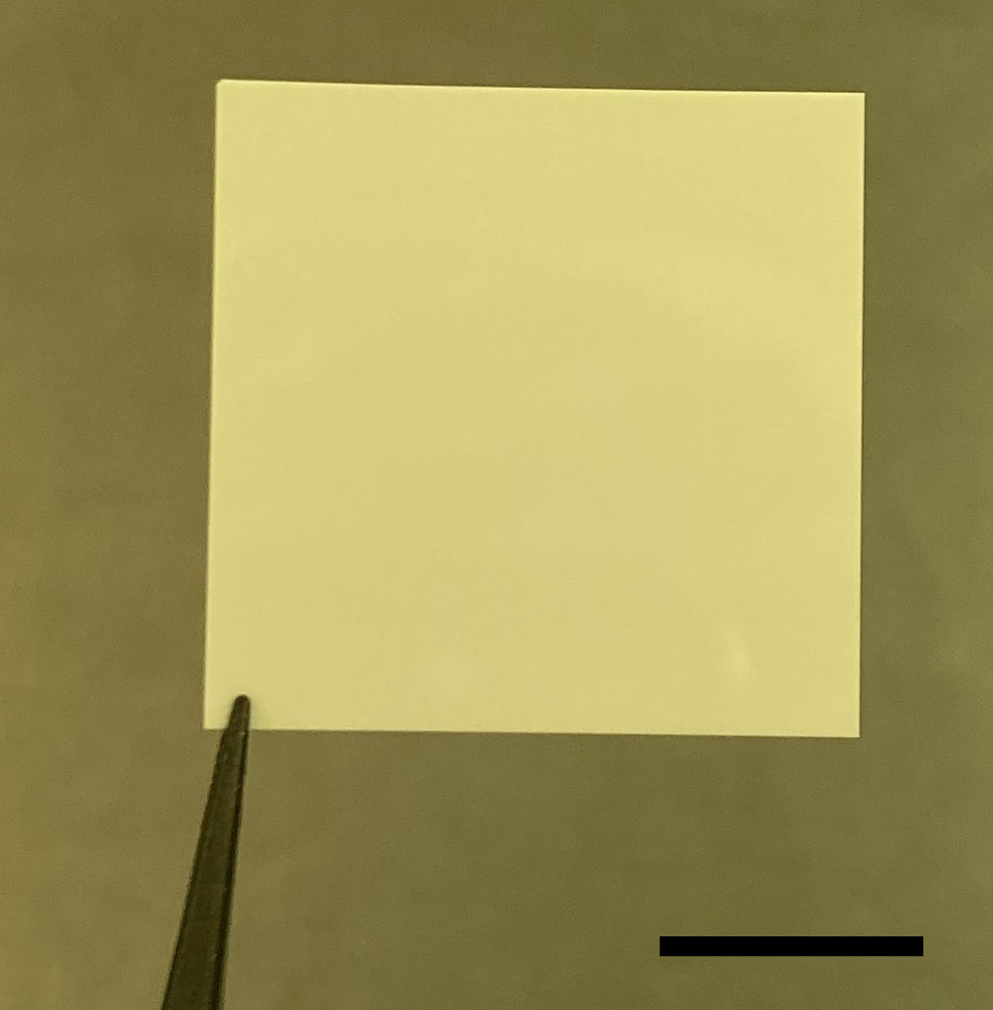
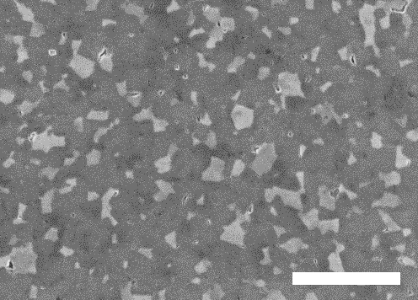
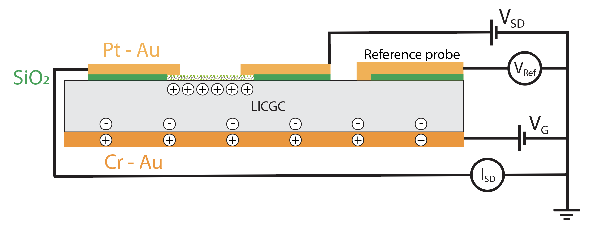
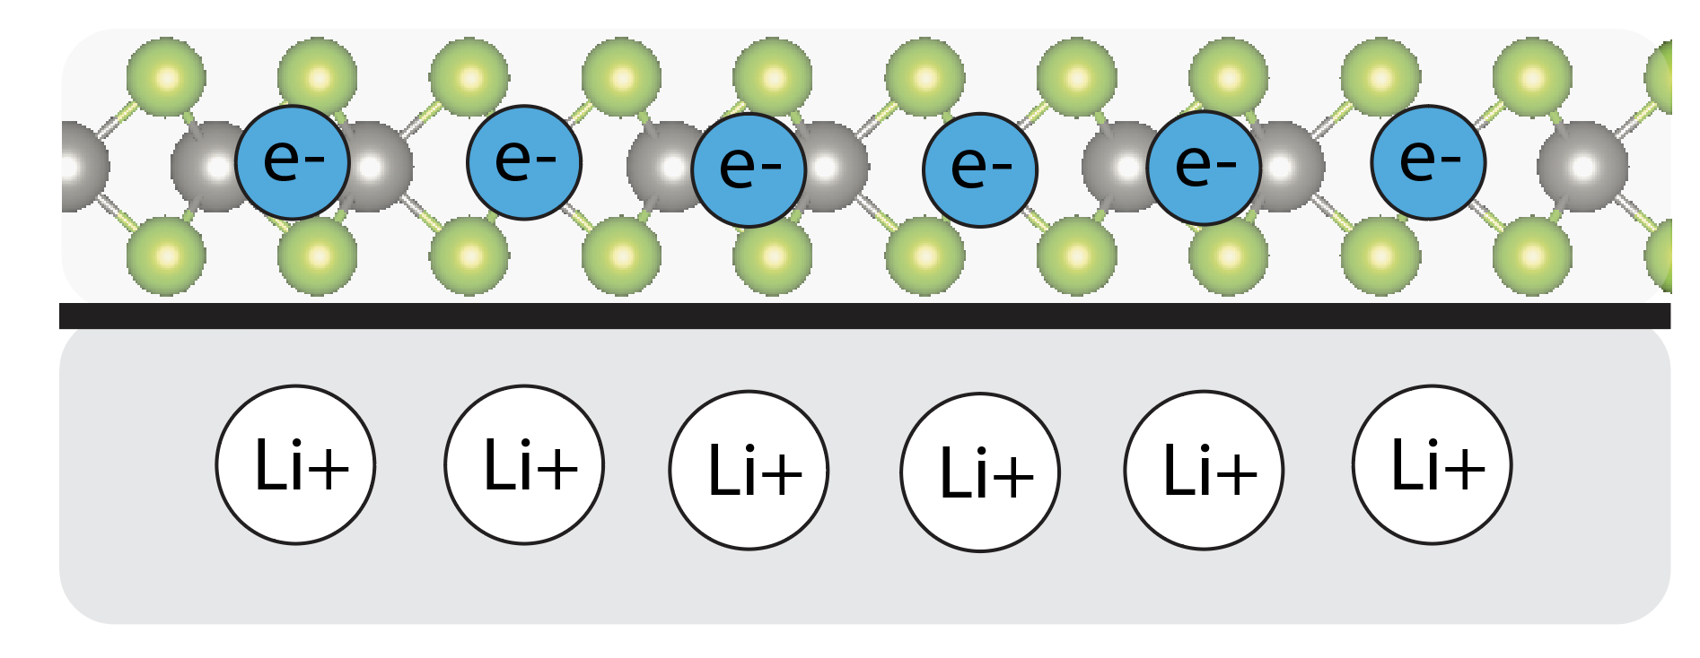
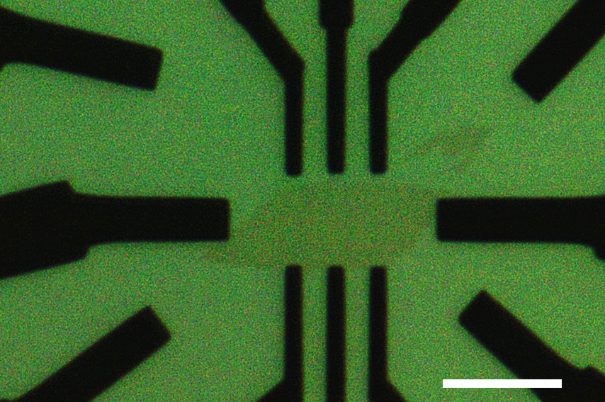
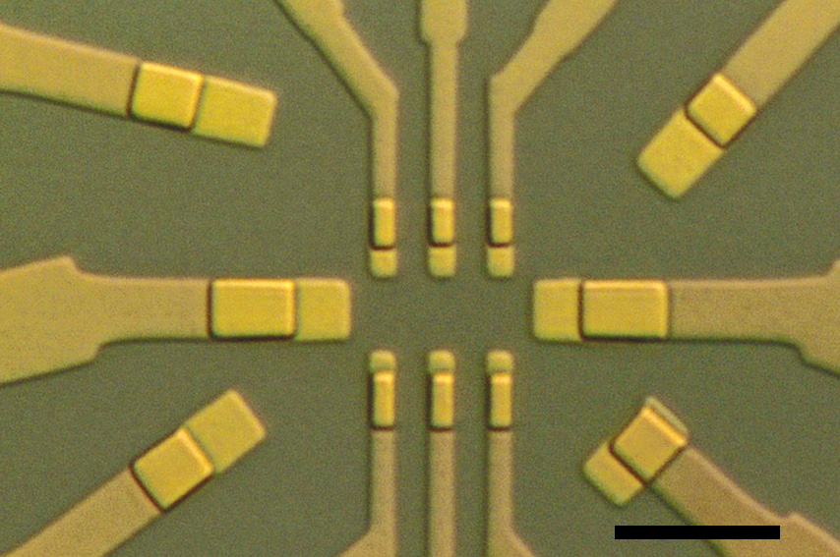
Lithium-Ion Glass Ceramics
Solid oxide framework with mobile alkali ions (Li+) with high ionic conductivity (10⁻³/10⁻⁴Scm⁻²)
Manly used as a component in batteries
Stable in ambient condition
Mean roughness around 1nm
Formation of an EDL at the surface with the gated material
V_{G}>0 Li + move to the gated material, V_{G}<0 ion movement to the gate electrode (depletion region at the surface)
Silicon oxide underneath the metal contacts in order to protect them from faradaic reaction with Li ions

Slide 5
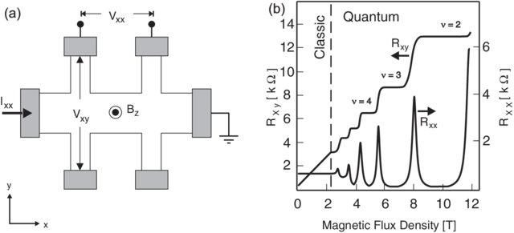
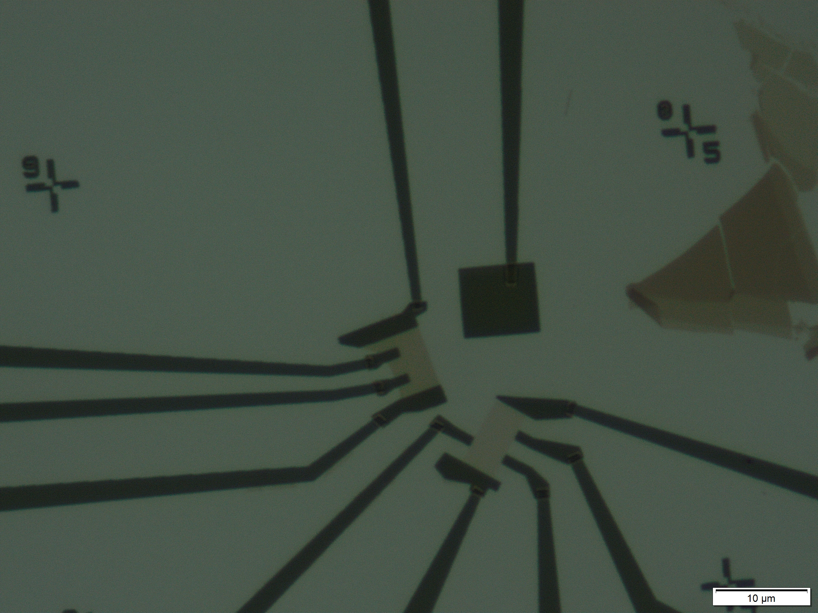
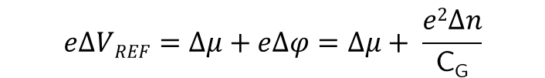


Ionic Gate Spectroscopy
Holes
Electrons
$$n=e\frac{dRxy−1}{dB}$$
Large geometrical capacitance together with the implementation of a local reference electrode allow us to measure the bandgap of a semiconductor directly from the transfer curve
Monolayer WSe₂
$$e∆VREF=∆μ+e∆φ=∆μ+ \frac{e2∆n}{\text{C}\text{G}}$$
$$∆VTH =1.9 ∓0.05$$
Ref-NL
$$e∆VREF=∆μ=e∆VTH$$
Band gap
Ref-L

Slide 6
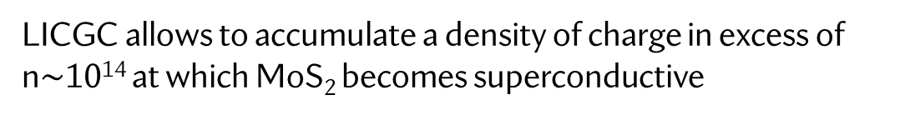
Gate induced Superconductivity
How to transform an insulator in a perfect conductor?
3L MoS₂
LICGC allows to accumulate a density of charge in excess of n$\sim$10¹⁴ at which MoS₂ becomes superconductive
Also, the Temperature T[K] and the Magnetic Field [B] play a role in the suppression of the superconductivity phase
T_{c}
I_{c}
T>T_{c}

Slide 7

Summary
We implemented a new Ionic Gating technique based on Solid Electrolyte (LICGC) in order to study new physical phenomena tuning easily charge density
Thanks to new technical improvement, we can reach large EDL capacitance which allows us to perform spectroscopy experiments on 2D semiconductors
Furthermore, also a high carrier density up to 10¹⁴ cm⁻² can be reached, which can transform a simple semiconductor in a superconductor

Slide 8
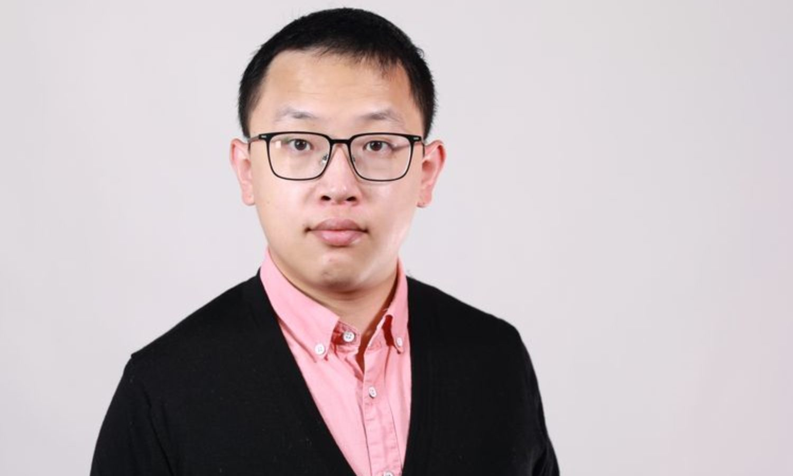




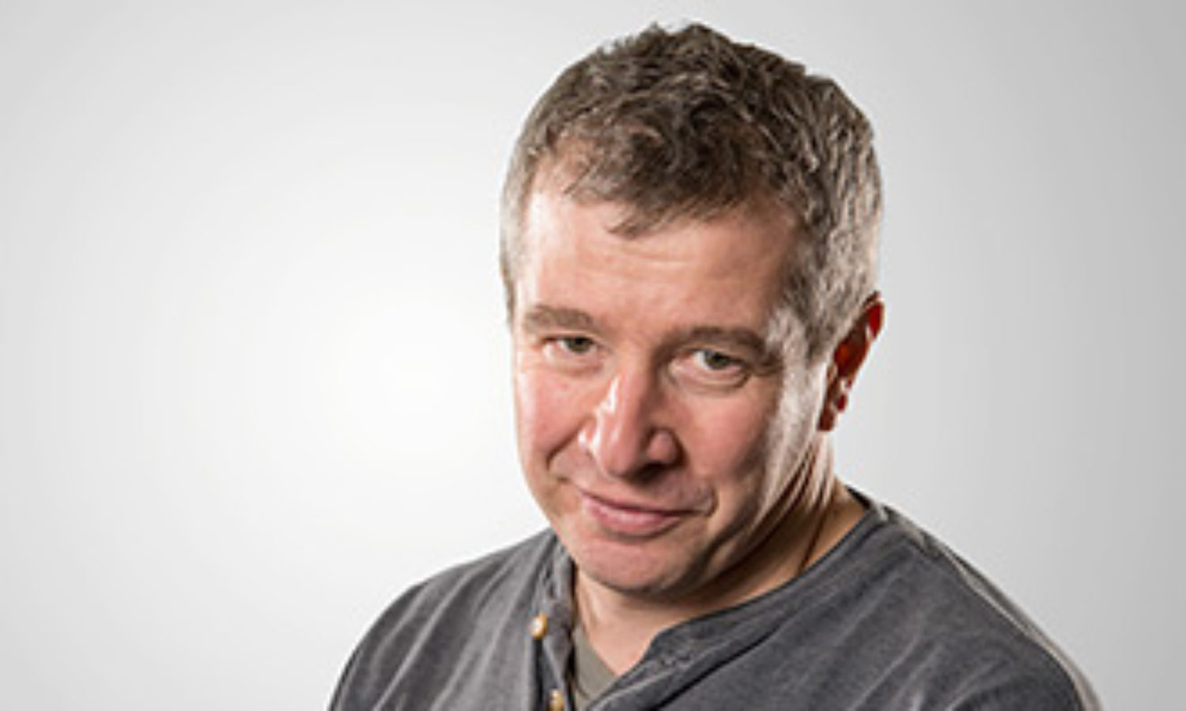
Acknowledgment
Chuan Wu
Cao
Ignacìo
Gutiérrez-Lezama
Alberto Morpurgo
Marc Philippi
Daniil Domaretskiy

