Slide 1
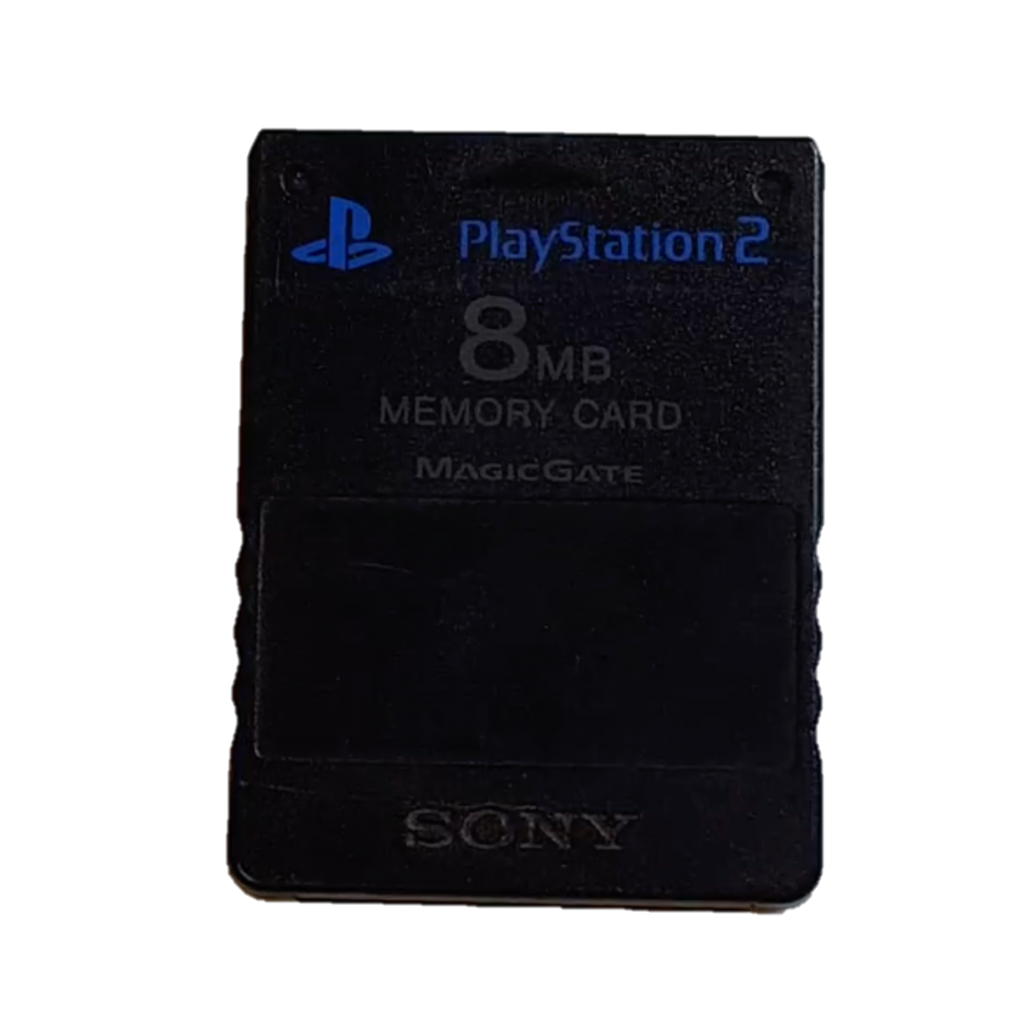

Ferroelectrics: From the PlayStation 2 to a Rewriteable Future
Ralph Bulanadi
Notes:
Hey everyone, I’m Ralph Bulanadi, also a PhD student in the Paruch Group of the University of Geneva, and today I’ll be talking about how we’ve used SPM to investigate the impact of defects on the statistics of ferroelectric domain wall motion, particularly in the context of power laws.
But before we get into that; what is a power law?

Slide 2
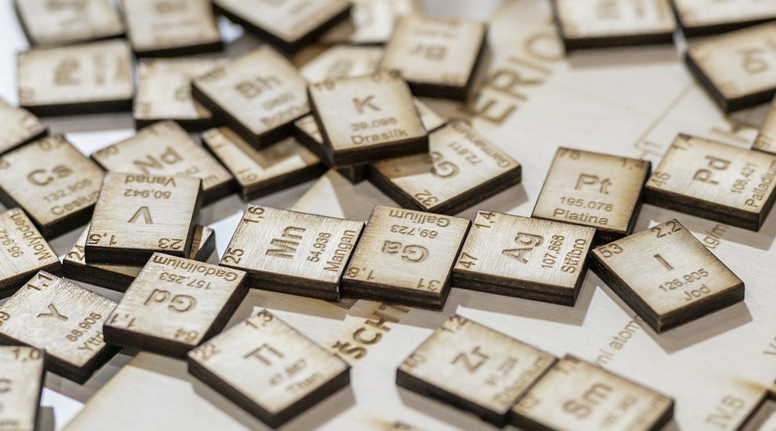
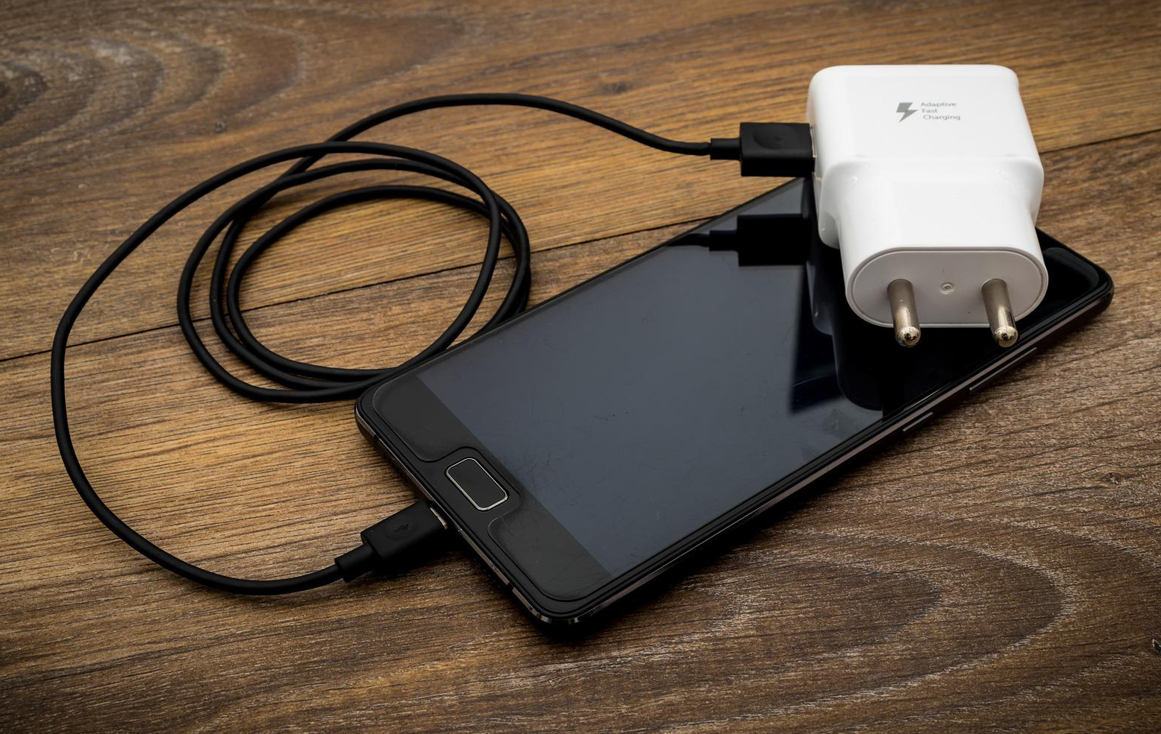
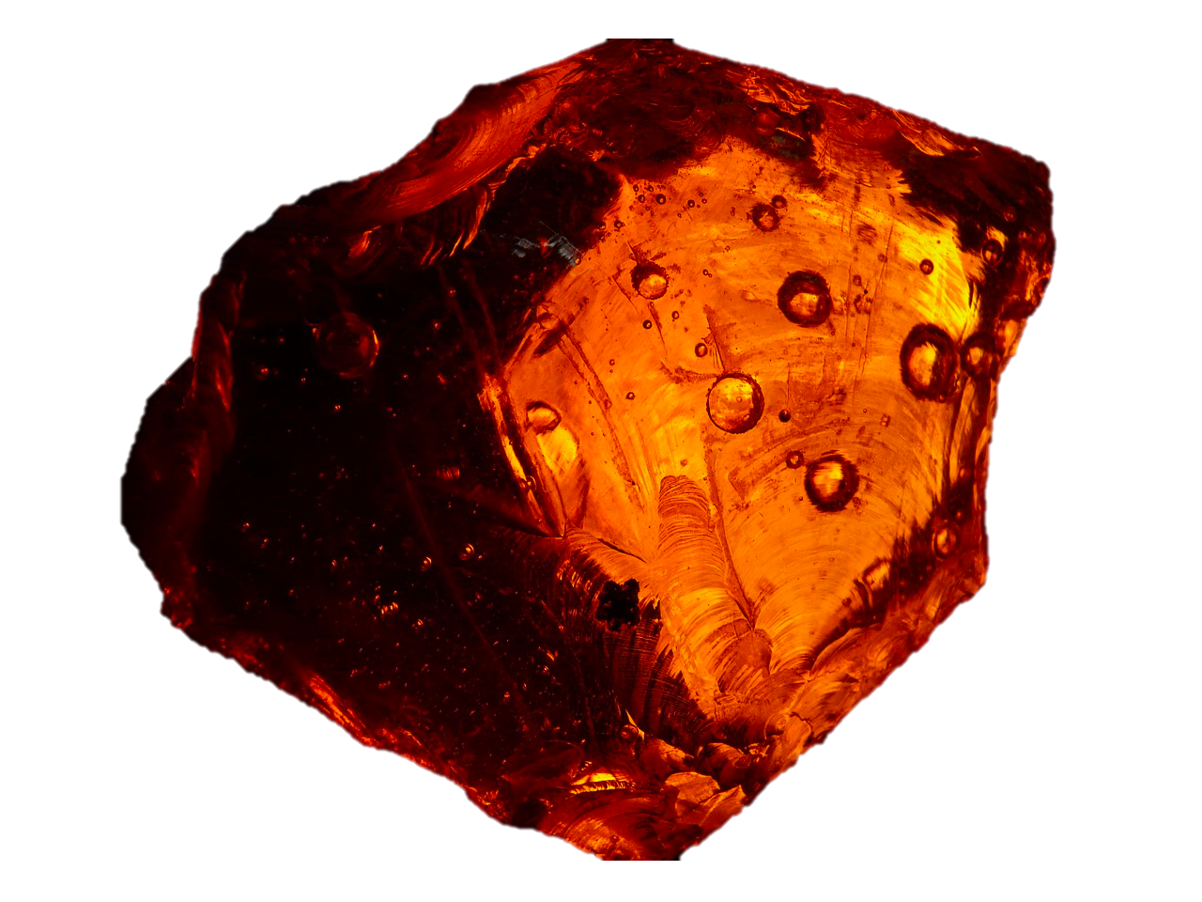
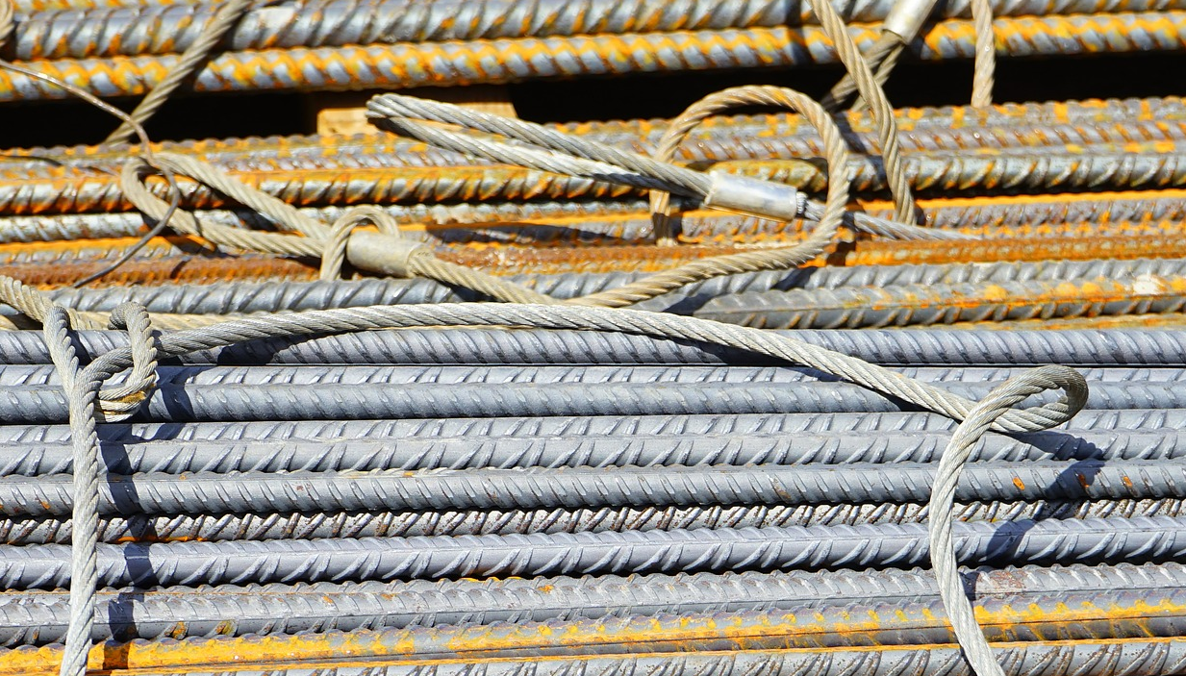
What is a Ferroelectric?
ferro + electric
Images: Pixabay, Nintendo
Notes:
so, you probably know that ferro means iron, and electric means... Well, electric. But you might also know, that English makes no sense... "electric" is an old word that means "amber" anyway.
And in the same way that Electrics part doesn't have anything to do with the Pokemon type, the ferro part has nothing to do with Iron.

Slide 3
What is a Ferroelectric?
Ferromagnet
Ferroelectric
N
+
S
-
H
E

Slide 4
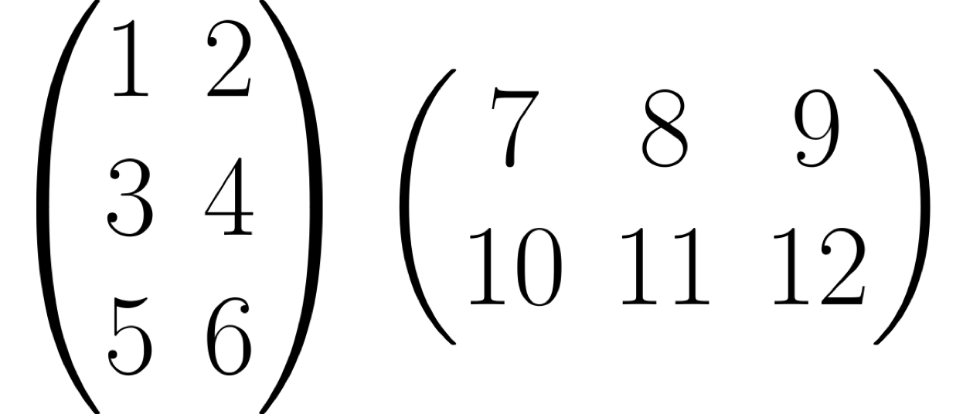
Think back to 1999...
Images: Bloomsbury, Interscope, Nintendo, Pixabay

Slide 5
Why use Ferroelectrics? (in 1999)
Flash Memory
Non-Volatile
1-10 ms/Byte
Random-Access Memory
Volatile
10-100 ns/Byte
Adapted from Scott, Ferroelectric Memories, Springer, (2000)
Images: Pixabay, Wikimedia

Slide 6
Why use Ferroelectrics? (in 1999)
Flash Memory
Non-Volatile
1-10 ms/Byte
FeRAM
Non-Volatile
10-100 ns/Byte
RAM
Volatile
10-100 ns/Byte
-
+
Adapted from Scott, Ferroelectric Memories, Springer, (2000)
Images: Pixabay, Wikimedia

Slide 7
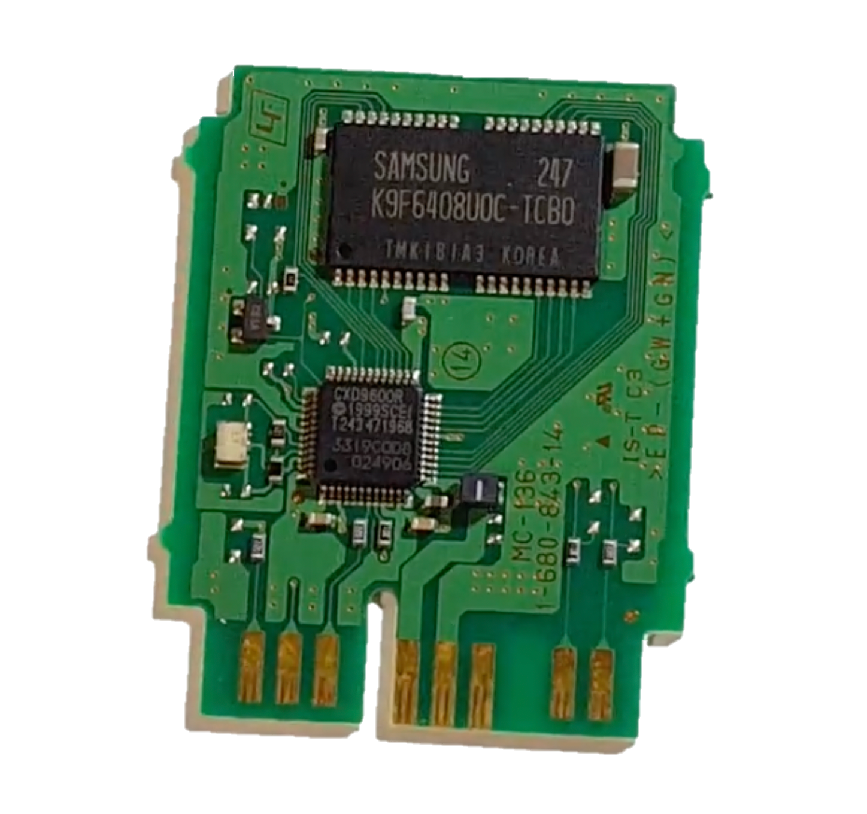
The PlayStation 2 Memory Card
8 MB Flash
1 kB RAM
4 kB FeRAM
Adapted from Tsakalakos, Nanostructures: Synthesis, Functional Properties and Application, Springer, (2003)
Image: Crypto-Computer Man, Playstation 2 Memory Card Teardown, YouTube (2018)

Slide 8
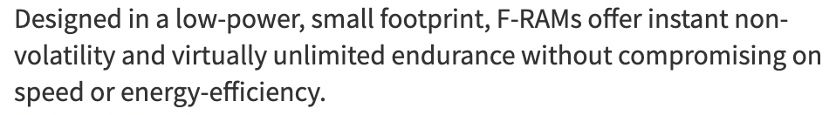
... And today?
Many companies continue to develop FeRAM
Infineon (Germany) is among the largest of these
Flash storage has greatly improved write speeds and larger capacity
FeRAM is today mostly used in small, low-power devices
F-RAM, https://www.infineon.com/cms/en/product/memories/f-ram-ferroelectric-ram/, Accessed Sep 2022

Slide 9
... And today?
New Materials
Domain Walls
Domain Walls
Multiferroics
Böscke et al., Ferroelectricity in hafnium oxide thin films, Applied Physics Letters (2011) Spaldin, Fiebig, The Renaissance of magnetoelectric multiferroics, Science (2005)
Seidel et al., Conduction at domain walls in oxide multiferroics, Nature Materials (2009)
Notes:
Photovoltaics? Novel topologies?

Slide 10
Conductivity at Domain Walls
1. Charge buildup can increase local DW conductivity.
+ + + + + + + + + + + + + + + + + + + +
+ + + + + + + + + + + + + + + + + + + + +
+ + + + + + + + + + + + + + + + + + + +
+ +
- - - - - - - - - - - - - - - - - - - - -
- - - - - - - - - - - - - - - - - - - - -
- - - - - - - - - - - - - - - - - - - - -
- -
3. p-n junctions can form.
2. DWs can be moved by moving domains.
2. DWs can be moved by moving domains.

Slide 11
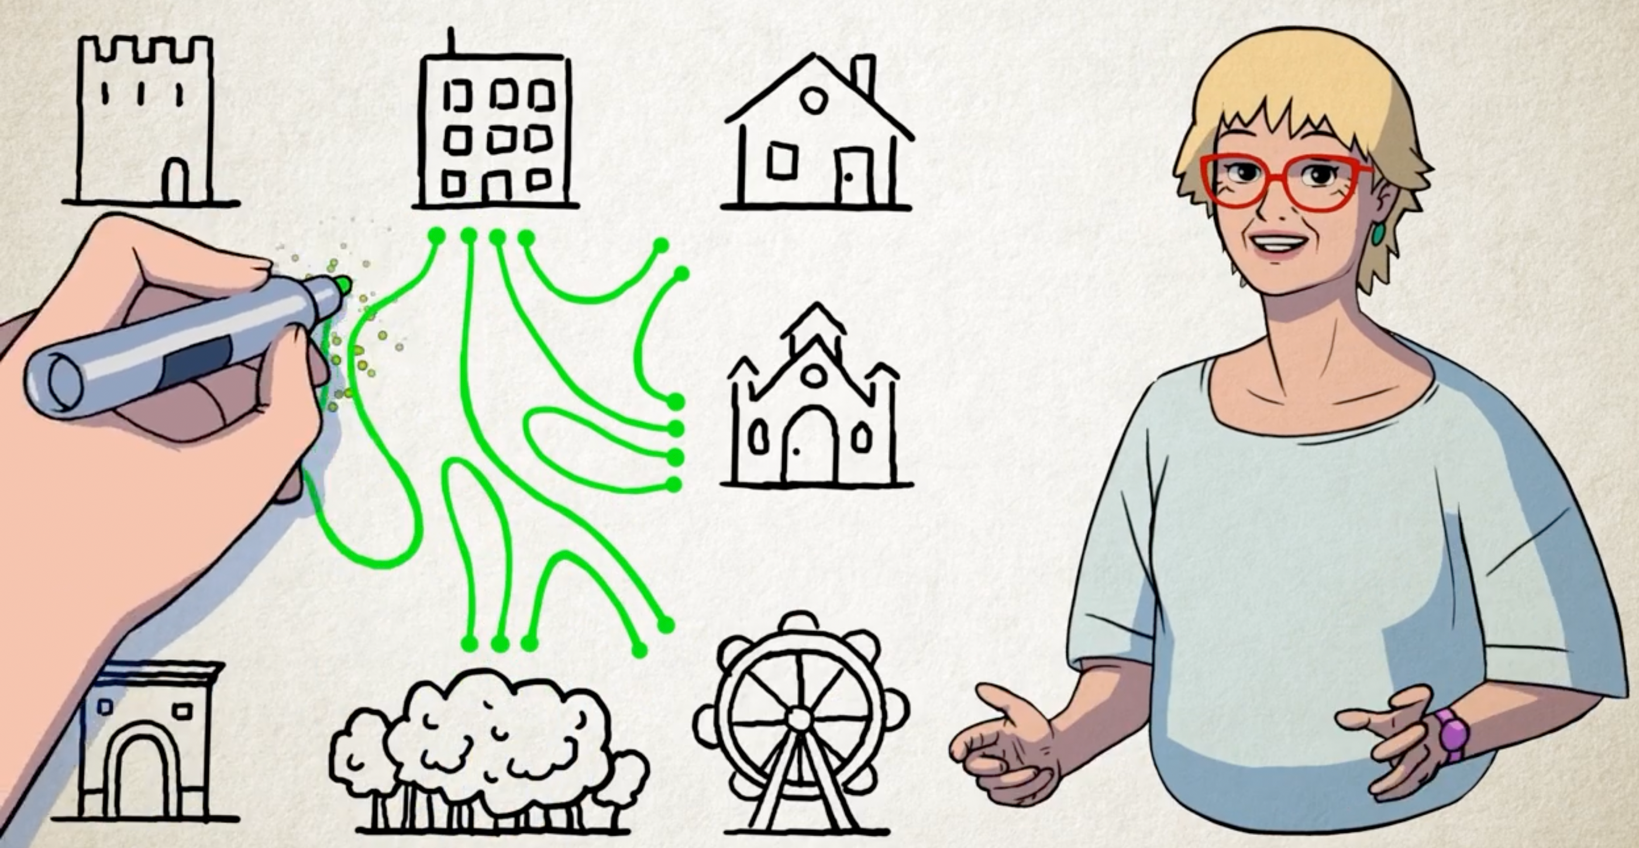
A Rewritable Future
EPFL School of Engineering, Reconfigurable circuits, YouTube (2017)

Slide 12
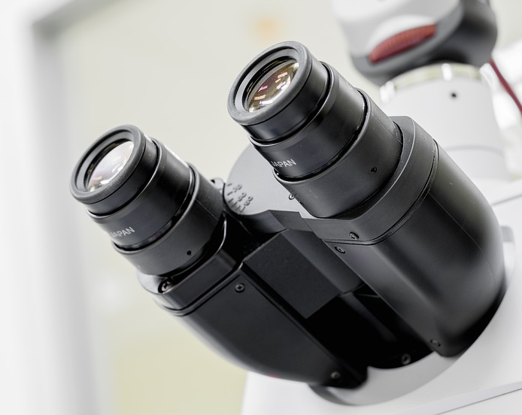
Imaging Ferroelectrics via Scanning Probe Microscopy (SPM)
SPM lets us directly "look" at different things in our ferroelectrics.
Images: Pixabay, Team Nanotec GmbH

Slide 13
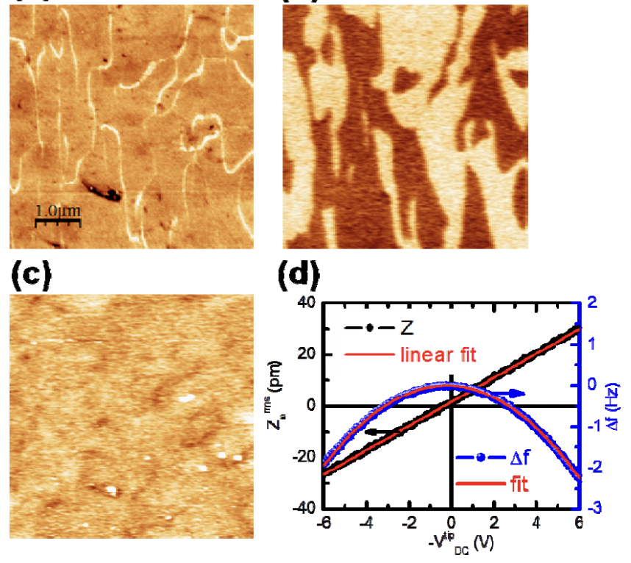
Varieties of Scanning Probe Microscopy
PFM
KPFM
C-AFM
Surface Potential
Conduction
Electric Poles
Wu, et al. Conduction of topologically protected charged ferroelectric domain walls. PRL (2012) Images: Pixabay, Wikimedia, Nintendo

Slide 14
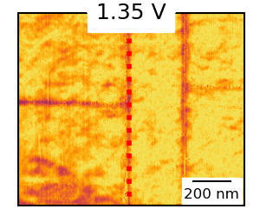
Patterning of Ferroelectric Domain Walls
Strain-relieving "a-domains"
Up Domain
Down Domain
Increasing positive voltage expands the down domain
This causes the domain wall to move
The domain wall gets "stuck" at the a-domain

Slide 15
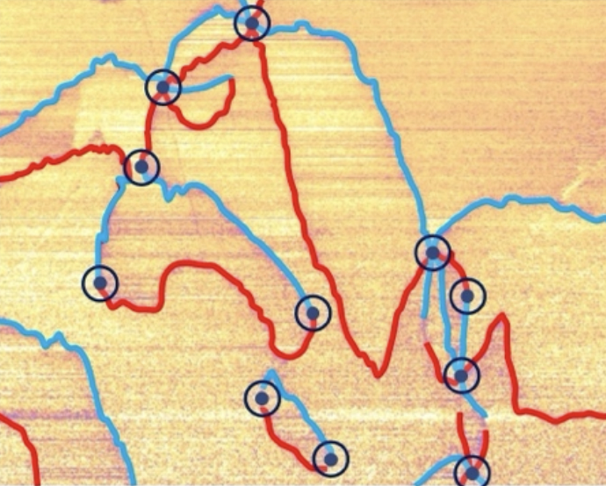
Take-Home Points
2000
2022
????
Gregg, A perspective on conducting domain walls and possibilities for ephemeral electronics. APL (2022)

