Slide 1

Frequency Dynamics of Power Grids
Julian Fritzsch
Young Researchers’ Day
16. September 2022

Slide 2
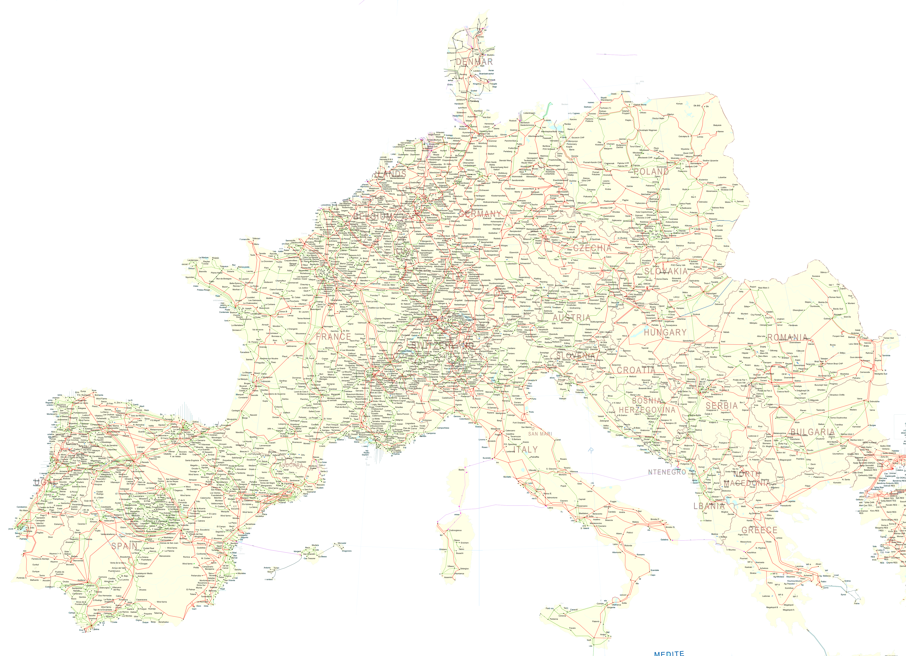
Motivation
Power grids are large connected networks
How do single components interact?
Can we use techniques from theoretical physics?
https://www.entsoe.eu/data/map/downloads/

Slide 3

Grid Frequency
Grid Frequency is an important measure of grid stability
Coupled to power balance
What happens in case of imbalance?
https://aemo.com.au/learn/energy-explained/energy-101/energy-explained-frequency

Slide 4
Swing Equations
When linearized around a fixed point:

Slide 5
Swing Equations
When linearized around a fixed point:

Slide 6
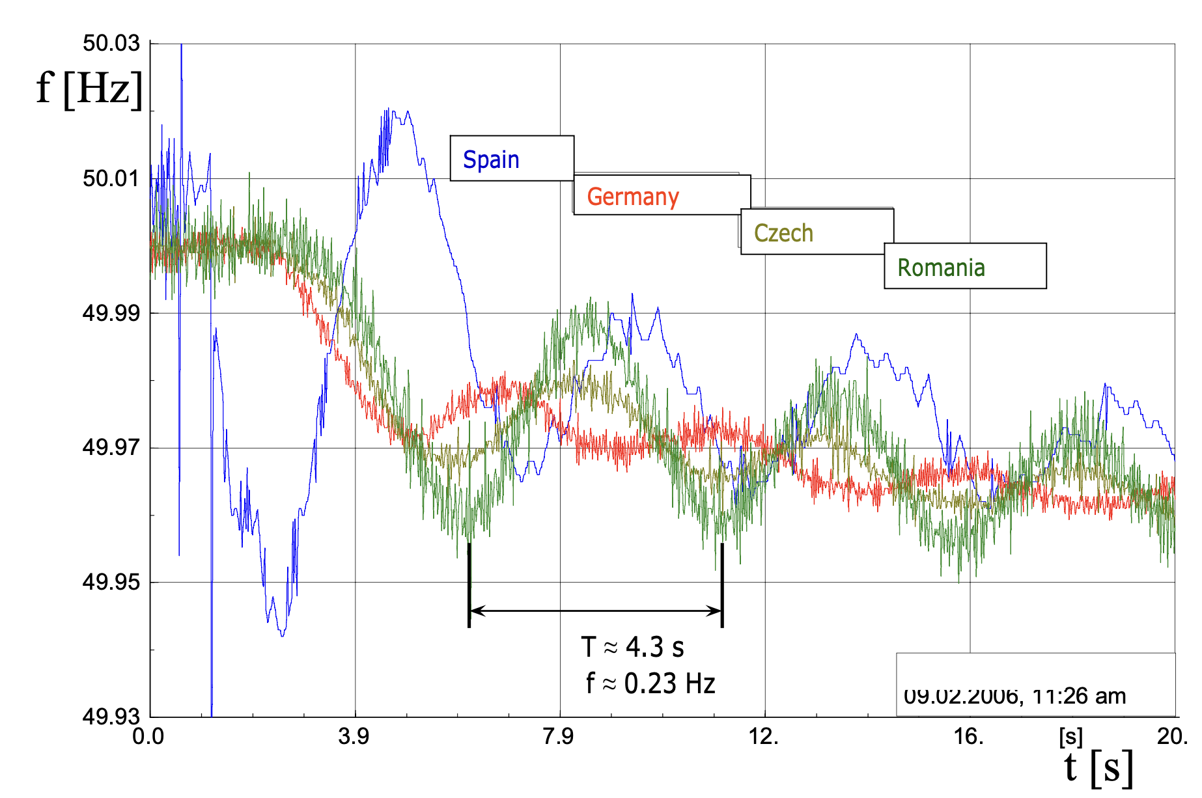
Larger Grids
Al-Ali et al. – 17th Power Systems Computation Conference 2011

Slide 7
Perturbation Theory
Start with disconnected areas
Connections are perturbations
How do they interact?

Slide 8
Results
European Model
3 Areas

Slide 9
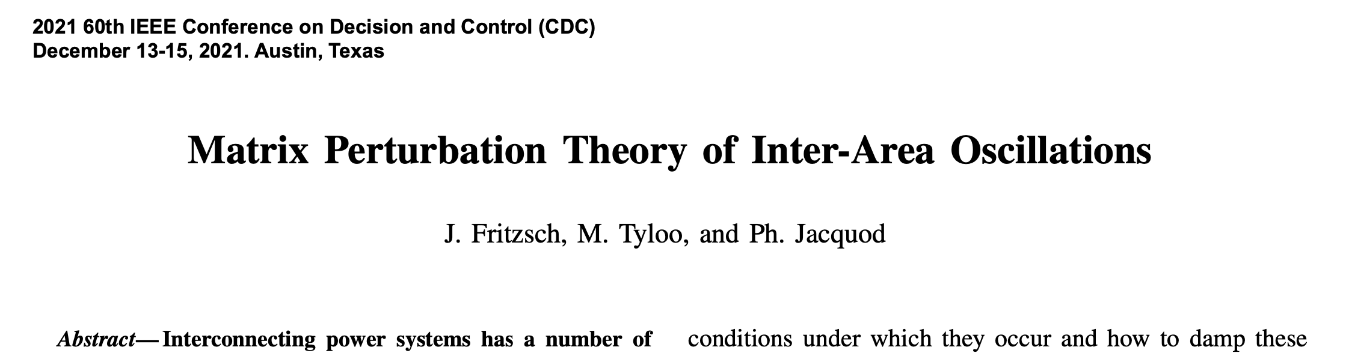
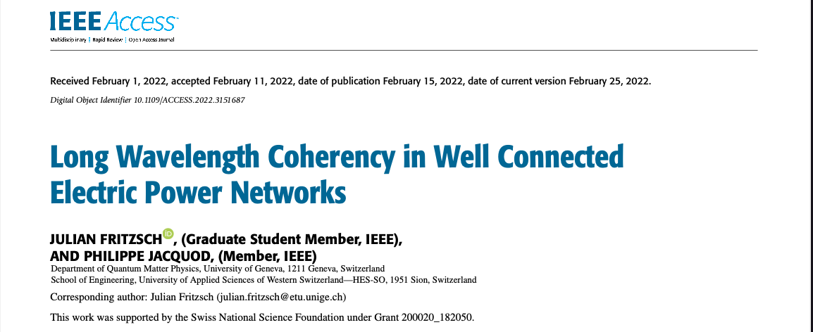
Results
European Model
3 Areas

Slide 10
Outlook
Adaptive
inertia
Continuous model

Slide 11
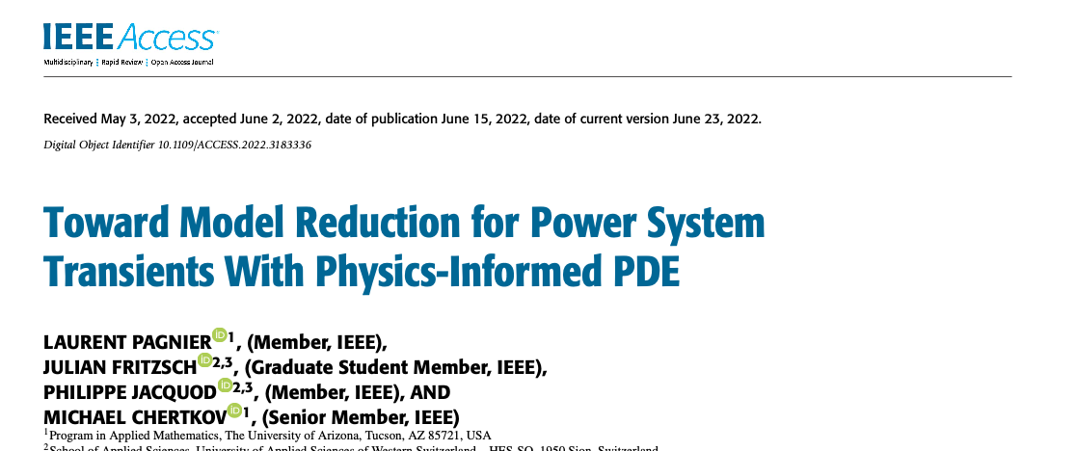
Outlook
Adaptive
inertia
Continuous model

Slide 12
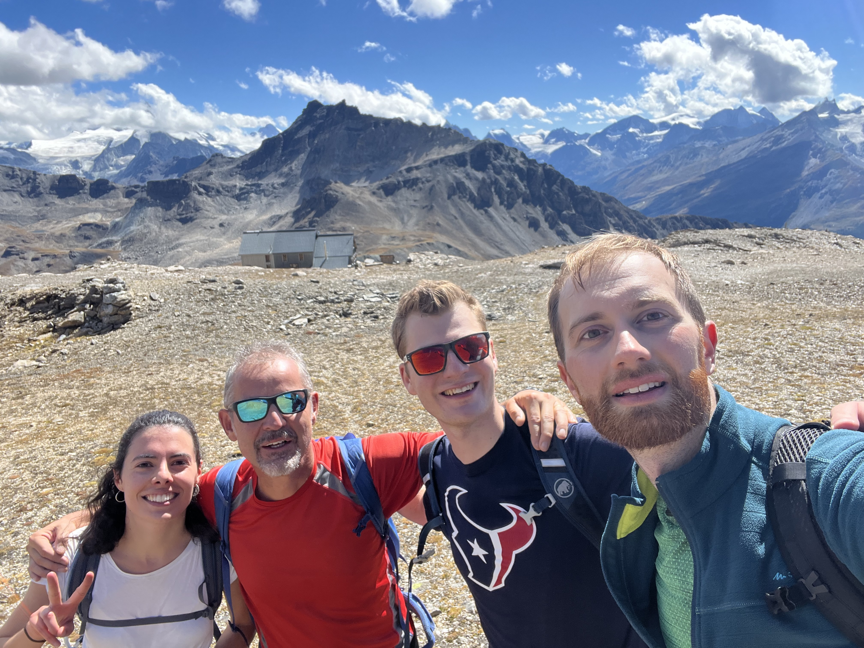

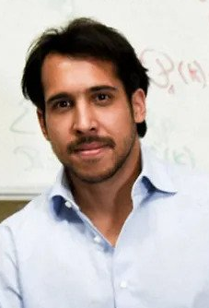
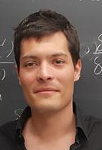



Group and Collaborators
https://etranselec.ch

