Slide 1

Measuring the distortion of time
Daniel SOBRAL BLANCO
3rd year PhD student with Camille Bonvin
Department of Theoretical Physics,
University of Geneva
Young Researchers Day Geneva 2022

Slide 2
SPECIAL RELATIVITY
Time passes at a different rate for observers moving at different velocities.
Albert Einstein (1905)

Slide 3
General relativity
In 1916
Special relativity + GRAVITY.
Clocks sitting at different distances with respect to a massive object tick at different rate.
Crucial for the GPS system.

Slide 4
Distortion of space and time
Passing of time
Gravitational well

Slide 5
The light shifts to the red
Alice sees the light coming from a star
GRAVITATIONAL REDSHIFT

Slide 6
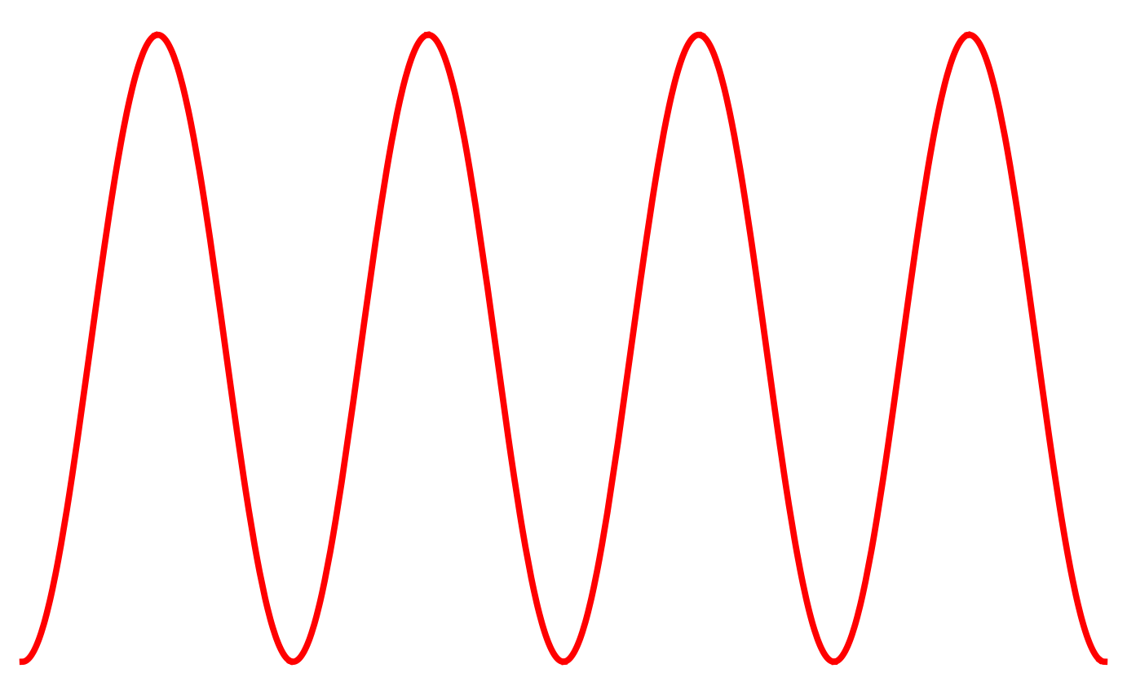
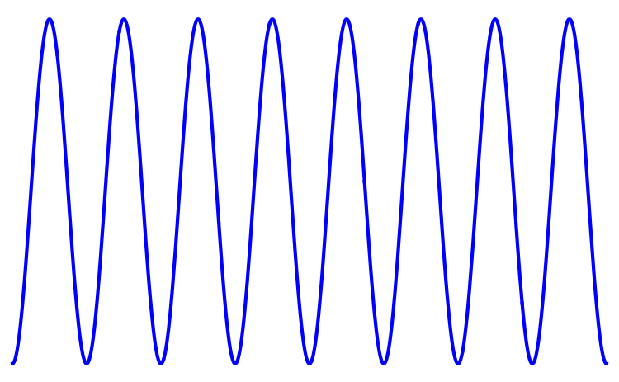

EXPANSION OF THE UNIVERSE
Supernova Cosmology Project
High-z Superonva Search Team
In 1998 two projects discovered the accelerated expansion of the Universe
REDSHIFT increases with the expansion

Slide 7
Doppler effect
Contribution to redshift due to the relative motion between observer and object.

Slide 8
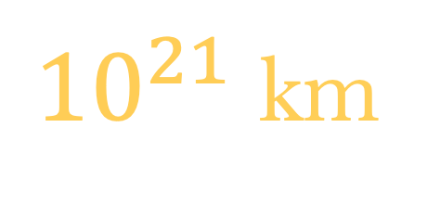

Measure the time distortion
GOAL:
Measure the gravitational redshift contribution alone
WHY?:
Test General Relativity on Cosmological scales
${10}^{21}$ km
$100$ million light-year
Signature for a new theory of gravity?

Slide 9
Measure the time distortion
GOAL:
Measure the gravitational redshift contribution alone
WHY?:
Test General Relativity on Cosmological scales
PROBLEM:
EXPANSION + DOPPLER are the dominant contributions

Slide 10
Measure the time distortion
HOW?:
Correlations between galaxies sitting in at different points inside a gravitational well.

Slide 11
Measure the time distortion
HOW?:
Correlations between galaxies sitting in at different points inside a gravitational well.
Isolate the gravitational redshift contribution
Remove the redshift due to the expansion of the Universe
First measurement of the time distortion at cosmic scales
Remove the doppler contribution
DESI
SKA
Looking forward upcoming surveys!

Slide 12
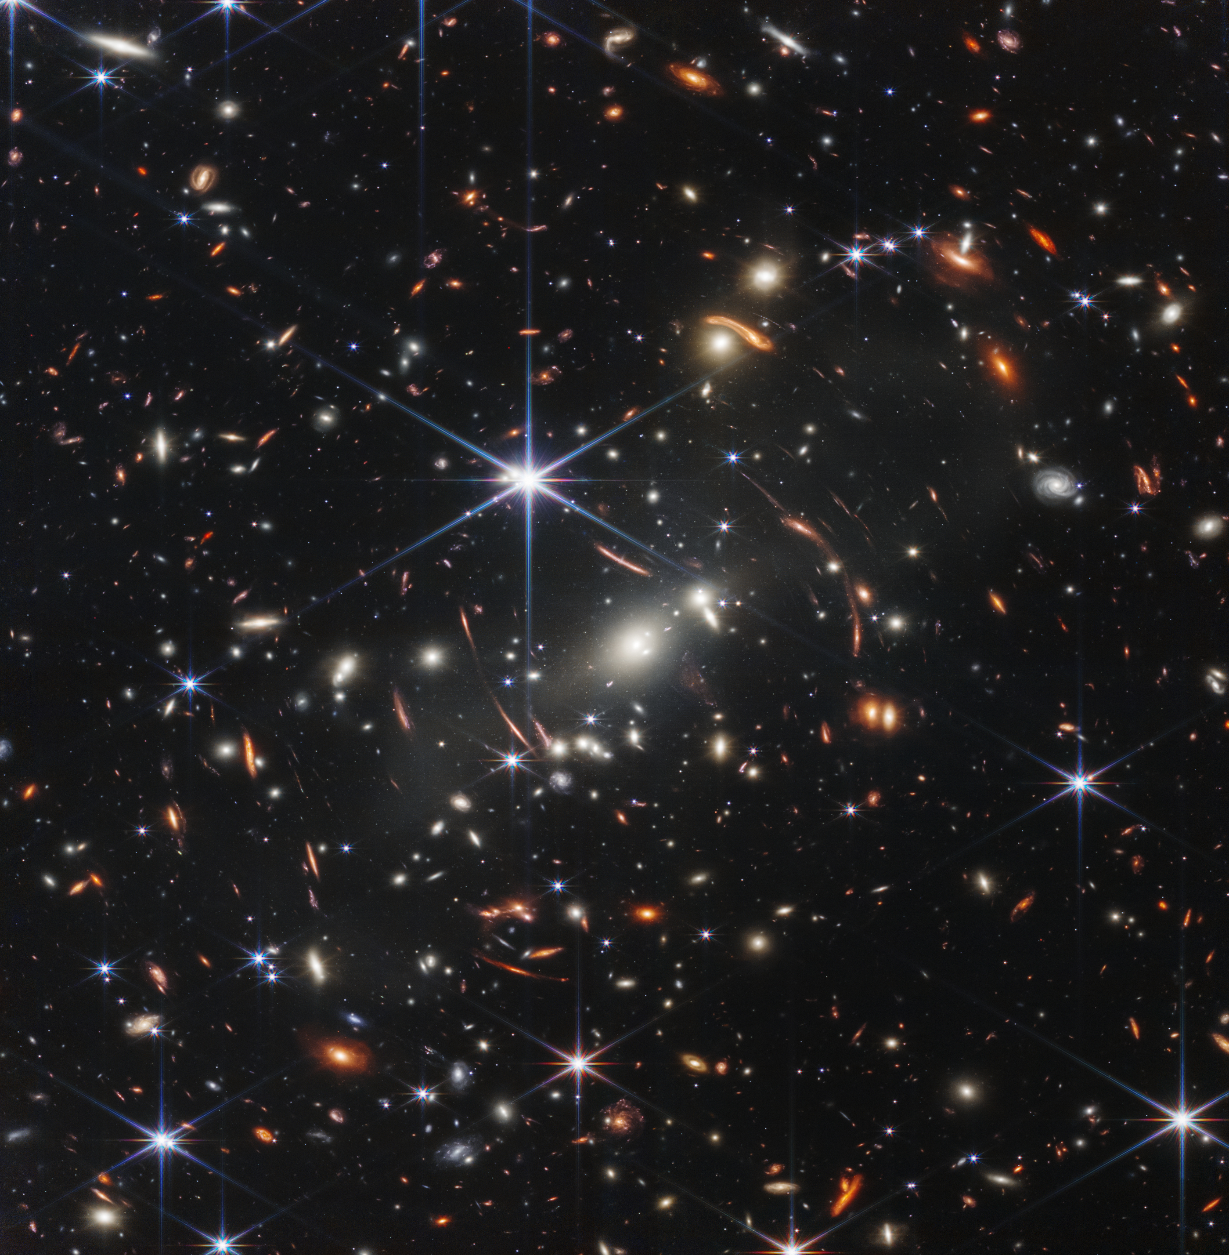
Thanks for listening!
Visit YouTube channel: COSMIC BLUESHIFT

