Slide 1
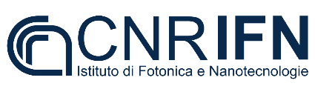




High-speed integrated Quantum Key Distribution system
Rebecka Sax¹, Alberto Boaron¹, Gianluca Boso⁴, Fadri Grünenfelder¹, Davide Rusca¹, Simone Atzeni^{2,3}, Roberto Osellame^{2,3}, Hugo Zbinden¹
¹University of Geneva
²Institute of Photonics and Nanotechnology CNR-IFN
³Politecnico di Milano
⁴ID Quantique
In collab. with:

Slide 2

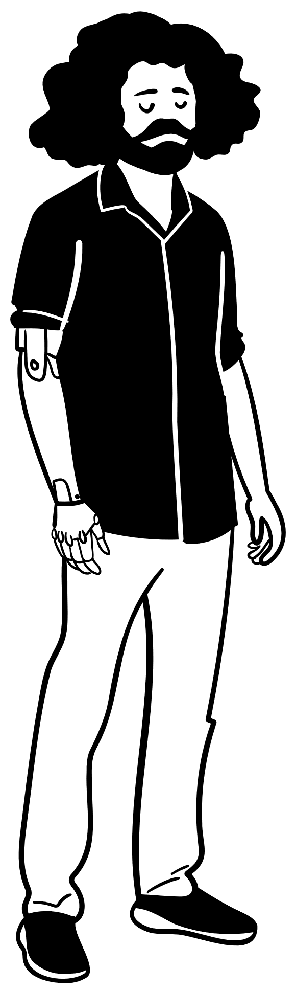




Sending a secret message
Alice
Bob
Eve

Slide 3

Encoding message with a secret key
Alice
Bob
Eve

Slide 4
Motivation of Quantum Key Distribution (QKD)
Classical cryptography: Security of key relies on hard mathematical problems
Quantum computer
Ergo: QKD
Quantum mechanics + cryptographic protocols -> information-theoretically secure protocols

Slide 5
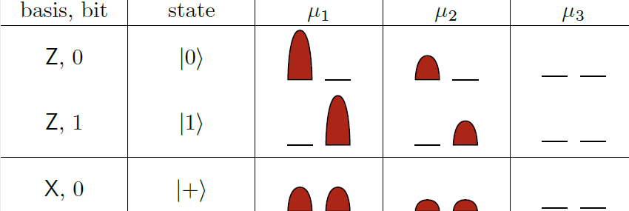
Protocol: 3-state Bennett-Brassard 1984
Alice
Quantum channel
Qubit
Key generation basis
Bob
Monitoring basis
Raw key: 0101100100111

Slide 6
Protocol: 3-state Bennett-Brassard 1984
Alice
Quantum channel
Figures of merit:
distance, secret key rate
Bob

Slide 7

Protocol: 3-state BB84
Alice
Bob
Gain-switched laser
Z basis detector
Single-mode-fiber
Intensity modulator
Variable attenuator
Interferometer
BS
Interferometer
X basis detector

Slide 8
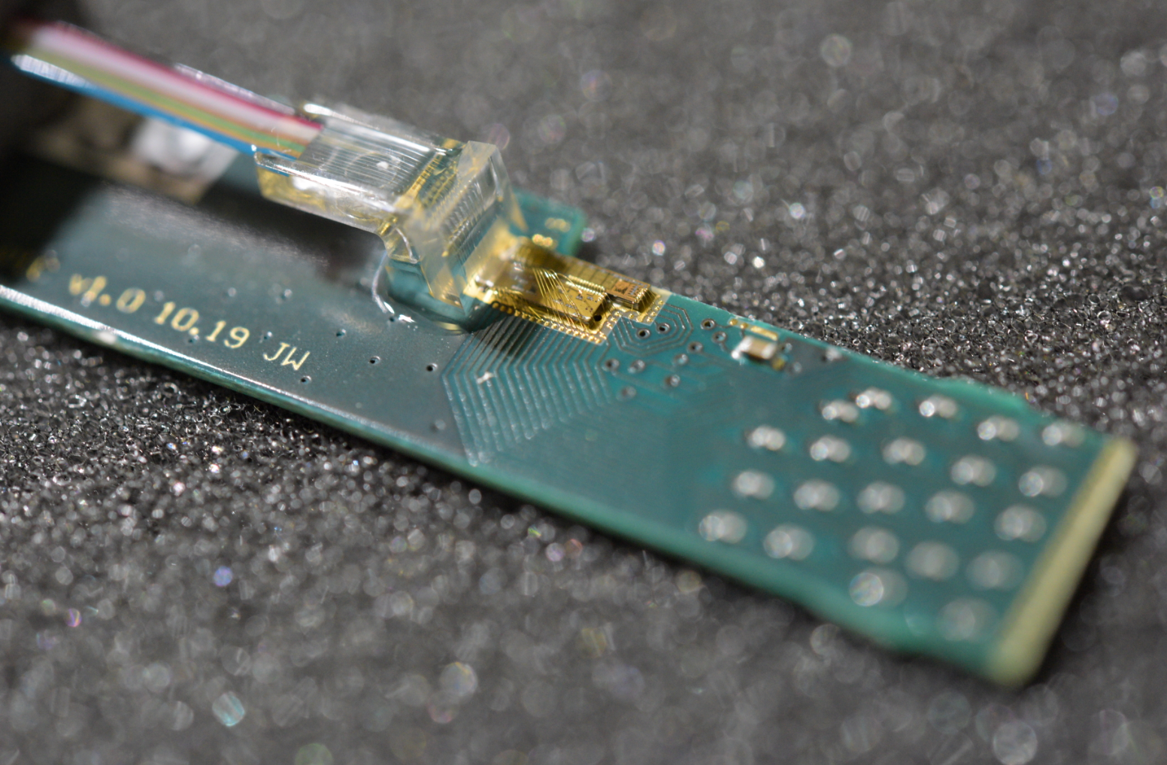
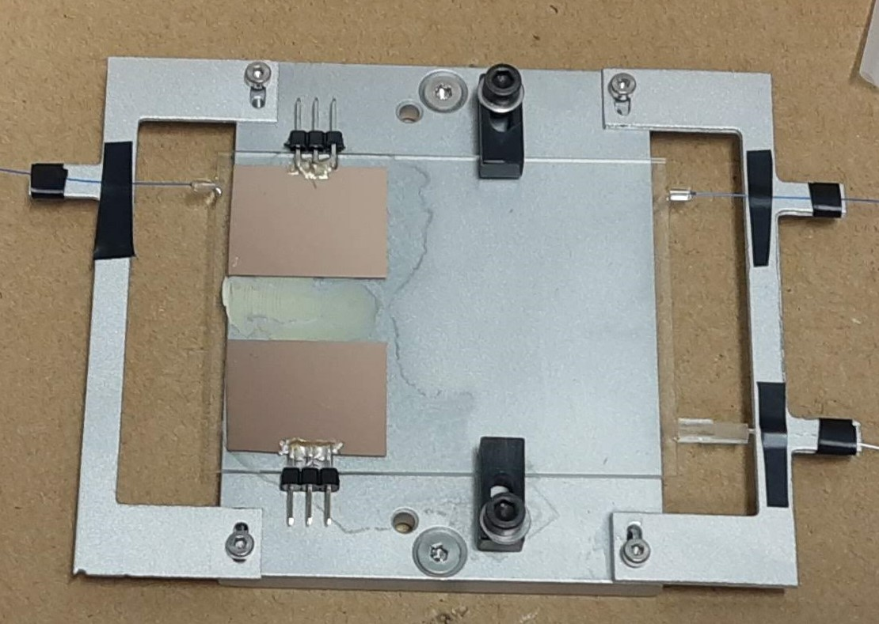
Integrated QKD
Goal: industrialize QKD
Practical, low cost, mass production, scalability

Slide 9
Integrated QKD
Fiber-based transmitter
Integrated transmitter
Interferometer, intensity modulator, variable attenuator, DAC, amplifier

Slide 10
Thank you for your attention!

Slide 11
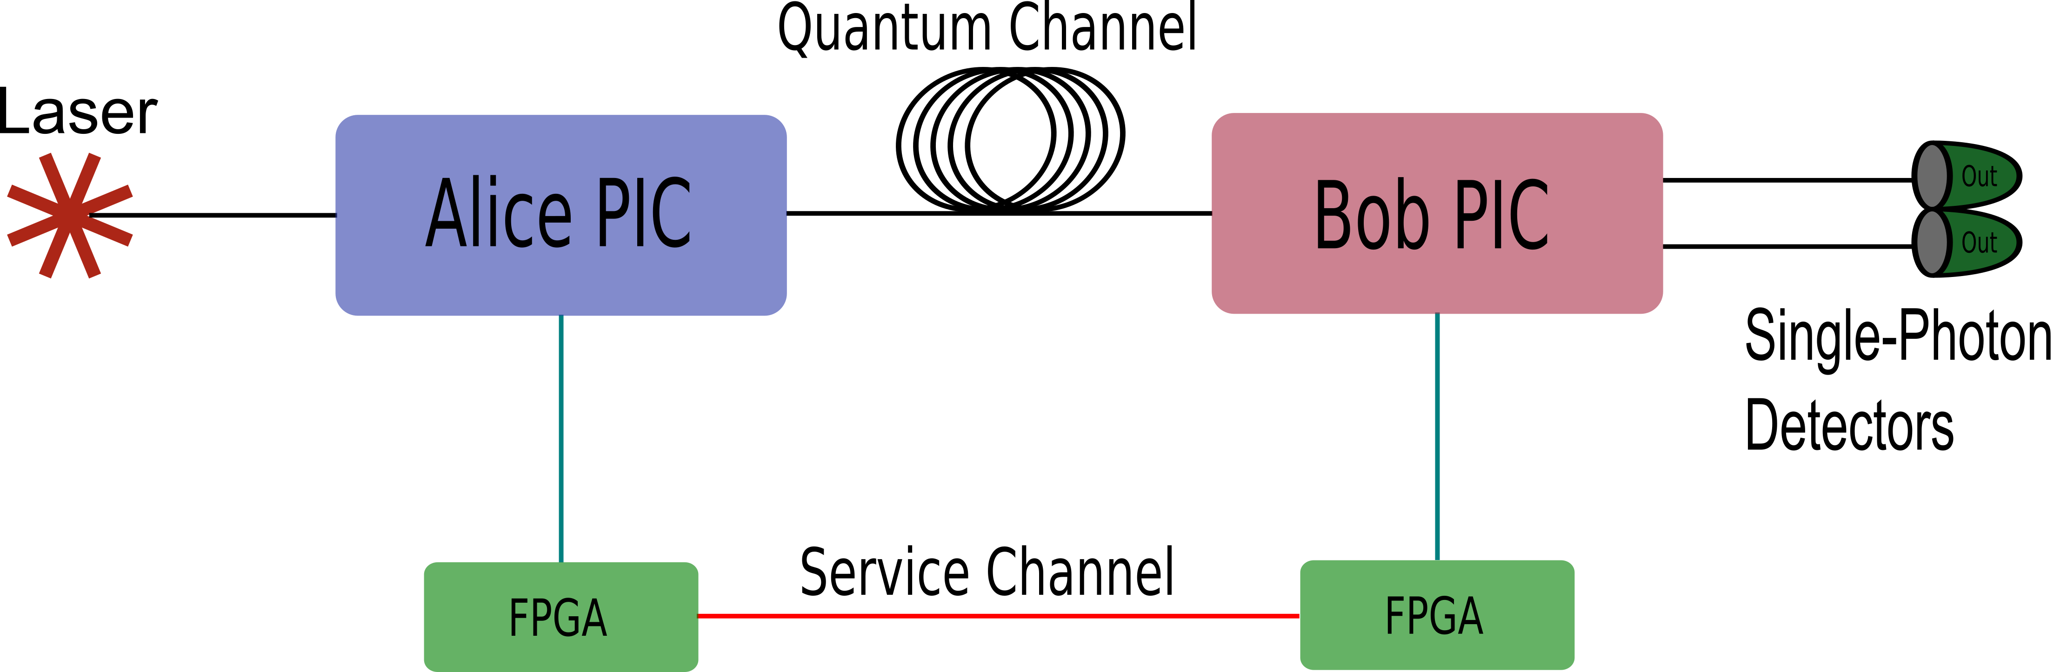
Full experimental setup

Slide 12
Protocol: 3-state BB84
Alice
Bob
Alice’s basis | Z | X | Z | Z
Photon state
Alice’s bit | 0 | 0 | 1 | 0
Bob’s basis | Z | Z | X | Z
Photon state
Bob’s bit | 0 | 1 | 1 | 0

Slide 13
Protocol: 3-state BB84
Alice
Raw key: 00
Bob
Alice’s basis | Z | X | Z | Z
Photon state
Alice’s bit | 0 | 0 | 1 | 0
Bob’s basis | Z | Z | X | Z
Photon state
Bob’s bit | 0 | 1 | 1 | 0

Slide 14
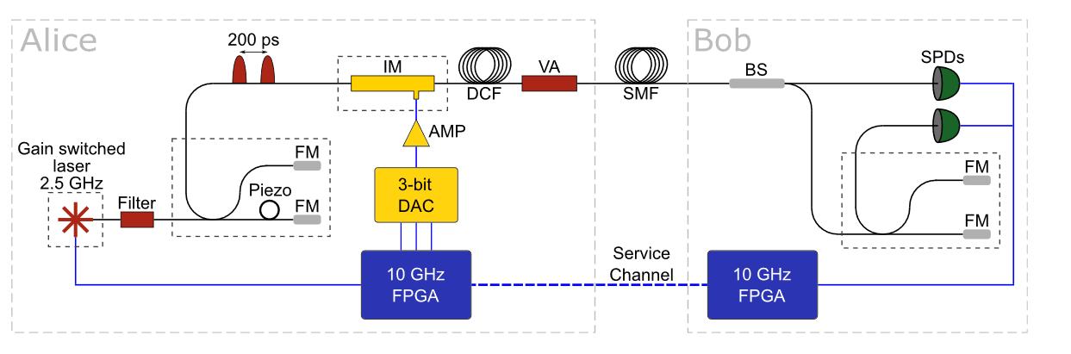
Protocol: 3-state BB84
Gain-switched phase-randomized pulses at 2.5 GHz and 1550 nm are generated
Unbalanced interferometer, delay 200 ps
Z basis detector
X basis detector
Simple 2.5 GHz time-bin quantum key distribution, Boaron et al., Applied Physics Letters, 2018

Slide 15
Reciever - Bob
Based on silica
Fabricated at CNR – IFN in Milano (R. Osellame) using femtosecond laser micromachining technique
Platform choice
Pros: Low loss (3dB), polarization insensitive (beam splitter and V of imbal-interferometer)
Cons: Cannot integrate detector,
«large» footprint (8 cm x 6 cm)

Slide 16
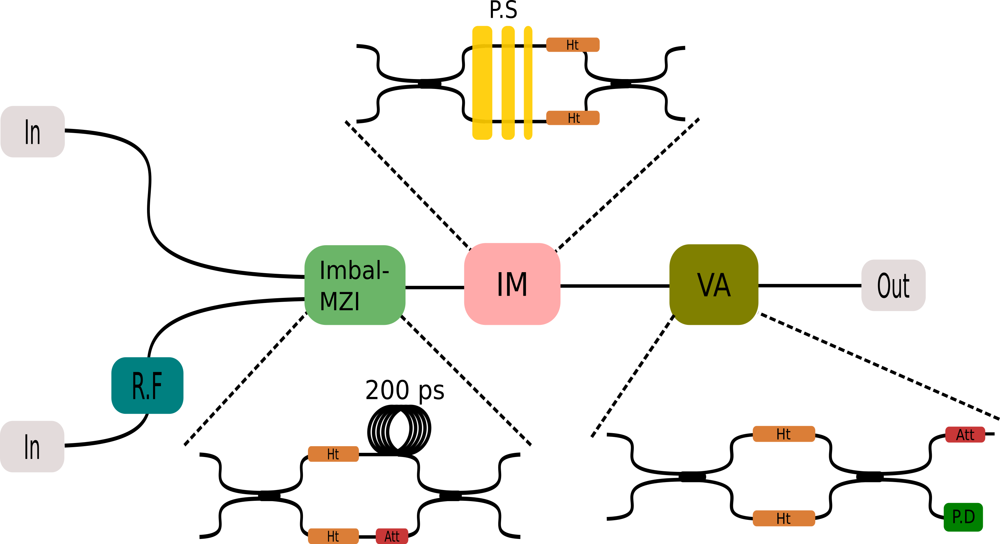
Transmitter – Alice

Slide 17



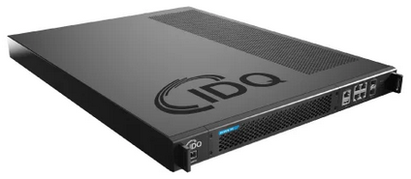
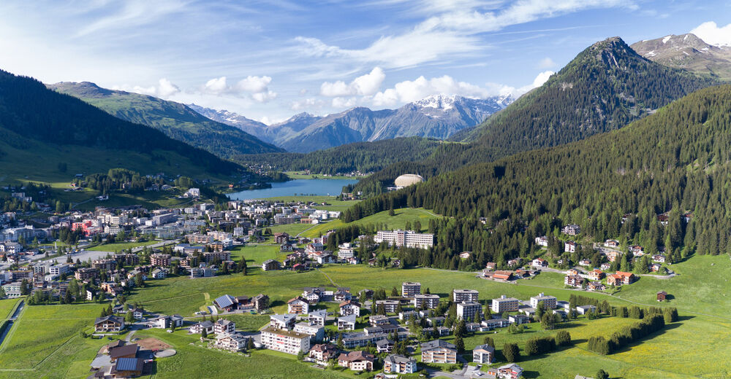

Quantum Key Distribution (QKD)
Figures of merit: distance, secret key rate
Long-distance fiber-based^{1,2}, satellite-QKD³ , commercial systems, …
Geneva, CH
Planet Earth
Davos, CH
Cinque Terre, IT
¹Twin-field quantum key distribution over 830-km fibre, Wang et al., Nature Photonics, 2022
²Secure Quantum Key Distribution over 421 km of Optical Fiber, Boaron et al., Physical Review Letters, 2018
³Satellite-to-ground quantum key distribution, Liao et al., Physical Review Letters, 2017

Slide 18
Motivation of Quantum Key Distribution (QKD)
Encryption: transfer data from a sender to a reciever securely
Symmetric:
Asymmetric:
Secret key
Sender
Encryption
Decryption
Reciever
Plaintext
Ciphertext
Plaintext
Asymmetric key pair
Public key
Private key
Sender
Encryption
Decryption
Reciever
Plaintext
Ciphertext
Plaintext

