Slide 1


Dimensional crossover in weakly-coupled chains
Lorenzo Pizzino
Young Researchers Day
16-09-2022
1

Slide 2


Excitations 2D vs 1D?
2D
1D
16-09-2022
16-09-2022
Lorenzo Pizzino - Young Researchers Day
2

Slide 3
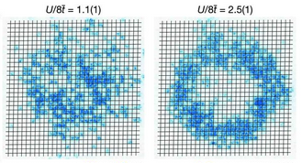



What do we want to study?
Weakly-coupled chains
Examples:
Ultracold atoms;
….
a
b
$$t_{a}$$
$$t_{b}$$
Very anisotropic: $t_{b}≪t_{a}$
Greif, Daniel, et al. "Site-resolved imaging of a fermionic Mott insulator." Science 351.6276 (2016): 953-957.
16-09-2022
16-09-2022
Lorenzo Pizzino - Young Researchers Day
4

Slide 4
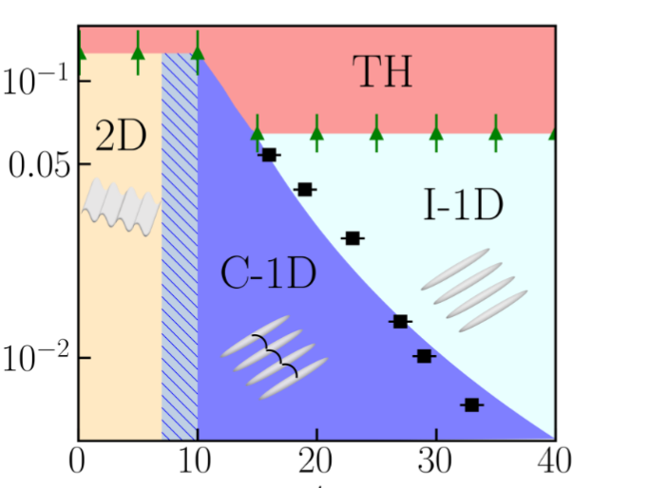
Result
1) Study transition C-1D to I-1D (Dimensional crossover).
Temperature
2) Result can be compared with numerics and experiments.
Interchain barrier
H. Yao, L. Pizzino, and T. Giamarchi. "Strongly-interacting bosons at 2D-1D Dimensional Crossover." arXiv:2204.02240 (2022).
16-09-2022
16-09-2022
Lorenzo Pizzino - Young Researchers Day
5

