Slide 1
Quantum Transport
João S. Ferreira
Group of Prof. Thierry Giamarchi
DQMP
|Young Researchers Day>

Slide 2
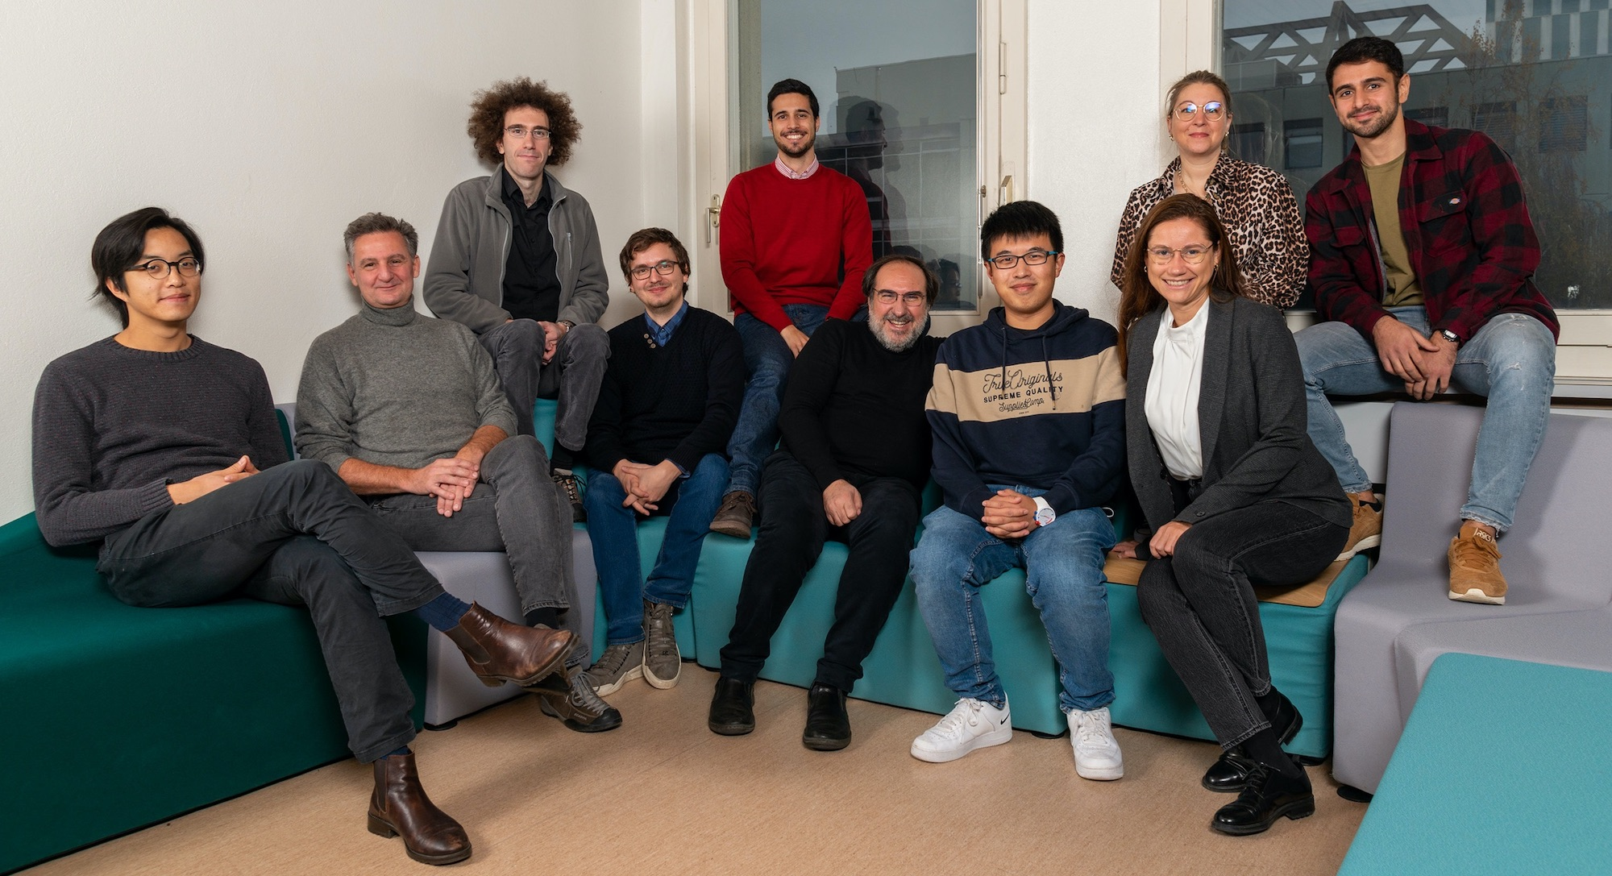
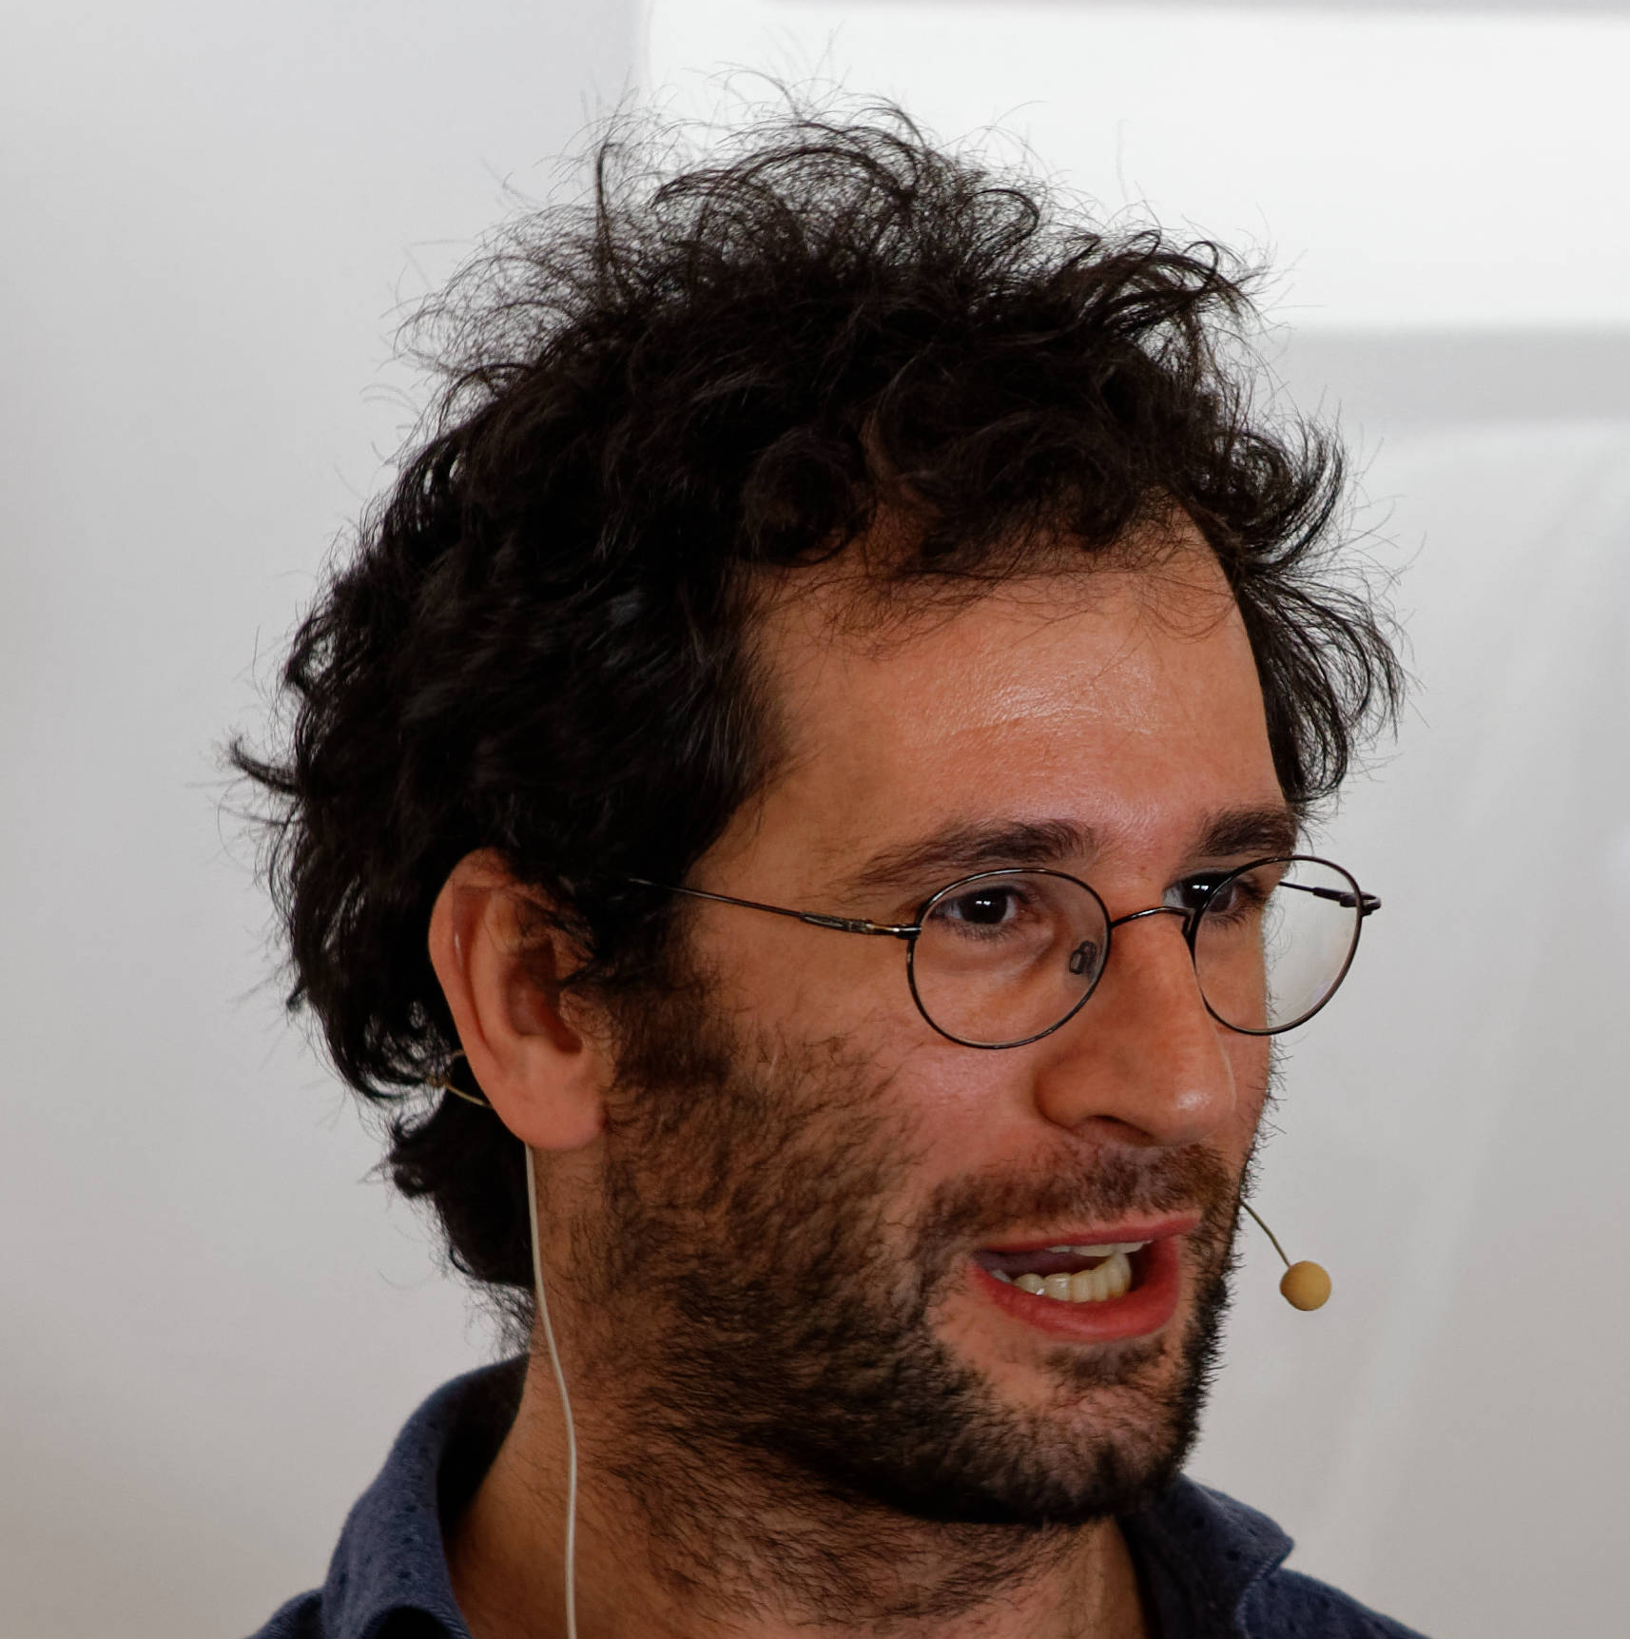
Who does Quantum Transport?
Tony
Thierry
Michele

Slide 3


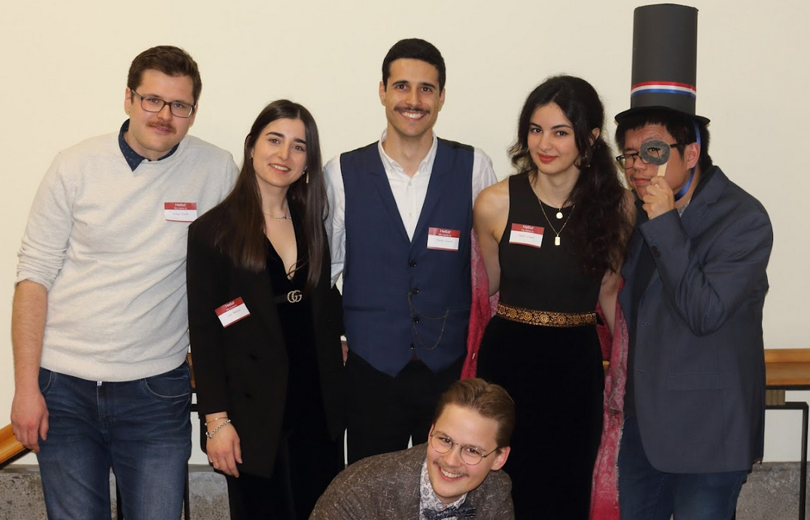
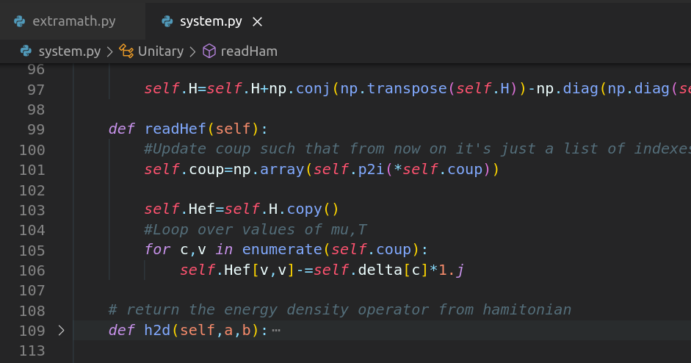
Who am I?
My time @ EdP

Slide 4
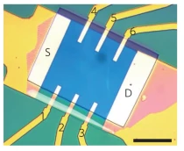
What is Quantum Transport?
Too Difficult
Fig. from Prof. Morpugo’s lab

Slide 5
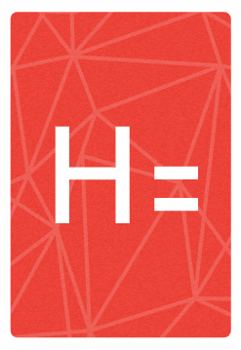
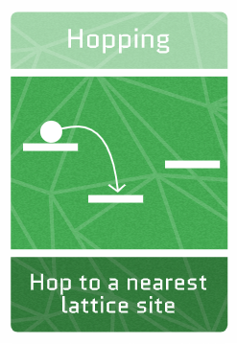
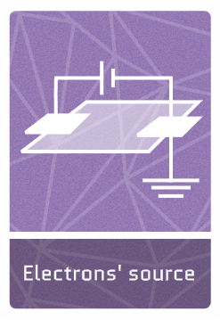

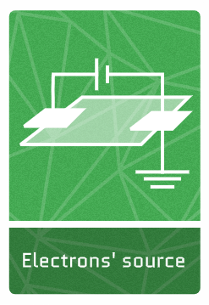

What is Quantum Transport?
Lattice of atoms / spins /etc.
Source
Drain
Ballistic current
(i.e. excellent conductor)

Slide 6
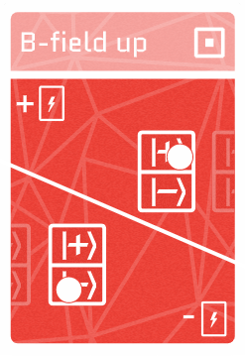

What is Quantum Transport?
@ zero temperature
Source
Drain
Magnetic impurity
Ballistic current
(i.e. excellent conductor)
Zero current
(i.e. insulator)

Slide 7
What do I do?
Stochastic reset of particle’s velocity & position
Dephasing
Source
Drain
Ballistic current
(i.e. excellent conductor)
Resistive current
(i.e. metal)
Zero current
(i.e. insulator)

Slide 8
Where to find me?
Office 007 - École de Physique
joao.ferreira@unige.ch
@hopquantumgame

