Slide 1
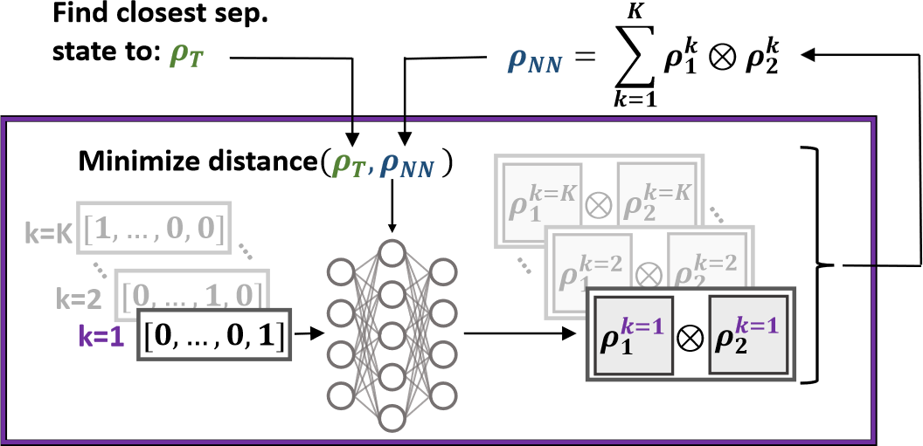
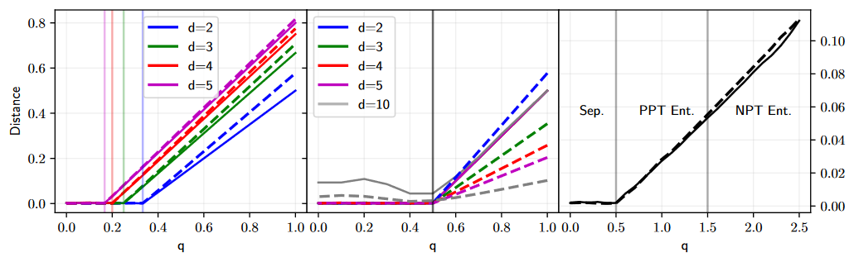
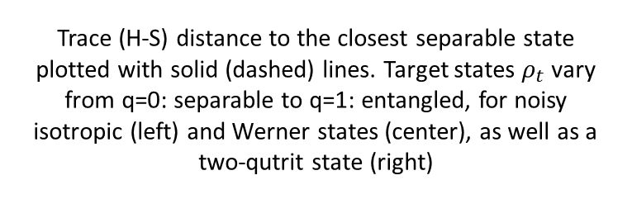
Building separable approximations for quantum states via neural networks
Antoine Girardin, Nicolas Brunner and Tamás Kriváchy
We use neural networks to build separable quantum states. This allows us to:
Quantify the amount of entanglement of a given state
Study robustness to noise of quantum states
Give analytical conjecture on Isotropic states and Werner states
Trace (H-S) distance to the closest separable state plotted with solid (dashed) lines. Target states $ρ_{t}$vary from q=0: separable to q=1: entangled, for noisy isotropic (left) and Werner states (center), as well as a two-qutrit state (right)

