Slide 1

Bright Entangled Photon Source Pumped by a GHz Oscillator
A. Djorović¹, L. La Volpe¹, M. Hamrouni², G. Gaulier¹, François Labaye² , V.J. Wittwer² , L. Bonacina¹, T. Südmeyer² and J.-P. Wolf¹
¹ University of Geneva, GAP-Biophotonics, Chemin de Pinchat 22, CH-1211 Geneva 4, Switzerland
² Laboratoire Temps-Fréquence (LTF), Institut de Physique, Université de Neuchâtel, Avenue de Bellevaux 51, 2000 Neuchâtel, Switzerland

Slide 2
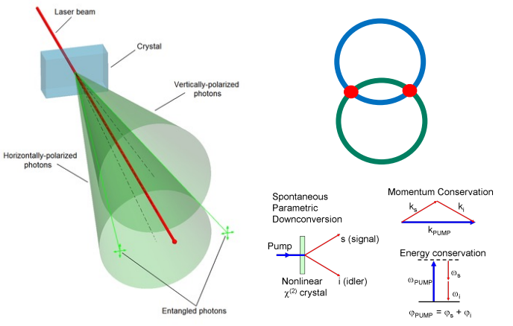
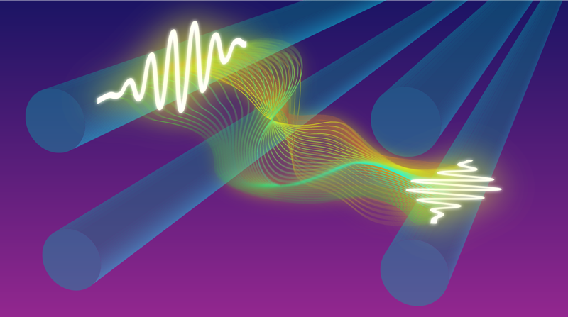
Spontaneous parametric down-conversion
If you want to have a chat about entanglement, come check out the poster!

