Slide 1
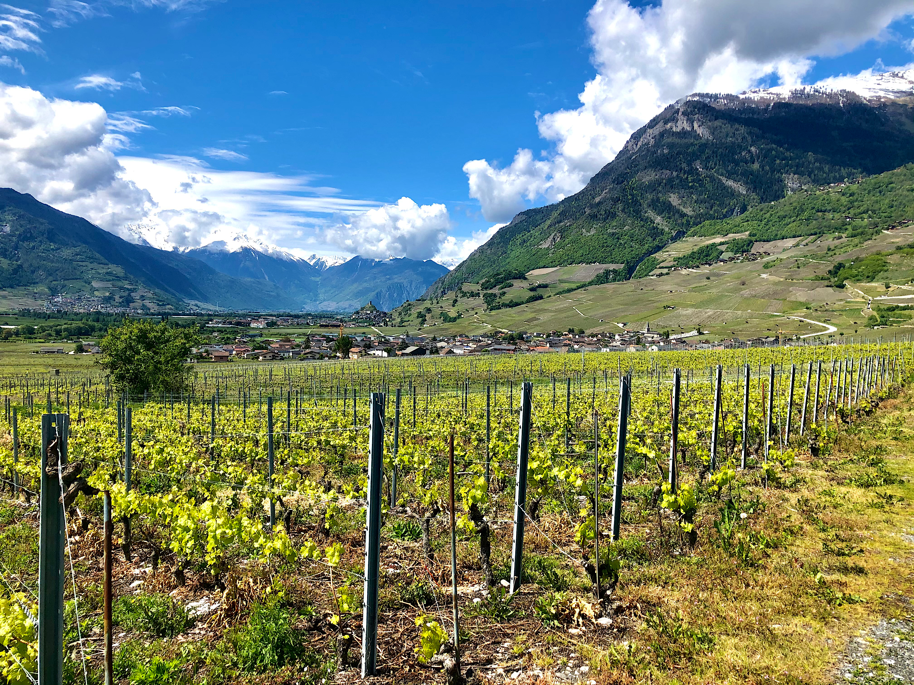
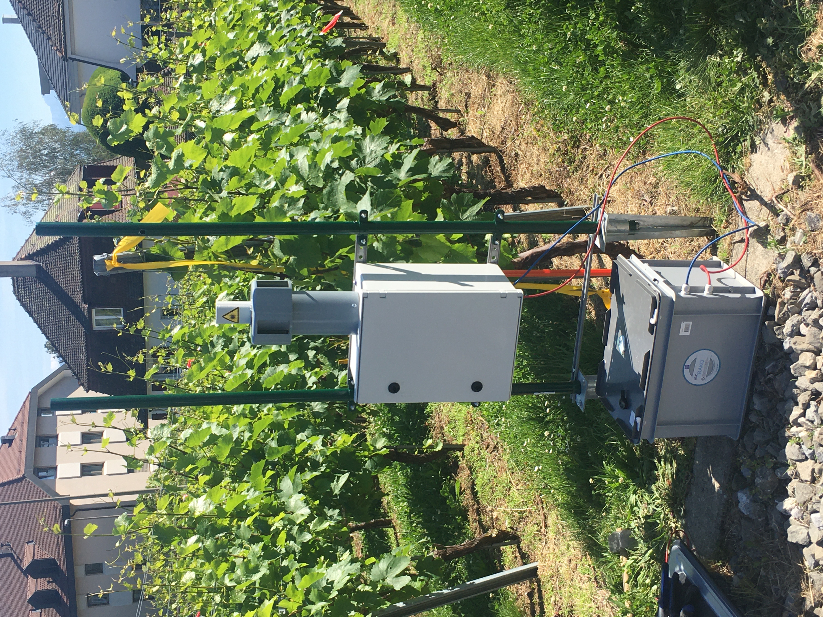
SMart Agriculture using Lasers and Artificial Intelligence
T. Basso¹,
S. Leoni², M. Tran¹, N. Berti¹, J. Kasparian^{1,3}, P.-H. Dubuis², J.-P. Wolf¹
Département de physique appliquée, Université de Genève
Agroscope, Changins
Institut des sciences de l’environnement, Université de Geneve

Slide 2
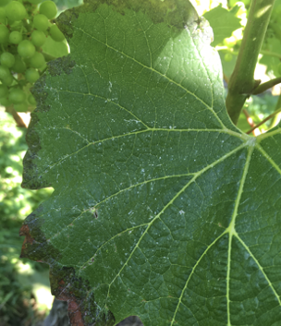
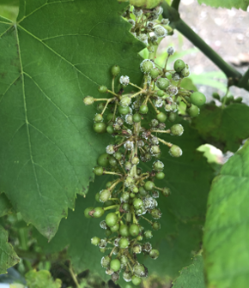



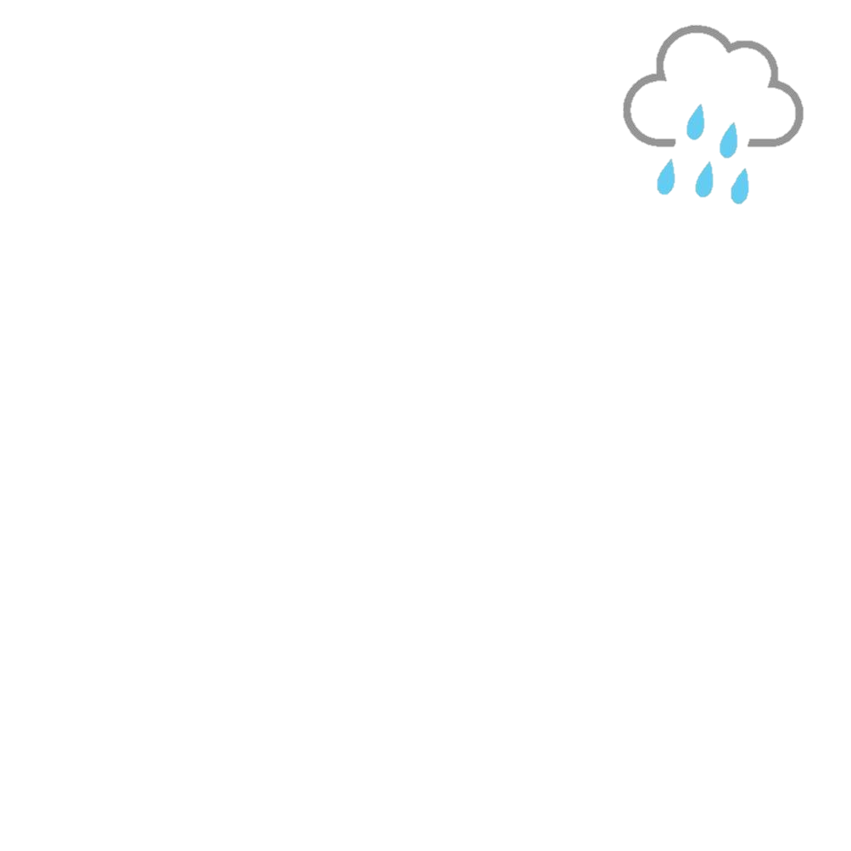
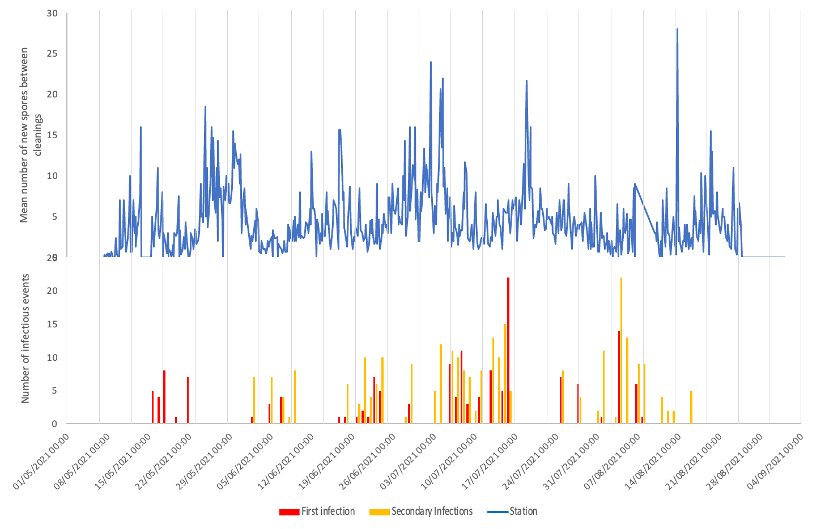

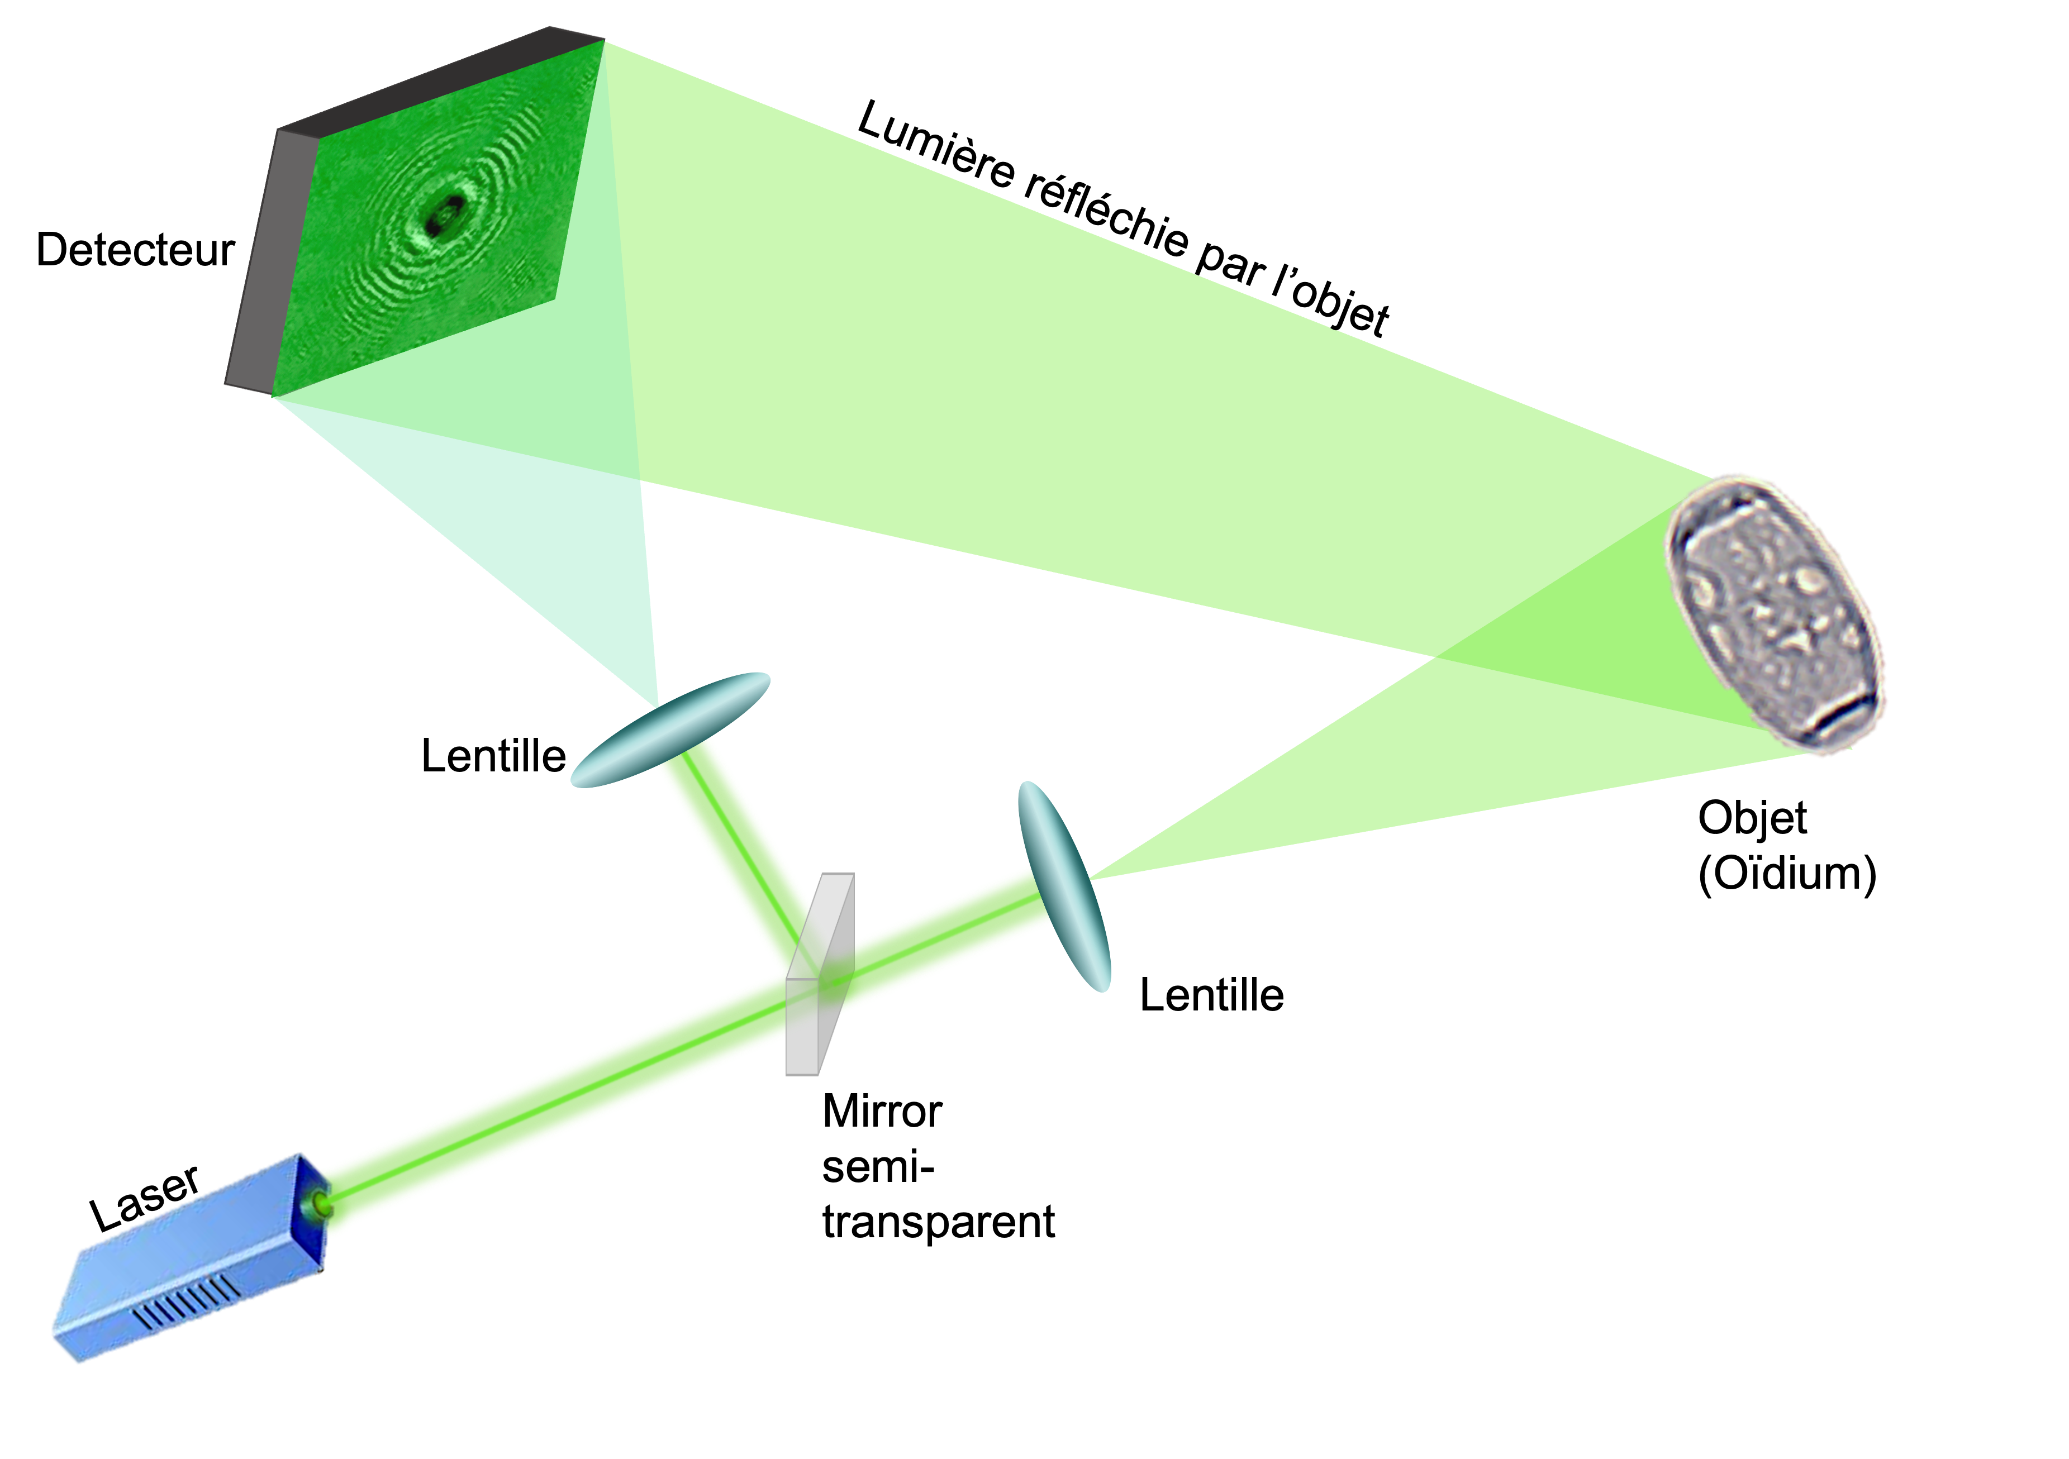

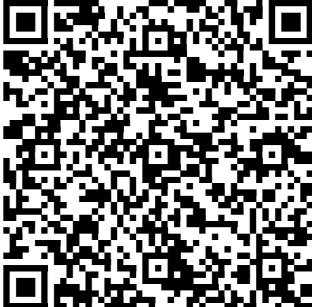



Improve disease prediction
2021 Campaign Results
Metrological Data + AgroMétéo Model
(www.agrometeo.ch)
Surveillance of disease in field
Complementarity between the AgroMétéo model
Sensibility to daily fluctuations and one-off events
Successful identification of the primary infection (from ground)
Holospore
Decision support for the winemaker: treat only where
and when it is necessary!
Innovation of the Bridge projet : PRESENCE OF PATHOGENS
AgroMétéo
Holography Principle
Using deep learning neural networks to identify downy and powdery mildew spores automatically

