Slide 1


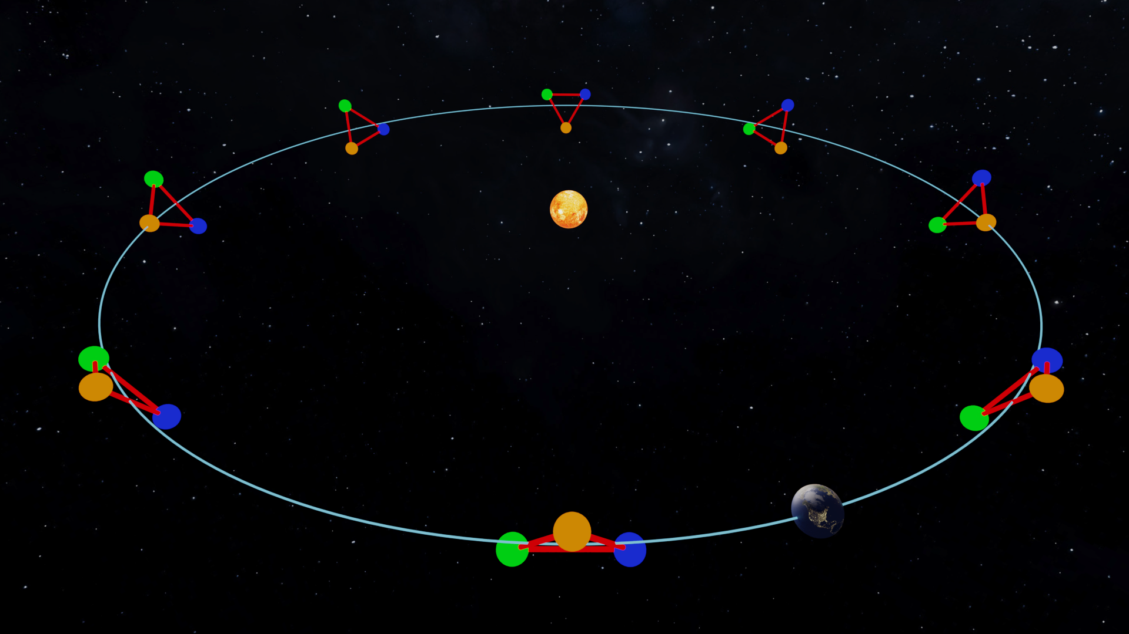


Research focus in EEG team
Geophysics
Inverse problems
Fast algorithms
Signal processing
Mathematical modelling
Scientific computing
Machine learning
Bayesian statistics
Notes:
In this presentation we focus on methods for galactic binaries. Large number of sim source..

Slide 2
Forward modelling
A good forward solver fundamental for development of methods for solving inverse problems.
Lisa Data Challenge (LDC) provides data for testing algorithms as well as code for simulation.
Fast algorithms to be able to generate million of samples.
However, not accurate.
The algorithms can be modified to be substantially more accurate

Slide 3
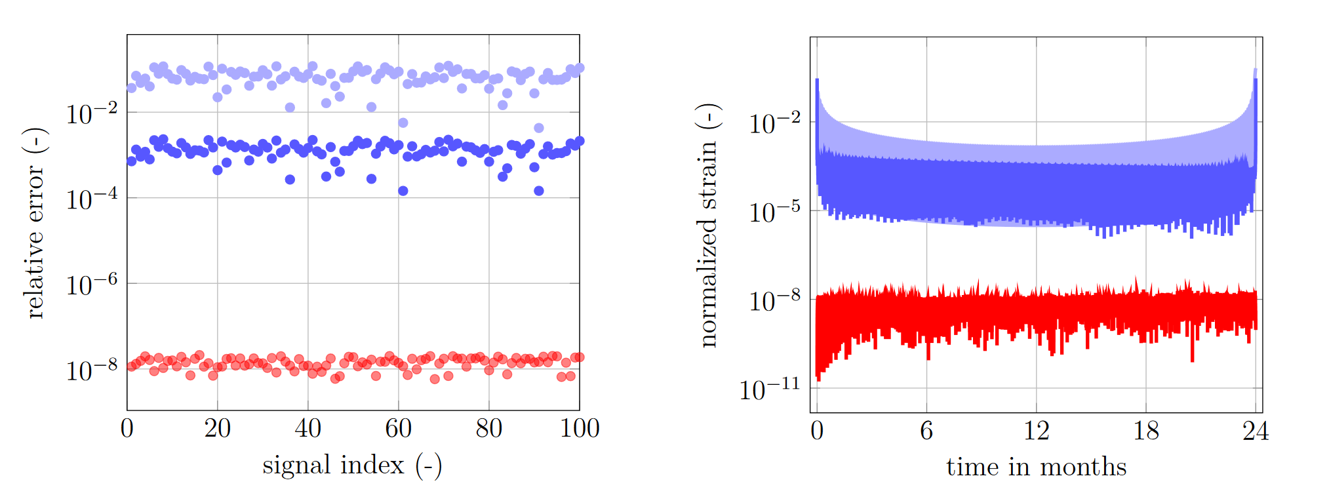
Forward modelling
Results from the two algorithms provided by LDC in blue, and results from suggested approach.

Slide 4
Inverse problem – statistical methods
Assume that data originates from one single galactic binary and use statistical methods to search through the parameter space
Differential evolution approach
Iteratively finds the strongest signal
Subtracts and repeat

Slide 5
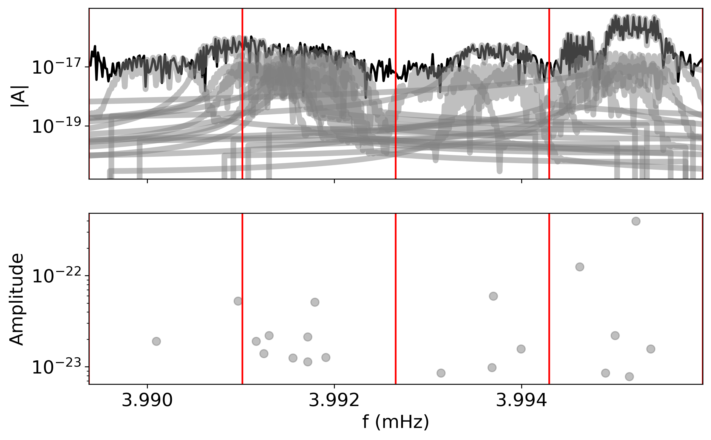
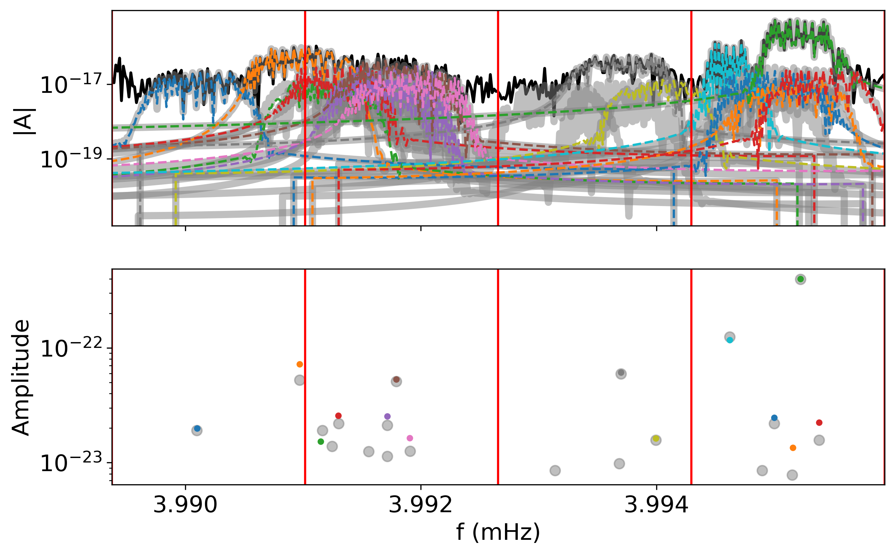
Inverse problem – statistical methods
Data
True Signals
Found Signals
14/20 found
Data
True Signals

Slide 6
Inverse problem – Tri-linear representation
The data depends non-linearly on some of the parameters (direction, frequency,..) and linearly on some (amplitude, phase,…)
Data can be well approximated by a tri-linear representation
Allows for usage of linear algebra and multilinear algebra for parameter estimation.

Slide 7
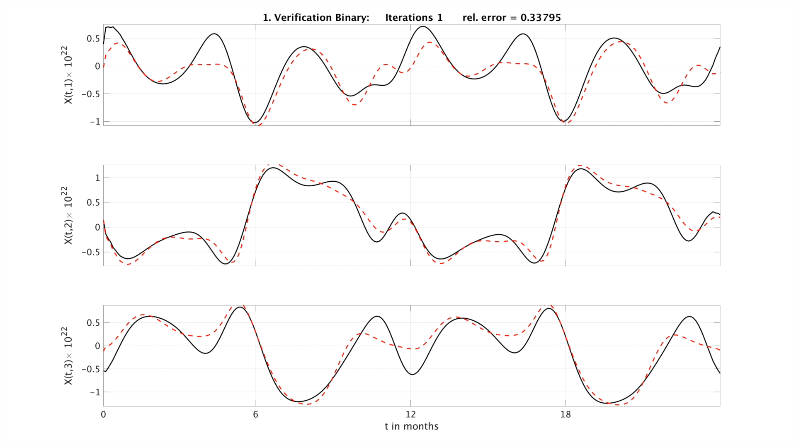

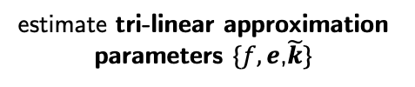
Analysing Galactic Binaries in two steps
Step 1
Step 2
estimate tri-linear approximation parameters $\{f, e$,$\tilde{k}\}$
extract source parameters
from $\{f, e$,$\tilde{k}\}$
tri-linear structure allows use of alternating least squares algorithm
Step 1
Step 2
true signal
reconstruction with alternating least squares
Notes:
we can formulate a least squares problem that is associated with the tri-linear approximation
The parameters can be derived by exploiting the special structure of the tri-linear approximation: when fixing two of the three TLA parameters, the problem becomes linear in the third
Hence, we have to solve three linear least squares problems

Slide 8
Inverse problem – Exhaustive search
Instead of iterative searching for one event can we find all at the same time?
Yes
By fixing non-linear parameters for single event the remaining ones can be solved by solving a linear system.
Do the same but instead for 10^11 events!

Slide 9
Inverse problem – Full simultaneous source search.
Naive approach is extremely expensive: Multiple iterations each with a computational cost O(N^3) with N=10^11.
Arrange parameters in groups, and form statistic formulation with misfit and cost of non-zero groups.
Construct fast iterative algorithm with weights from each group.
In each iteration, the inversion step has a cost that is independent of the number of groups.
Possible to solve for several millions of Galactic binaries per second on consumer hardware.

Slide 10


Inverse problem – Full simultaneous source search.
Use Peirce quincuncial projection
to display directions in the universe

Slide 11
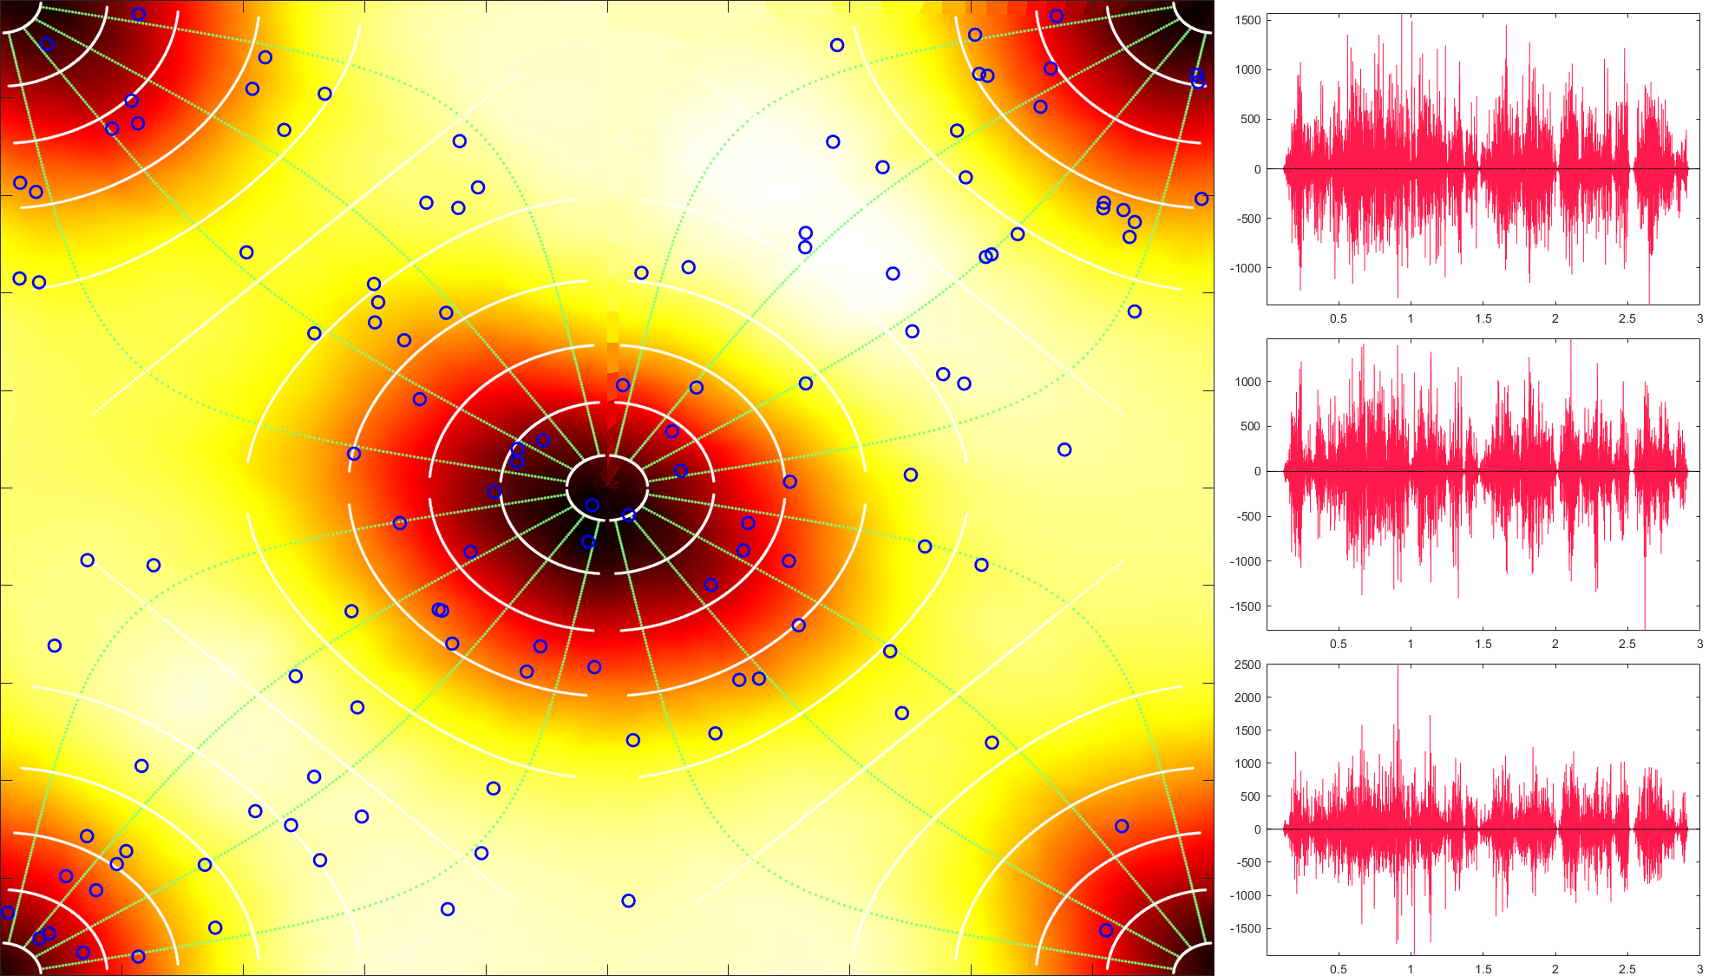
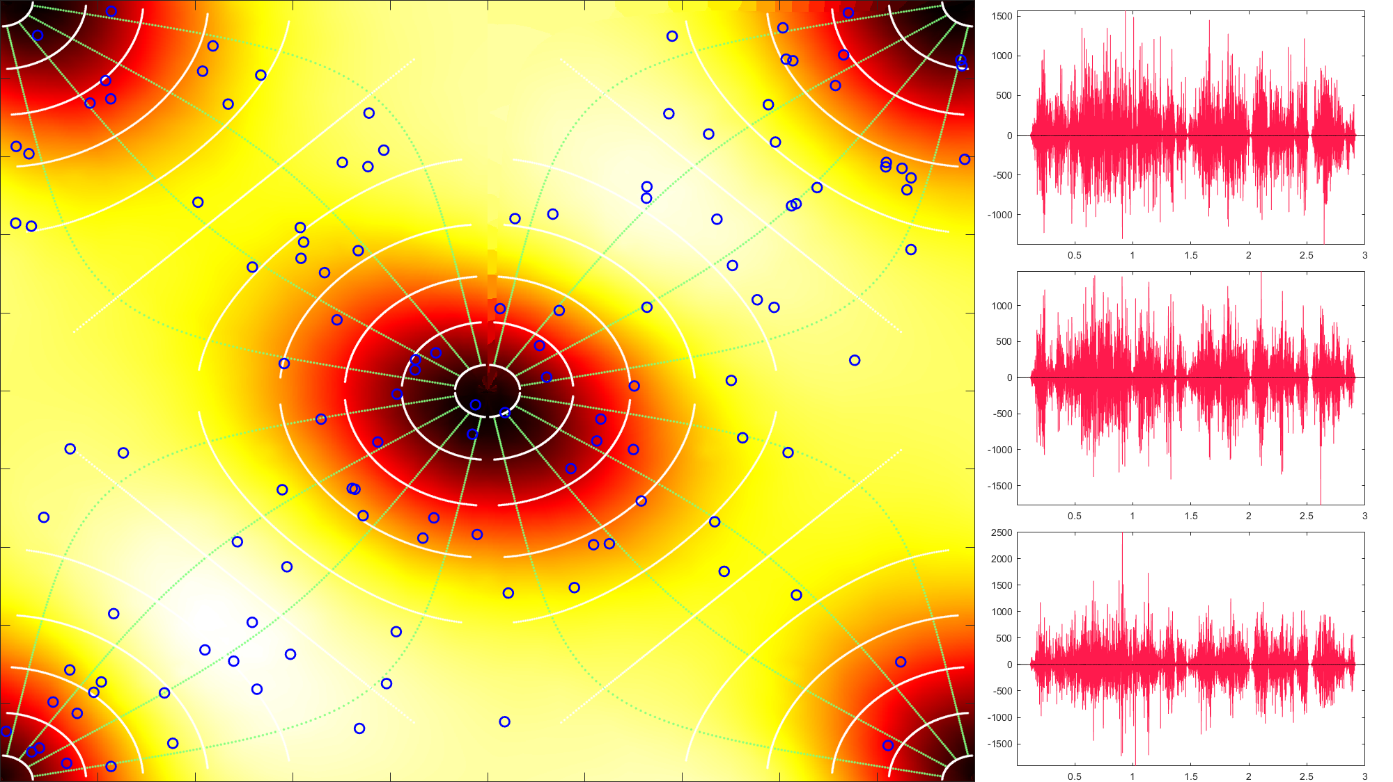
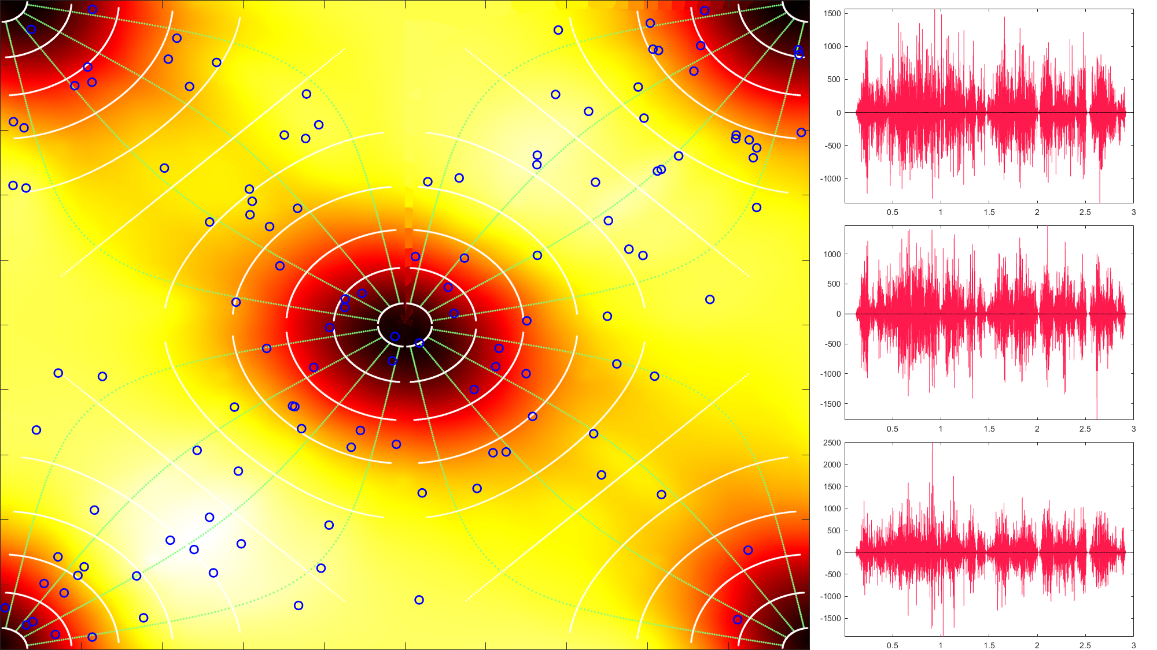
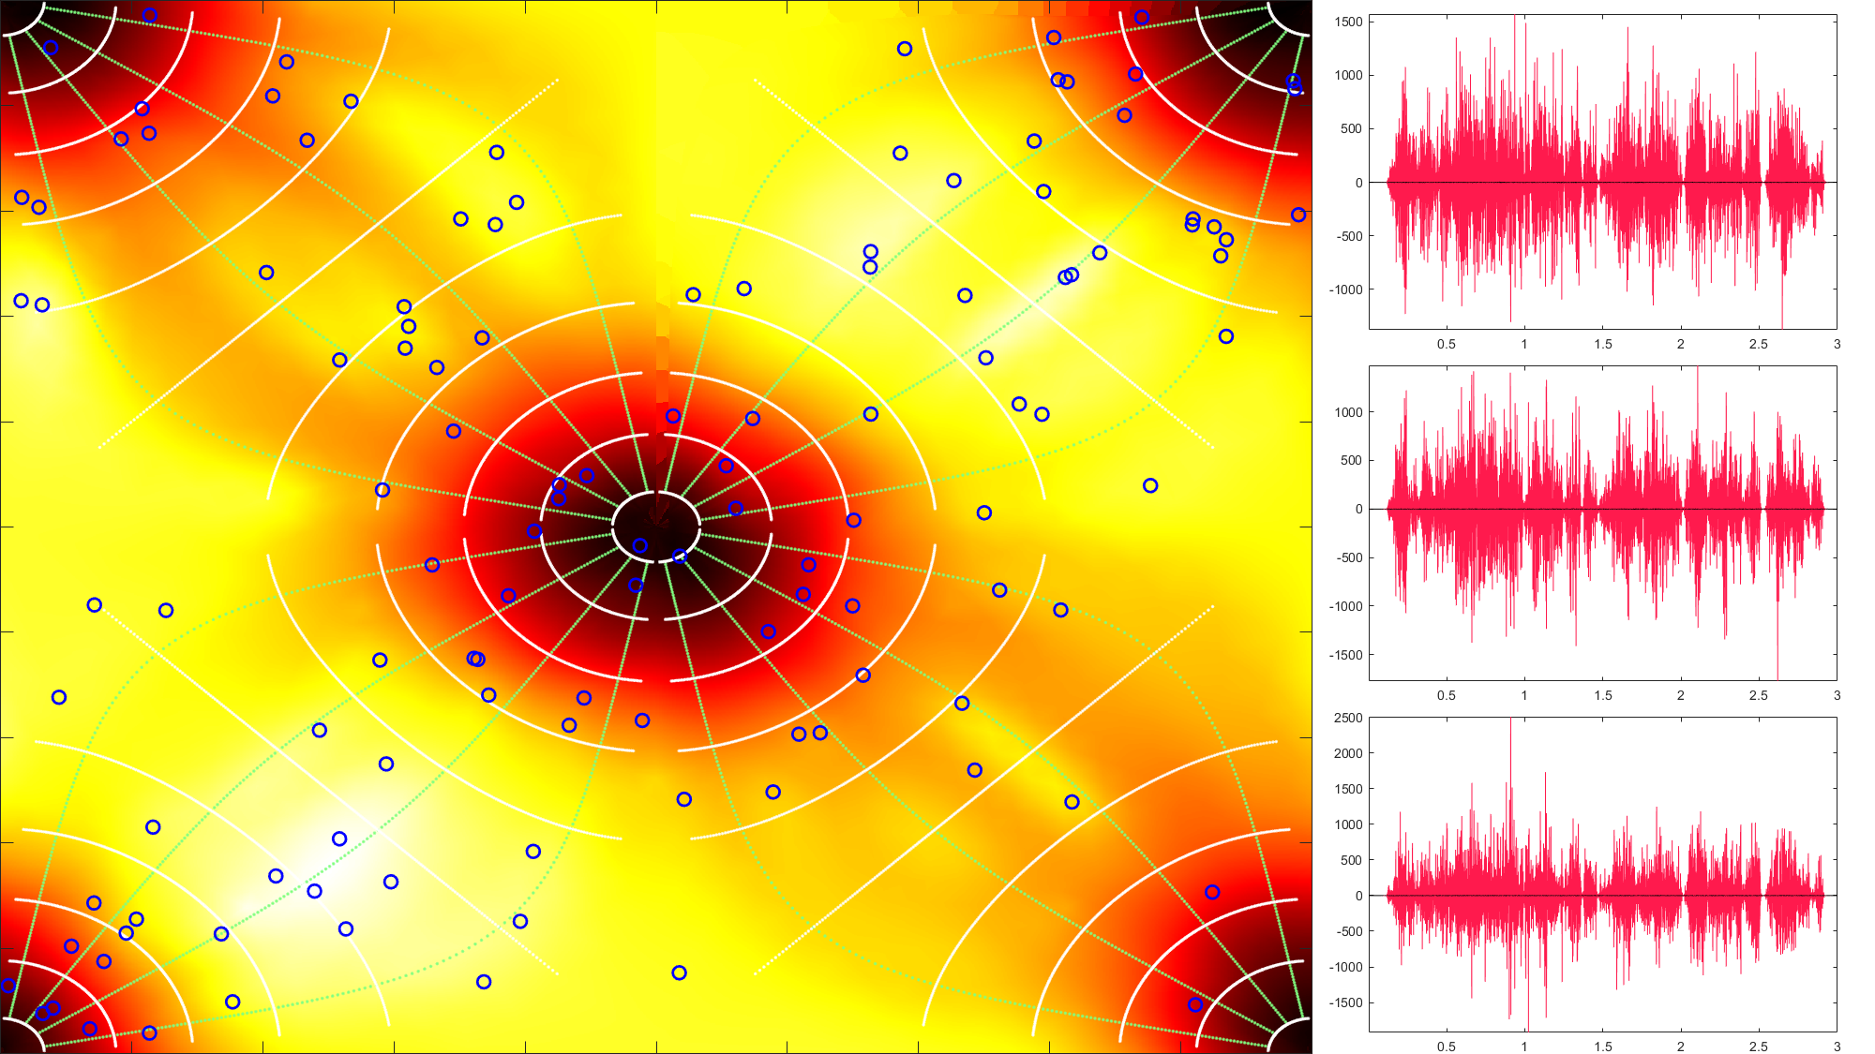
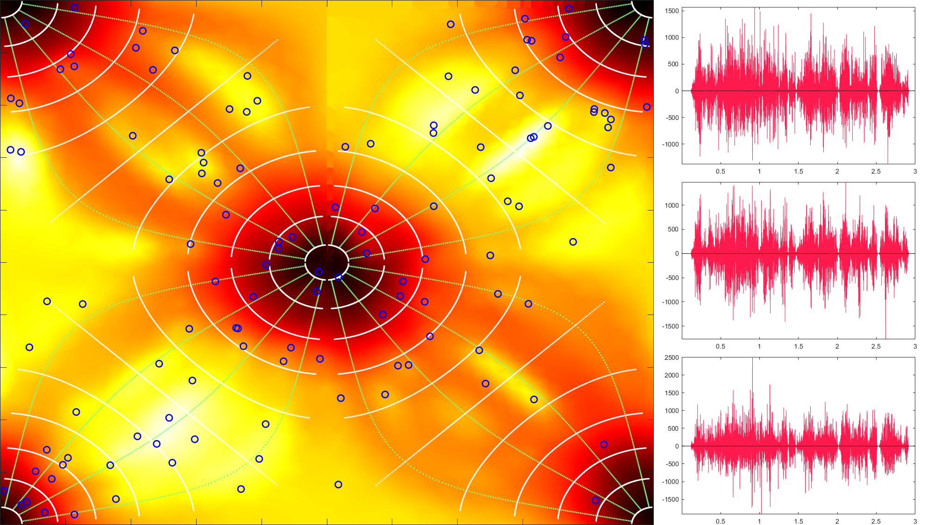
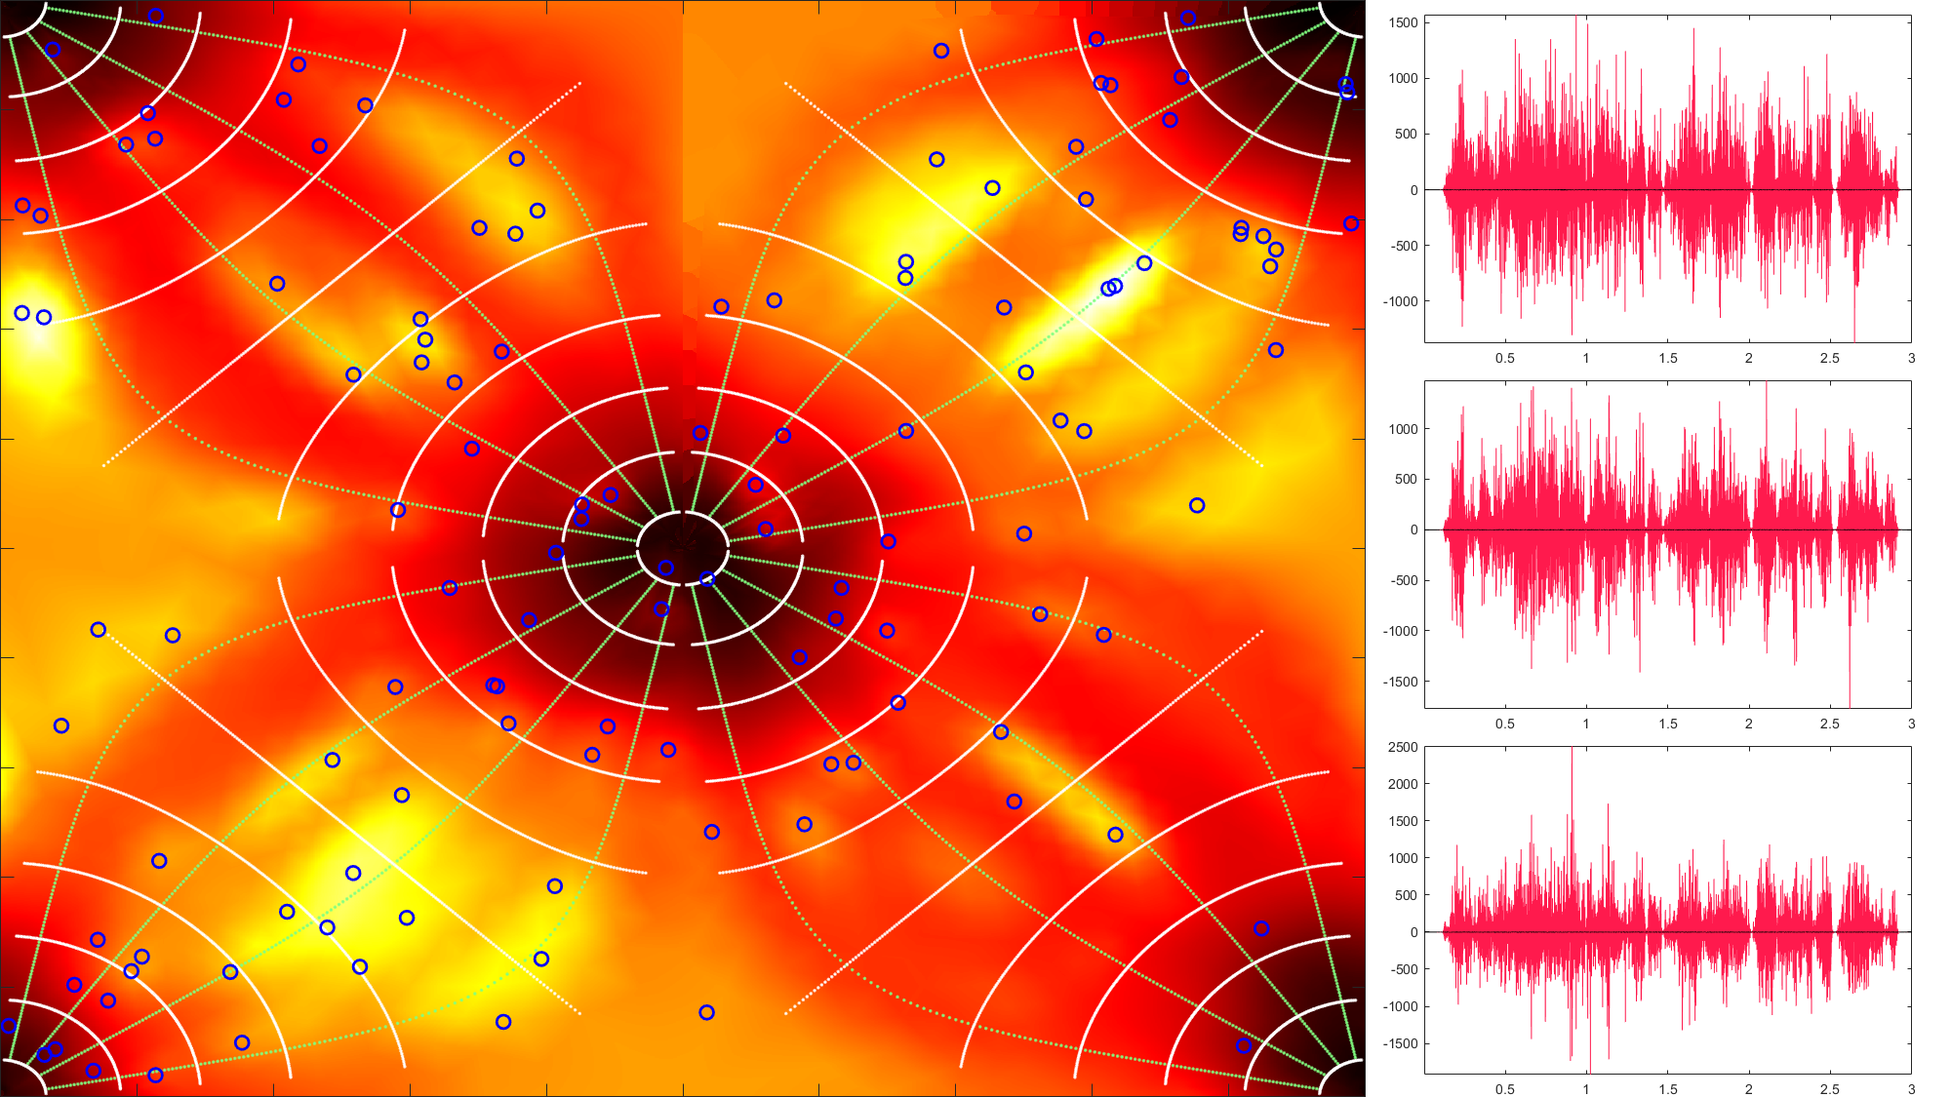
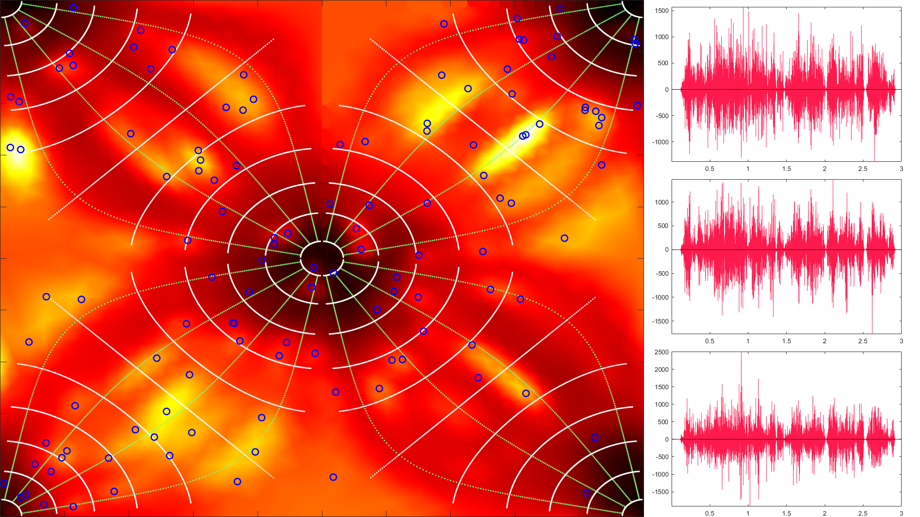
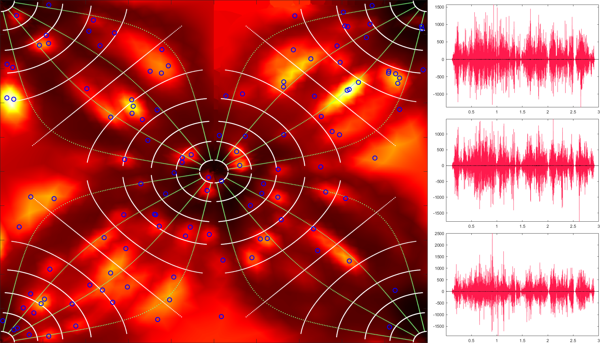
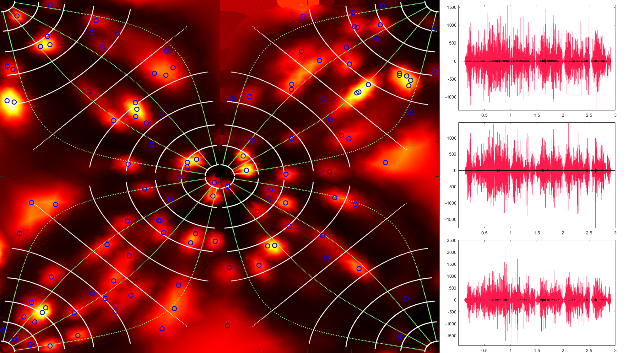
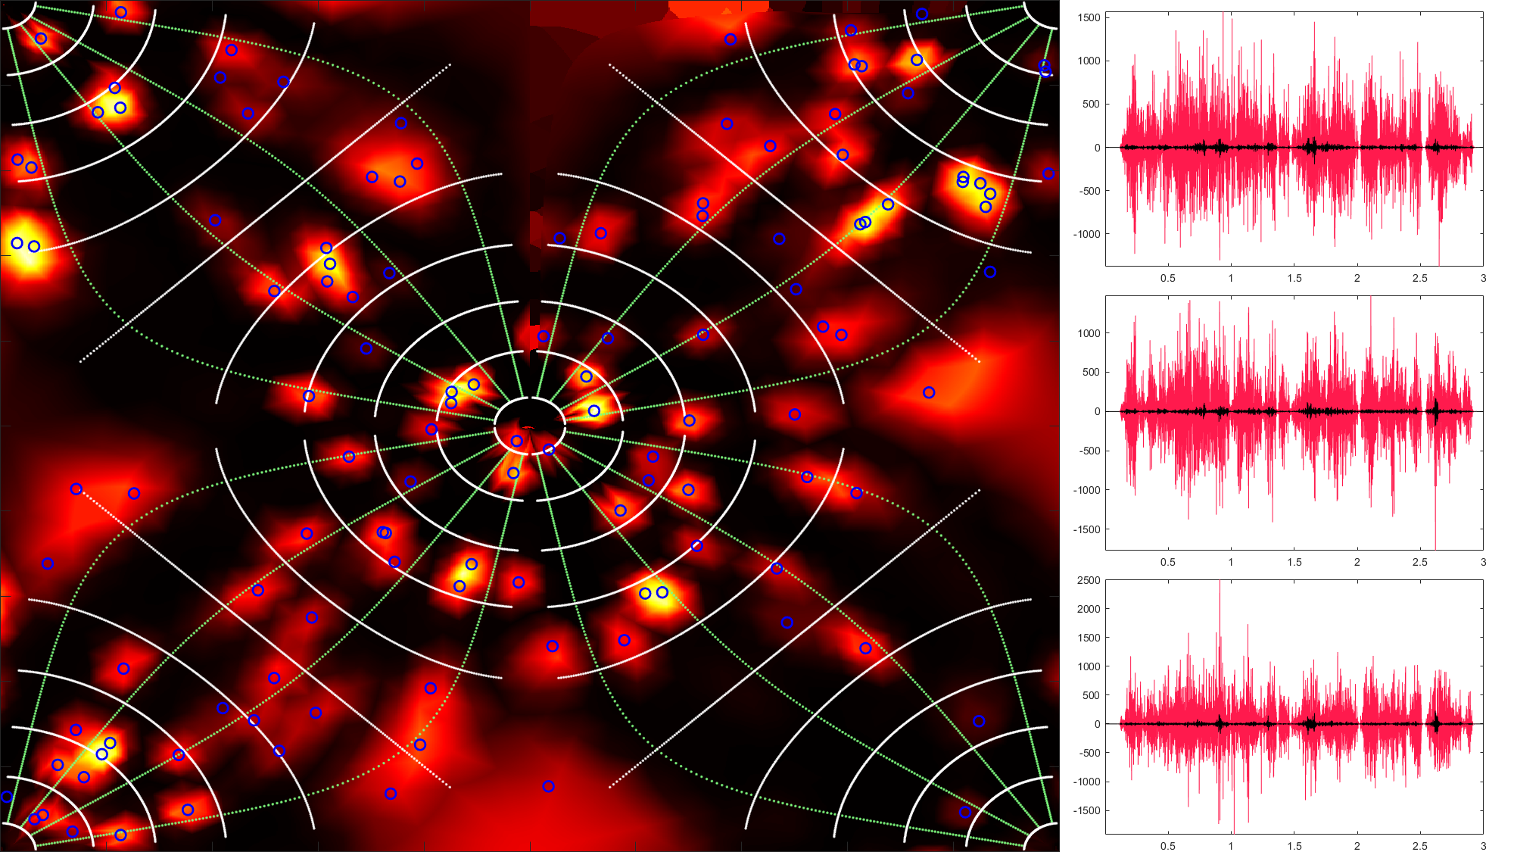
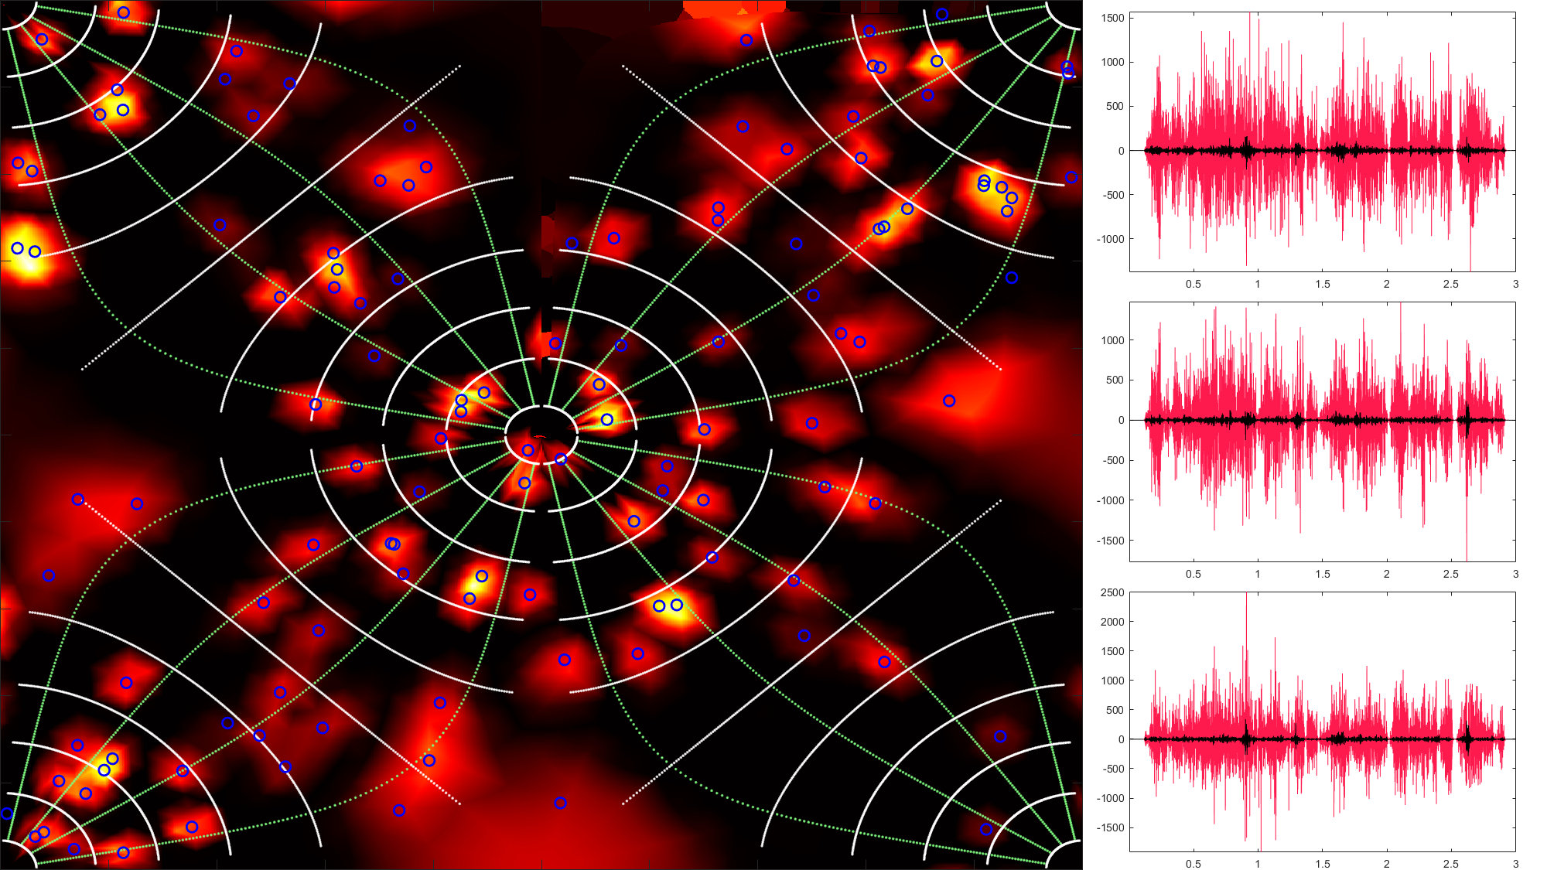
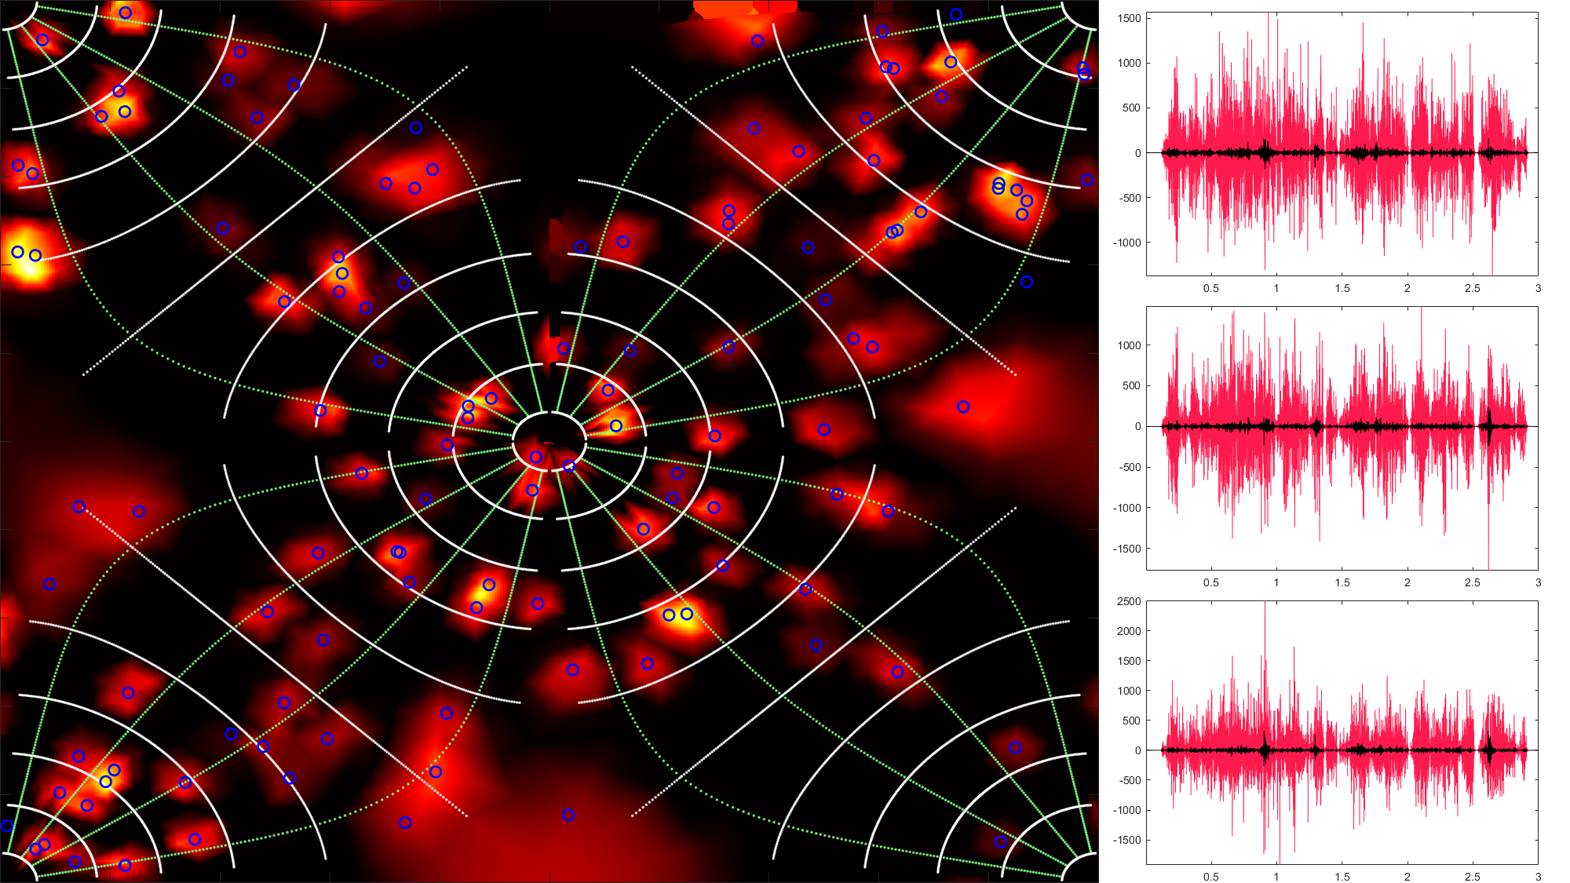
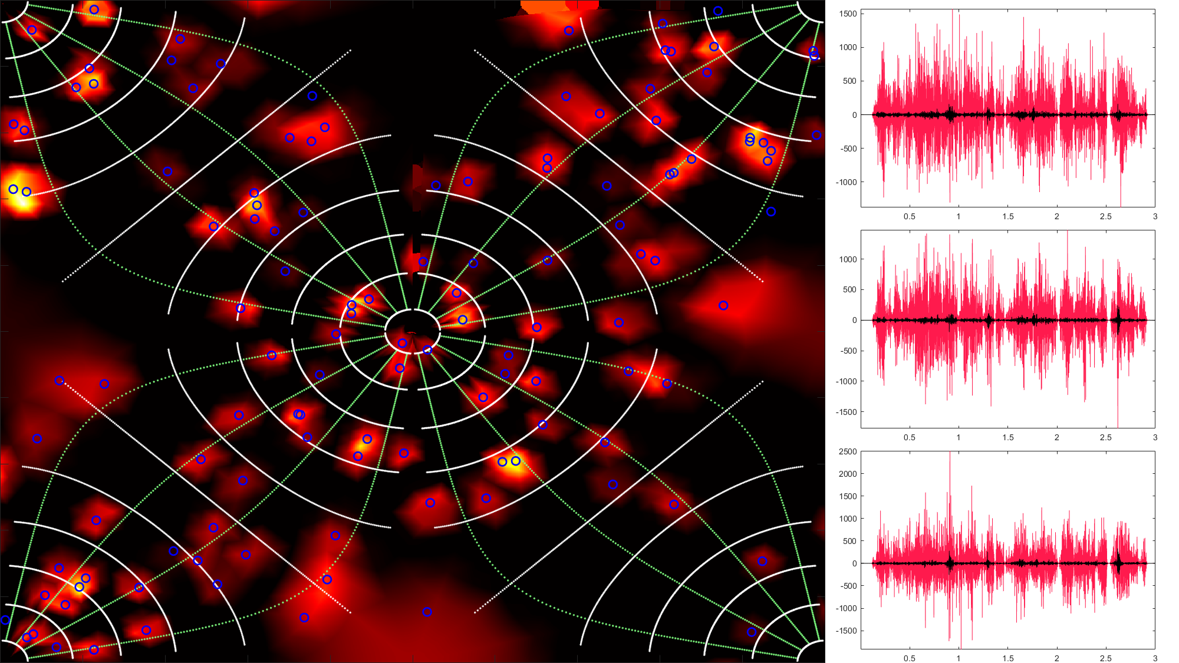

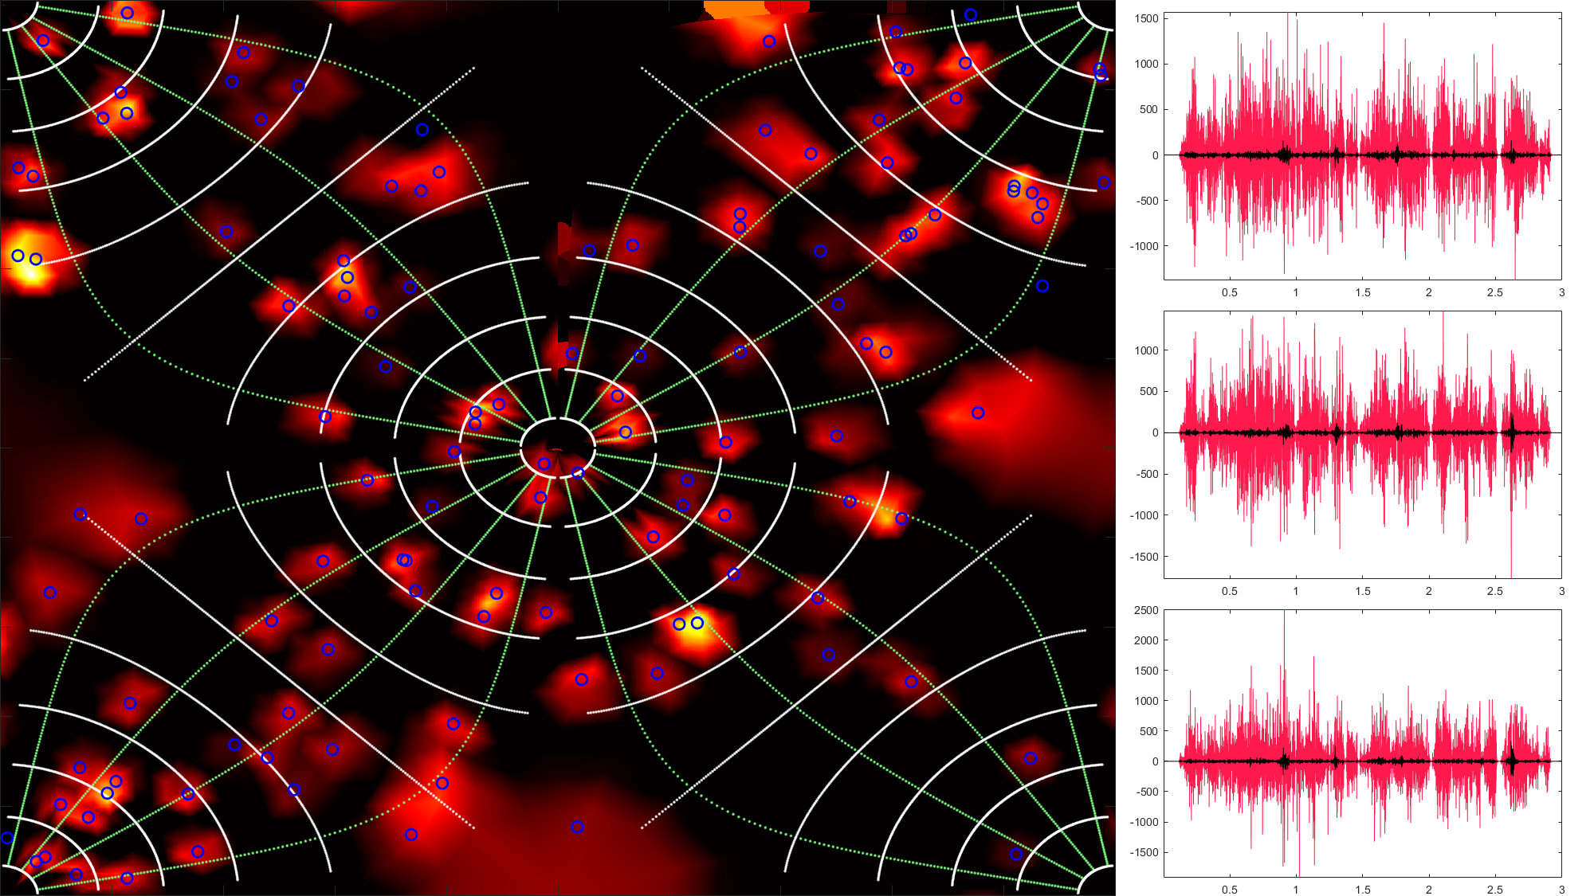
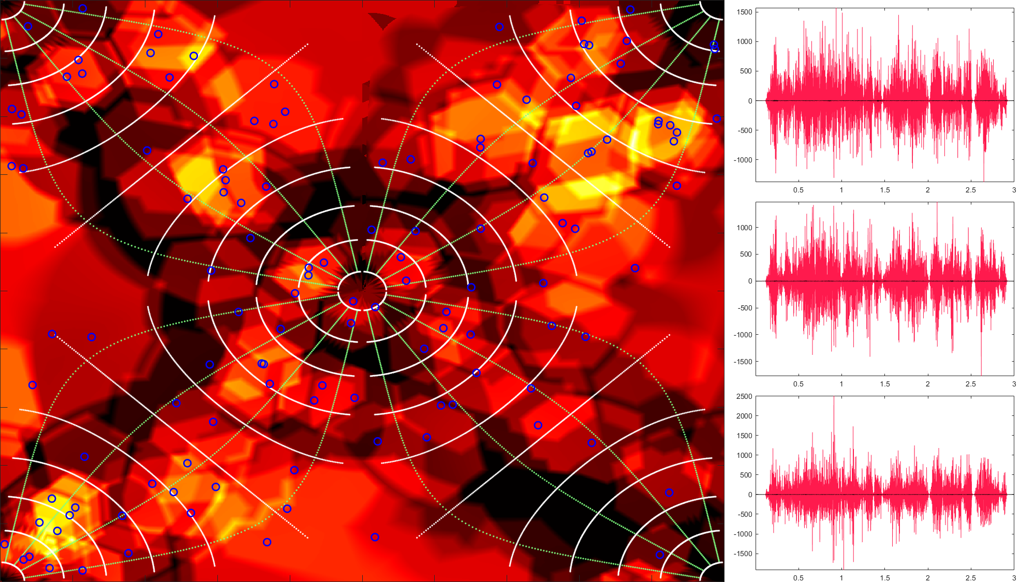
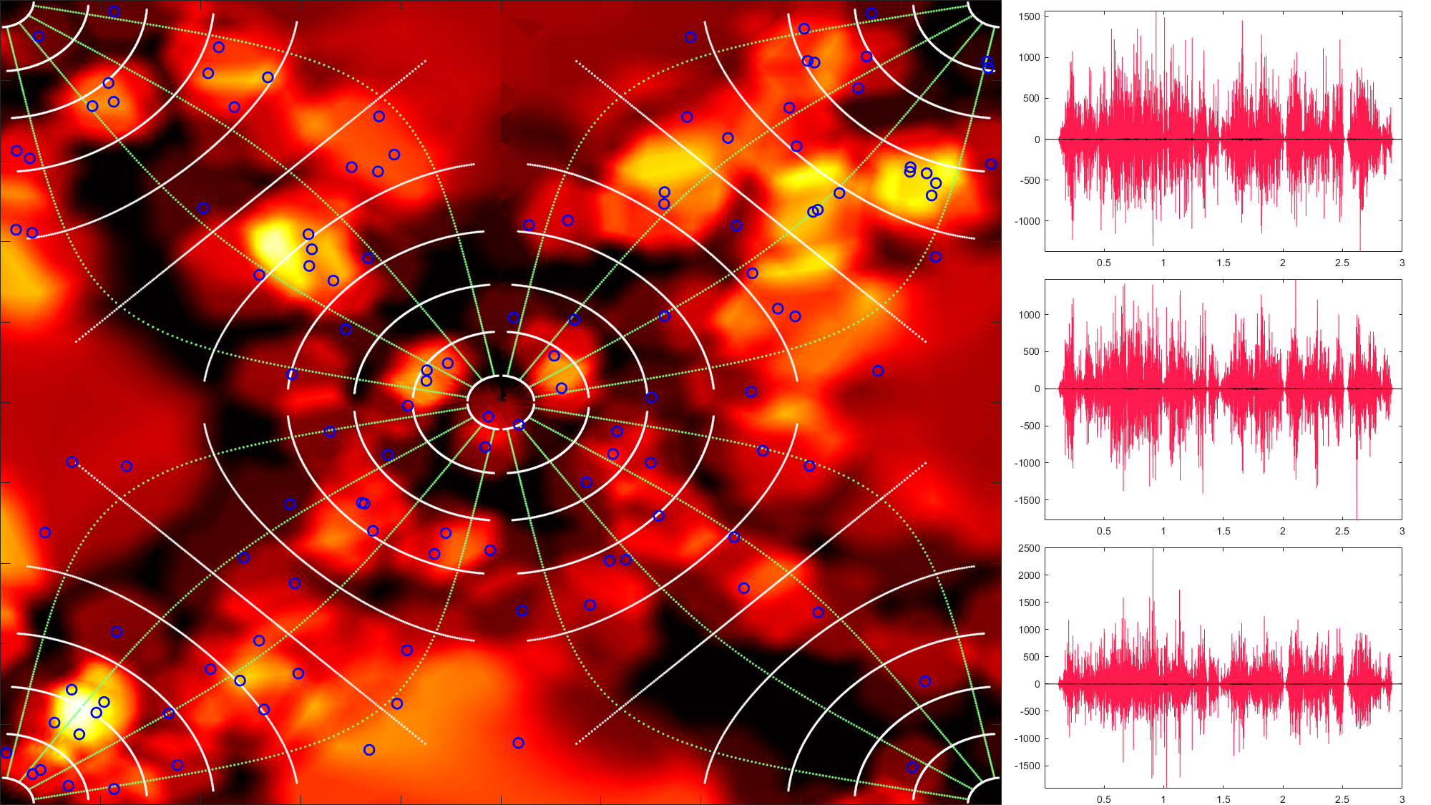
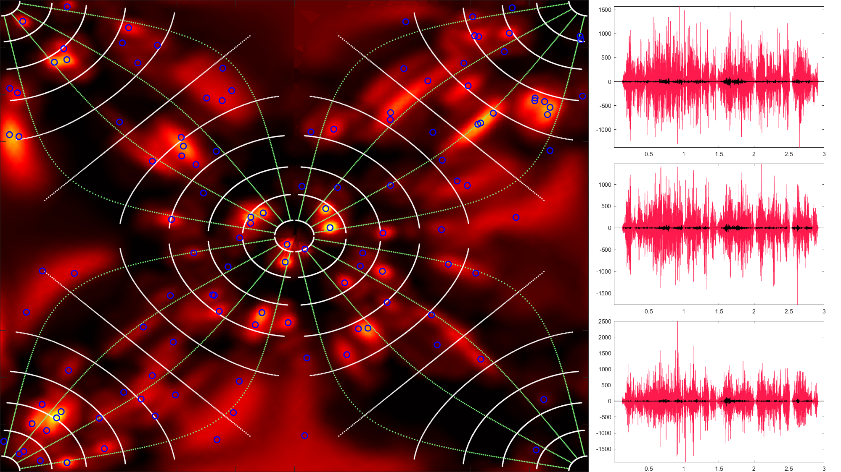
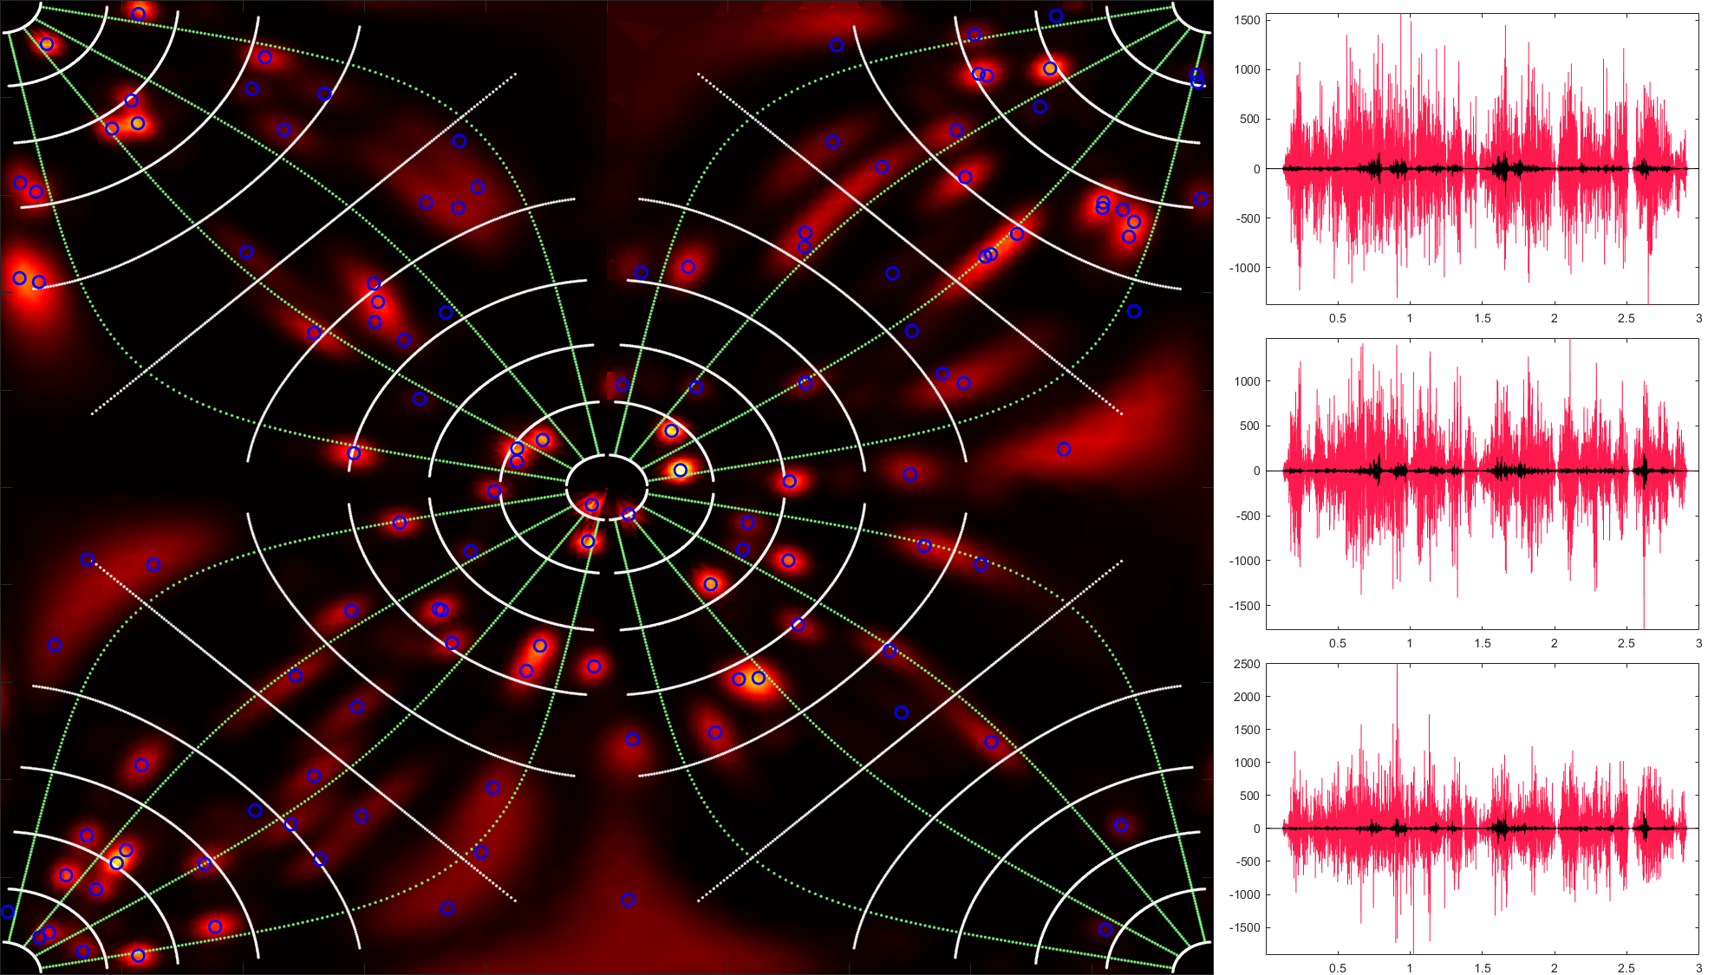
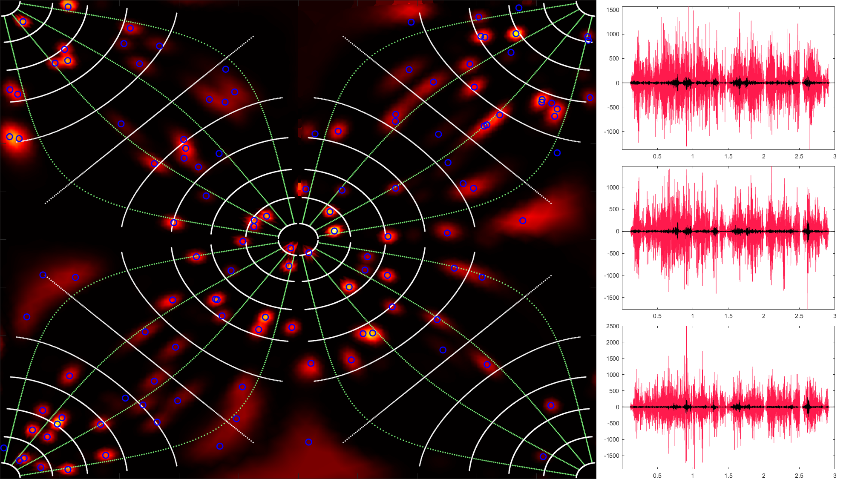
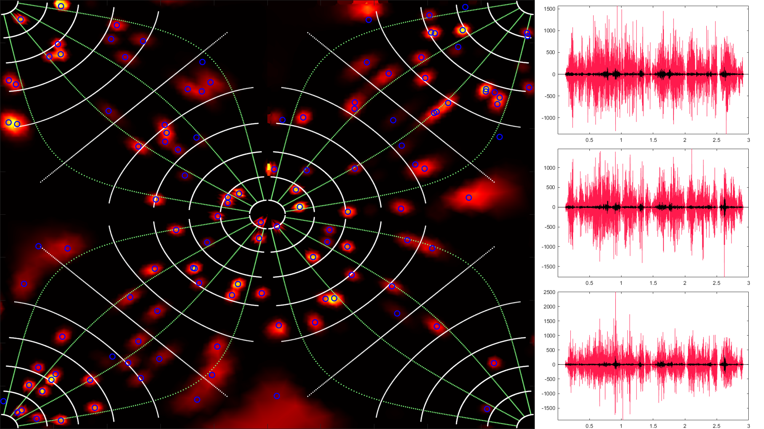
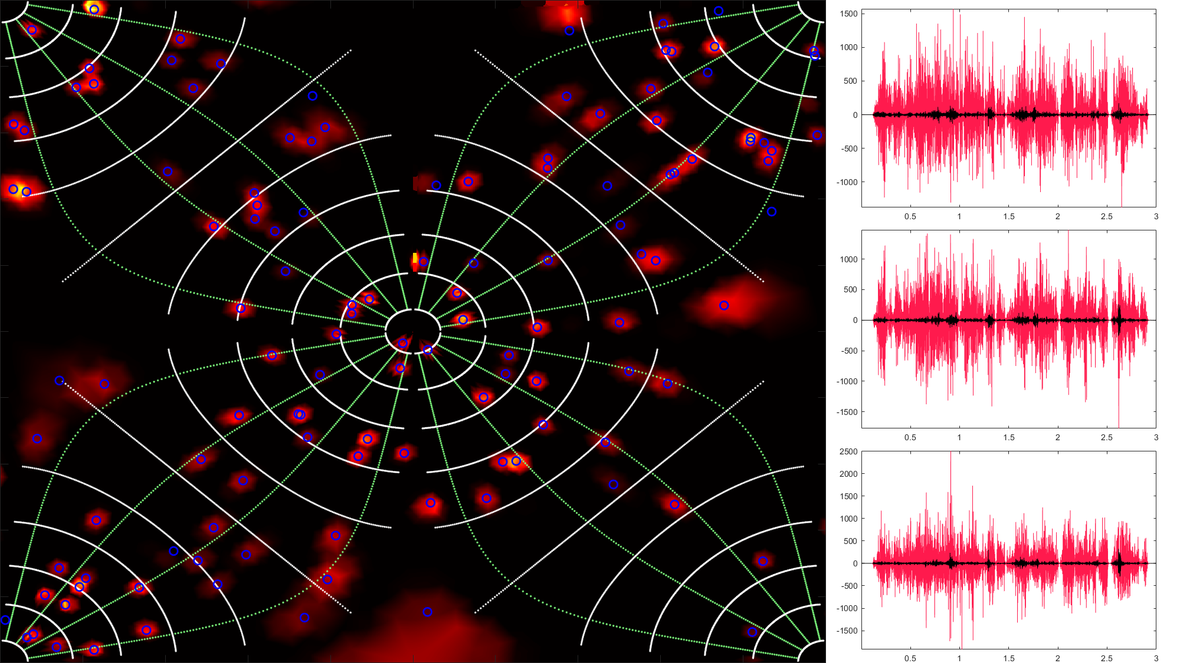
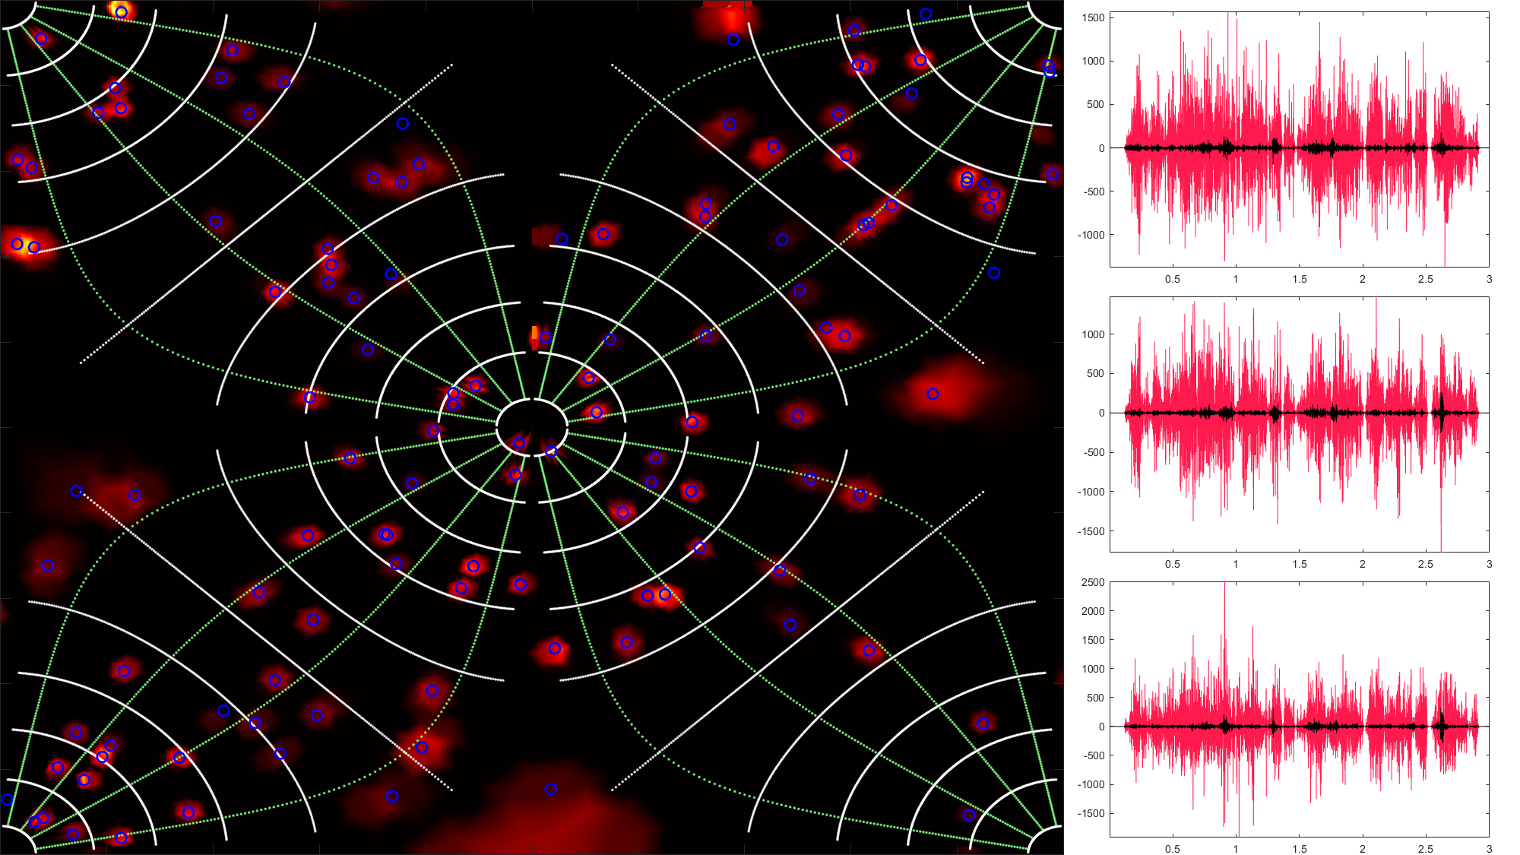
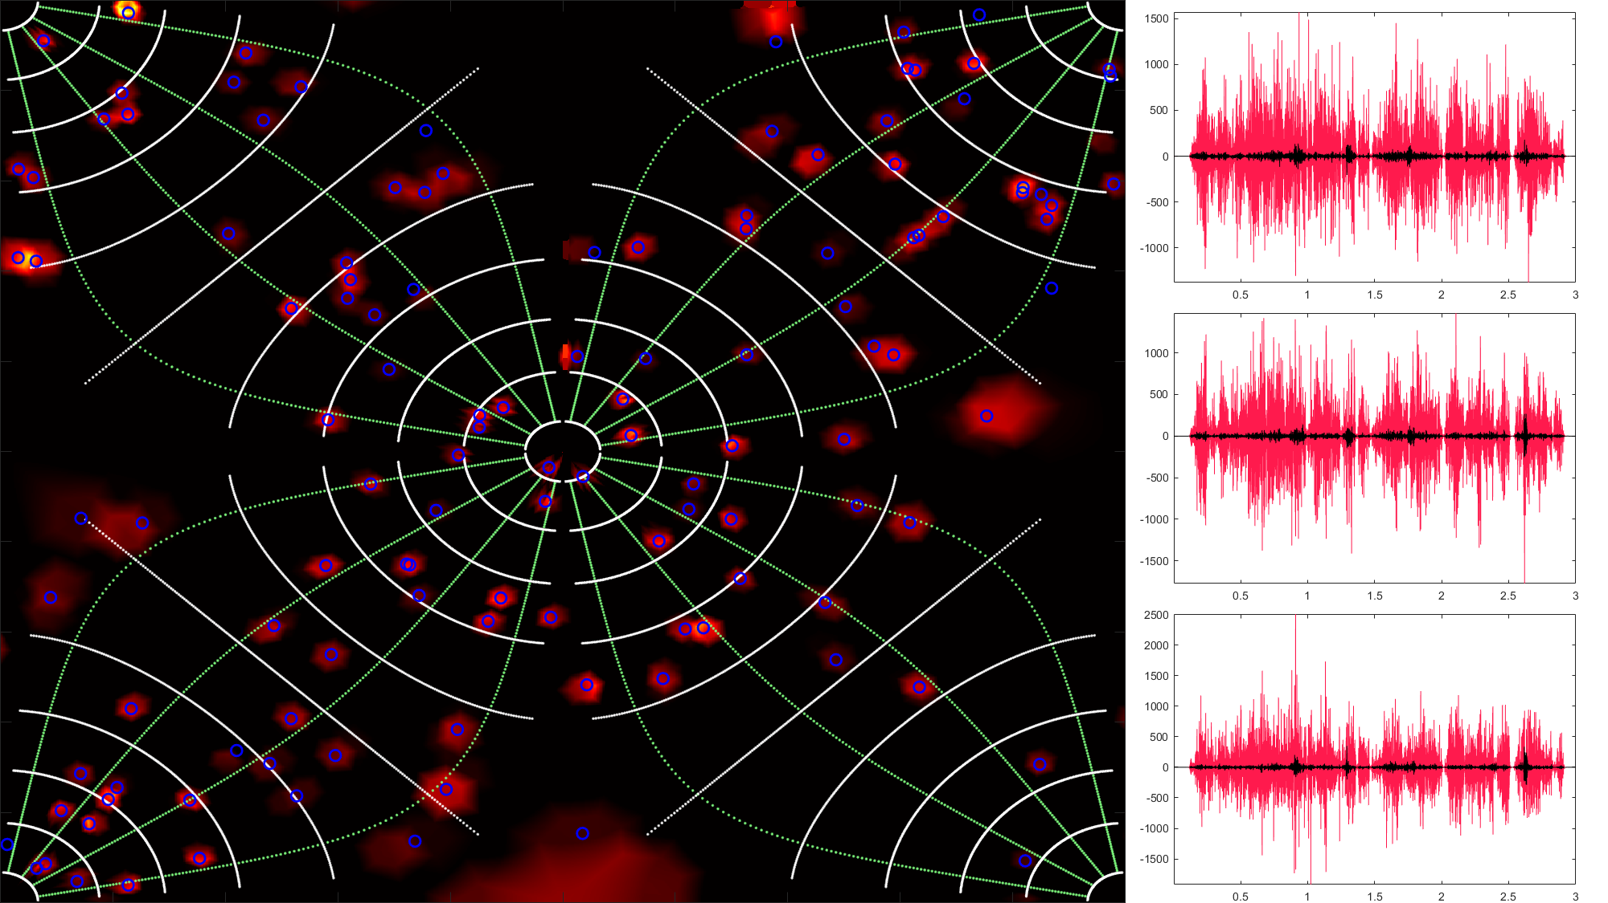



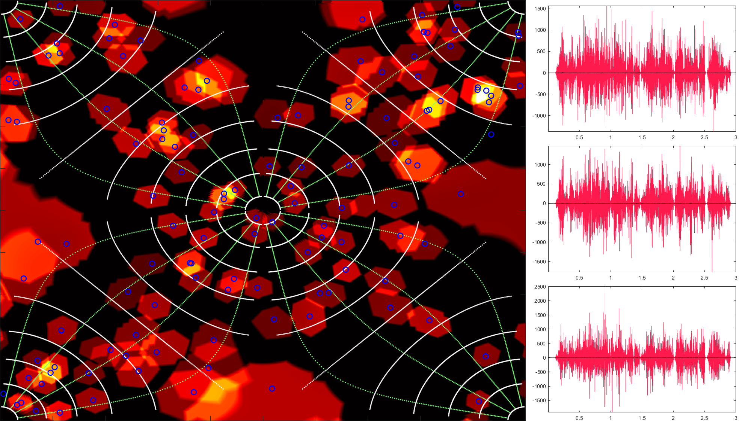
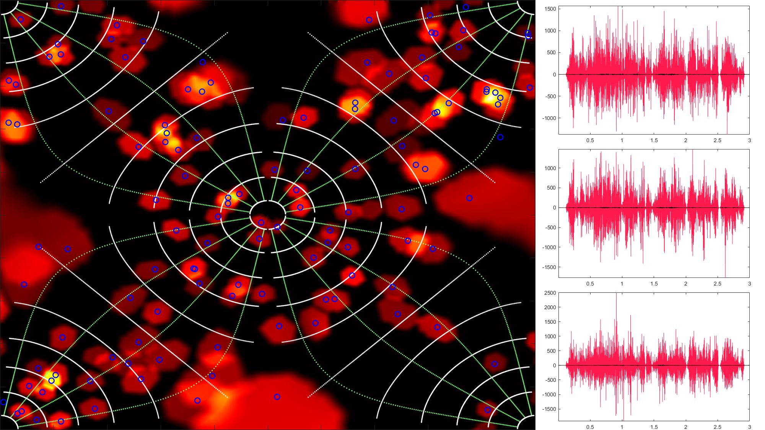
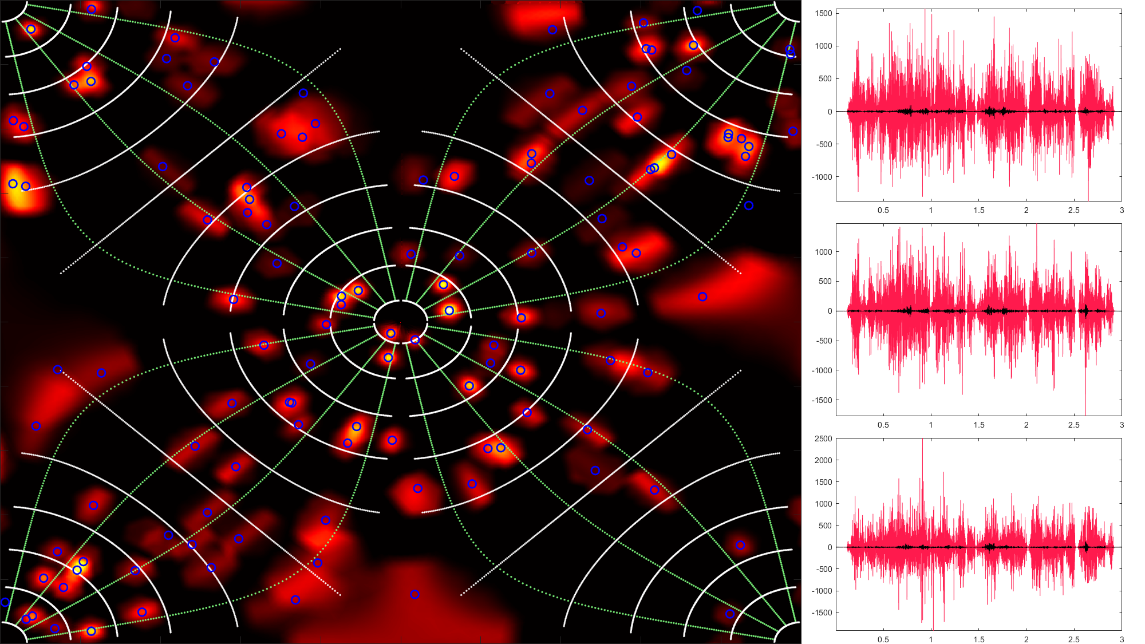
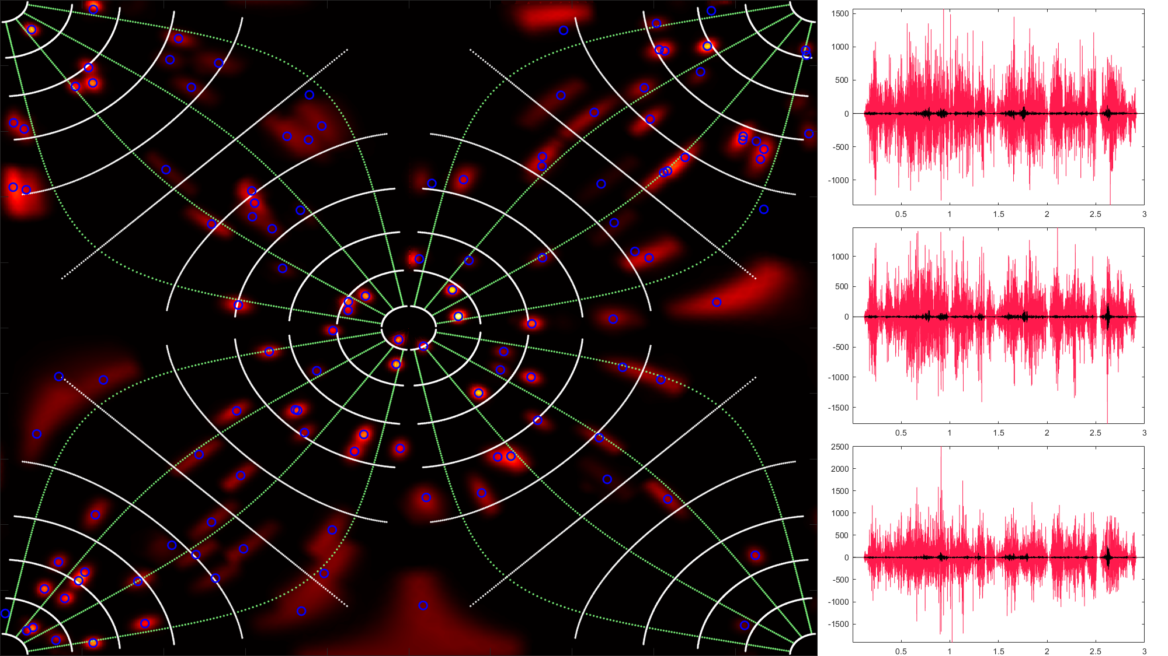
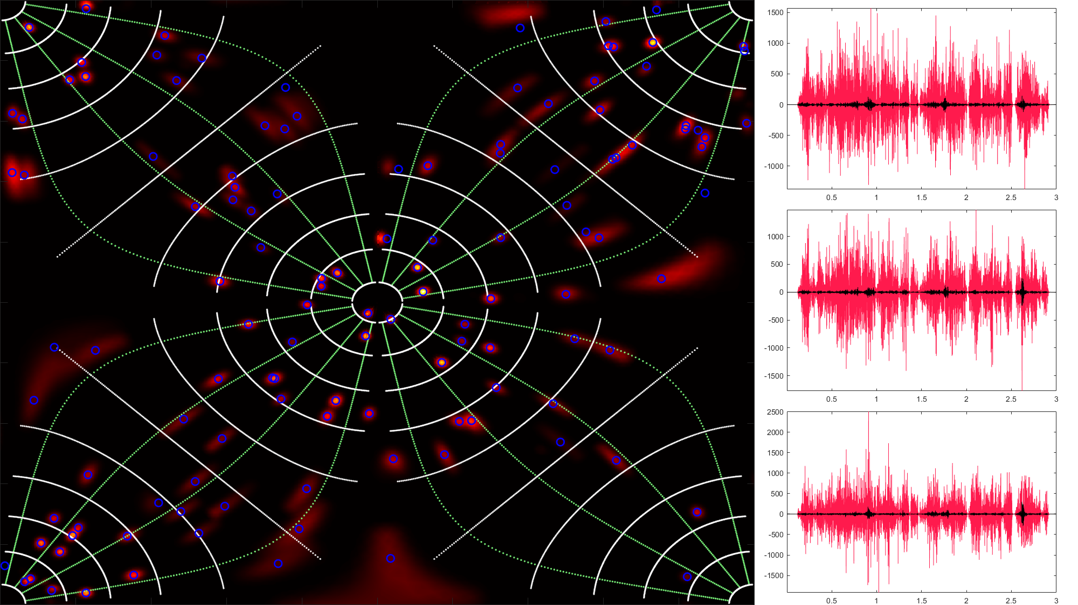



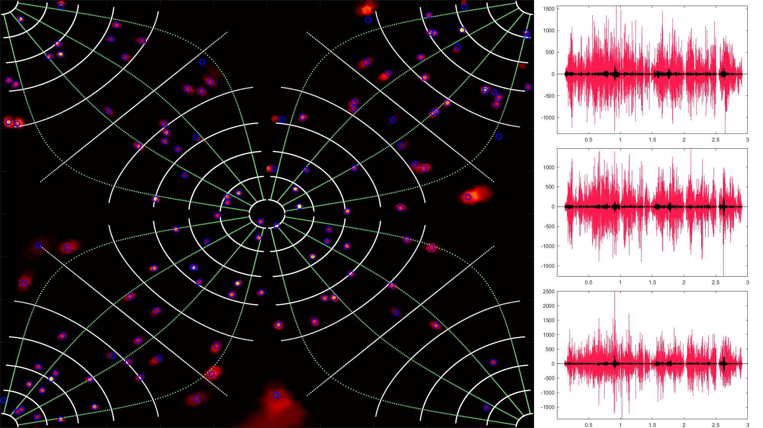



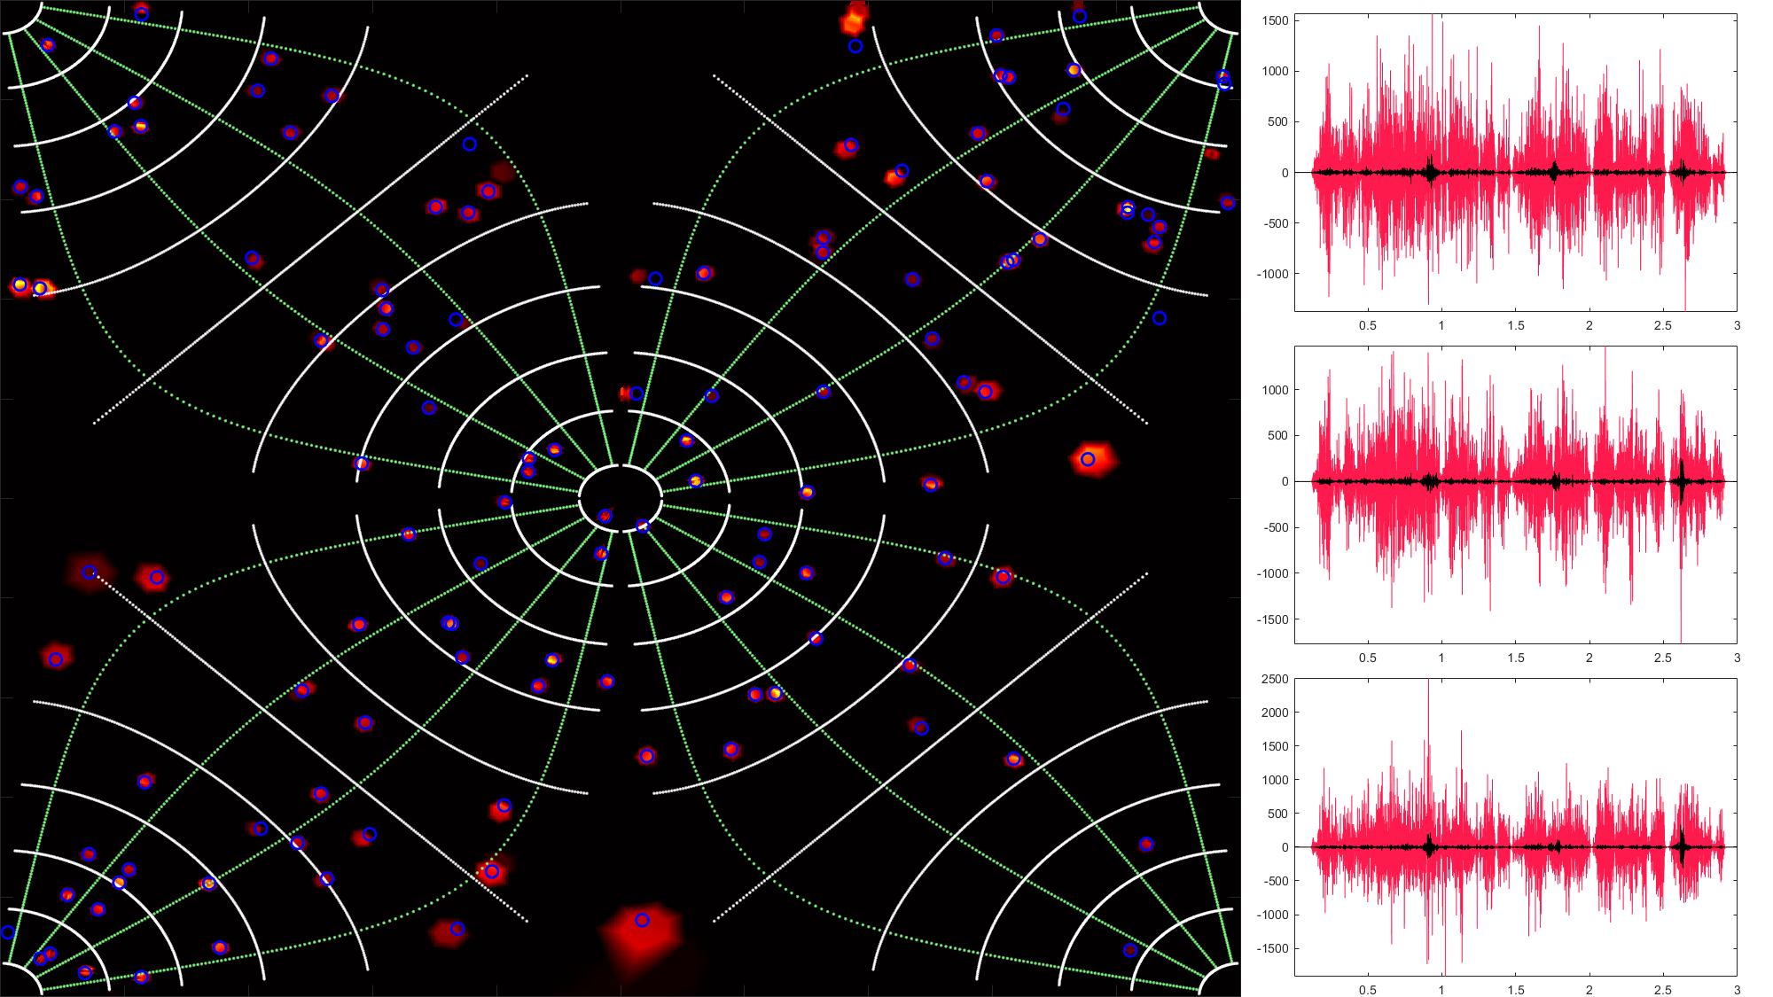

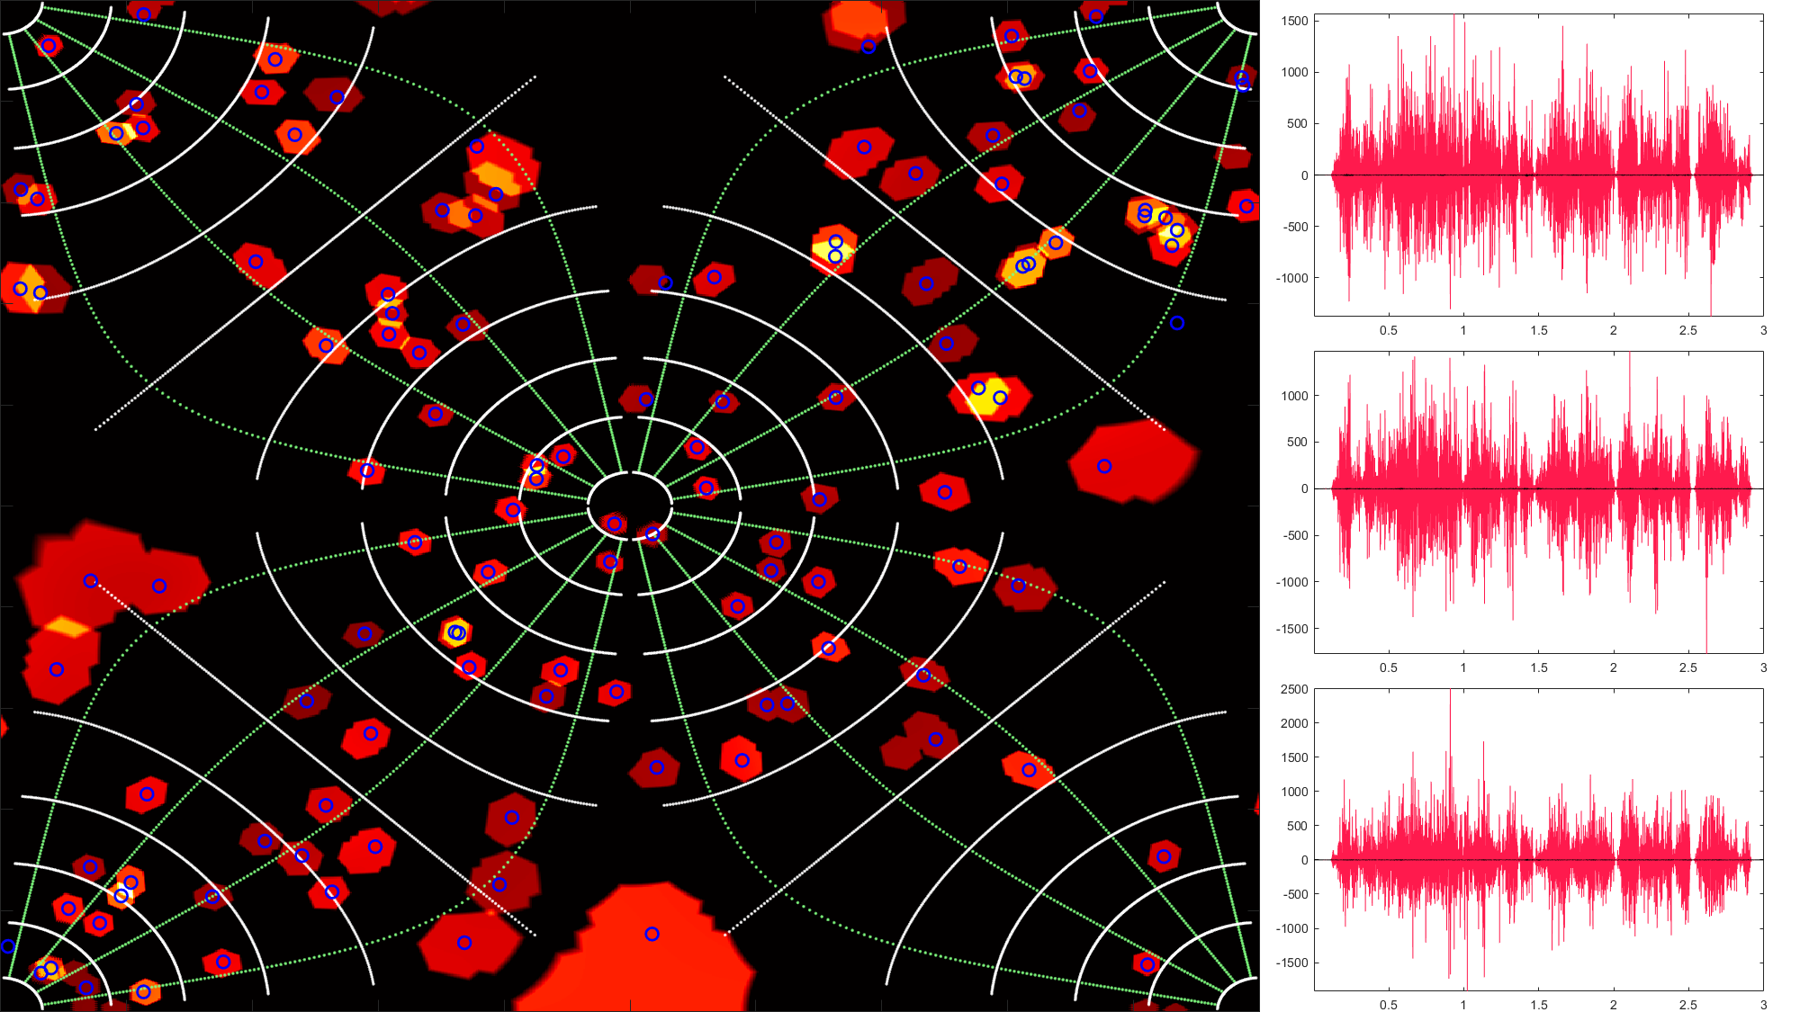
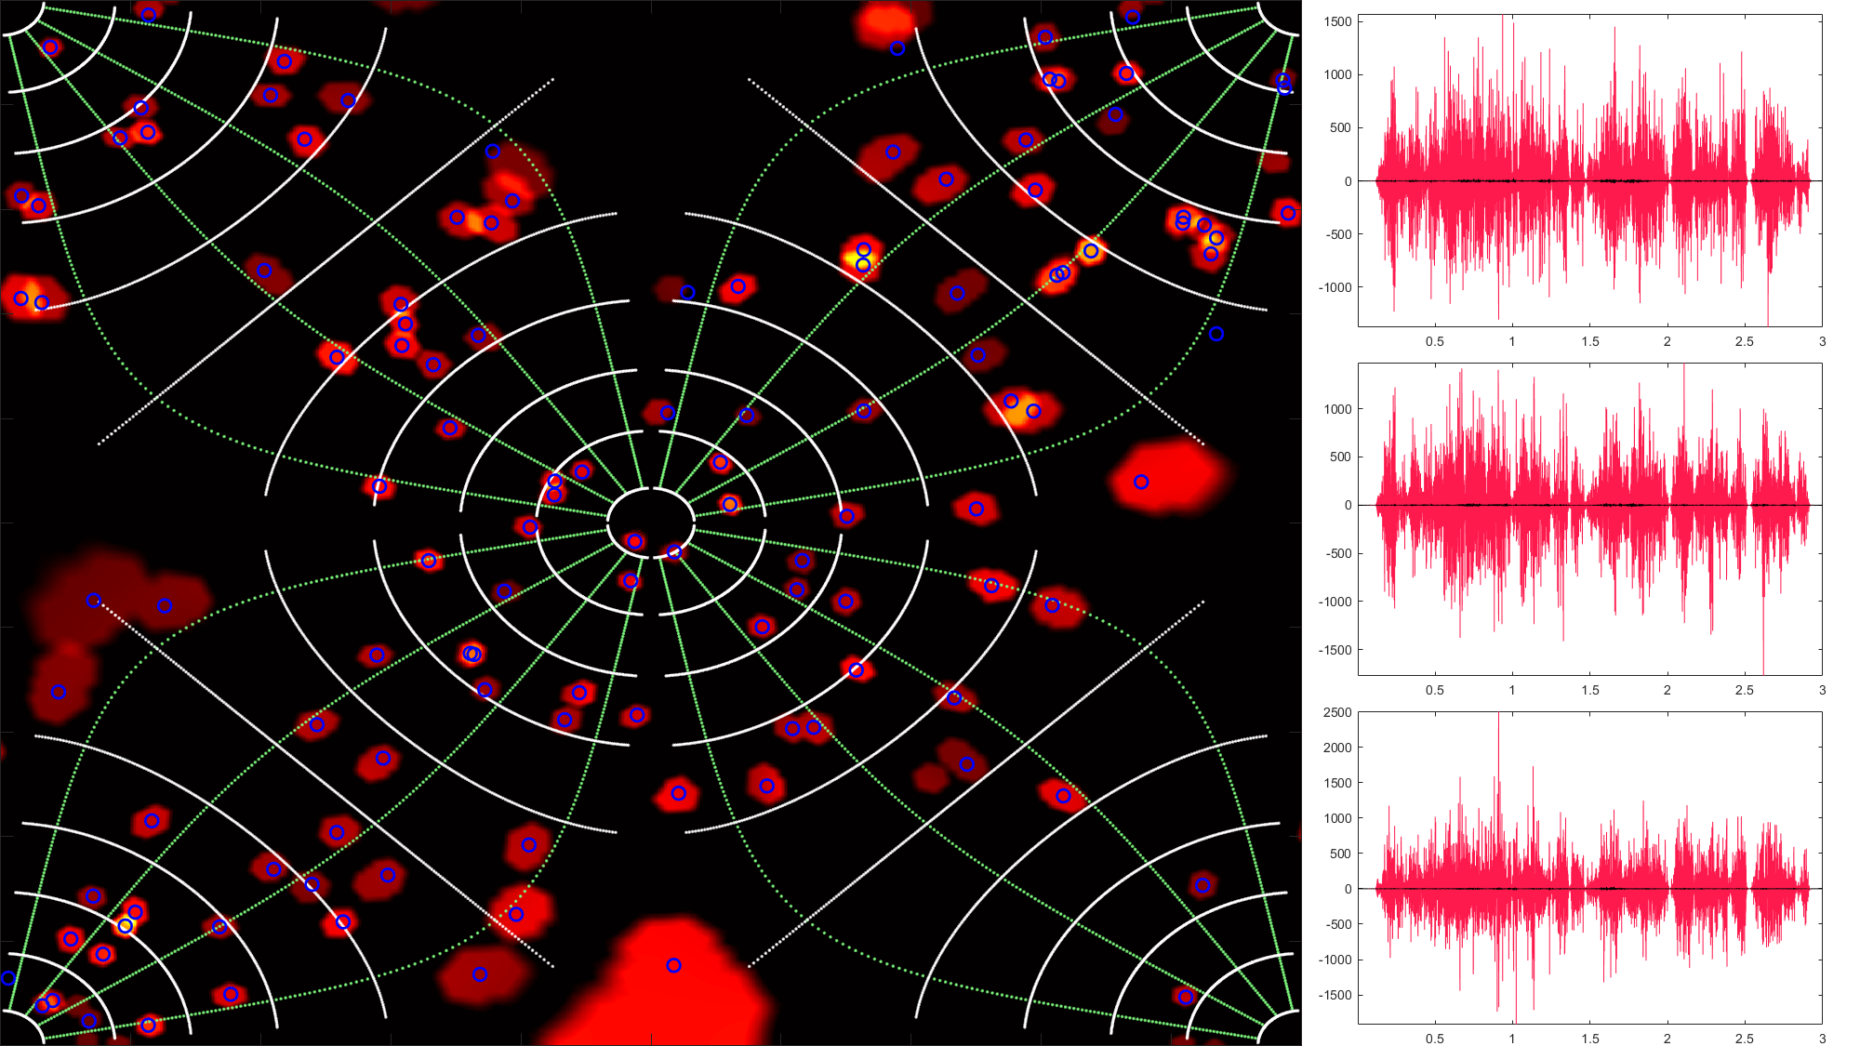
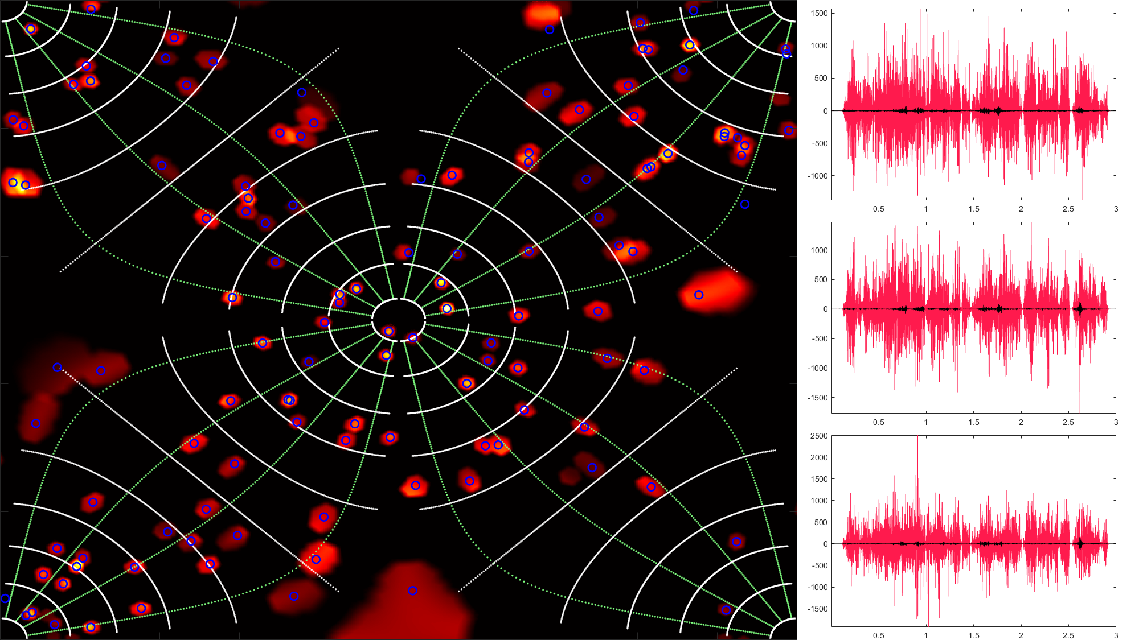



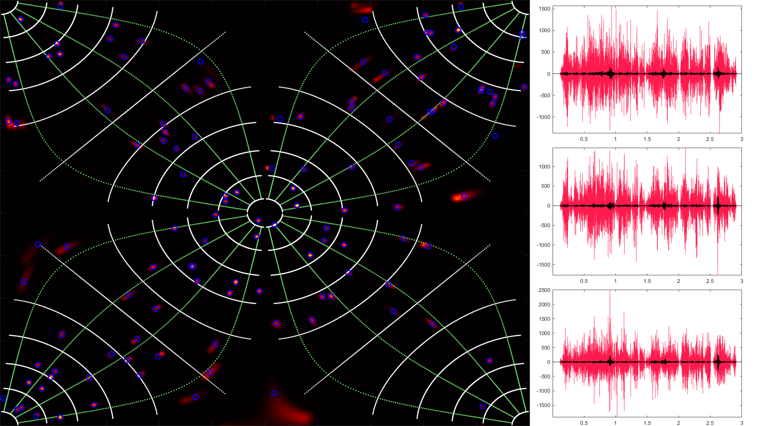
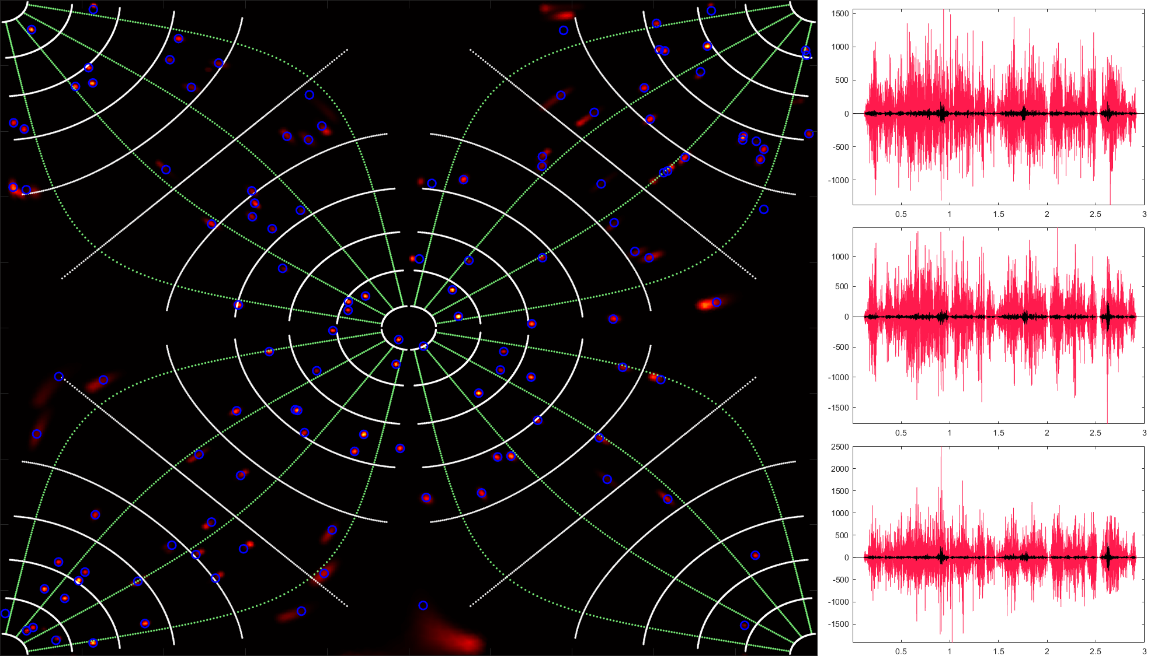

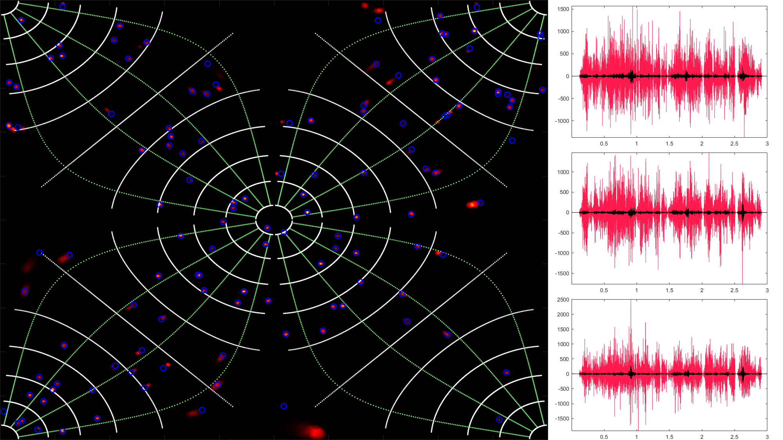




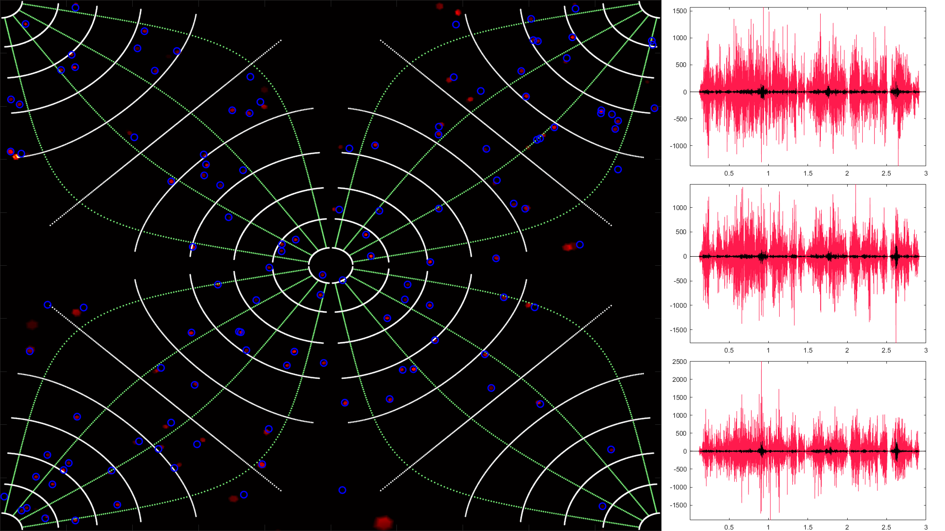

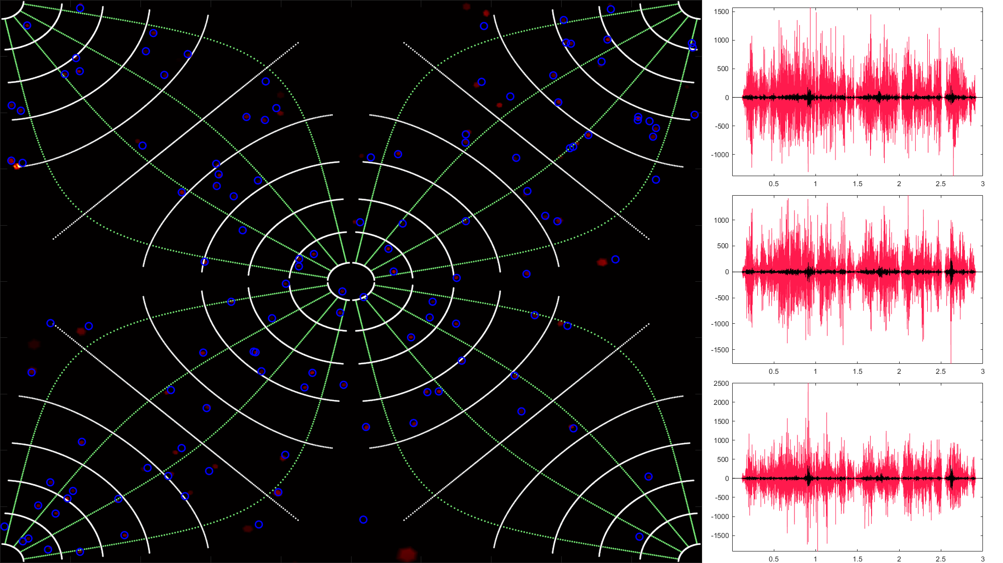
























Slide 12
Where do we go from here?
Methods are very fast and estimation can be done on regular consumer GPU hardware
  many of the steps generalize to deal with arbitrary waveforms
  some method development needed to replace the sparsity structure
  potentially need to move to HPC
Define batch system for early signal detection
Develop “nearline” data analysis and conditioning tools for LISA

